Slide 1
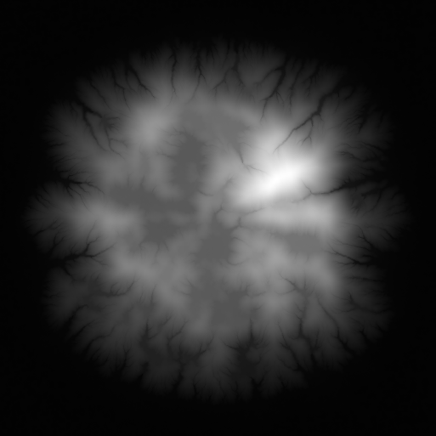
Frustum limit
POV 2
10000m High layer
Conflict zone
4500m Middle layer
Projected sketch onto layer
2000m Low Layer
POV 1
User point of view
And sketch
Frustum limit

