Slide 1
Anime Popularity
Trend Analysis
By: Yiling H. Tan
CS 210 — Data Management for Data Science | Rutgers University | Spring 2026 | Dataset: MyAnimeList (28,825 entries)
github.com/MoonCrepe/ProjectAnimePopAnalysis

Slide 2
What is the Goal/Objective?
Genre & Studio
Format Type (TV, Movie, OVA...)
Episode Count & Duration
Age Rating (R18 excluded)
Release Year Trend (2000–2024)
Voter Count vs Score
Python + Pandas — load, clean, group
defaultdict — multi-genre analysis
pd.cut() — episode/duration binning
.groupby() — Split-Apply-Combine
.corr() — Pearson correlation modeling
re.search() — regex duration parsing

Slide 3
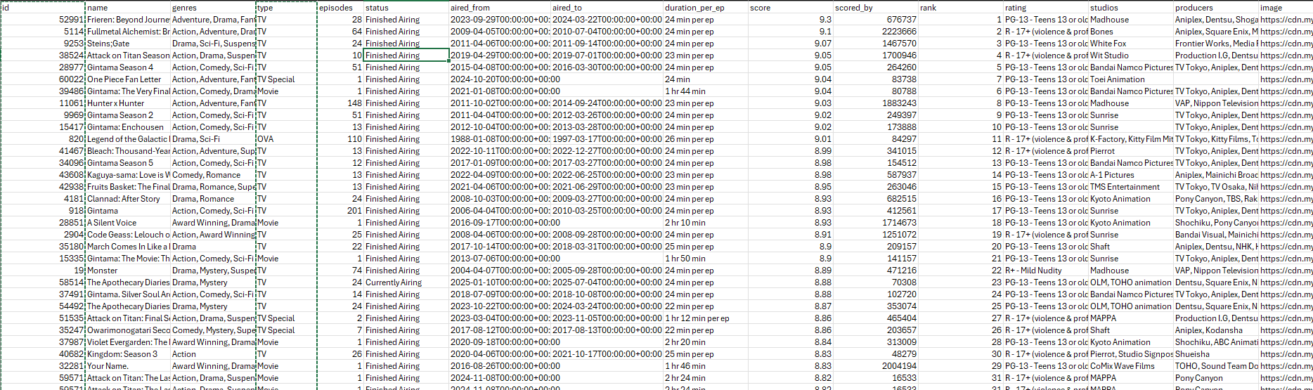
Dataset
Genre & Studio
Format Type (TV, Movie, OVA...)
Episode Count & Duration
Age Rating (R18 excluded)
Release Year Trend (2000–2024)
Voter Count vs Score
Python + Pandas — load, clean, group
defaultdict — multi-genre analysis
pd.cut() — episode/duration binning
.groupby() — Split-Apply-Combine
.corr() — Pearson correlation modeling
re.search() — regex duration parsing

Slide 4
Dataset & Methodology
28,825
14,127
18
14
Total Anime Entries
After Cleaning (R18-)
Columns Analyzed
Charts Generated
What I Analyzed
Tools & Techniques
Genre & Studio
Format Type (TV, Movie, OVA...)
Episode Count & Duration
Age Rating (R18 excluded)
Release Year Trend (2000–2024)
Voter Count vs Score
Python + Pandas — load, clean, group
defaultdict — multi-genre analysis
pd.cut() — episode/duration binning
.groupby() — Split-Apply-Combine
.corr() — Pearson correlation modeling
re.search() — regex duration parsing
R18 (Rx - Hentai) removed from main analysis — preserved separately as df_all for Fig 2 comparison (avg score: 4.74 vs 6.52 non-R18)

Slide 5
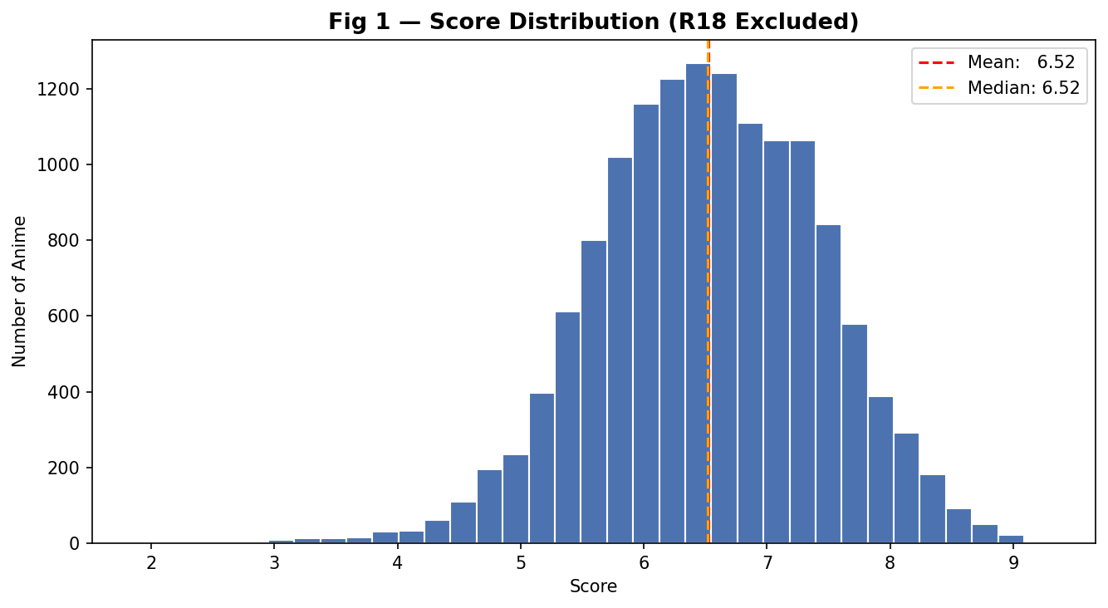
Score Distribution — All Anime (R18 Excluded)
Fig 1 — Most anime score between 5.5 and 7.5. Mean and median are both 6.52, indicating a symmetric distribution.

Slide 6
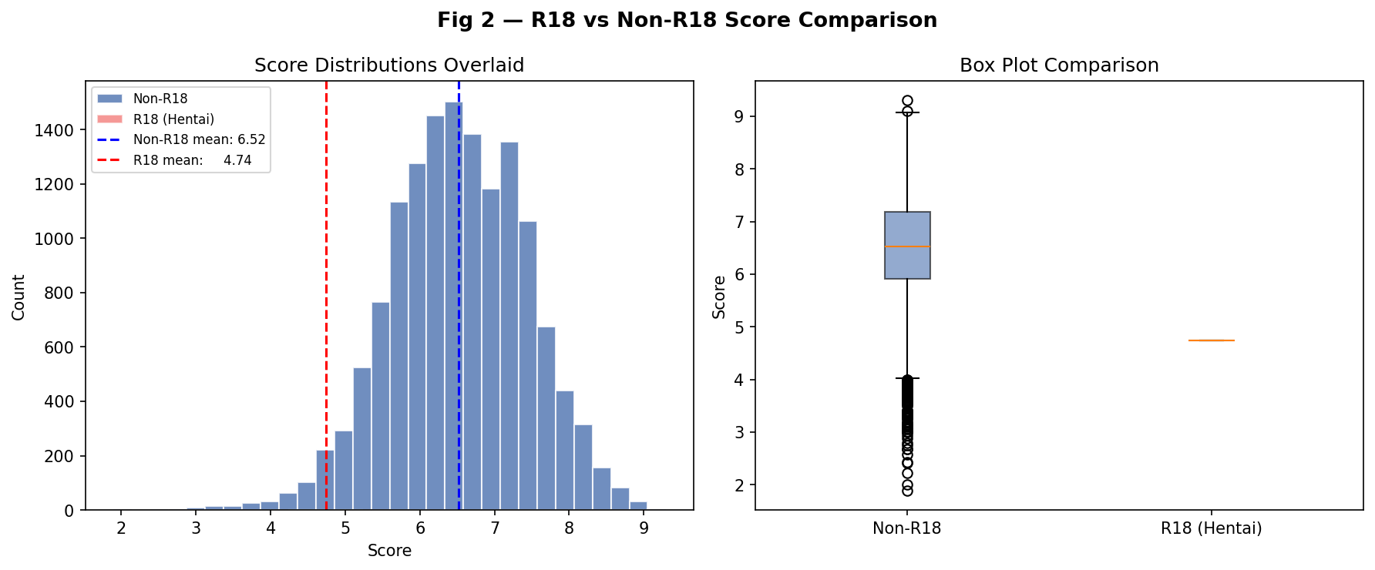
Why R18 Content Was Excluded
Fig 2 — R18 anime average 4.74 vs 6.52 for non-R18. The box plot confirms the distributions are fundamentally different.

Slide 7
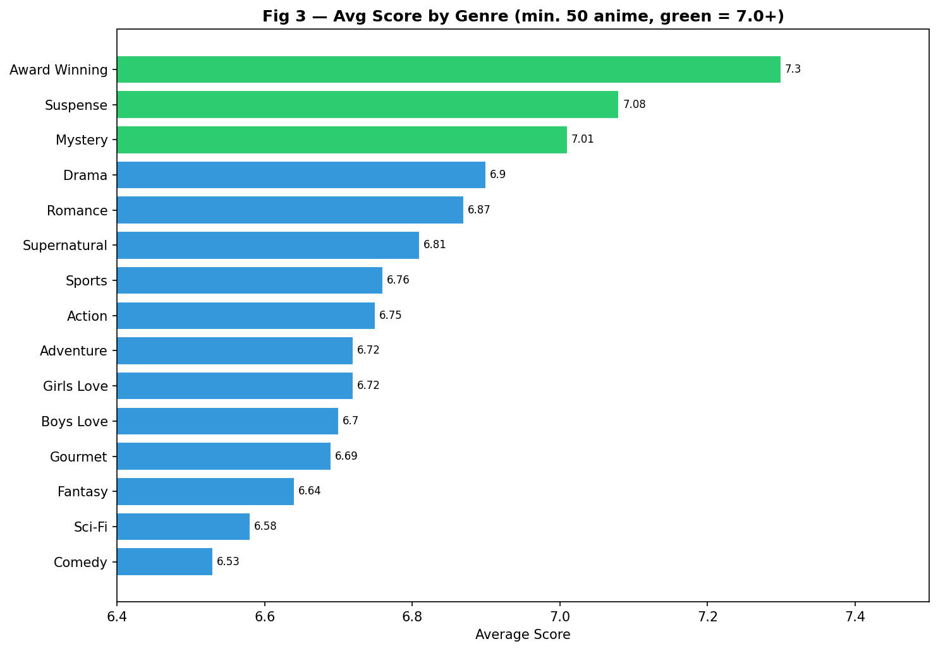
Average Score by Genre (Top 15)
Fig 3 — Award Winning, Suspense, and Mystery lead. Green bars average 7.0+. Story-driven tension-heavy genres score highest.

Slide 8
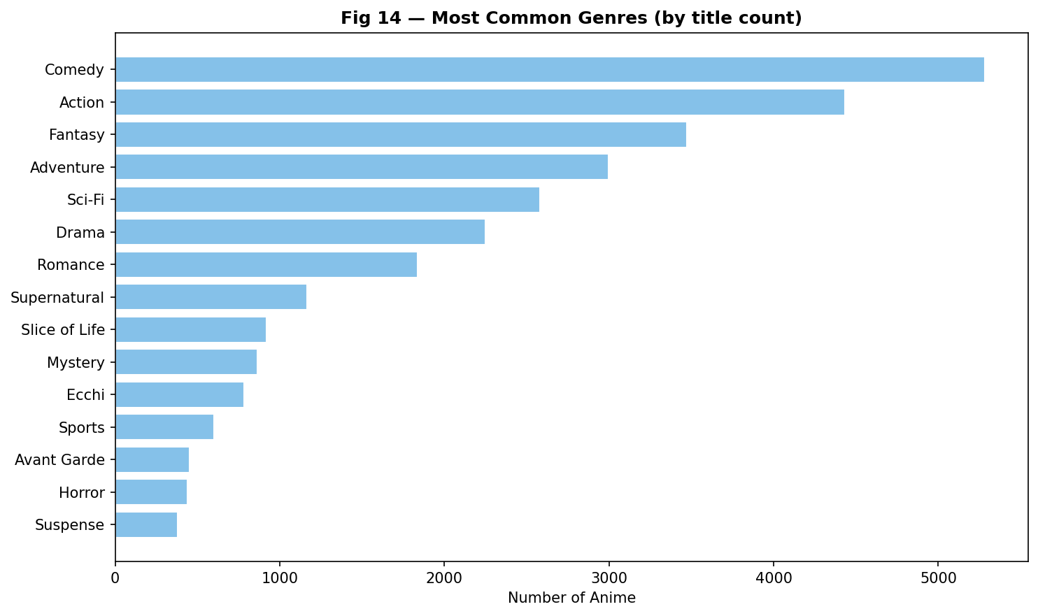
Most Common Genres by Title Count
Fig 14 — Action and Comedy dominate by count but don't lead in score. Popularity by volume ≠ quality.

Slide 9
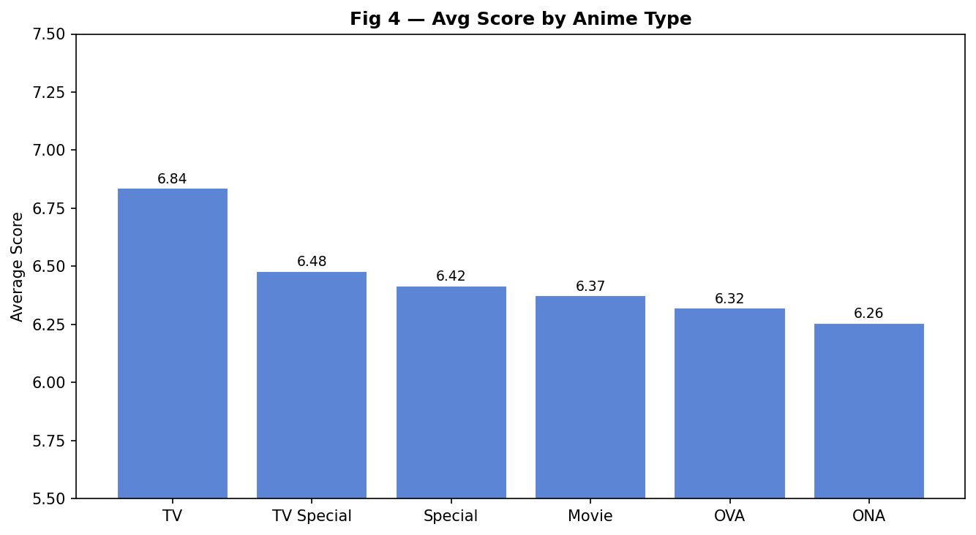
Average Score by Anime Format (Type)
Fig 4 — TV series score highest at 6.84. ONA (web anime) score lowest at 6.26. Serialized storytelling wins.

Slide 10
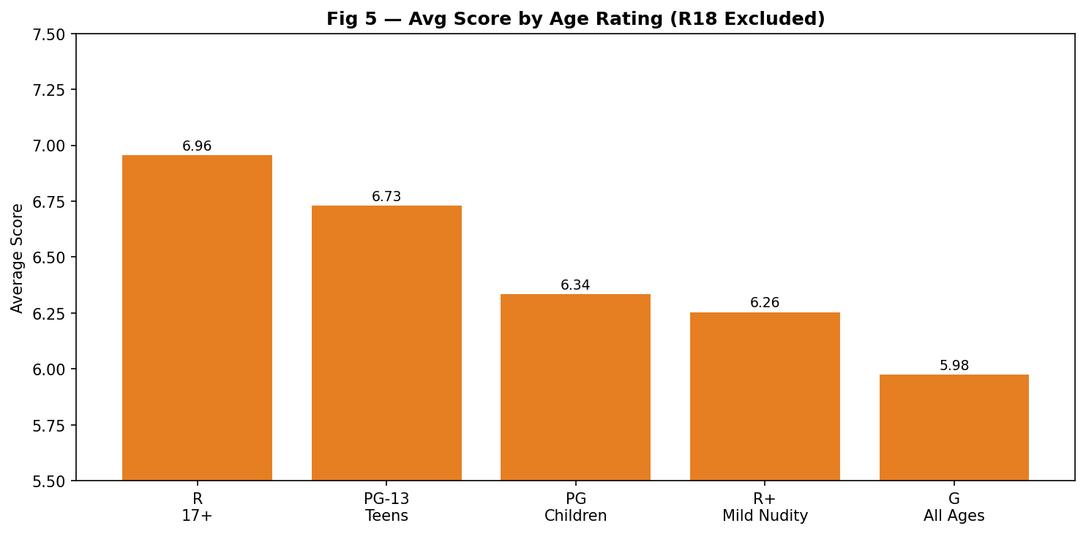
Average Score by Age Rating (R18 Excluded)
Fig 5 — R-rated (17+) anime score highest at 6.96. G-rated score lowest at 5.98. Mature themes correlate with better reception.

Slide 11
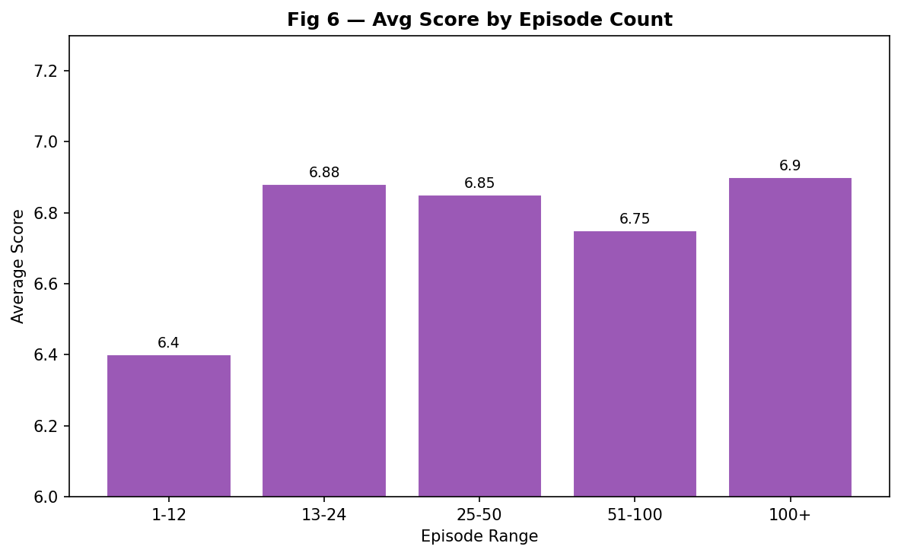
Average Score by Episode Count
Fig 6 — 100+ and 13–24 episode ranges both average ~6.89. Very short anime (1–12 eps) score lowest at 6.40.

Slide 12
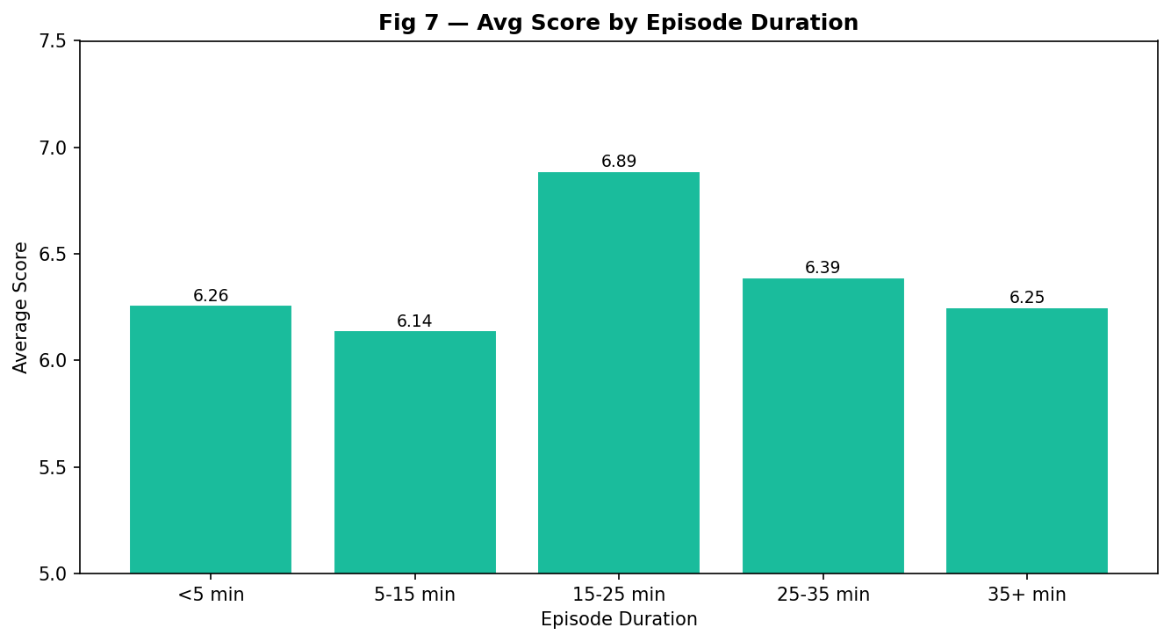
Average Score by Episode Duration
Fig 7 — Standard 15–25 min episodes score highest at 6.89. Very short (<5 min) and very long (35+ min) both score lower.

Slide 13
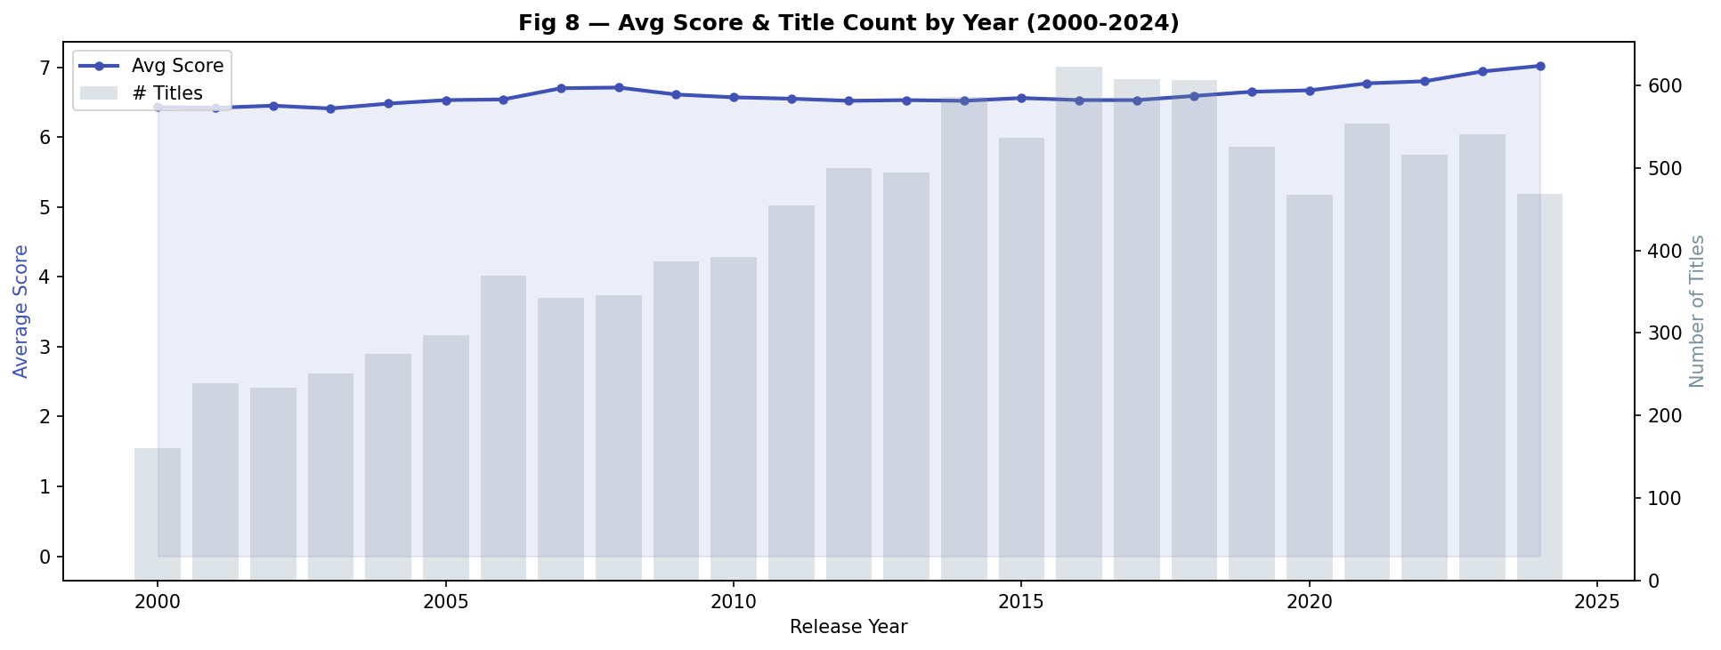
Score Trend Over Time (2000–2024)
Fig 8 — Average scores have risen steadily. 2024 anime averaged 7.02 — the highest on record. Output volume also growing.

Slide 14
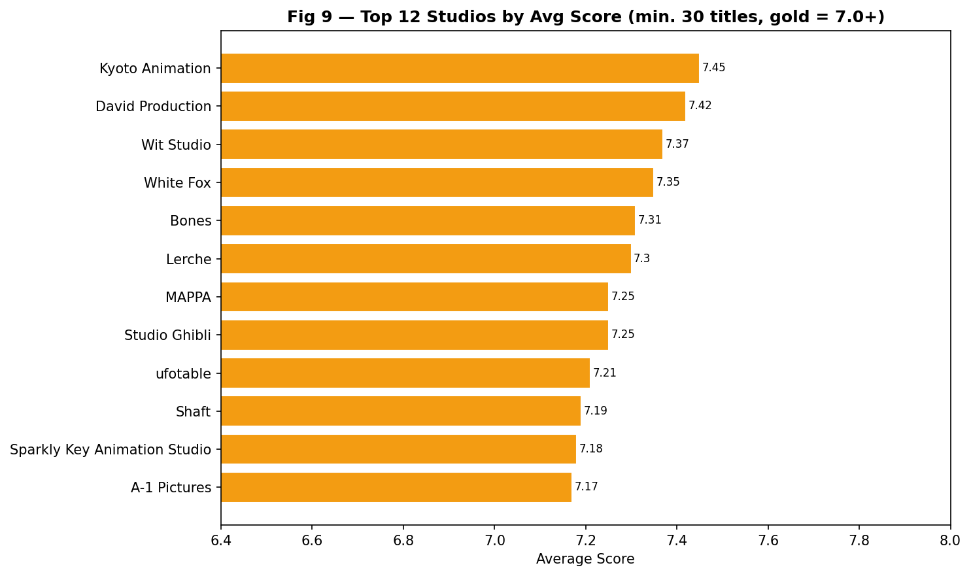
Top 12 Studios by Average Score
Fig 9 — Kyoto Animation leads at 7.45. Gold bars average 7.0+. Studio identity is a meaningful quality signal.

Slide 15
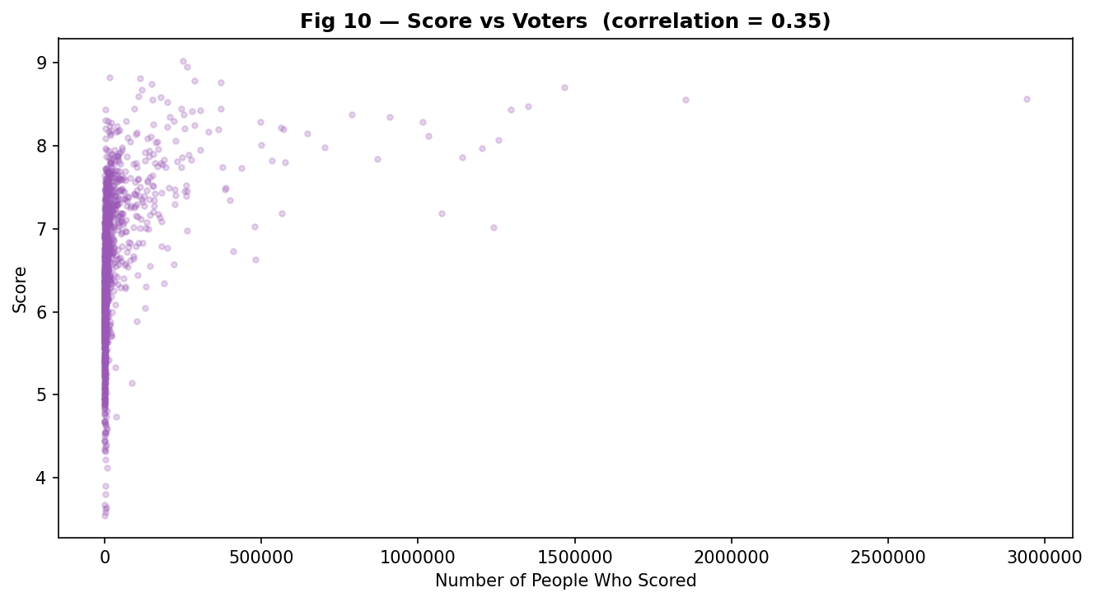
PART 1 — Findings & Methodology
Score vs Number of Voters
Fig 10 — Correlation = 0.355. More popular anime tend to score higher but the relationship is moderate, not strong.

Slide 16
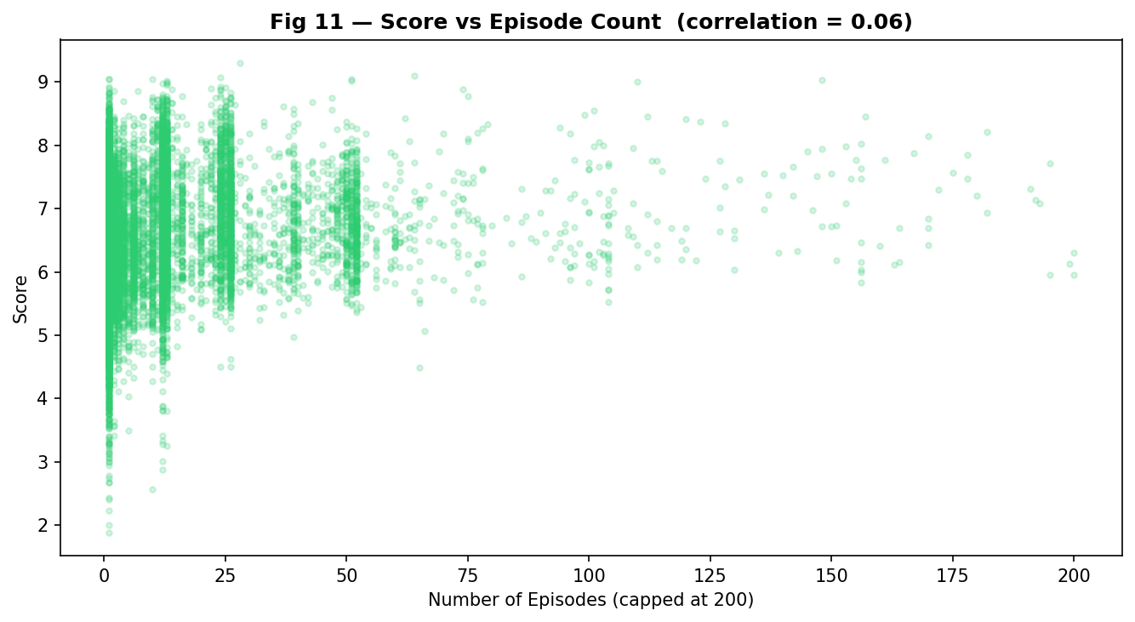
Score vs Episode Count
Fig 11 — Correlation = 0.061. Almost no linear relationship. Episode count is NOT a meaningful predictor of score.

Slide 17
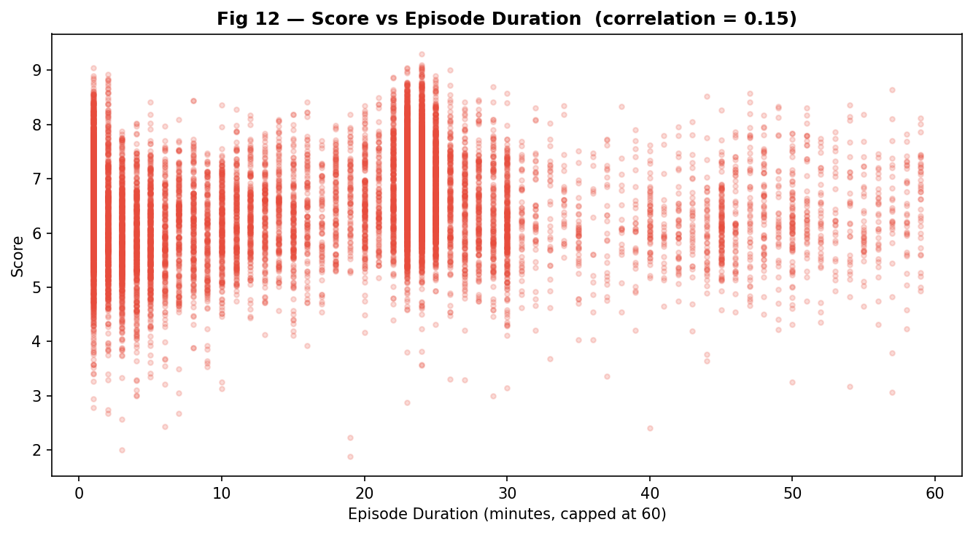
Score vs Episode Duration
Fig 12 — Correlation = 0.148. Very weak relationship. Duration alone tells us almost nothing about quality.

Slide 18
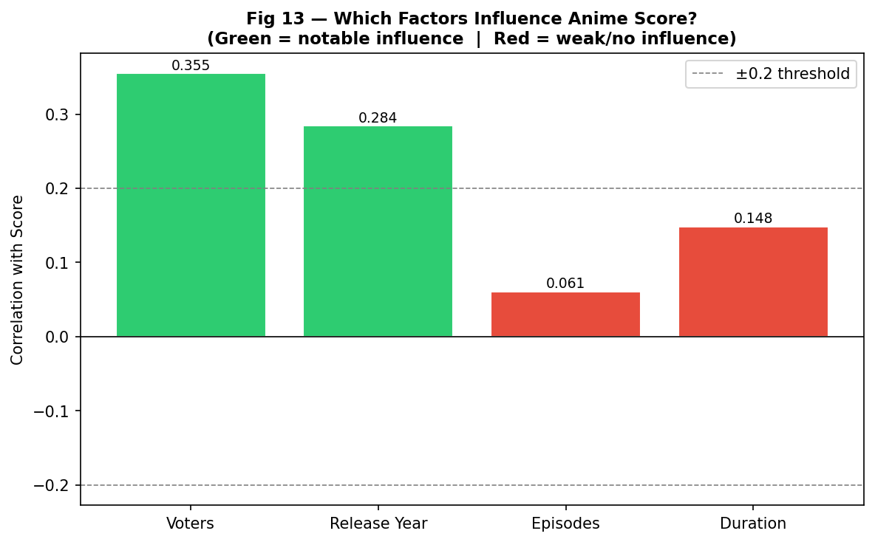
Which Numeric Factors Actually Influence Score?
Fig 13 — Green = notable influence (≥0.2). Red = weak/no influence. Voters and Year matter; Episodes and Duration do not.

Slide 19
Key Findings — Categorical Trends
Best Genre
Best Format
Best Studio
Suspense (7.08)
TV Series (6.84)
Kyoto Animation (7.45)
Mystery (7.01) close behind
Serialized storytelling wins
MAPPA (7.25) · Bones (7.31)
Best Age Rating
Best Episode Count
Best Duration
R 17+ (6.96)
100+ or 13–24 (~6.89)
15–25 min/ep (6.89)
Mature themes = higher scores
1–12 episode anime score lowest
Standard runtime performs best
Top rated anime: Frieren (9.30) · FMA Brotherhood (9.10) · Steins;Gate (9.07) — all TV format

Slide 20
What Actually Influences Popularity?
Numeric Correlations with Score
Verdict
Genre + Studio
Strongest categorical influence
Age Rating
R 17+ scores ~1pt above G-rated
Voter Count
Corr = 0.355, moderate link
Release Year
Corr = 0.284, slight upward trend
Episode Count
Corr = 0.061, barely anything
Duration
Corr = 0.148, very weak
Ideal popular anime: TV series · R 17+ rating · Suspense/Mystery genre · Top studio · Released 2020+

Slide 21
PART 2
Code Walkthrough
& Things That Didn't Work
anime_popularity_analysis.py · python · ~350 lines · 14 charts · 1 output text file

Slide 22
PART 2 — Code Walkthrough
Imports
import pandas as pd
import matplotlib.pyplot as plt
import matplotlib.ticker as mticker
from collections import defaultdict
import re
• pandas
• matplotlib
• defaultdict
• re — Python's built-in regex module

Slide 23
PART 2 — Code Walkthrough
Loading & Cleaning
df = pd.read_csv("popular_anime.csv")
df = df.dropna(subset=["score", "rank", "scored_by"])
df = df.reset_index(drop=True)
df["score"] = pd.to_numeric(df["score"], errors="coerce")
df["year"] = pd.to_datetime(df["aired_from"], errors="coerce").dt.year
df["duration_min"] = df["duration_per_ep"].apply(parse_duration)
• dropna (28,825 → 14,128 rows)
• parse_duration
• pd.to_numeric with errors='coerce'
• pd.to_

Slide 24
PART 2 — Code Walkthrough
R18 Exclusion)
df_all = df.copy()
df = df[df["rating"] != "Rx - Hentai"].reset_index(drop=True)
print(f"Removed {len(df_all) - len(df)} R18 rows")
• df_all
• The != operator keeps every row where rating is anything other than Rx - Hentai
Why? → adult content operates under completely different audience dynamics

Slide 25
PART 2 — Code Walkthrough
Analysis
genre_scores = defaultdict(list)
for _, row in df.iterrows():
for genre in row['genres'].split(','):
genre = genre.strip()
genre_scores[genre].append(row['score'])
genre_avg = {g: round(sum(v)/len(v),2)
for g,v in genre_scores.items() if len(v)>=50}
• Same exact approach used for studio analysis

Slide 26
PART 2 — Code Walkthrough
Groupby & pd.cut() Binning
# Split-Apply-Combine
type_avg = df.groupby("type")["score"].mean().sort_values(ascending=False)
# Bin episode counts into labeled ranges
bins = [0, 12, 24, 50, 100, 10000]
labels = ["1-12", "13-24", "25-50", "51-100", "100+"]
df["episode_range"] = pd.cut(df["episodes"], bins=bins, labels=labels)
ep_avg = df.groupby("episode_range", observed=True)["score"].mean()
• pd.cut converts
• observed=True prevents pandas from showing empty categories in the output

Slide 27
PART 2 — Code Walkthrough
Correlation & File Output
# Pearson correlation
corr_voters = df["score"].corr(df["scored_by"])
corr_episodes = df["score"].corr(df["episodes"])
corr_duration = df["score"].corr(df["duration_min"])
corr_year = df["score"].corr(df["year"])
# File output
with open("anime_findings.txt", "w") as f:
f.write(f"Total analyzed: {len(df)}\n")
• .corr()
• Results: Voters (0.355) and Year (0.284) matter while
Episodes (0.061) and Duration (0.148) do not
• open() with 'w'

Slide 28
PART 2 — Things That Didn't Work Out
Challenges
01
File path errors
Script crashed with FileNotFoundError
02
Messy duration column
'1 hr 44 min' format returned 1 instead of 104
03
groupby failed on genres
df.groupby('genres').mean() treated 'Action, Drama' as one category
04
Only 1 R18 row removed
Expected more
05
Correlation lower than expected
Difference in expectation. Hypothesis = wrong

Slide 29
Conclusion
What Was Found
Genre + Studio
Strongest predictors — Suspense/Mystery + Kyoto Animation top the rankings
Age Rating
R 17+ scores highest (6.96) — mature themes resonate with audiences
Voter Count
Corr = 0.355 —> popularity and quality overlap but aren't identical
Release Year
Corr = 0.284 —> newer anime score higher; 2024 avg = 7.02
Episode Count
Corr = 0.061 —> almost no influence. Content quality matters, not length.
github.com/MoonCrepe/ProjectAnimePopAnalysis · CS 210 Spring 2026 · Rutgers University

Slide 30
Thank You!
github.com/MoonCrepe/ProjectAnimePopAnalysis · CS 210 Spring 2026 · Rutgers University
github.com/MoonCrepe/ProjectAnimePopAnalysis · CS 210 Spring 2026 · Rutgers University

