Slide 1
ENUM
Desgined. 2018 YPTLAB

Slide 2
INDEX
ENUM
ENUM 활용
마무리

Slide 3
CHAPTER 01
ENUM
ENUM
enumeration
관련이 있는 상수의 집합

Slide 4
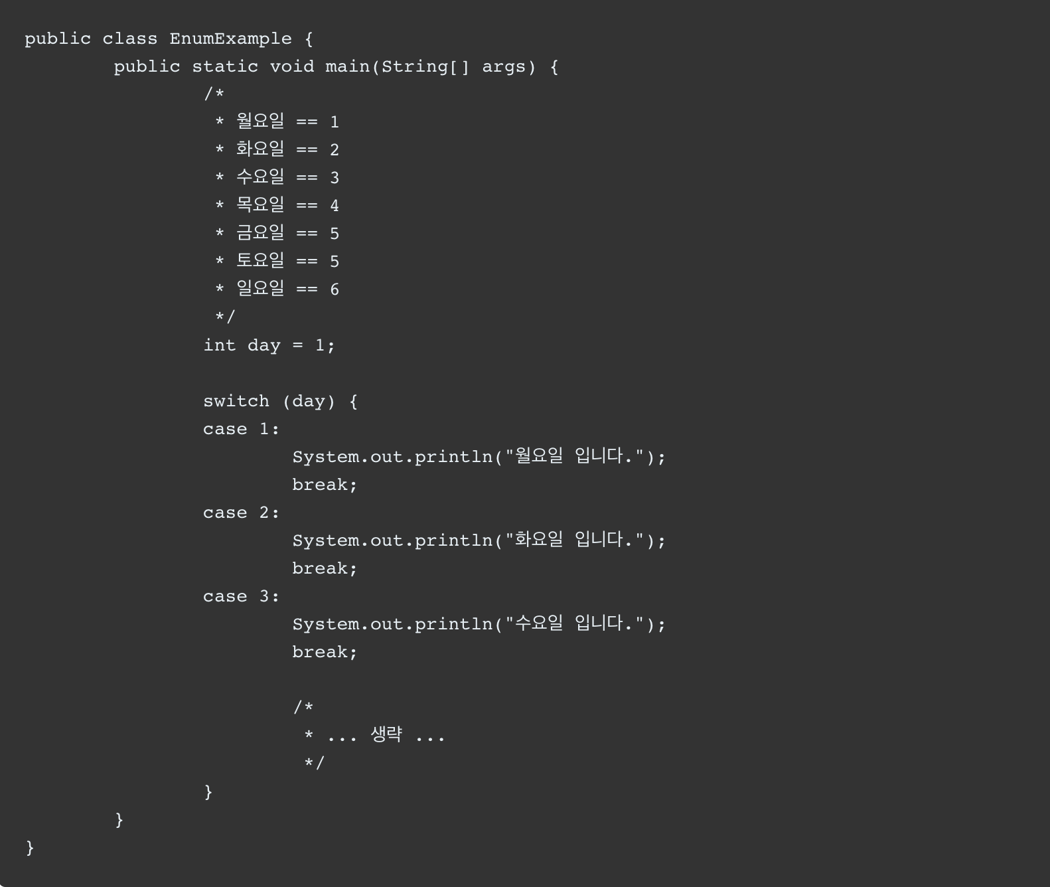

Slide 5
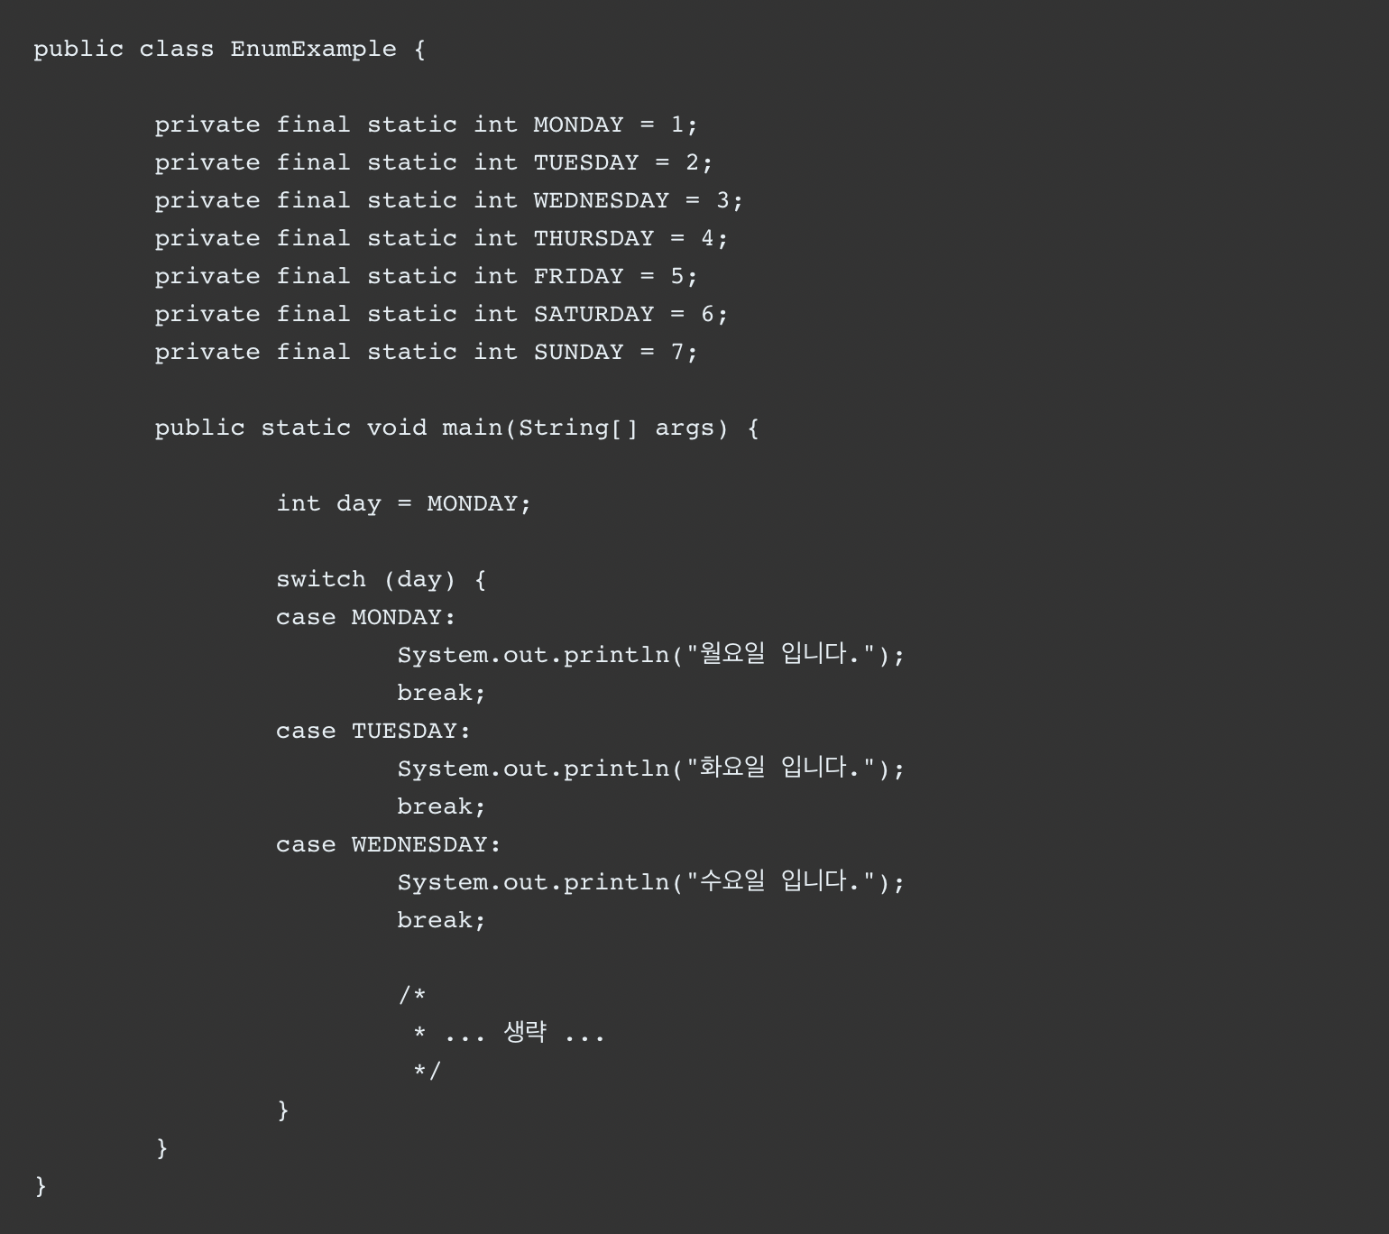

Slide 6
interface DAY{
int MONDAY = 1;
int TUESDAY = 2;
int WEDNESDAY = 3;
int THURSDAY = 4;
int FRIDAY = 5;
int SATURDAY = 6;
int SUNDAY = 7;
}
interface MONTH{
int JANUARY = 1;
int FEBRUARY = 2;
int MARCH = 3;
int APRIL = 4;
int MAY =5;
int JUNE = 6;
int JULY = 7;
int AUGUST = 8;
int SEPTEMBER = 9;
int OCTOBER = 10;
int NOVEMBER = 11;
int DECEMBER = 12;
}
public class EnumExample {
public static void main(String[] args) {
if(DAY.MONDAY == MONTH.JANUARY){
System.out.println("두 상수는 같습니다.");
}
int day = DAY.MONDAY;
switch (day) {
case DAY.MONDAY:
System.out.println("월요일 입니다.");
break;
case DAY.TUESDAY:
System.out.println("화요일 입니다.");
break;
case DAY.WEDNESDAY:
System.out.println("수요일 입니다.");
break;
/*
* ... 생략 ...
*/
}
}
}

Slide 7
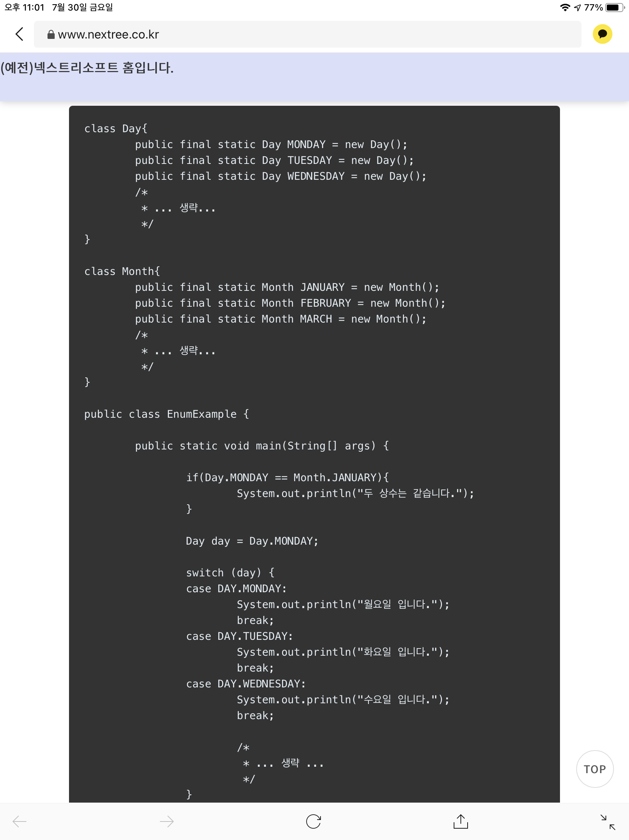

Slide 8
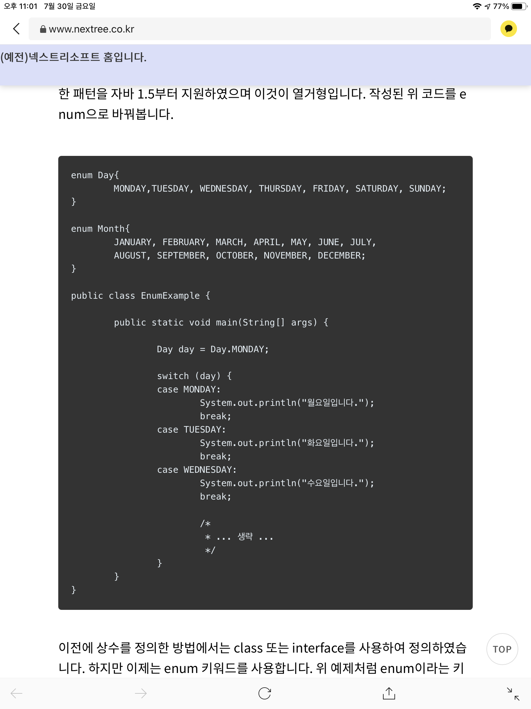

Slide 9
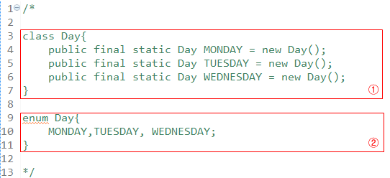

Slide 10
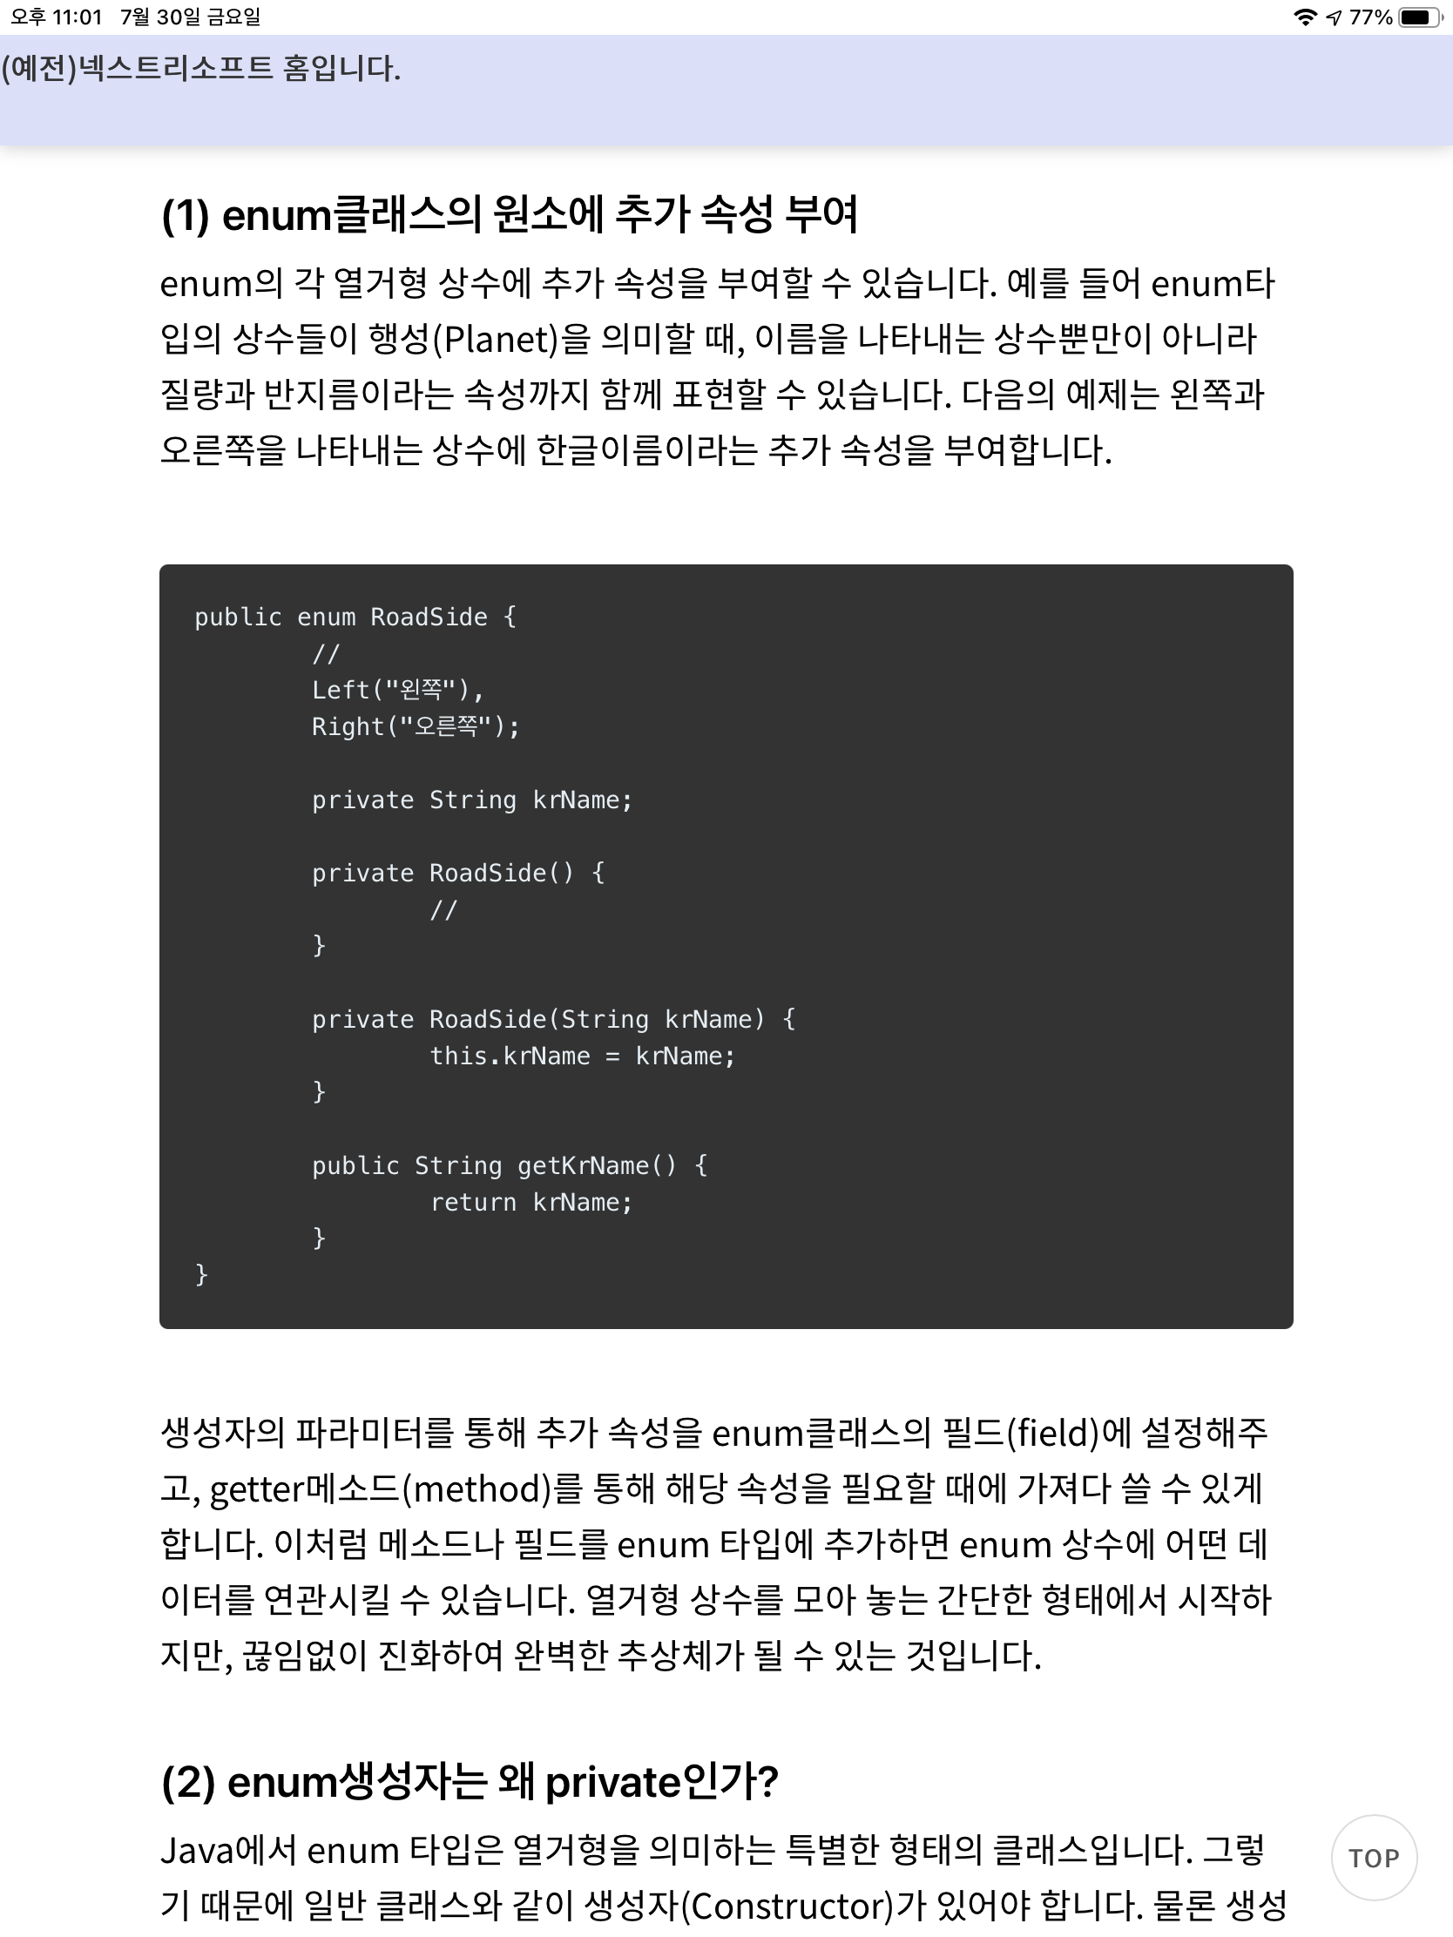

Slide 11
CHAPTER 02
ENUM 활용

Slide 12
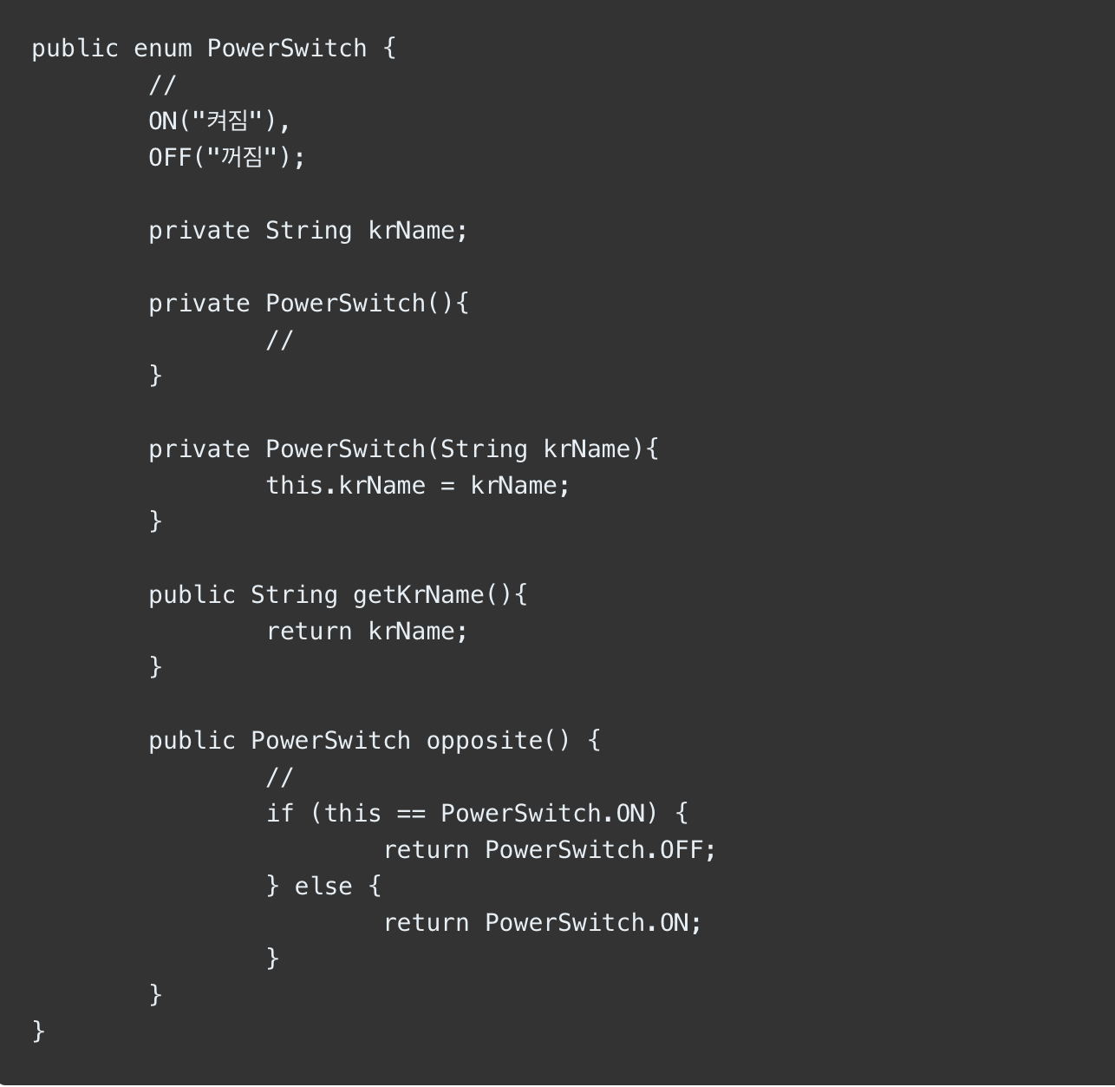

Slide 13
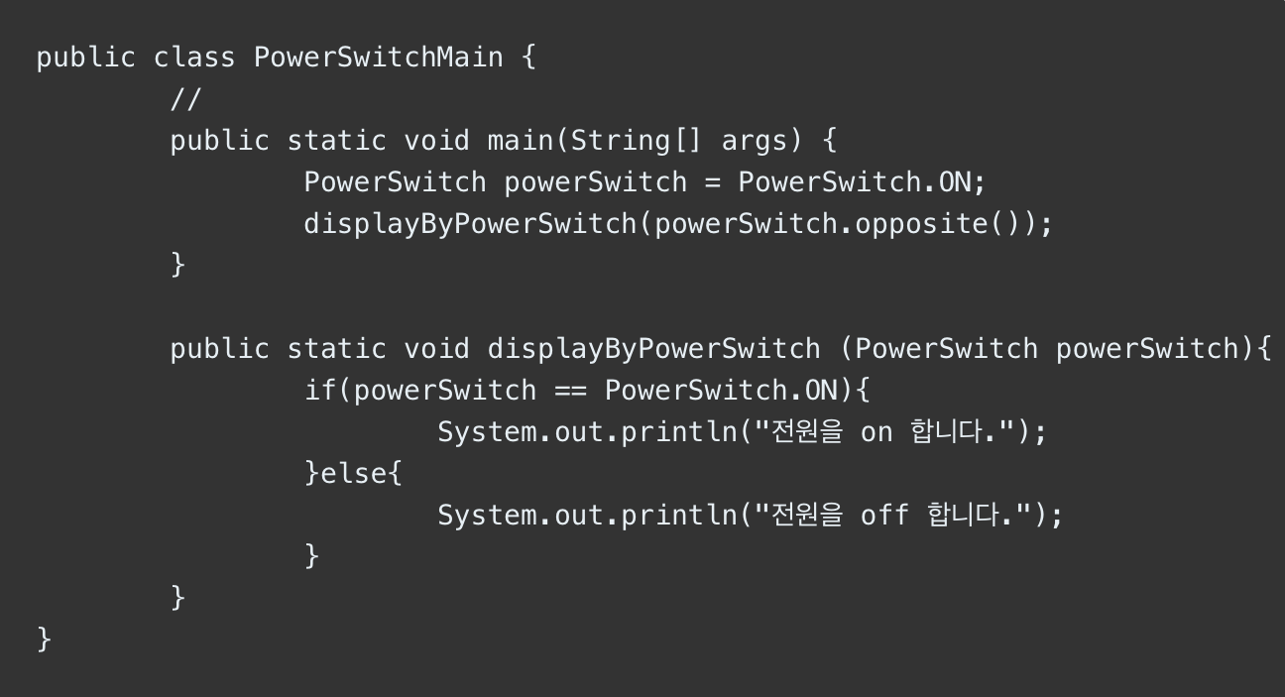

Slide 14
감사
합니다
Desgined. 2018 YPTLAB

