Slide 1
JavaScript Teamwork

Slide 2
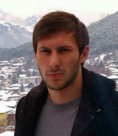
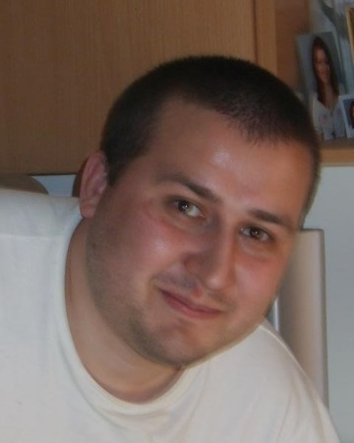
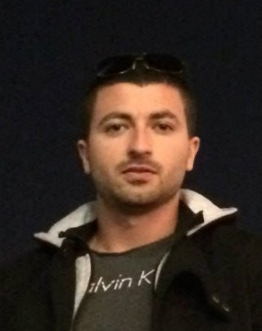
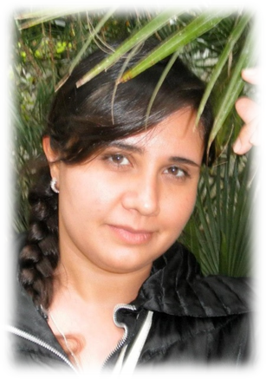
TEAM“MOON ORCHID”
Iliya Boyanov
Vladimir Ivanov
Valeri Manchev
Plamena Nikolova

Slide 3
TEAM“MOON ORCHID”
Master in the judge system
Javascript exam 400/400

Slide 4
TEAM“MOON ORCHID”
Part of the coding team

Slide 5
TEAM“MOON ORCHID”
Our designer
Part of the coding team
https://www.youtube.com/user/MANCHEV720966

Slide 6
TEAM“MOON ORCHID”
Supporting with ideas
Presentator

Slide 7
TEAM“MOON ORCHID”
Our first idea
“super NAkov”

Slide 8
TEAM“MOON ORCHID”
Our second and main idea
game “sheep collector”

Slide 9
LIVE DEMO
https://github.com/MoonOrchid/MoonOrchid-Project

