Slide 1

Optimising a Task Scheduler for Dark Silicon Parameters
A Thesis Seminar by Thomas Steel
University of Queensland

Slide 2
Overview
What is dark silicon?
Methodology
Roadmap
Questions

Slide 3
Background Information
Dark Silicon
Dennardian Scaling
Wire Losses

Slide 4
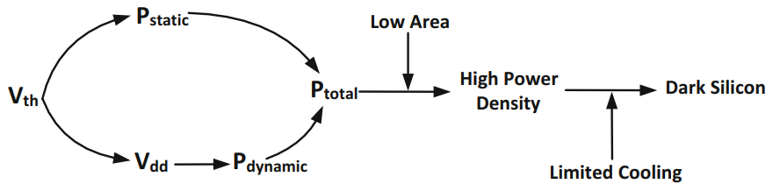
Dark Silicon
Dark Silicon is unpowered circuitry on a chip
It is a confluence of multiple factors:
A fundamental breakdown of Dennardian Scaling
Increasing power density on silicon chips
No concurrent increase in the capacity to cool a chip
This results in circuitry remaining unpowered to prevent heat damage

Slide 5
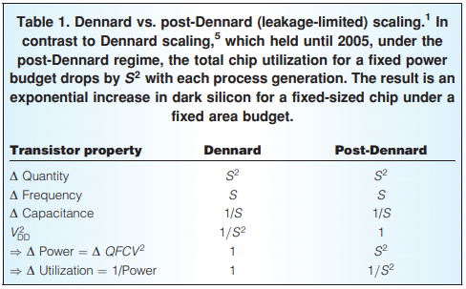
Dennardian Scaling
Moore’s Law: the number of transistors on a chip doubles every 18 months
Dennardian and Post-Dennardian Scaling describe how Moore’s Law affects the maximum operating conditions of the chip
In Dennardian Scaling, power usage and chip utilisation are constant
In Post Dennardian Scaling, power usage and chip utilisation of exponential

Slide 6
Wire Losses
Power consumption of semiconductors reduces in each generation
Power consumption of interconnecting wires do not
Interconnecting wires have RLC properties that are affected by their length
These properties constrain the power consumption of interconnects, preventing significant power decreases

Slide 7
Dark silicon Methodologies
Reviewing dark silicon, Michael Taylor outlined the “Four Horsemen of the Coming Dark Silicon Apocalypse”
The Shrinking Horseman
The Dim Horseman
The Specialist Horseman
The Deus Ex Machina Horseman
From these we derive the main methods of hardware optimisation
Computational Sprinting
Memory Driven Computing
Heterogeneous Cores

Slide 8
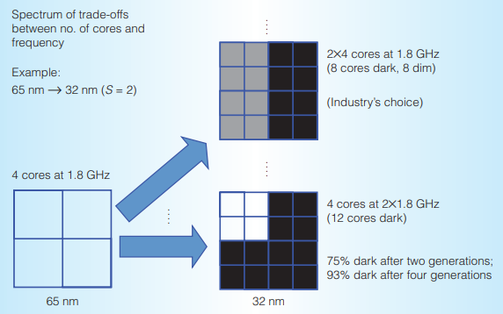
The Dim Horseman
Dim silicon – Dark silicon’s more attractive cousin
Dim silicon describes 2 main scenarios:
A chip is underclocked
Transistors are powered below standard voltages
These methods reduce power density allowing more area to be used on a chip
Computational Sprinting comes under this methodology.

Slide 9
Specialist Horseman
Specialised circuits (ASIC’s) operate 100 to 1000 times more quickly and utilise 157 to 707 times less power than general processing units
Producing ASIC for every use is not a feasible possibility at present
Producing general processing units that have ASIC-like qualities is feasible.
The Specialist Horseman considers the viability of installing hardware accelerators and heterogeneous cores that can be powered on and off as

Slide 10
The Shrinking Horseman and The Deus Ex Machina Horseman
Shrinking Horseman:
Chip designers react by reducing the size of chips.
Circumvents power density and cooling problems by being too small for these problems to arise
Sidesteps the problem rather than addressing management techniques
The Deus Ex Machina Horseman relies on a circumstance where technological advancement renders dark silicon invalid.
Examples include:
using different chemical structures for transistors (e.g. diamond, or gallium-arsenic)
sudden increase in cooling technology
New transistor designs such as Quantum Field Effect Transistor

Slide 11
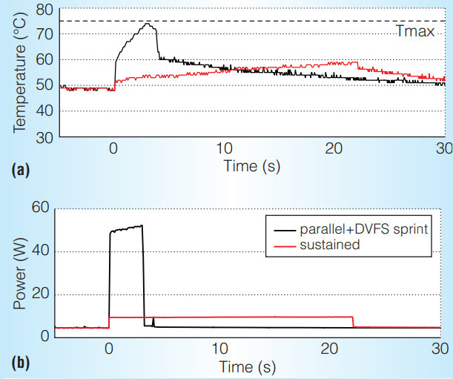
Computational Sprinting
DVFS – Dynamic Voltage/Frequency Scaling
The clocking frequency on chip is dynamic
Produces ‘sprints’ of high throughput

Slide 12
Memory Driven Computing
Memory driven computing seeks to address the dark silicon by optimising memory storage on chip
Traditional design involves large blocks of memory, often exacerbating wire related power consumption
By distributing small blocks of memory across the chip, wire related power consumption can be reduced

Slide 13
Heterogeneous Cores
The idea behind heterogeneous cores is to exploit dark silicon by adding cores that are optimised for different processes

Slide 14
CPU Scheduling
Task scheduling is a key component of any operating system.
Good task scheduling can be the difference between naïve resource allocation and optimum resource allocation
Optimising for dark silicon parameters requires optimisation for power
Good resource allocation allows real time optimisation of power and circuit utilisation

Slide 15
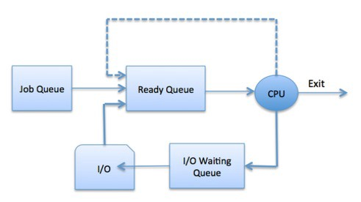
CPU Scheduling
Task Scheduling
task switching
I/O operations
Good task scheduling is about optimising throughput
In this project, there will be the additional control element of controlling the hardware
This project will implement a variant on the multilevel feedback queue

Slide 16
CPU Scheduling Challenge
The task scheduler for this project will have to control hardware
It will have to pick appropriate times for computational sprints
It will need to choose when to switch between different cores for different calculations
It will need to efficiently handles data storage for a balance between travel distance and priority of access

Slide 17
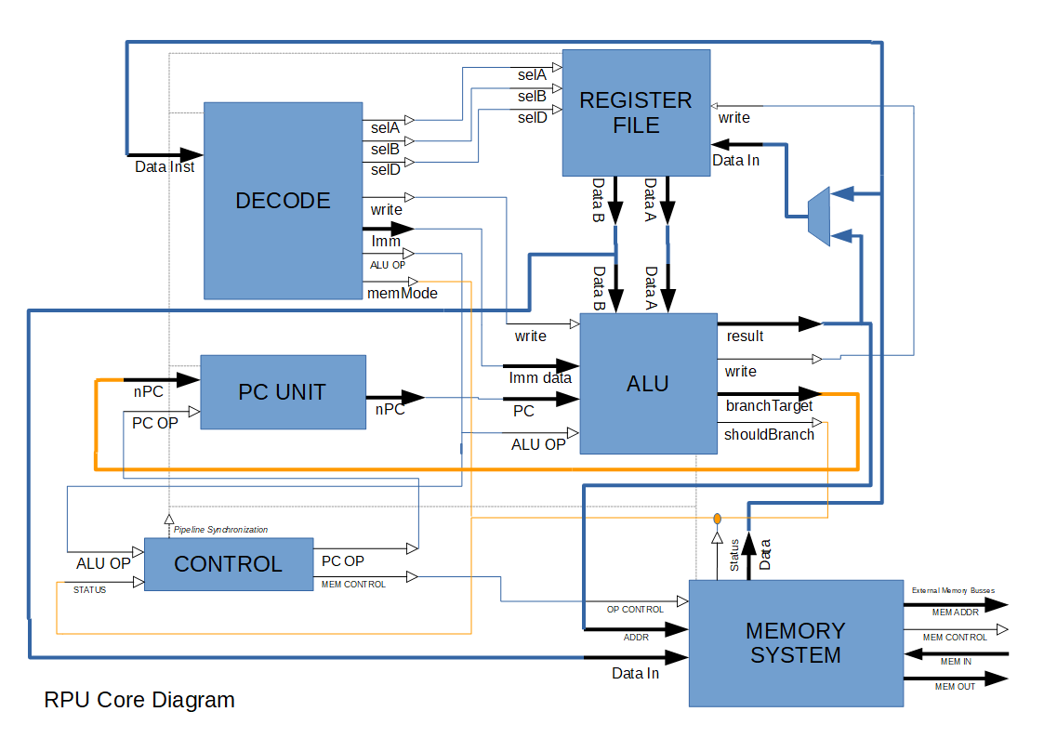
RPU Risc-V Core
Chosen for:
Simplicity
Appropriate License
Language familiarity (VHDL)

Slide 18
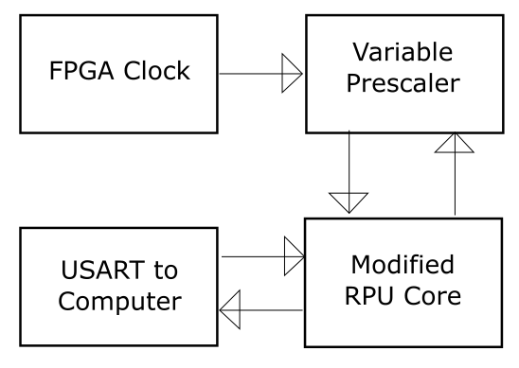
System Diagrams - Sprints

Slide 19
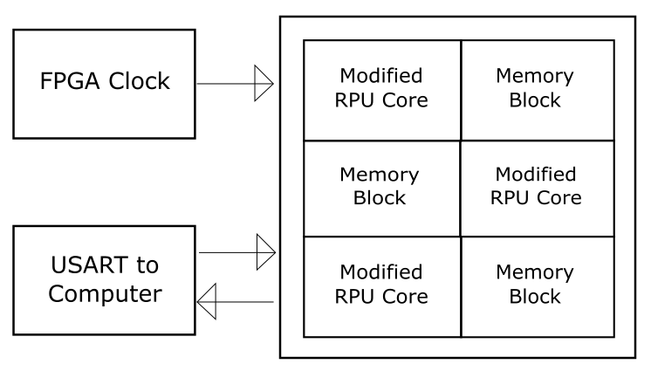
System Diagram – Memory Driven

Slide 20
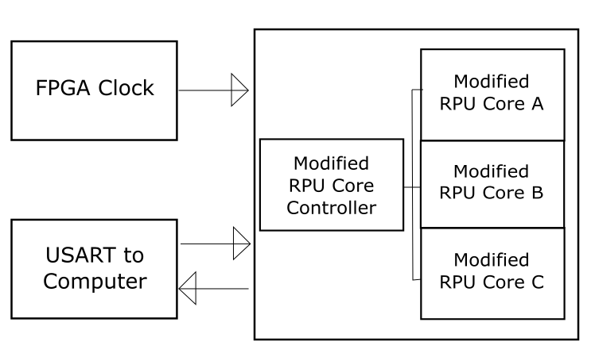
System Diagram – Heterogeneous Cores

Slide 21
Progress - Implementation
Programming the WARP FPGA Board:
The board has a Xilinx Virtex-4 Chip on it
This requires Xilinx ISE Webpack 14.7, which was archived in 2013
Installing this in Windows 10 is an adventure
Installing Webpack on Windows 10 resulted in error after error
Forums have suggested a windows 7 emulator
Resultantly, the installation has had some setbacks

Slide 22
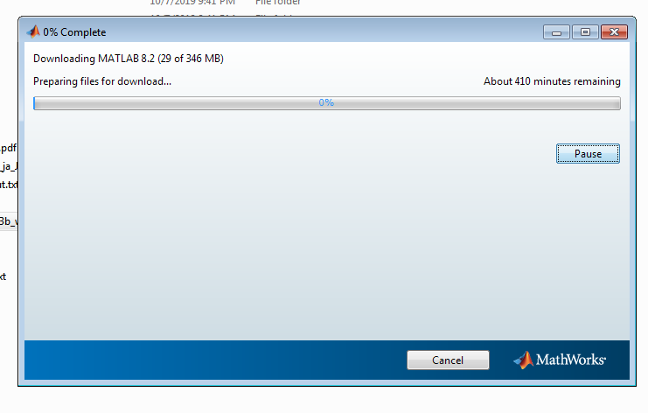
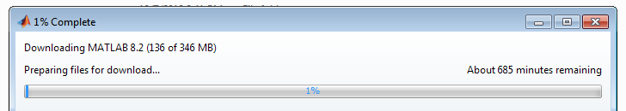
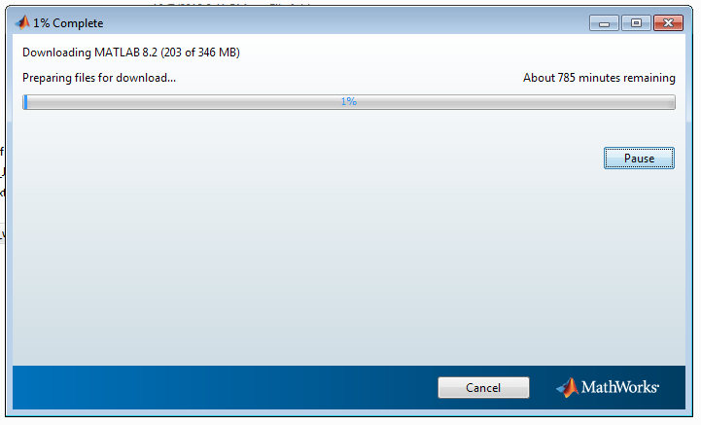
Progress - Implementation

Slide 23
Progress - Implementation
Total progress achieved so far:
A basic script to blink an LED as been prepared and is ready for implementation
Theoretical approaches for all 3 methodologies have been prepared
The relevant software has been prepared and will eventually finish installing

Slide 24
Roadmap
4 blocks of implementation
Computational Sprinting
Memory Driven Computing
Heterogeneous Cores
Integration
Each block follows the same cycle
Design Verification
Hardware Optimisation
Firmware Optimisation
Testing

Slide 25
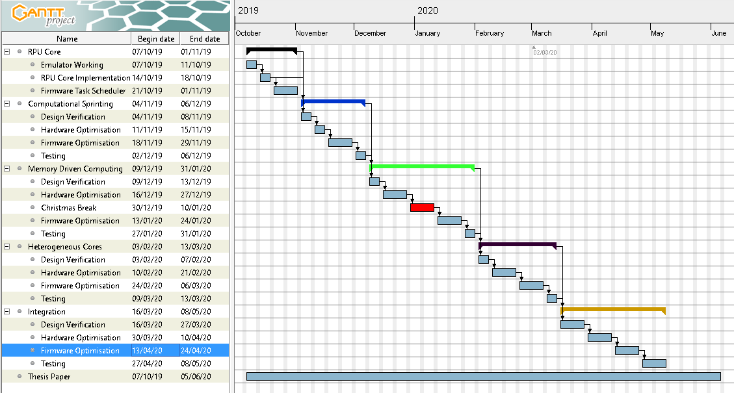

Slide 26
Questions

