Slide 1
Heart Failure Clinical Records
Angela Chen
Data Analytics
9/2026

Slide 2

Introduction
Research Question: How are certain clinical characteristics associated with death among patients with heart failure?
Interested in medical research
It is important to understand what contributes to increased possibility of heart failure.

Slide 3
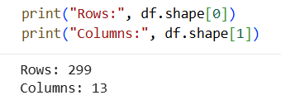
Data Sources
Heart Failure Clinical Records - UCI Machine Learning Repository
Patient Records from 2020
There are 299 rows and 13 columns

Slide 4
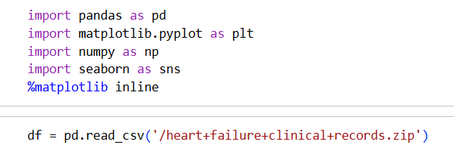
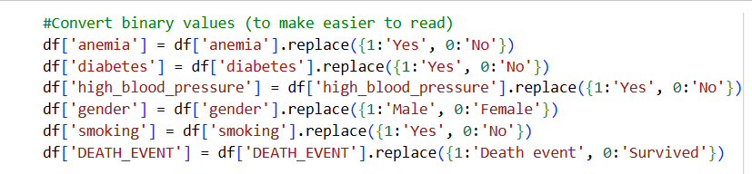
Methodologies
Inspected data with df.head(), df.tail(), df.columns, df.shape, df.index, df.info(), df.describe(), dtypes, count
Searched for null values
Renaming Columns
Converted binary values
Created age groups
Used box plot, histogram, and bar plot

Slide 5
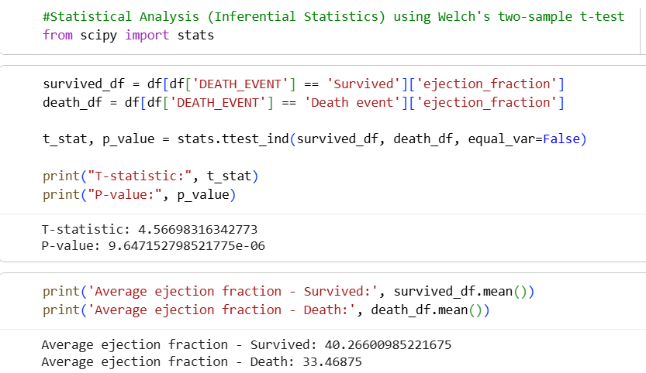
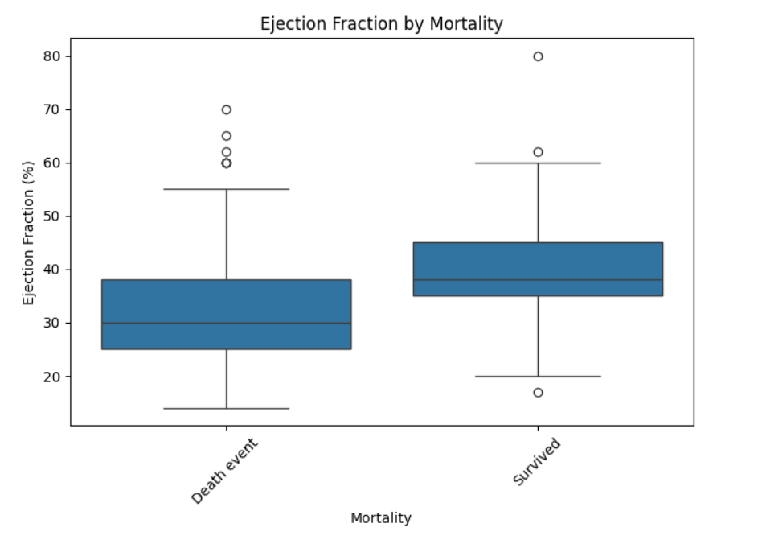
Ejection Fraction by Mortality

Slide 6
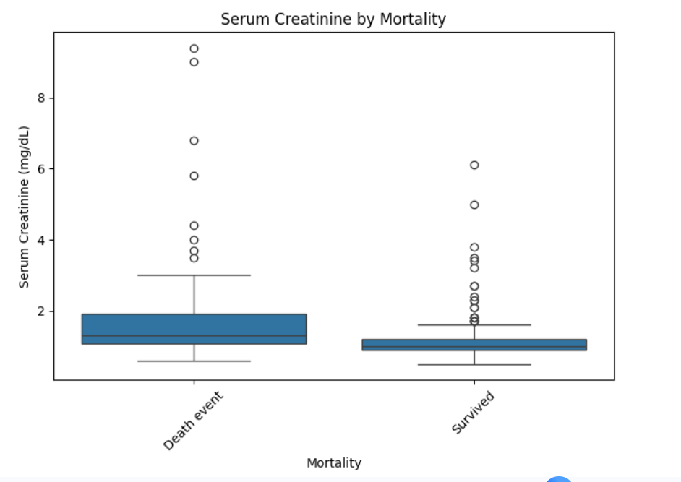
Serum Creatinine Box Plot

Slide 7
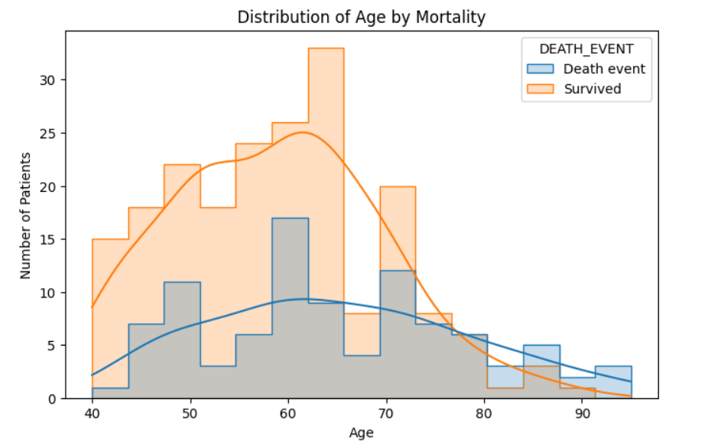
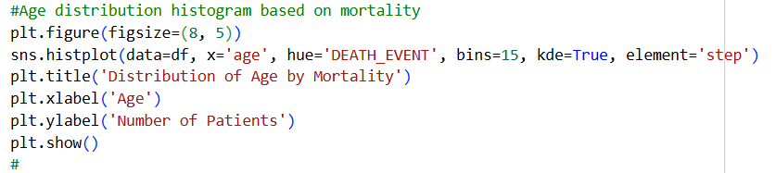
Distribution of Age by Mortality
Histogram
A lot of survivors ages mid 60s and younger
More spread out for death
event group

Slide 8
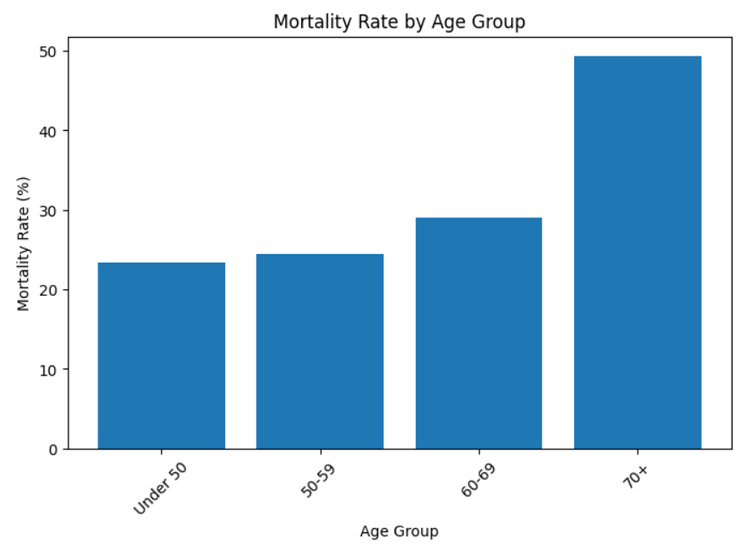
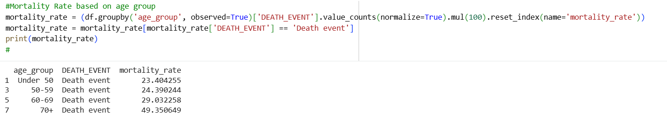
Mortality Rate by Age Group
Mortality Rate
Bar Plot

Slide 9
Conclusions
Results were as expected
Age, ejection fraction, and serum creatinine levels differed between mortality groups
Ejection fraction showed a statistically significant difference between both outcome groups
Resource: pandas.DataFrame.plot.box — pandas 3.0.6 documentation

Slide 10
Thank you

