Slide 1

PROJECT-BASED LEARNING
PHASE-II EVALUATION
Algo Vision
Team ID: T218
Department of Computer Science & Engineering
Graphic Era (Deemed to be University), Dehradun
Academic Session 2026–27

Slide 2
Team & Mentor Details
Team Information
Team Members
Team ID: Semester: Section: Domain:
T218
3rd
Cyber, H, G, J (DSA) Visualization
Abhishek – 2510012494 (Lead)
Chaitanya Maithani – 2510011693
Chaitanya Kharakhwal – 2510010395
Arihant Rawat – 2510012102
Mentor
Mr. Kuldeep Nautiyal
Interactions completed:4

Slide 3
Phase-I Recap & Feedback Incorporated
Phase-I Status
In Phase-I we proposed Algo Vision, a platform that combines DSA learning, step-by-step visualization and practice. The problem, objectives, architecture and technology stack were finalised, and initial development was started.
Feedback Received
Suggestion / Feedback 1
Suggestion / Feedback 2
Suggestion / Feedback 3
Changes Incorporated
Technology stack made clearer: HTML/CSS/JavaScript for the interface, Local Storage for data
Modification 2
Modification 3

Slide 4
Problem Statement & Finalized Objectives
Problem Statement
Beginners find DSA hard to understand through code alone, especially pointers, nodes and memory changes. Learning, visualization and practice are available only on separate platforms.
Finalized Objectives
Explain DSA concepts with C++ examples.
Visualize operations on Arrays, Linked Lists, Stacks and Queues step by step.
Provide practice questions based on topic and difficulty.
Track student progress locally in the browser.

Slide 5
Updated System Architecture / Workflow
Input
Topic / Operation
Processing UI & DOM
Core Logic DSA Operations
Storage Local Storage
Output Visual Steps
Major Components
User Interface
Learning & Visualization Module
Practice & Progress Module
Changes Since Phase-I
Each operation is converted into a list of steps that the interface draws one by one
Local Storage defined as the storage layer
Modules communicate through
Department of Computer Science & Engineering — Graphic Era (Deemed to be University) JavaScript functions and shared
5/15

Slide 6
Module Design & Functional Requirements
Major Modules
UI & Topic Navigation
Learning Module (concepts + C++ examples)
Visualization Module
Practice & Progress Module
Functional Requirements
Select a DSA topic and operation
Show concept and C++ code
Show each step with next / previous controls
Filter questions by topic and difficulty and save progress
Module Dependency
The UI calls the Learning and Visualization modules; the Practice module uses the same topic list and writes results to Local Storage.

Slide 7
Technology Stack & Development Methodology
Technology Stack
Development Methodology
Programming: C++ (examples) / JavaScript
Interface: HTML, CSS, JavaScript
Storage: Local Storage
Development Tool: VS Code / Browser
Version Control: Git / GitHub
Requirement Analysis
System Design
Module Development
Integration
Testing & Validation
These technologies are simple, accessible and suitable for an interactive browser-based DSA learning platform.

Slide 8
Implementation of PBL Course Concepts
Course
Concepts Actually Implemented
Project Module
Data Structures in C
Arrays, Linked Lists (nodes and pointers), Stacks (push / pop), Queues (enqueue / dequeue)
HTML, CSS, JavaScript, DOM manipulation, Lo-cal Storage
Visualization & Practice
Web Development
Learning & Visualization Interface
Integration: DSA operations drive what the web interface draws, so both subjects work together in one project.

Slide 9
Development & Implementation Progress
Module | Status | Work Completed
UI & Topic Navigation | Completed | Website layout and navigation between topics
Learning Module | Completed | Concept notes and C++ examples for the topics
Visualization Module | In Progress | Step-by-step display of basic operations; linked list work continuing
Practice & Progress Module | Pending | Question set and Local Storage design prepared; imple-mentation planned
Overall Project Completion: 40%

Slide 10
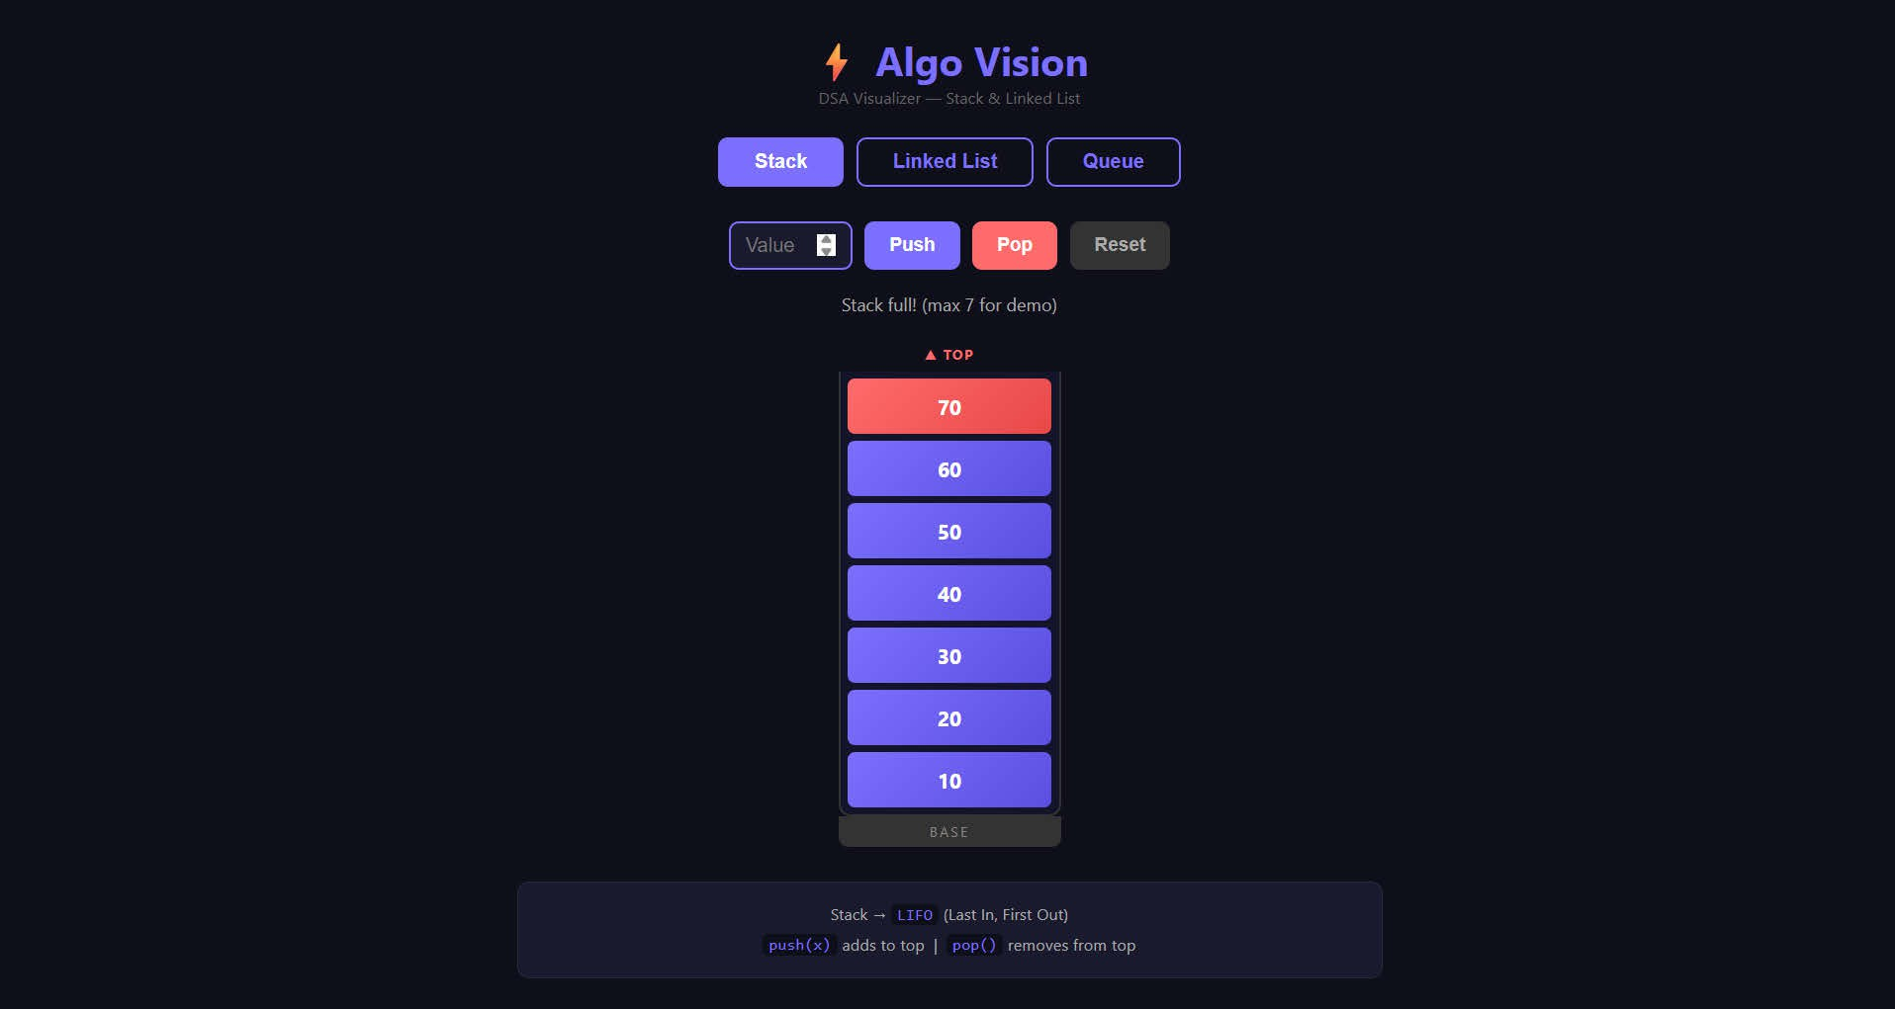
Working Prototype / Demonstration
Implemented Features
Topic selection and navigation
Concept explanation with C++ examples
Step-by-step visualization of operations
Practice questions (in progress)
Prototype / Output
Insert screenshot / output / prototype evidence here

Slide 11
Testing, Results & Validation
Test / Module
Expected Result
Observed Result
Status
Topic navigation
Every topic page opens correctly
All 3 tabs correctly show their panel on click. Stack loads by default. Active tab highlights purple.
Push adds block to top
(red highlight). Pop re-moves it.Log updates af-ter each step.
Insert Front/End re-
renders nodes with → arrows and NULL tail correctly
No localStorage found in
code. All data resets to empty on reload.
Pass
Stack push / pop
Each step shows the cor-rect stack state
Pass
Linked list insert / delete
Nodes and pointers up-date correctly at each step
Pass
Local Storage
Saved progress remains after page reload
fail

Slide 12
GitHub Repository & Development Activity
Repository Information
GitHub Link: Repository URL
README.md: project overview and how to run
Contributors: all four members
Repository Status: latest code uploaded
Branches: main / feature branches
Development Activity
Regular commits maintained
Meaningful commit messages
Individual contribution visible
Latest implementation uploaded
Documentation maintained
Requirement: All team members must be contributors and must commit
individually using their own GitHub accounts.

Slide 13
Individual Contribution
Member | Role |  | Technical Contribution | GitHub Commits
Abhishek | Lead |  | Assign tasks ,task coordination,Website layout, and visualization using HTML and DOM | 13
Chaitanya Kharakhwal | Developer |  | Frontend,C++,manage local storage and imple-mentation | 7
Arihant Rawat | DB / Testing |  | Test cases, practice question structure and Local Storage progress design | 3
Chaitanya Maithani | Developer Docs | / | C++ examples, learning content, website sup-port and documentation | 3
Individual Evaluation
Every member should be prepared to explain and demonstrate their own technical contribution to the project.

Slide 14
Challenges, Remaining Work & Phase-III Roadmap
Challenges Faced
Drawing pointer and node changes in sync with each step
Going back to an earlier step correctly
Saving progress without a database
Phase-III Roadmap
Complete linked list visualization
Complete practice module and progress tracking
System integration
Testing / optimization
Final validation and documentation
Solutions / Learning
Store each operation as a list of state snapshots
Save progress as JSON in Local Storage

Slide 15
Expected Outcomes & References
Expected Final Outcomes
Complete working DSA learning platform
Interactive step-by-step visualizations
Topic-wise and difficulty-wise practice
Local progress tracking
Better understanding of DSA for beginners
References
C++ Documentation (cppreference.com)
MDN Web Docs
LeetCode
T. H. Cormen et al., Introduction to Algorithms
DSA textbooks
Thank You
Questions & Suggestions

