Slide 1



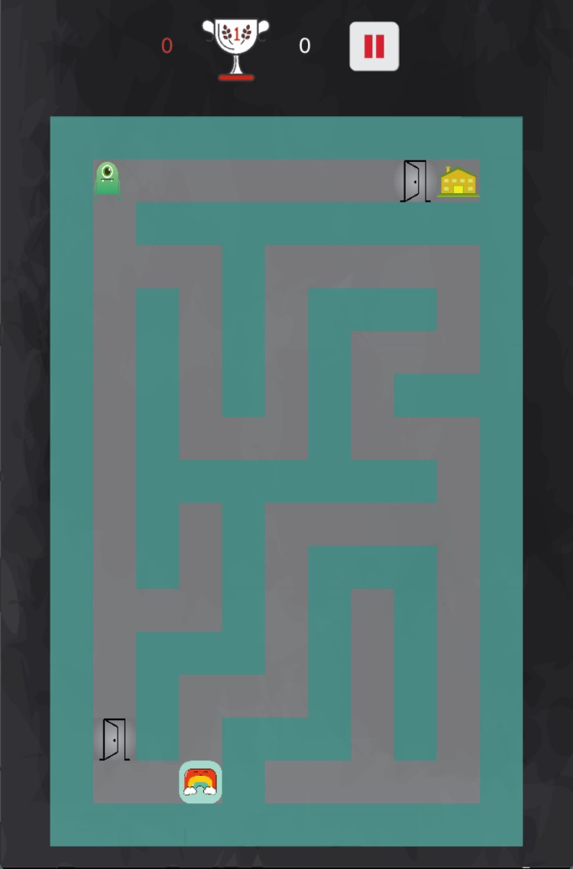
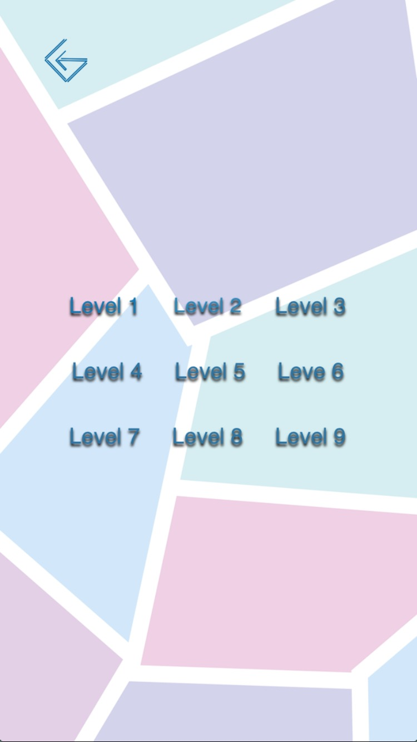
FindThePath Chanjuan Zheng
The Game
Maze Game with Dokodemo Door
Control a battle-group of starships
Move up/down/left/right by swiping the screen
Keep your player alive
Take advantage of dokodemo doors to move player faster
Designed for the iPhone 6
Written in Objective-C
Built on Cocos2D Game Engine
Challenges
Randomly Generated Maze
Designed an algorithm for a maze generator
The costomized number of columns and rows and the start point， the maze will become more complicate in higher levels
Multiple ways to arrive the destination
Dokodemo Door
Player node moves in the maze to get the destination --- the yellow house
The dokodemo door helps player moving faster by transferring it from one door to another one
The dokodemo door can be placed in both the wall and the path
Monsters
Player loses the current game if it gets touched by the monsters
The amount of monsters will grow when the level gets higher
Notable Features
Swipe control node
The player node is moved by swiping up/down/left/right in the game scene
Monsters randomly wander on the path
The dokodemo doors can expedite the game process and help player to avoid monsters
Assets
Yellow house – The destination that the player needs to arrive at
Dokodemo doors – The term origins from a Japanese cartoon, the door can transfer object to other place instantly
Enemy monster– attempt to collide with player block
Maze – Build the path
Dokodemo door in the path/wall
The doors in the path cannot be bypassed if player block wants to path the way
The door can be both helpful and harmful, it might send node to a far place

