Slide 1
The Magic Compass
Eric Bronner
Alison Wong

Slide 2
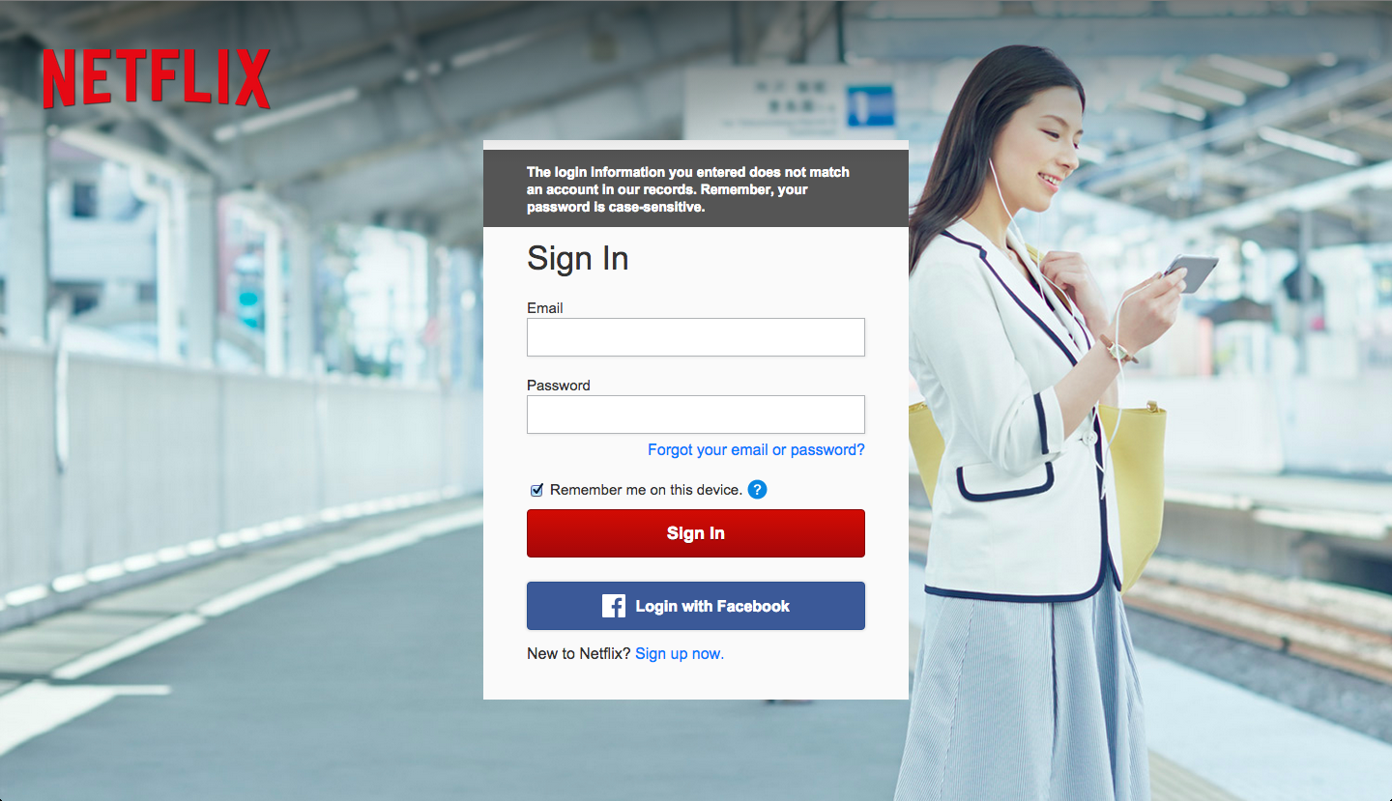
Has this ever happened to you?
Not enough money for a netflix account?

Slide 3

You know where to go.
But what are you looking for?

Slide 4
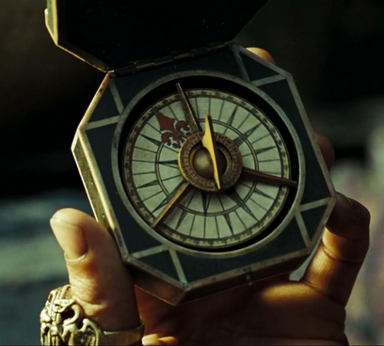
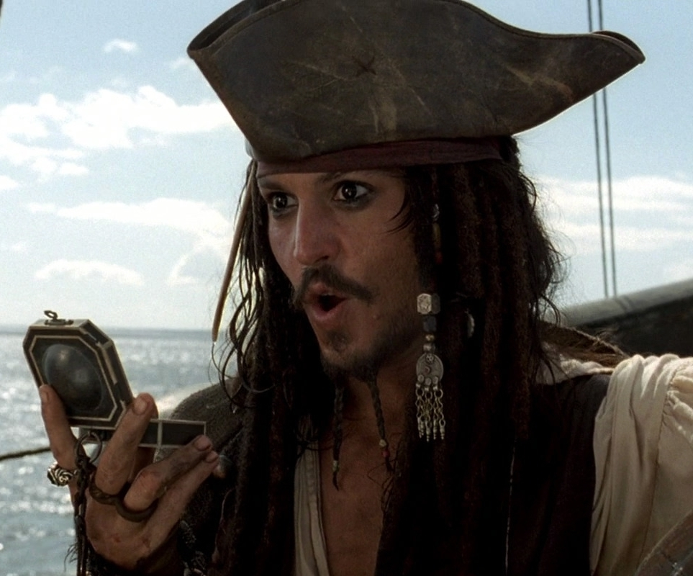
Introducing …

Slide 5
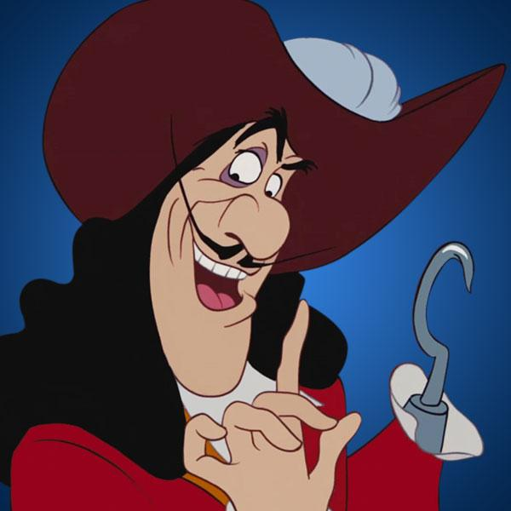

… The Magic Compass
For the movie-goer on a budget.
We’ll tell you what you want to pirate.
Featuring data scraped fresh from imdb, our algorithms will match your taste to the movies you didn’t know you wanted to see.

