Slide 1
Back
Input Document
Opsi HASH
INPUT DOCUMENT
Selesai

Slide 2
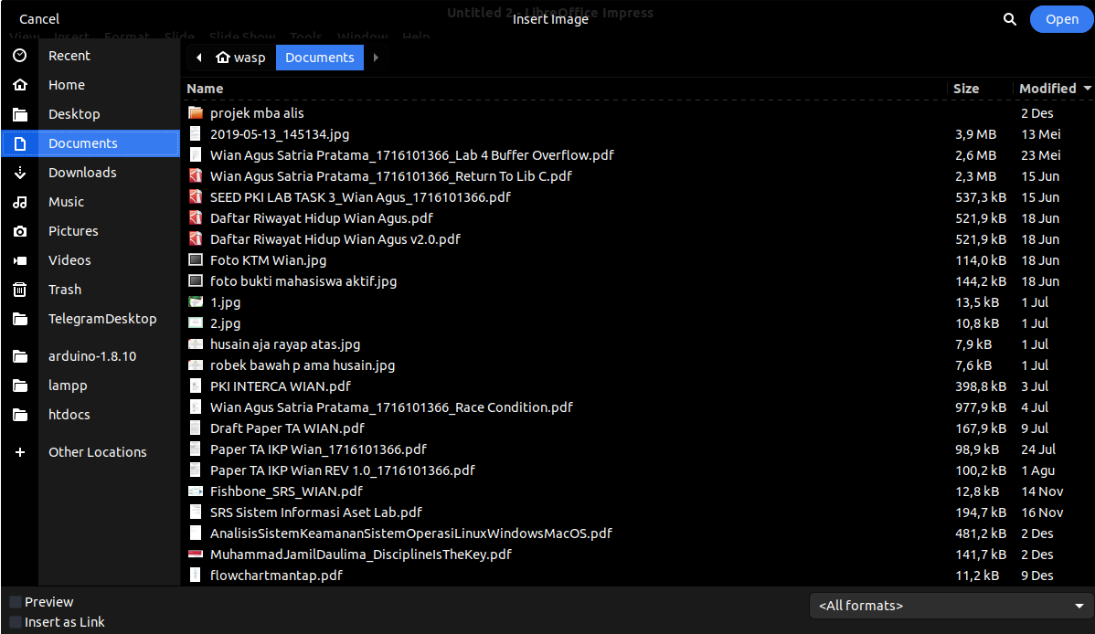

Slide 3

Back
Input Document
Opsi HASH
Selesai

Slide 4
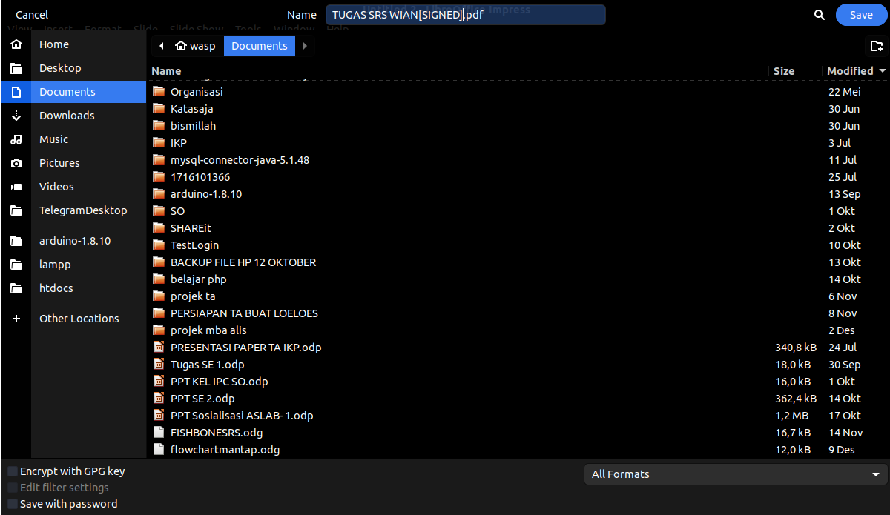

Slide 5
Back
Input Document
Opsi HASH
INPUT DOCUMENT
Selesai

