Slide 1
20486B
Developing ASP.NET MVC 4 Web Applications

Slide 2
Hello
Jônatas Afonso
MCT +5, MCSD, CSM, ….
Software Developer and Architect
15+ experience, 4 countries, 10+ Companies
https://www.linkedin.com/in/jonatasafonsoneto/
Jonatas_afonso@hotmail.com

Slide 3
Hello
Nome
Experiência
Expectativas

Slide 4
Dinâmica
Horário – 19:00 – 21:00 (terças e quintas)
15 Sessões
Dinâmica das aulas: A aplicação exemplo
Idioma das aulas
Requisitos de Máquina (VS2022)
https://github.com/MoongyProjetos/ASPNETMVC202304
Notes:
https://github.com/MoongyProjetos/ASPNETMVC202304

Slide 5
About This Course
Audience
Professional web developers who use Microsoft Visual Studio in an individual-based or team-based, small-sized to large development environment.
Professional web developers seeking certification in the 70-486: Developing ASP.NET 4.5 MVC Web Applications exam.
Course Prerequisites
A minimum of two to three years of experience in developing web-based applications by using Microsoft Visual Studio and Microsoft ASP.NET.
Proficiency in using the .NET Framework and some familiarity with the C# language.
Equivalent knowledge of courses - 20483A: Programming in C# and 10958A: Programming Fundamentals of Web Applications.

Slide 6
Course Outline
Module 1: Exploring ASP.NET MVC 4
Module 2: Designing ASP.NET MVC 4 Web Applications
Module 3: Developing ASP.NET MVC 4 Models
Module 4: Developing ASP.NET MVC 4 Controllers
Module 5: Developing ASP.NET MVC 4 Views
Module 6: Testing and Debugging ASP.NET MVC 4 Web Applications
Module 7: Structuring ASP.NET MVC 4 Web Applications
Module 8: Applying Styles to ASP.NET MVC 4 Web Applications

Slide 7
Course Outline (continued)
Module 9: Building Responsive Pages in ASP.NET MVC 4 Web Applications
Module 10: Using JavaScript and jQuery for Responsive MVC 4 Web Applications
Module 11: Controlling Access to ASP.NET MVC 4 Web Applications
Module 12: Building a Resilient ASP.NET MVC 4 Web Application
Module 13: Using Windows Azure Web Services in ASP.NET MVC 4 Web Applications

Slide 8
Course Outline (continued)
Module 14: Implementing Web APIs in ASP.NET MVC 4 Web Applications
Module 15: Handling Requests in ASP.NET MVC 4 Web Applications
Module 16: Deploying ASP.NET MVC 4 Web Applications

Slide 9
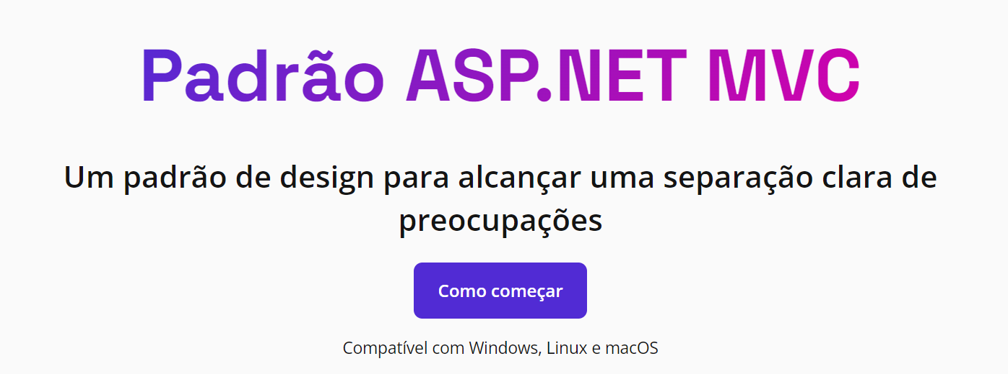
Demonstração: Testando o ambiente
https://dotnet.microsoft.com/pt-br/apps/aspnet/mvc

