Slide 1

Architecture and Design Patterns
Software architecture is the high-level structure and organization of a software system, encompassing its components, their relationships, and how they interact. It's the foundation upon which the software is built, influencing its design, development, and maintenance. Essentially, it's the blueprint for how the software will be structured and how its various parts will work together.

Slide 2
Welcome
Architecture and Design Patterns
Good morning and welcome
Buongiorno e Benvenuto
Bom dia e sejam bem vindos
Bonjour et bienvenue
Buenos días y bienvenido

Slide 3
Welcome
Architecture and Design Patterns
Thank you for joining us today
Moongy worked hardly to bring you a world-class learning experience.
Microsoft Certified Trainers + Instructors.
Your instructor is a premier technical and instructional expert who meets ongoing certification requirements.
We wish you a great learning experience and ongoing career success!

Slide 4

Hello! Instructor introduction
Architecture and Design Patterns
Instructor
Jonatas Afonso, Brazilian from Rio de Janeiro, living in Lisbon since 2017.
Solutions Architect + Systems Engineer = A Passionate Developer
Moongy Partner since 2020
Microsoft Certified Trainer since 2018
Microsoft Certified Solutions Developer since 2017
Microsoft Certified DevOps Expert since 2020
+ Microsoft Certifications ….
Scrum Alliance Certified Scrum Master
20 years of professional experience
Worked in more than 150 different projects in 7 different countries (So many bugs!)
https://www.linkedin.com/in/jonatasafonsoneto/

Slide 5
Hello! Student introductions
Architecture and Design Patterns
Let’s get acquainted:
Your name
Your country
Company affiliation
Title/Function
Development experience in .NET Framework and with Design Patterns
Your expectations for the training

Slide 6



Facilities
Architecture and Design Patterns
We are flexible ☺
Class hours
Monday – 19:00 – 21:00 (no interval)
Wednesday – 19:00 – 21:00 (no interval)
Breaks
Dinner break at 21:05 (60 minutes)
Vale Tudo (Novela) break at 22:00 (60 minutes)

Slide 7
About this training: Audience
Architecture and Design Patterns
This training is intended for professional developers who recognize that domain modeling is fundamental to software design.
Candidates for this training are interested in developing applications using models to validate valuable functionalities and translate them into a software implementation that truly meets the needs of their users. It is known that, despite its obvious importance, there are few practical resources that explain how to incorporate efficient domain modeling into the software development process.

Slide 8
About this training: Prerequisites
Domain Driven Design
Candidates who attend this training typically are IT professionals who have:
Experience with requirements gathering.
Experience with object-oriented programming.
Experience in using the .NET Framework Languages that supports OOP.

Slide 9

About this training: Objectives
Architecture and Design Patterns
After completing this training, students will be able to:
Understand that software development is an iterative process.
Recognize the interdependence between developers and business/domain specialists.
Design the architecture and implementation of an application that fulfills a set of functional requirements, user interface requirements, and addresses business models effectively.
Recognize that Domain-Driven Design presents technical challenges but also provides opportunities, especially when dealing with legacy software projects that have become difficult to maintain.
✅ Understand that software development is an iterative process requiring continuous architectural decisions.
✅ Recognize the importance of collaboration between developers, architects, and domain experts to align technical solutions with business goals.
✅ Design application architecture using key architectural patterns such as:
Layered Architecture
Model-View-Controller (MVC)
Command Query Responsibility Segregation (CQRS)
Event-Driven Architecture
✅ Apply fundamental design patterns to build scalable and maintainable solutions, including:
Factory Method
Strategy
Adapter
Decorator
Repository
Unit of Work
✅ Analyze how design and architectural patterns help modernize and manage legacy systems, improving maintainability and reducing technical debt.

Slide 10
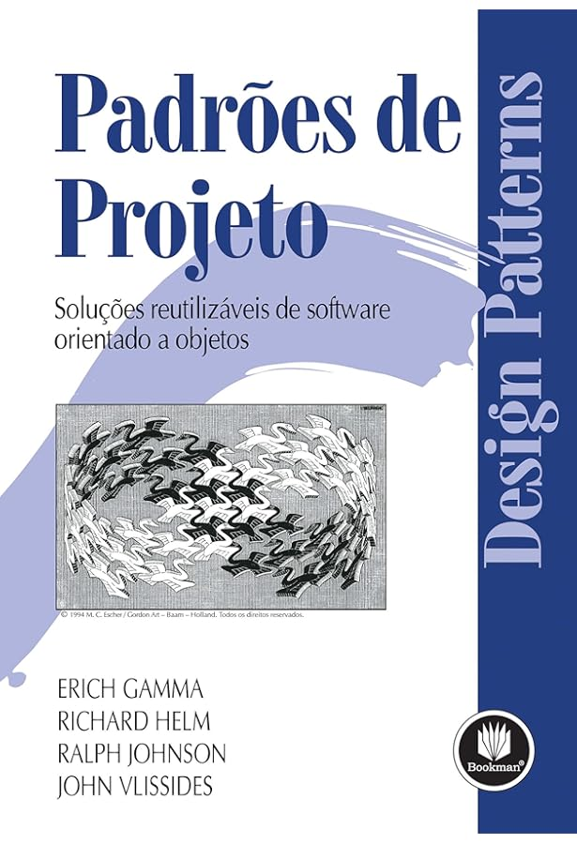

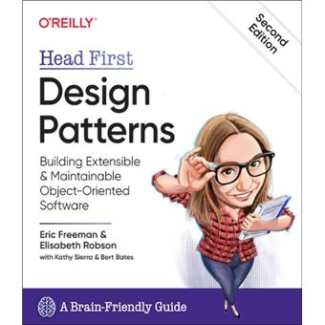





Your training materials
Architecture and Design Patterns
This training was created based on these books, available on Amazon ☺ …

