Slide 1

In silico bulk(Pseudo-bulk) using muscat
Epi
Sp
Sq
Cell BC IDs
Sample id
3/3
3/3
3/3
Counts
Mean
Sum
Median
Non-zero
Gene
X 18( 3 tissue,
2conditions,
3replicates)
Gene
GO-term
Gene
Generated pseudo-bulk data
PCA
Deg search

Slide 2
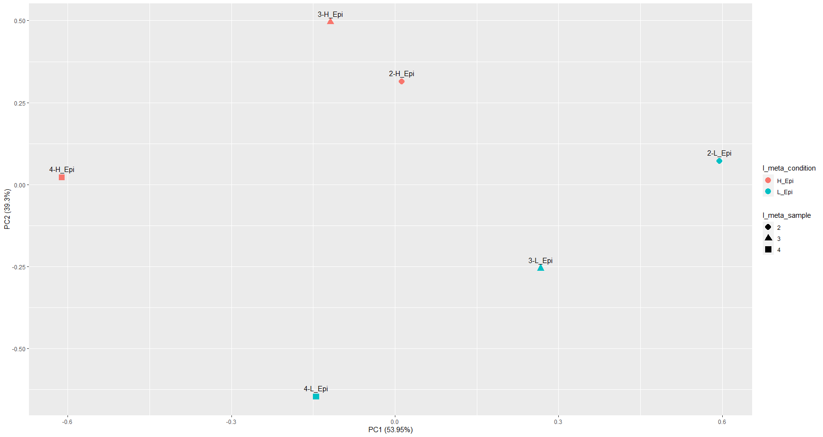
Pseudo-bulk for 6 Epi using sum aggregated

Slide 3
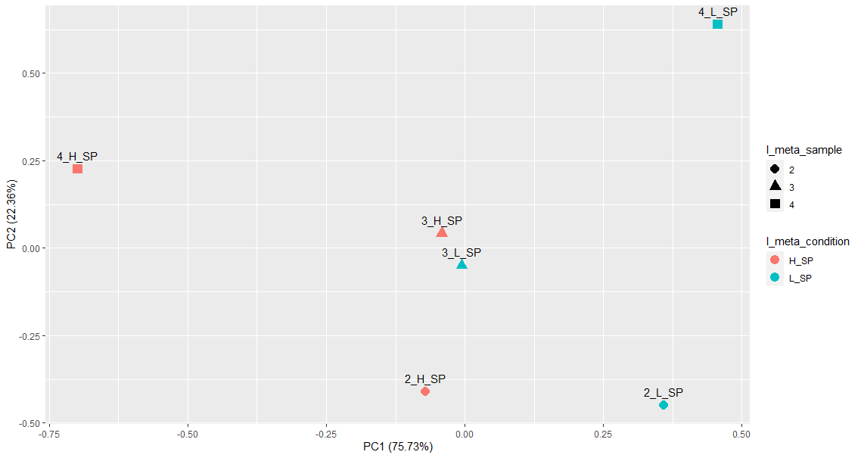
Pseudo-bulk for 6 SP using sum aggregated

Slide 4
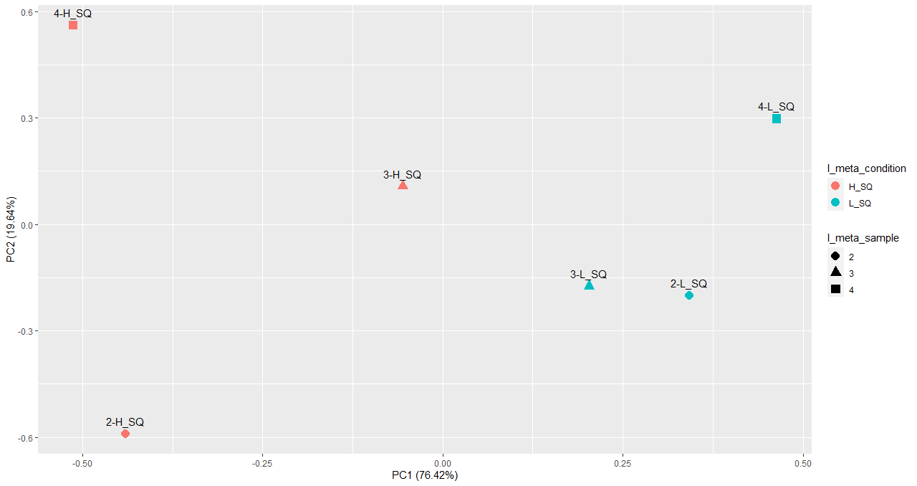
Pseudo-bulk for 6 SQ using sum aggregated

Slide 5
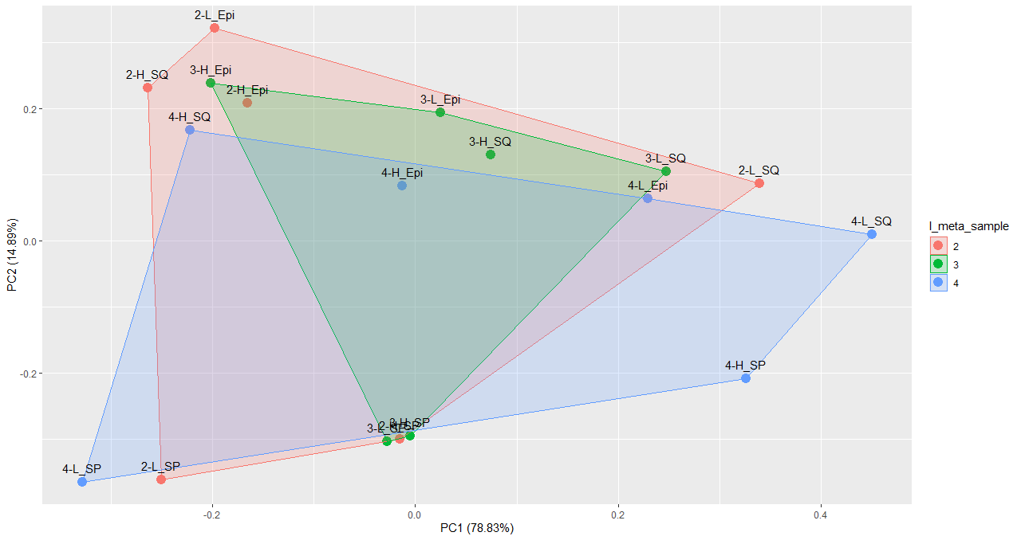
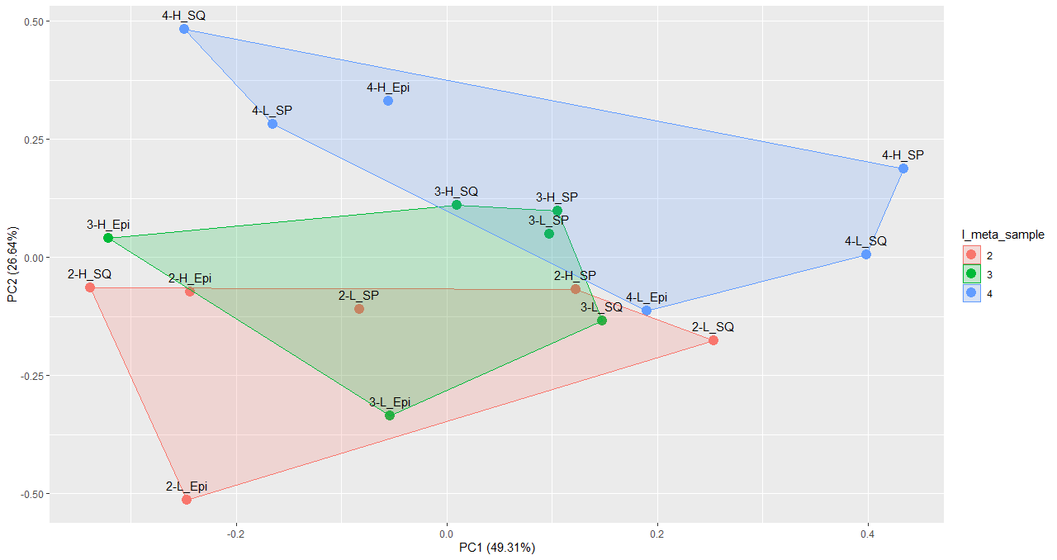
Pseudo-bulk PCA for 18samples for detecting sample-batch
Num-detected
Sum

Slide 6
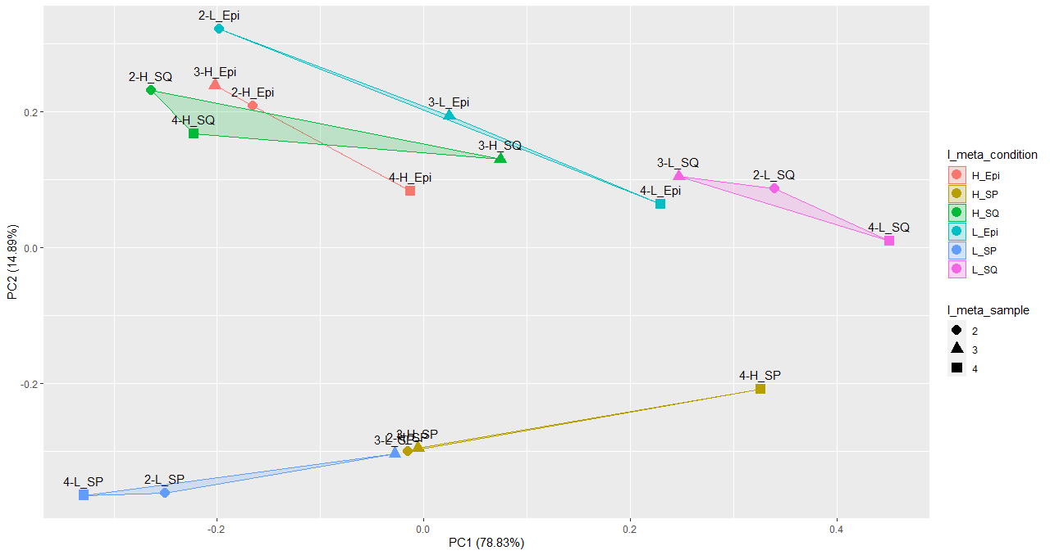
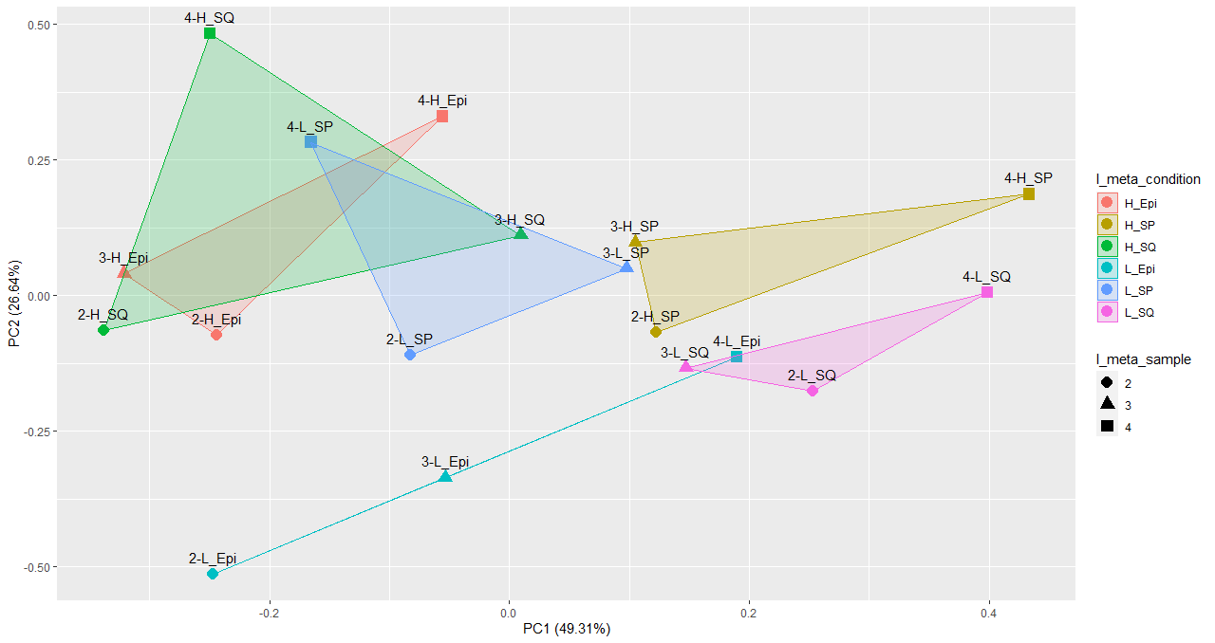
Pseudo-bulk PCA for 18samples, colored by condition
Num-detected
Sum

Slide 7
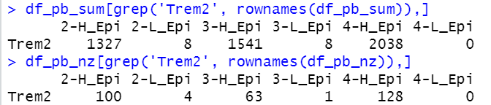
4월1일 이후 추가내용
Muscat 수정해서 edgeR 제대로 돌림. <- interactive plot만듦(검색가능하게 바꾸기)
Deg파일 정리해서 ppt에 올려놓겠습니다
Volcano 보기 좋게
Trem2는 아마 nk cell 아닌듯? <- Lpl 0이 아닌 세포랑, 0인 세포 개수 맞춰서 랜덤으로 비교?

Slide 8
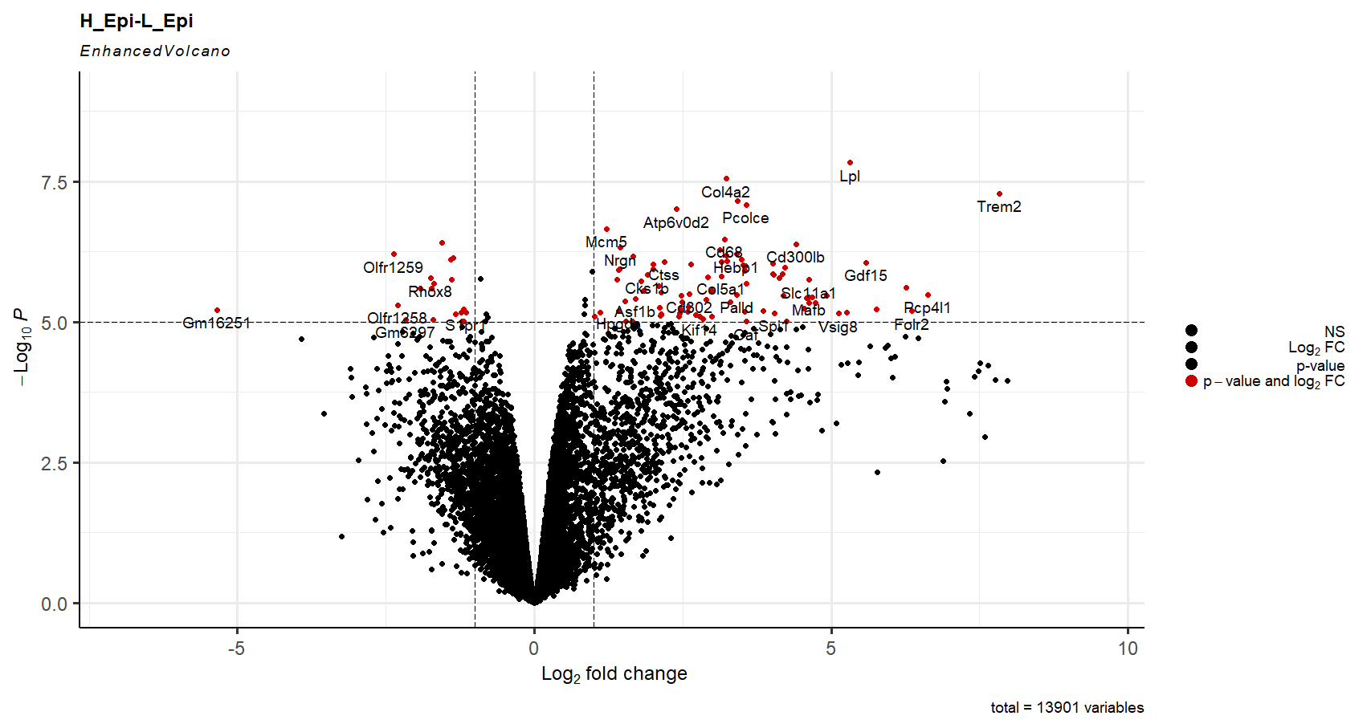

Slide 9
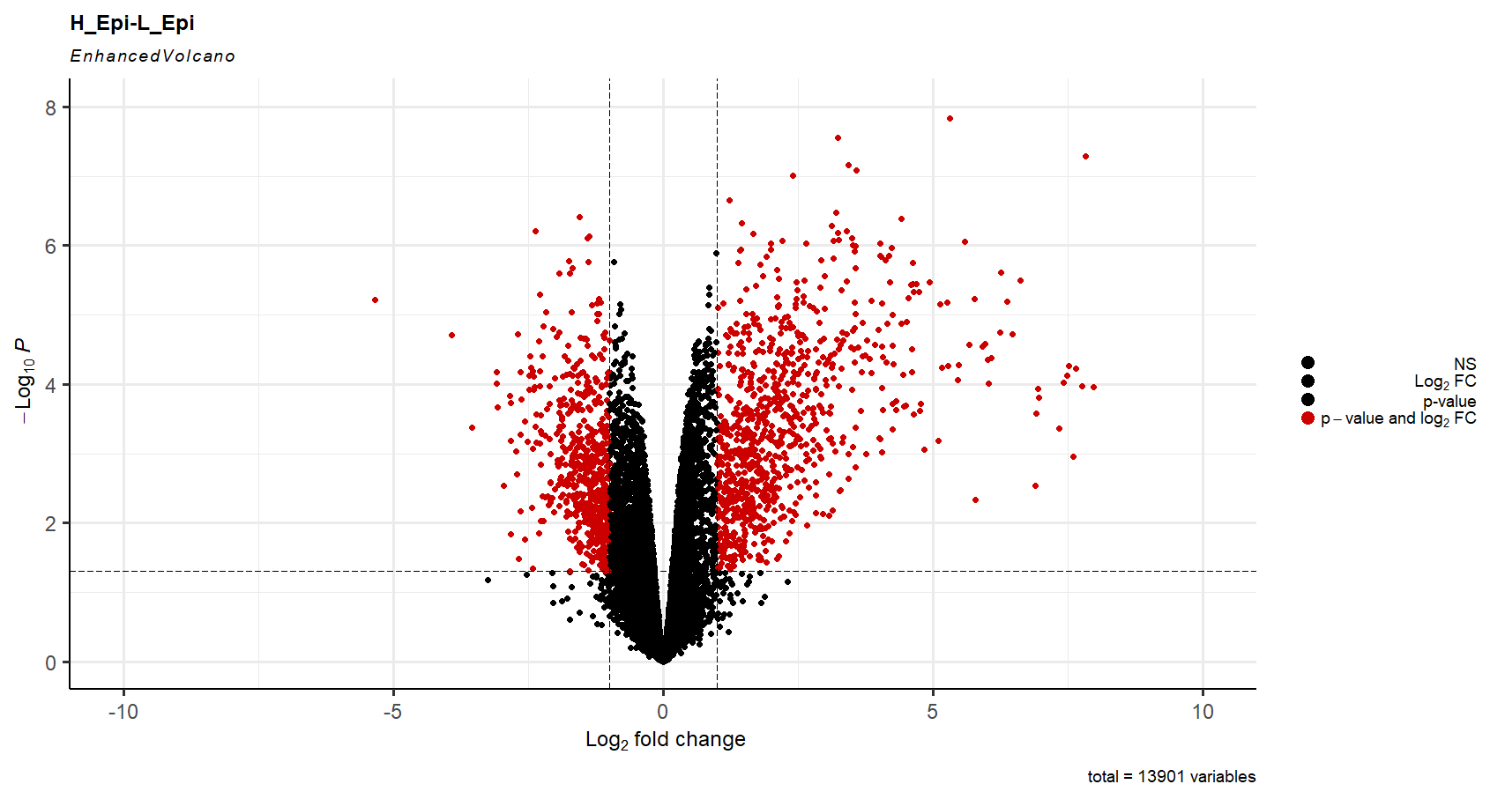
608
861
0.05
-1
1

Slide 10

498
774
0.05
-1
1

Slide 11
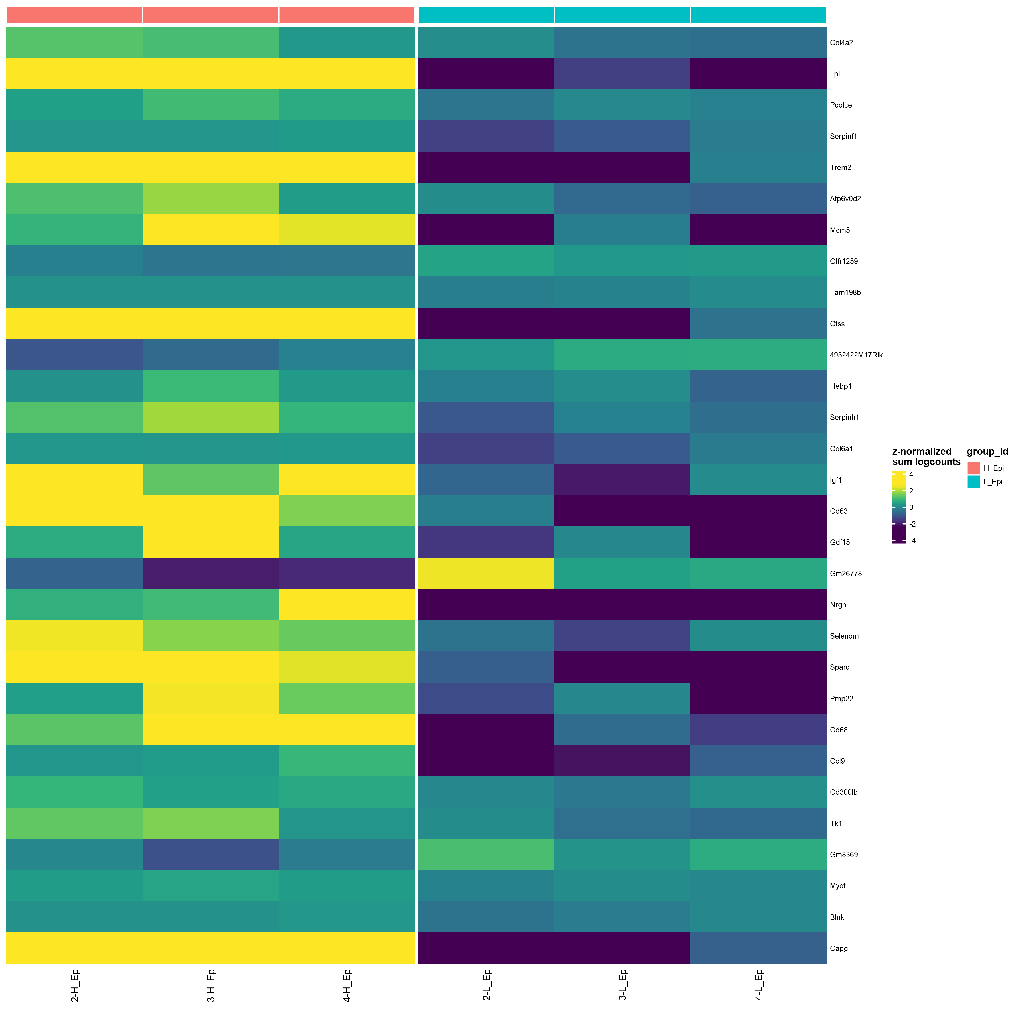
Pseudo-bulk(sum) for Epi, colored by condition
Sorted by p_adj.loc ( FDR < 0.05 )
top30

Slide 12
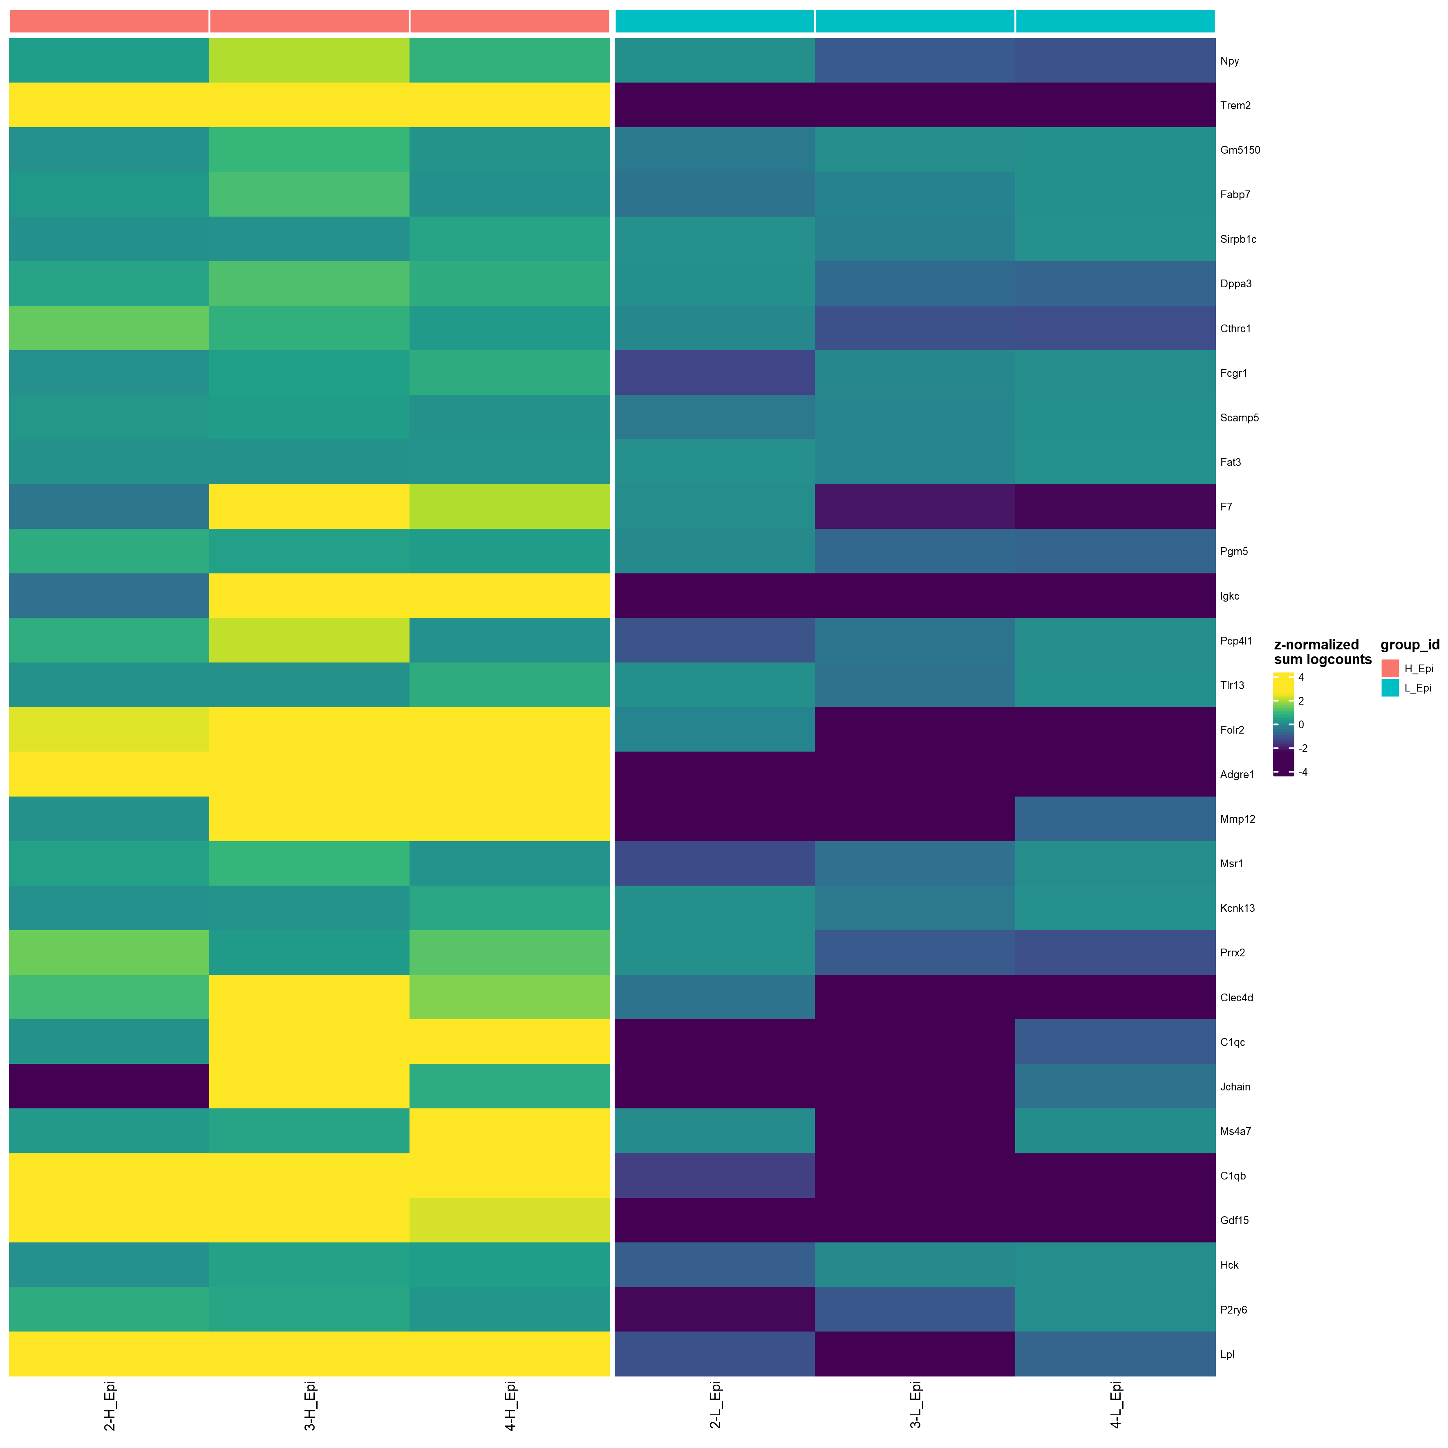
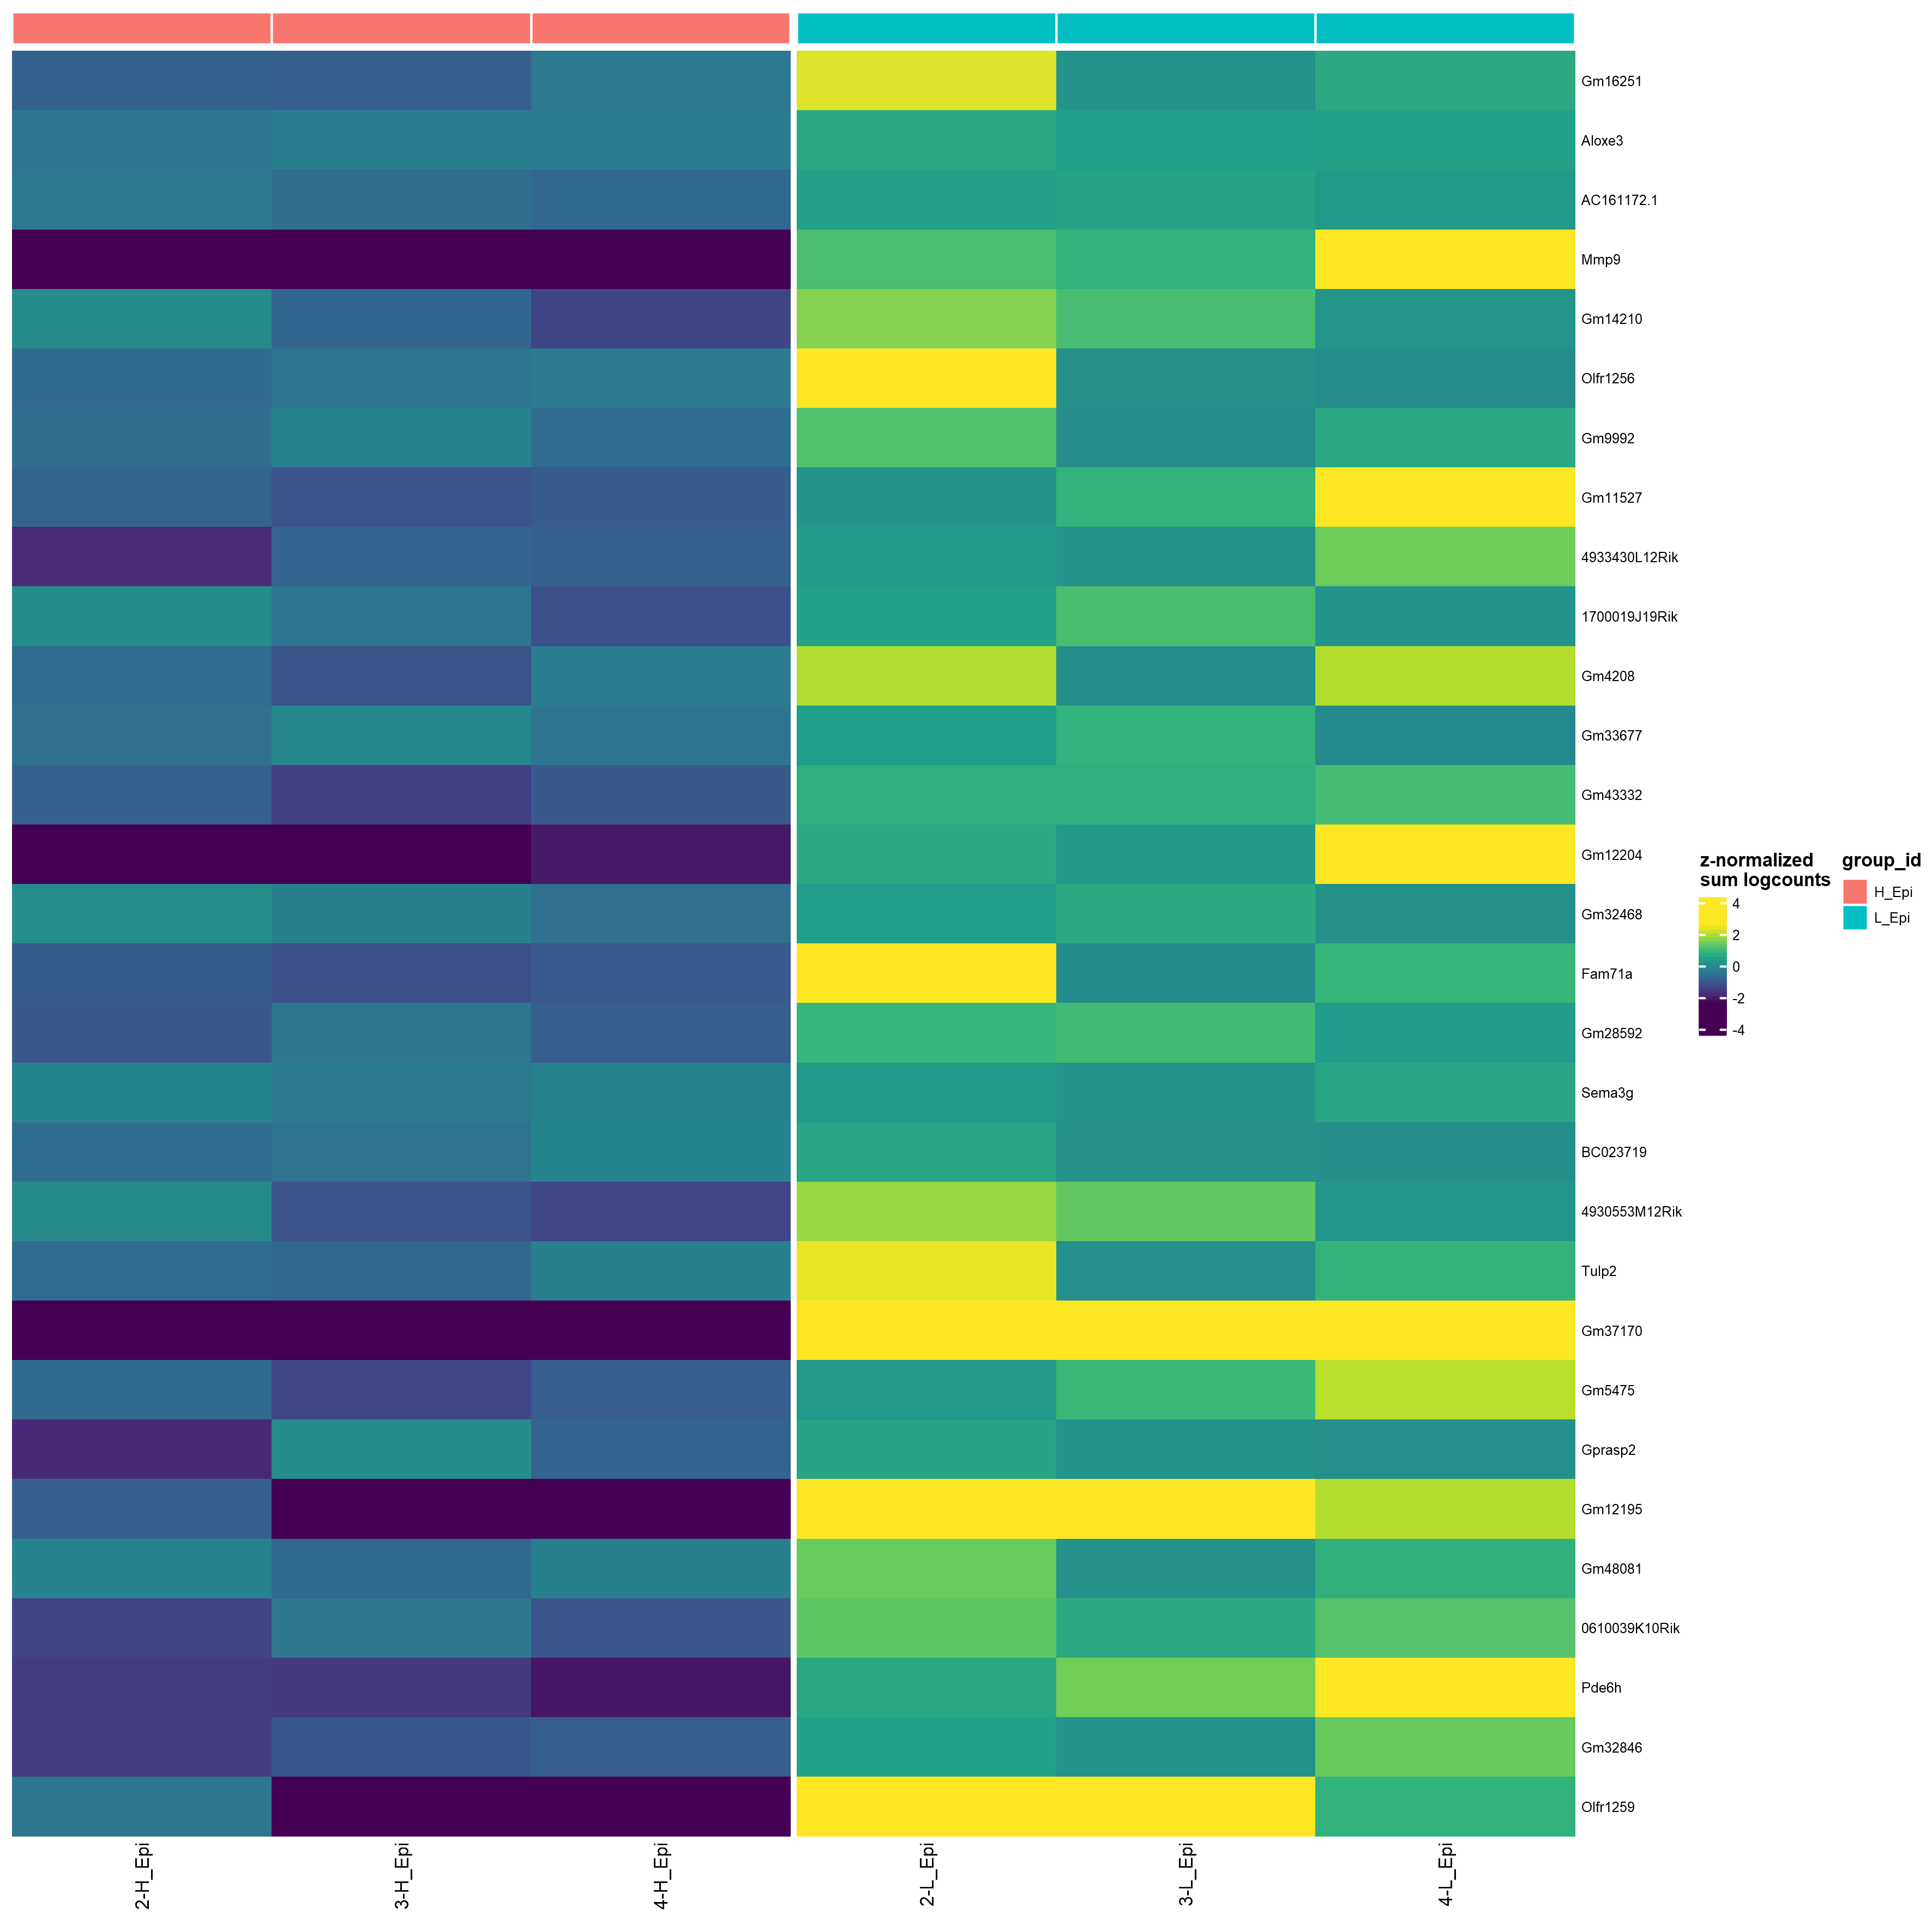
Pseudo-bulk(sum) for Epi, colored by condition
Sorted by logFC ( FDR < 0.05 )
top30

Slide 13
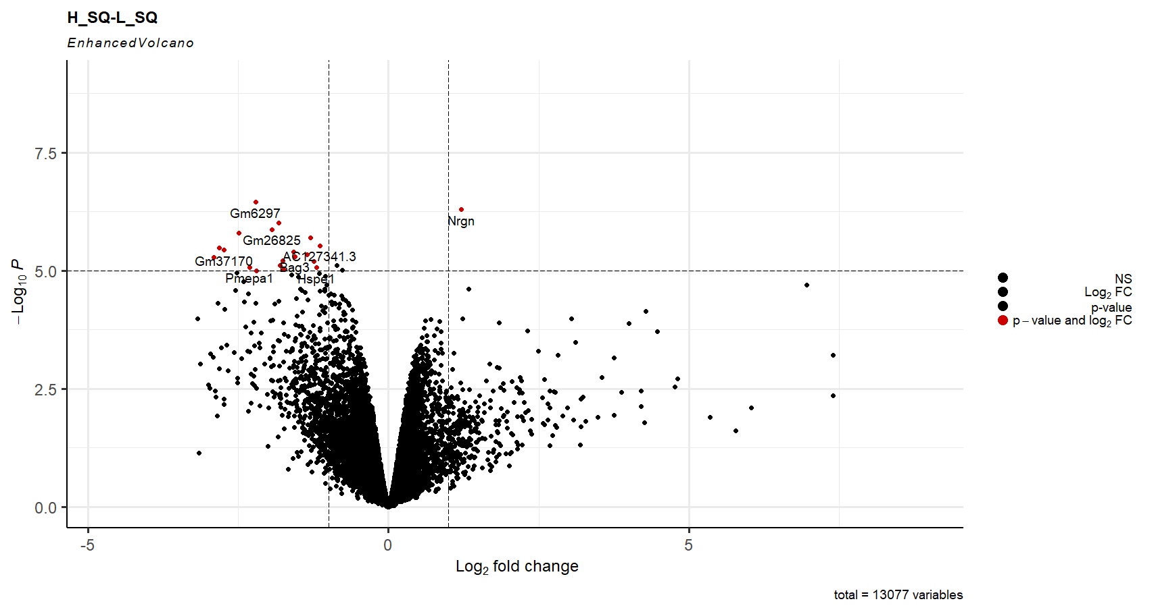

Slide 14
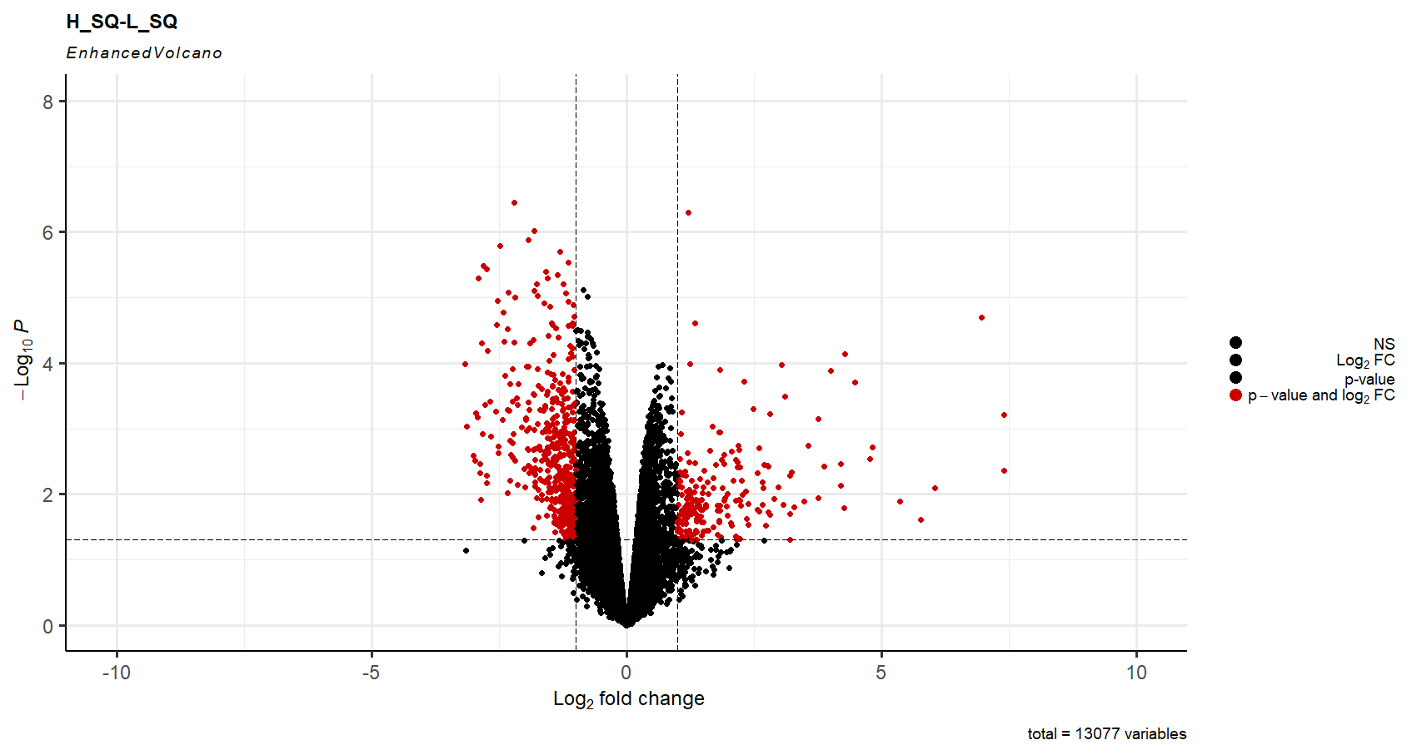
451
220
0.05
-1
1

Slide 15
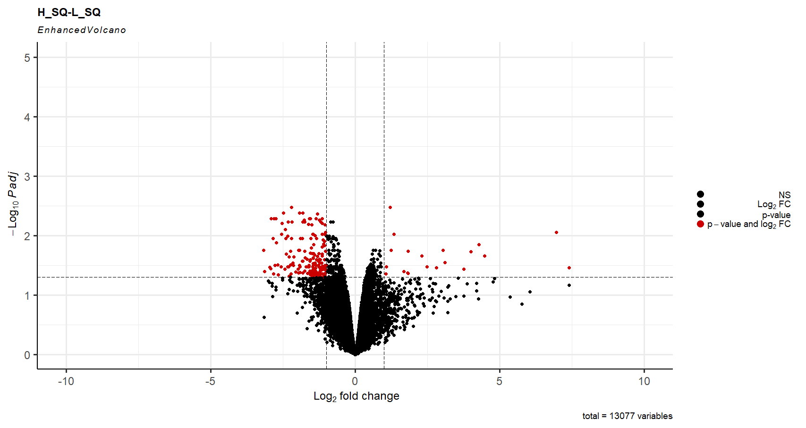
172
20
0.05
-1
1

Slide 16
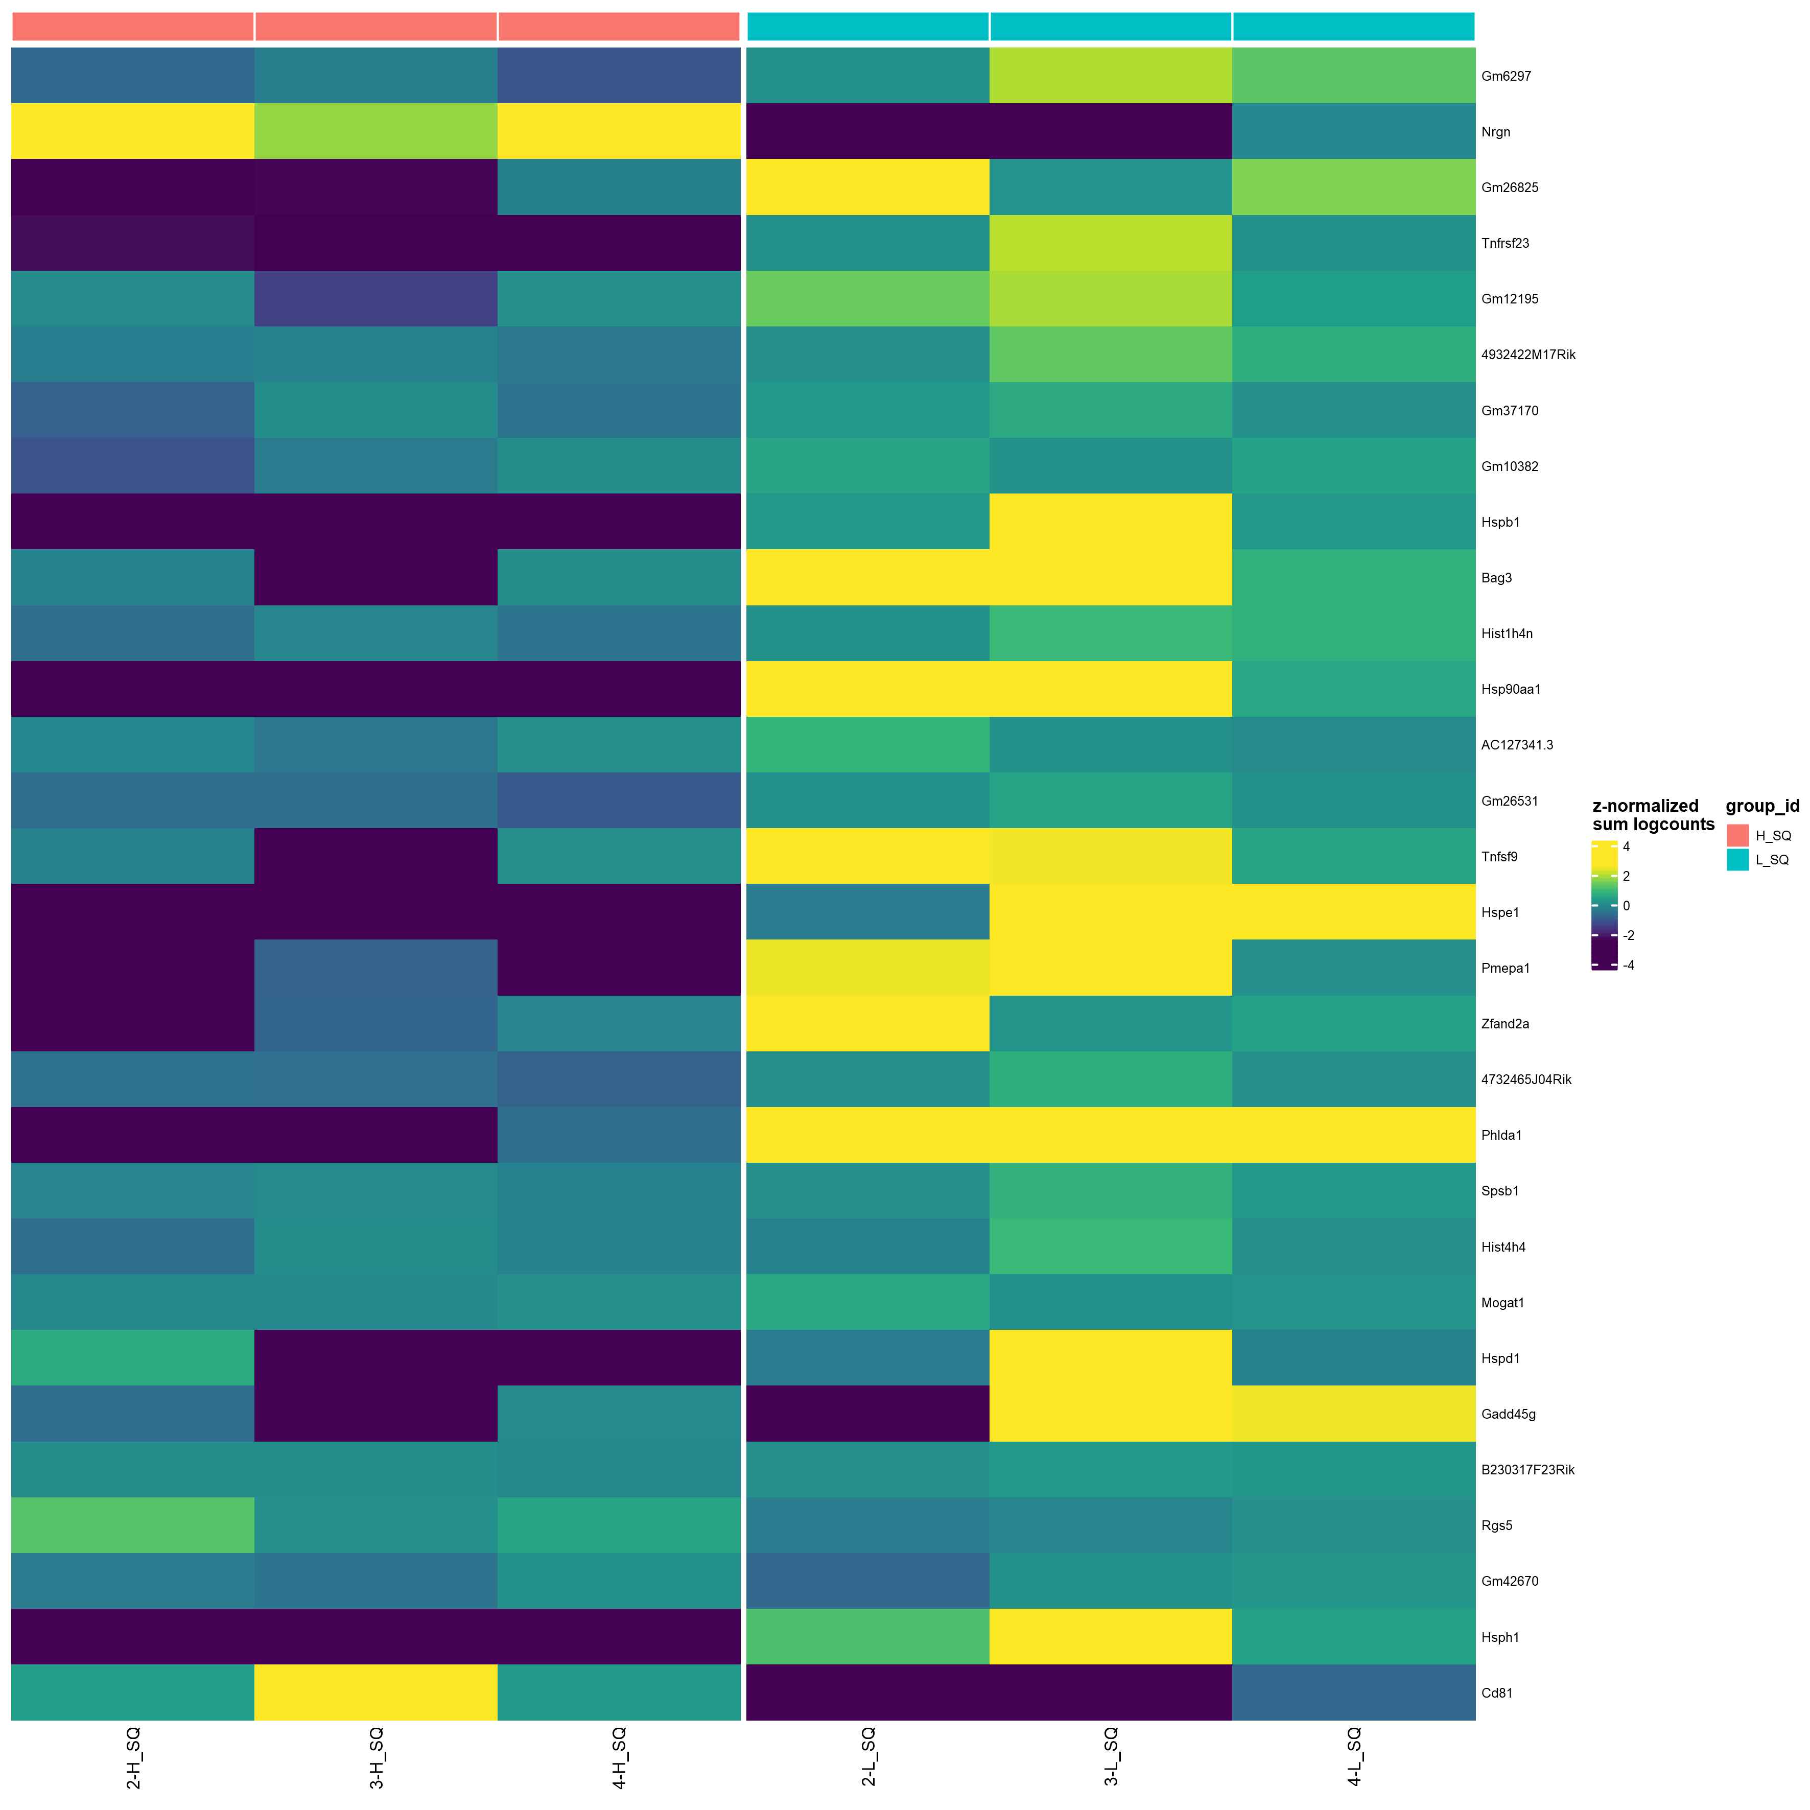
Pseudo-bulk(sum) for SQ, colored by condition
Sorted by p_adj.loc ( FDR < 0.05 )
top30

Slide 17
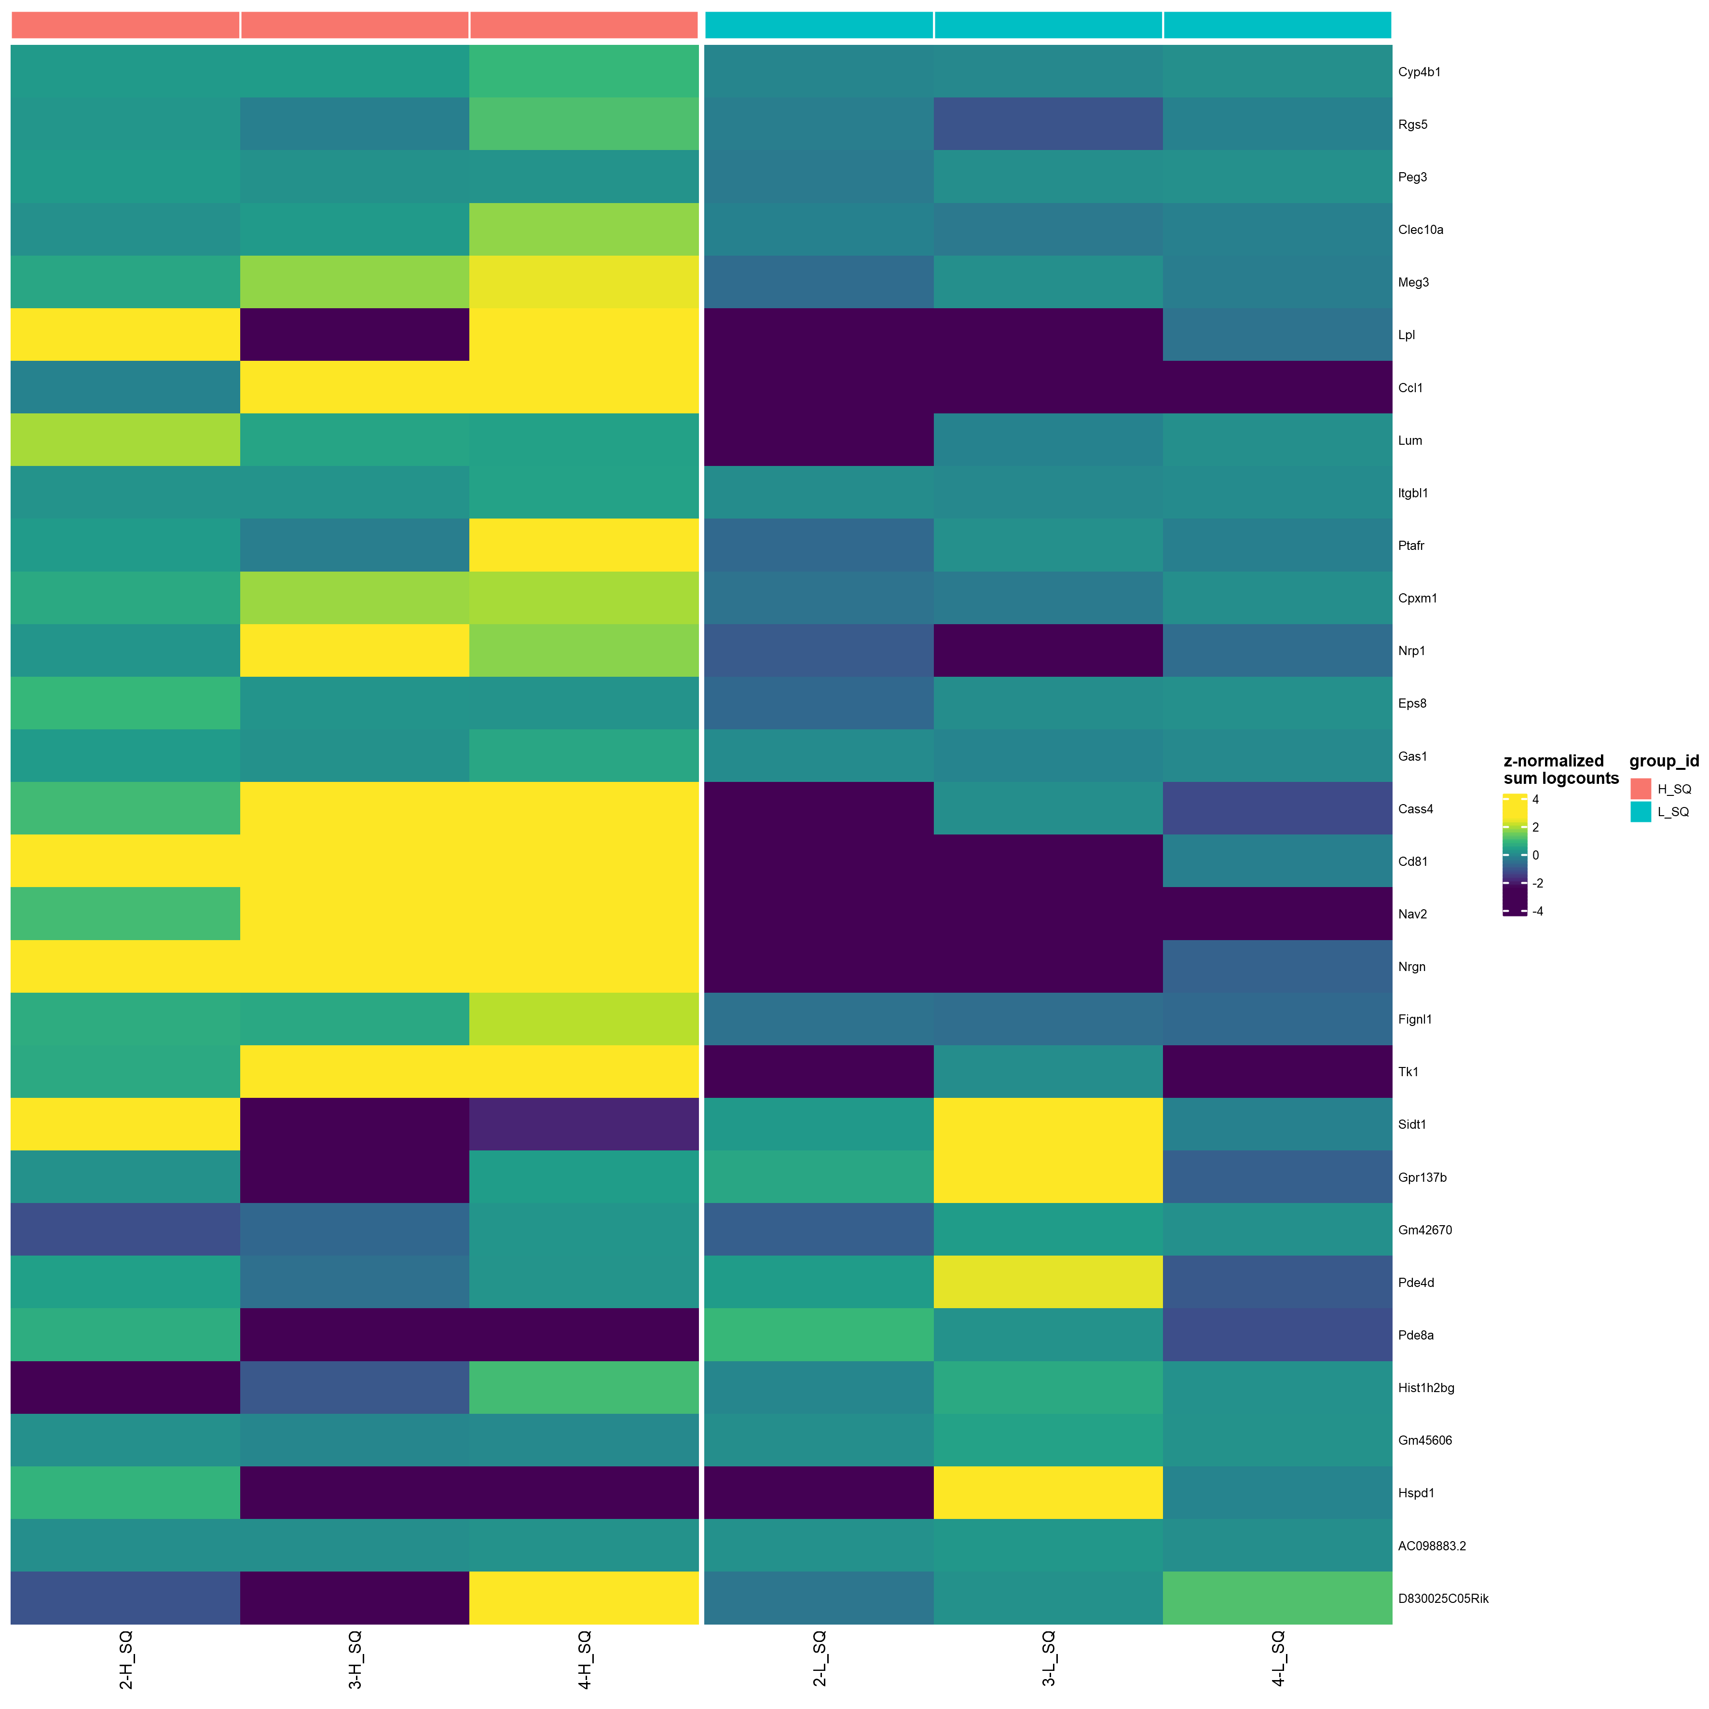
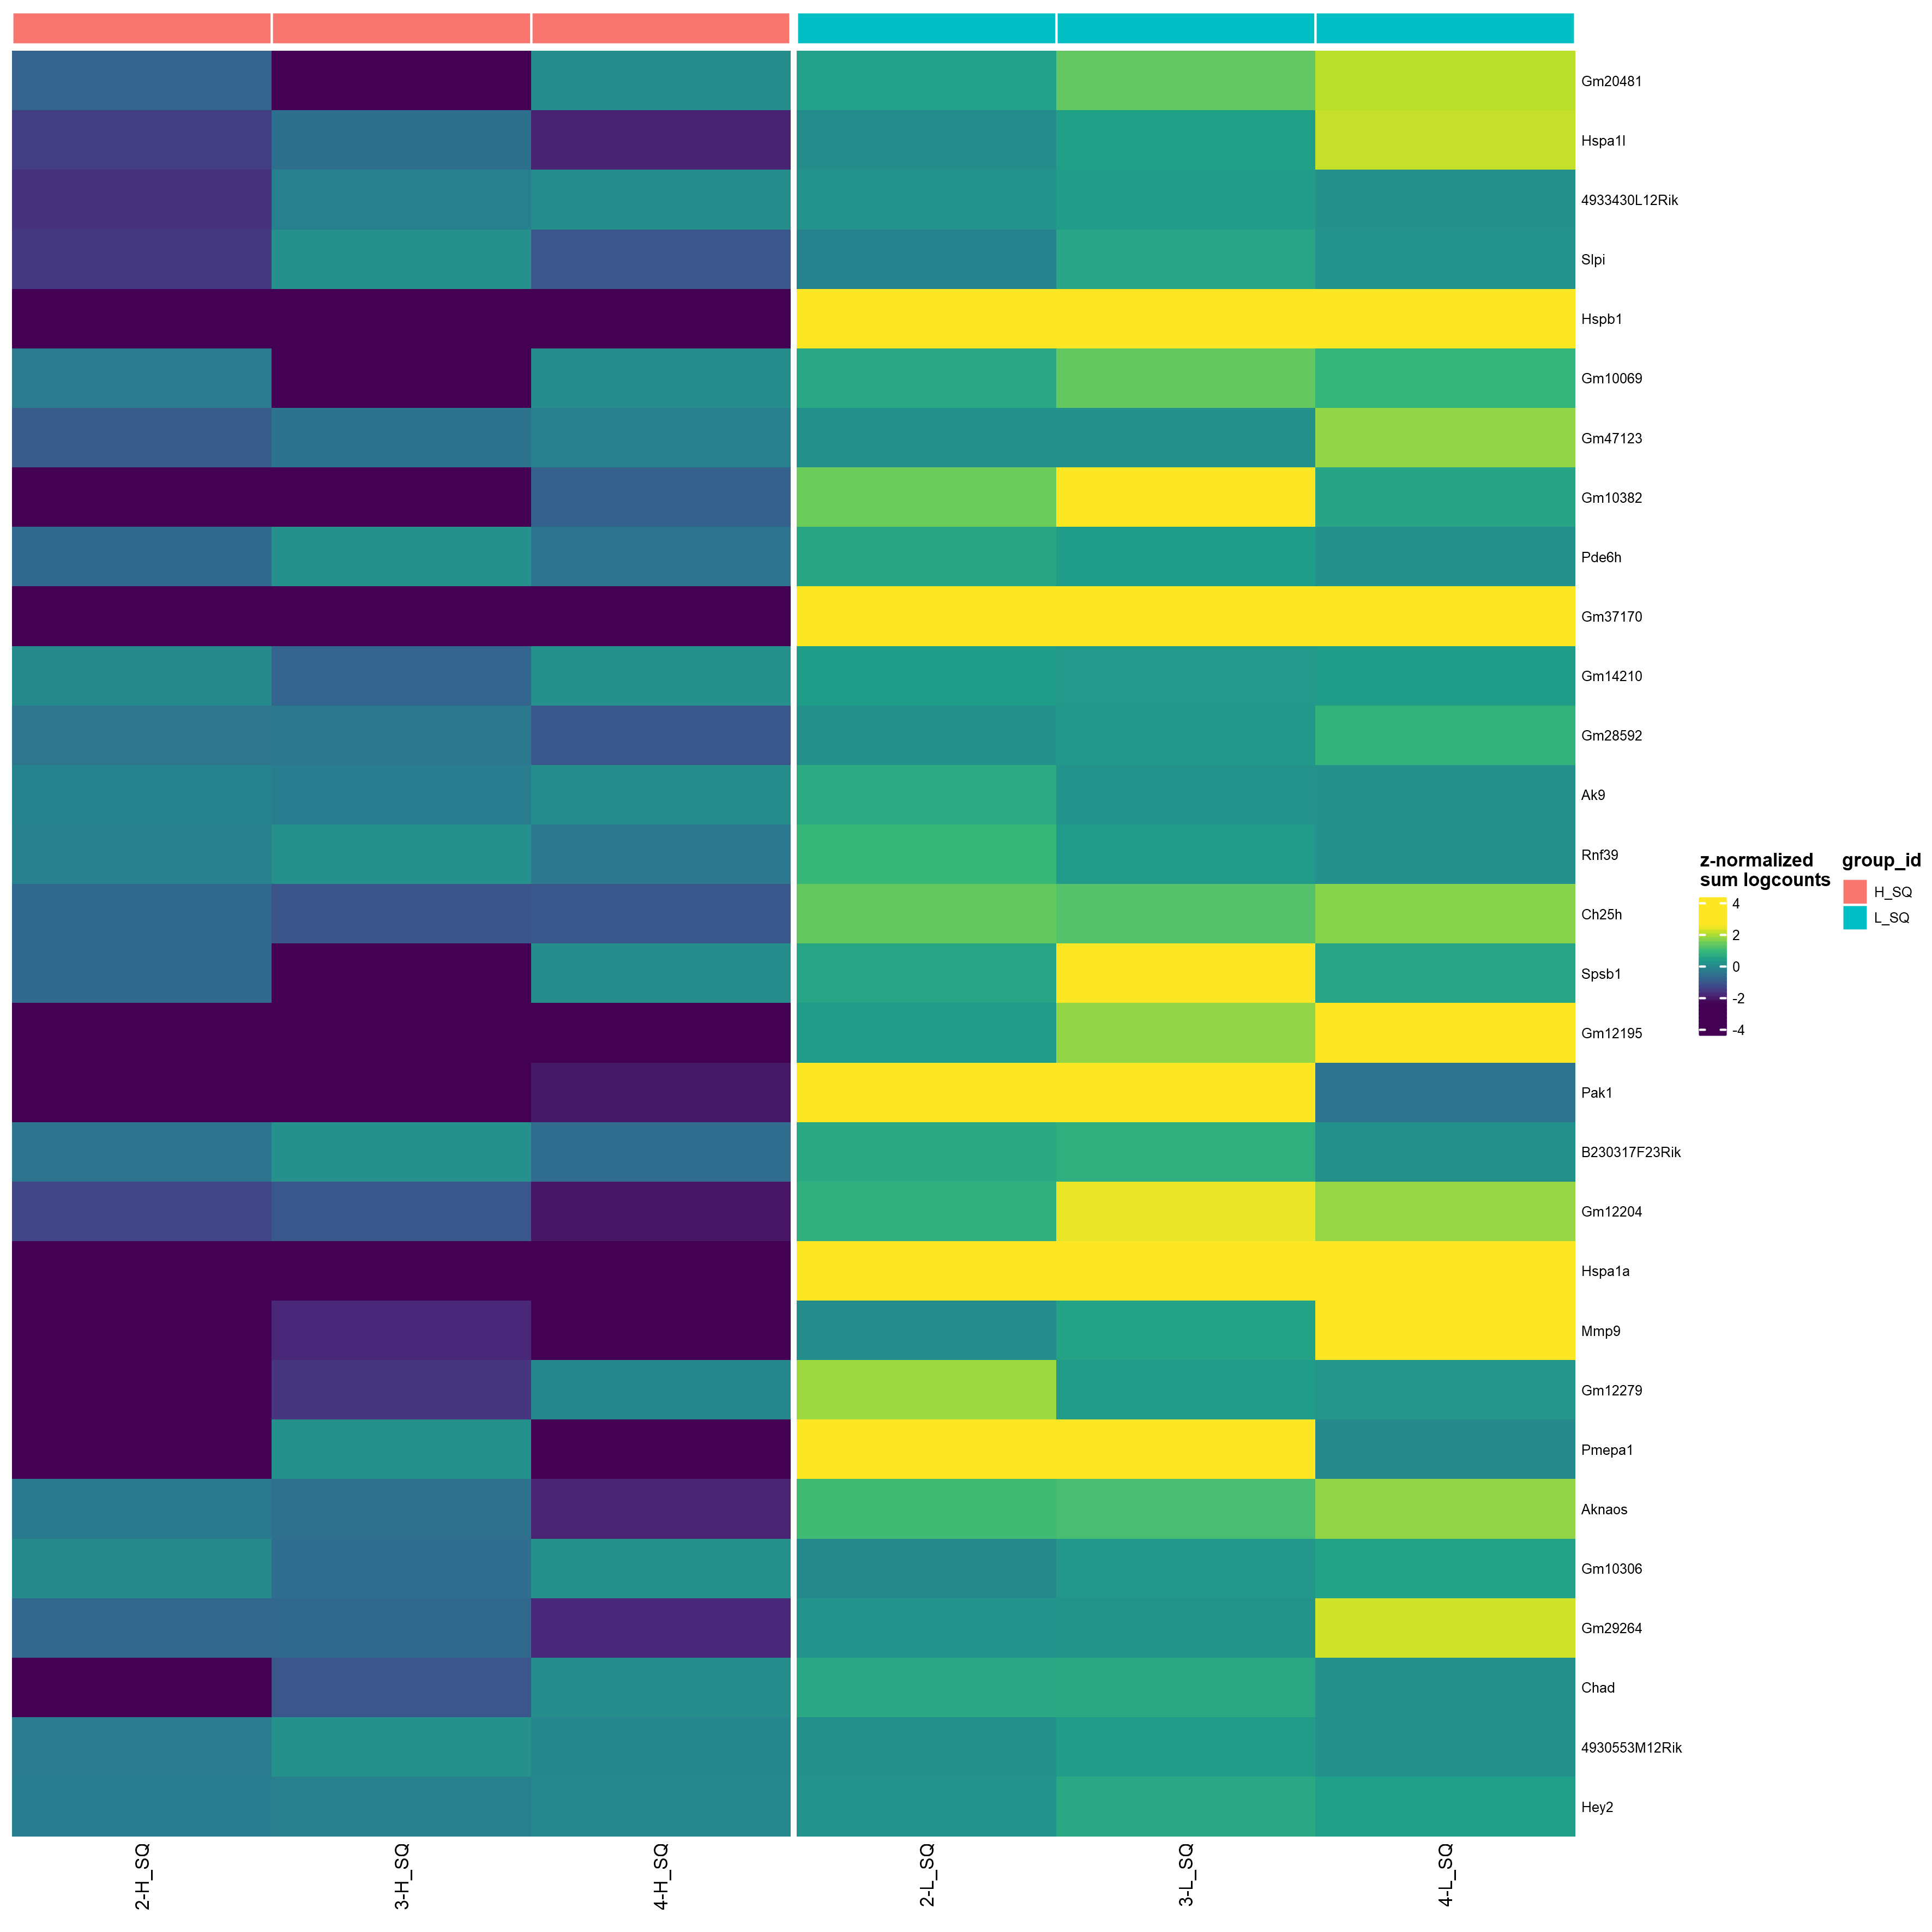
Pseudo-bulk(sum) for SQ, colored by condition
Sorted by logFC ( FDR < 0.05 )
top30

Slide 18
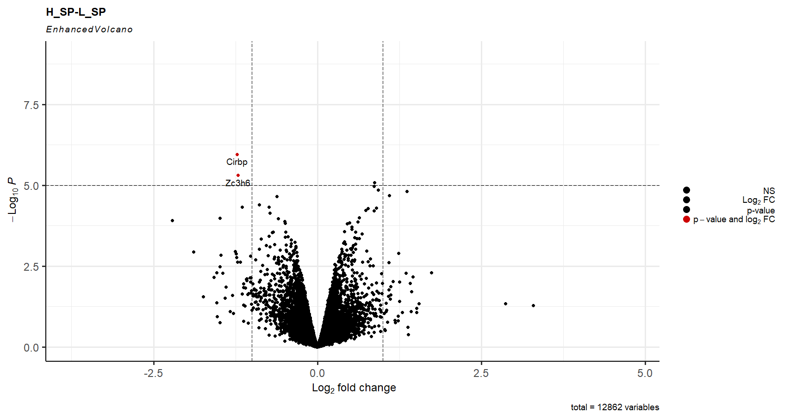

Slide 19
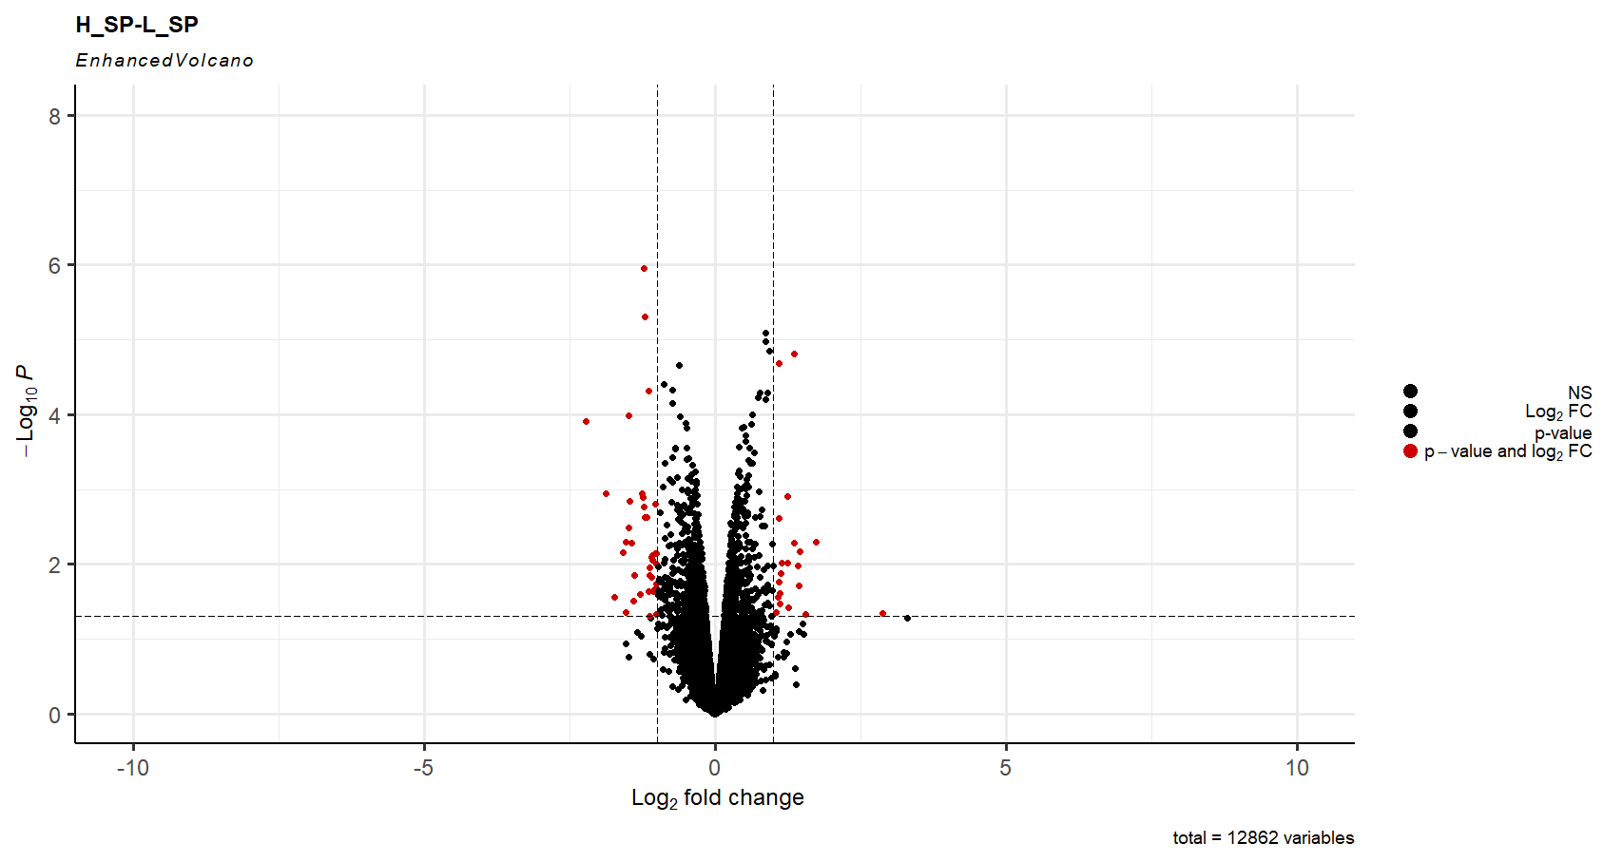
38
20
0.05
-1
1

Slide 20
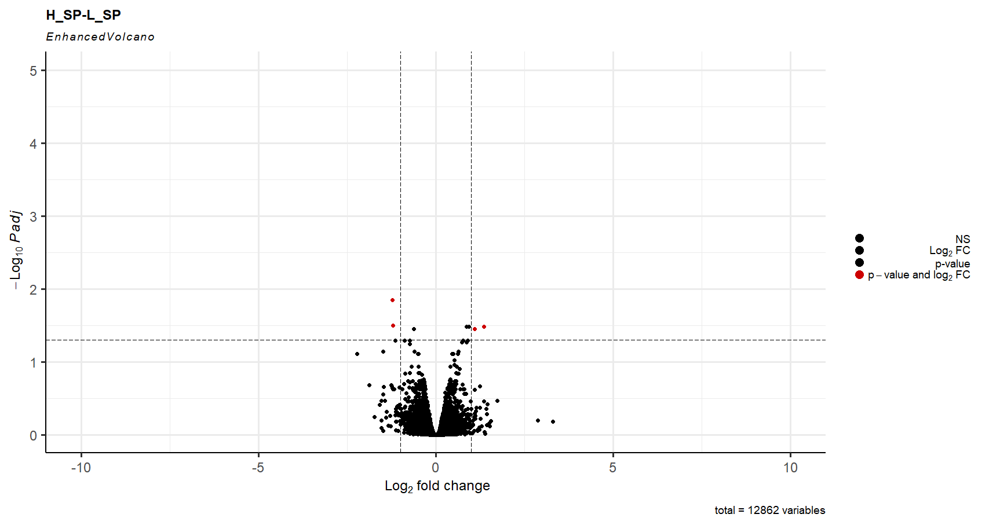
2
2
0.05
-1
1

Slide 21
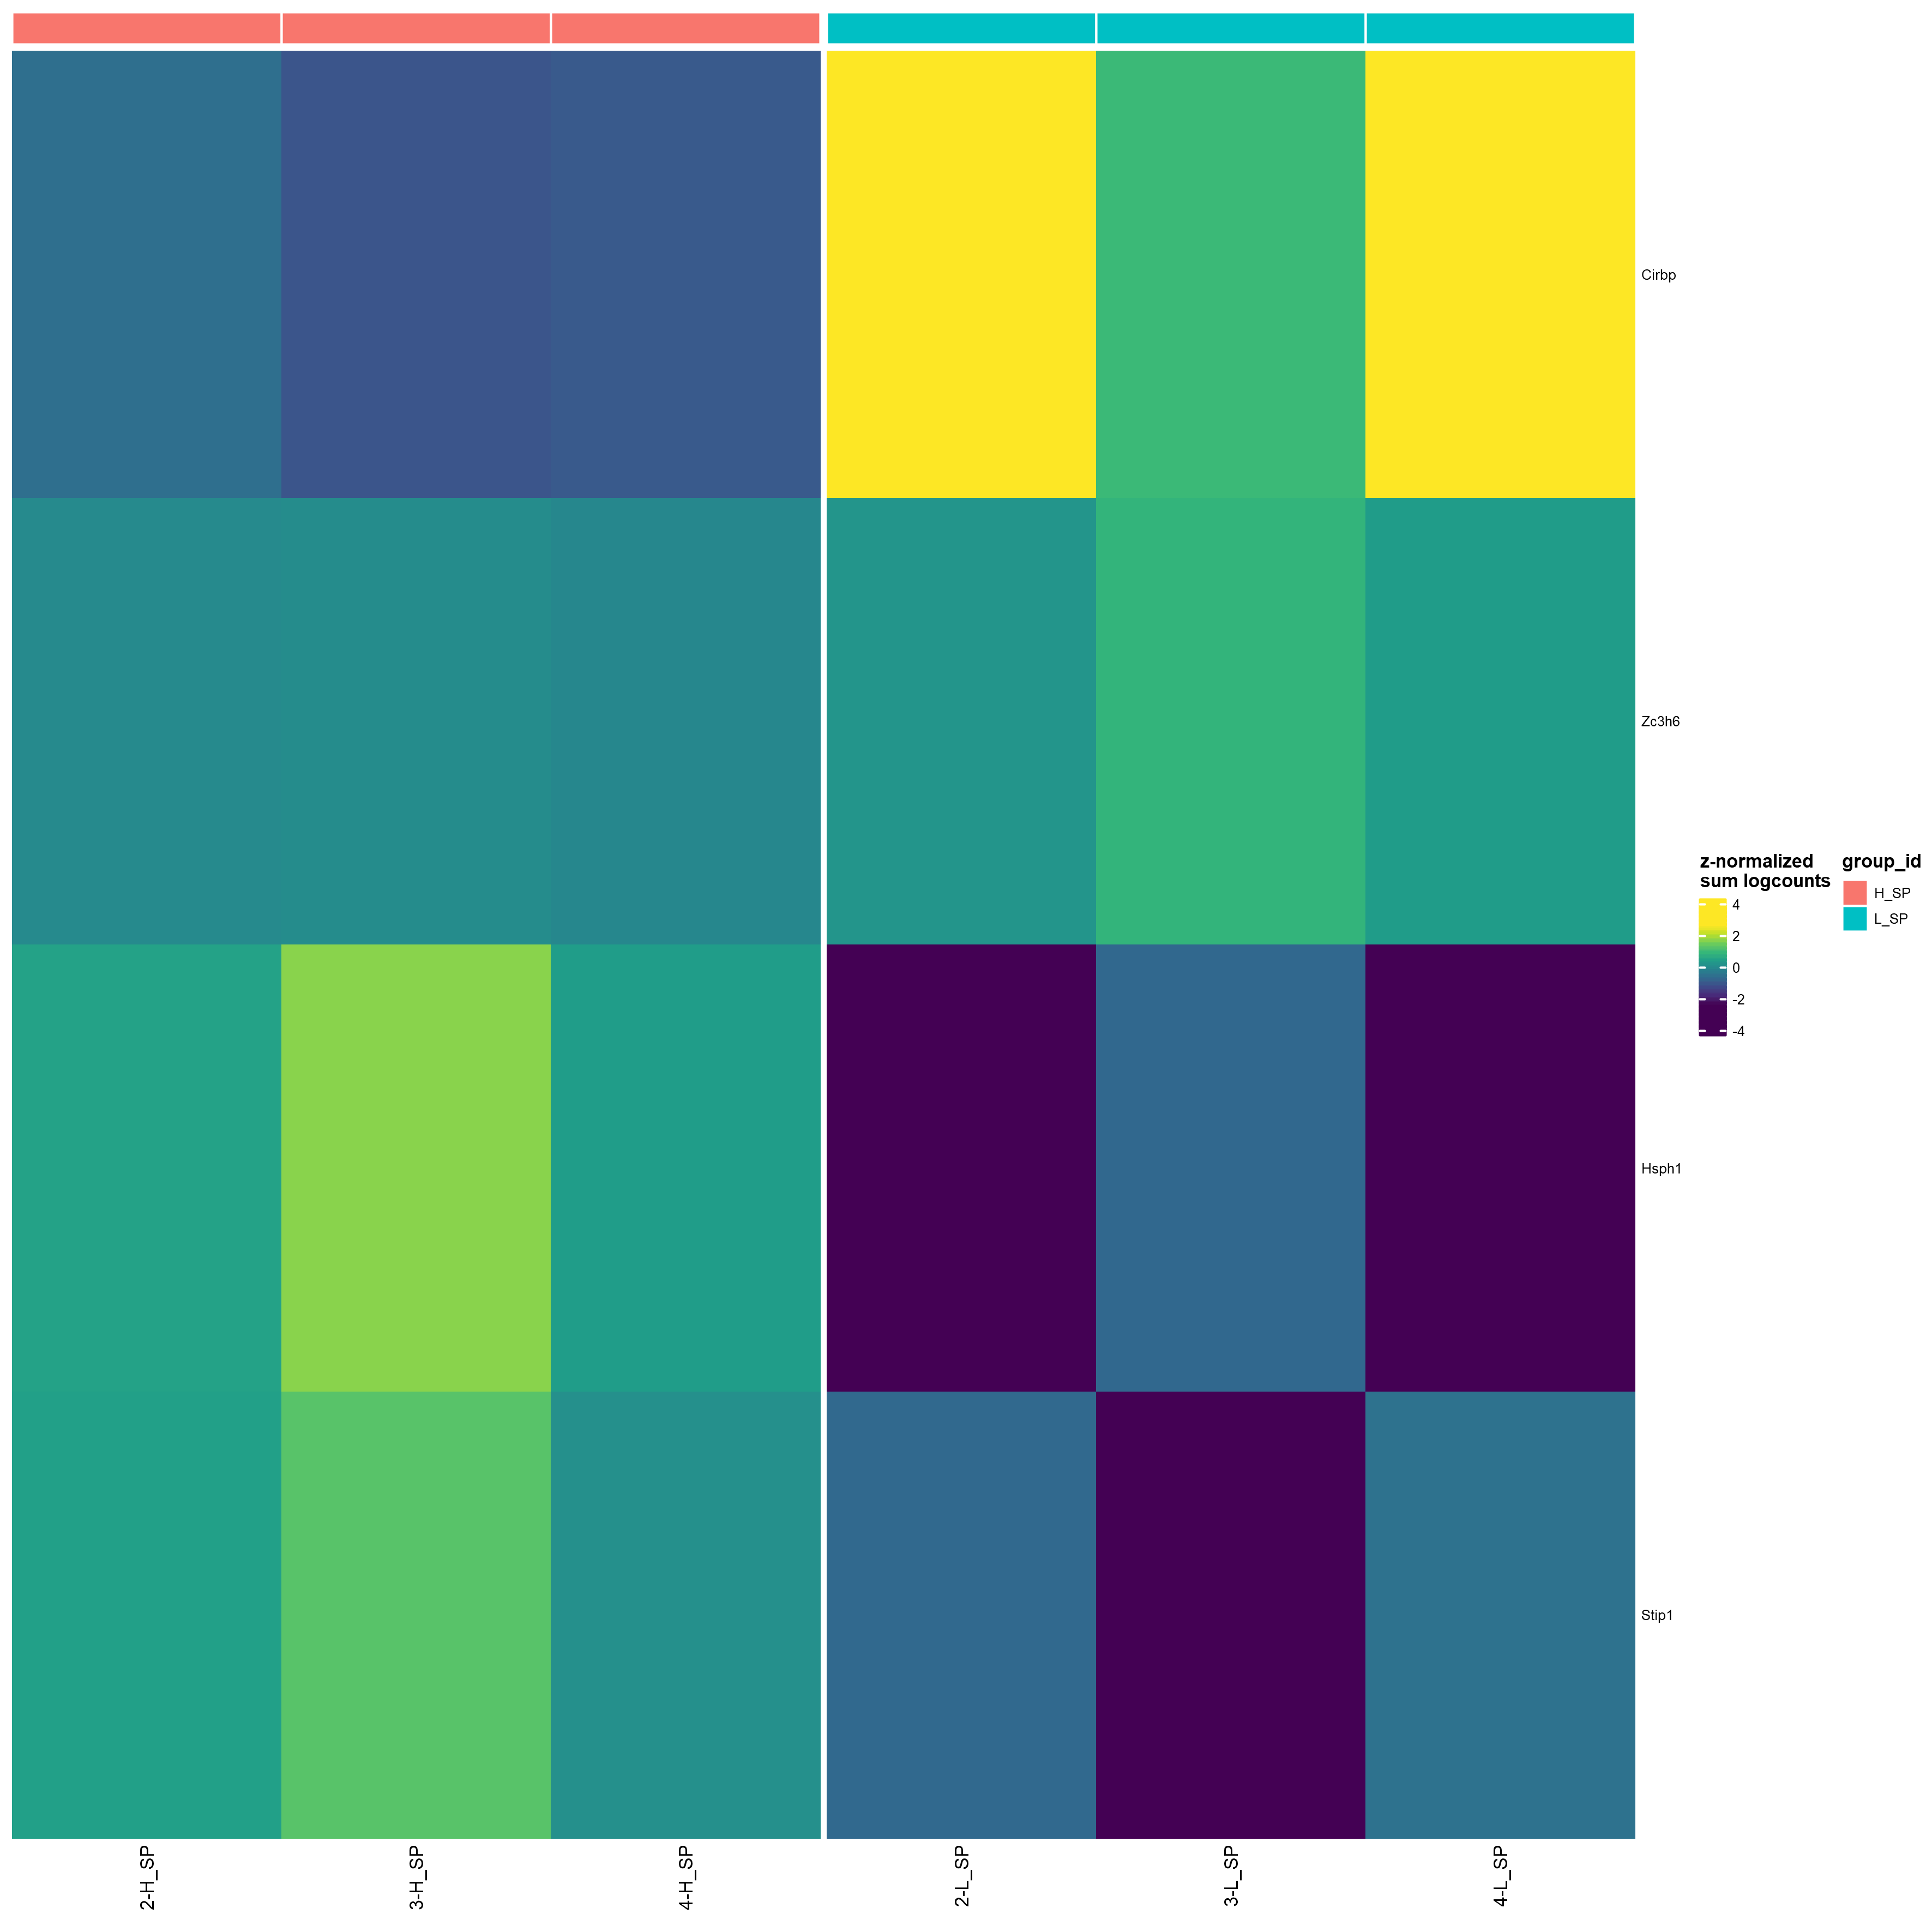
Pseudo-bulk(sum) for SP, colored by condition
Sorted by p_adj.loc ( FDR < 0.05 )
top30

Slide 22
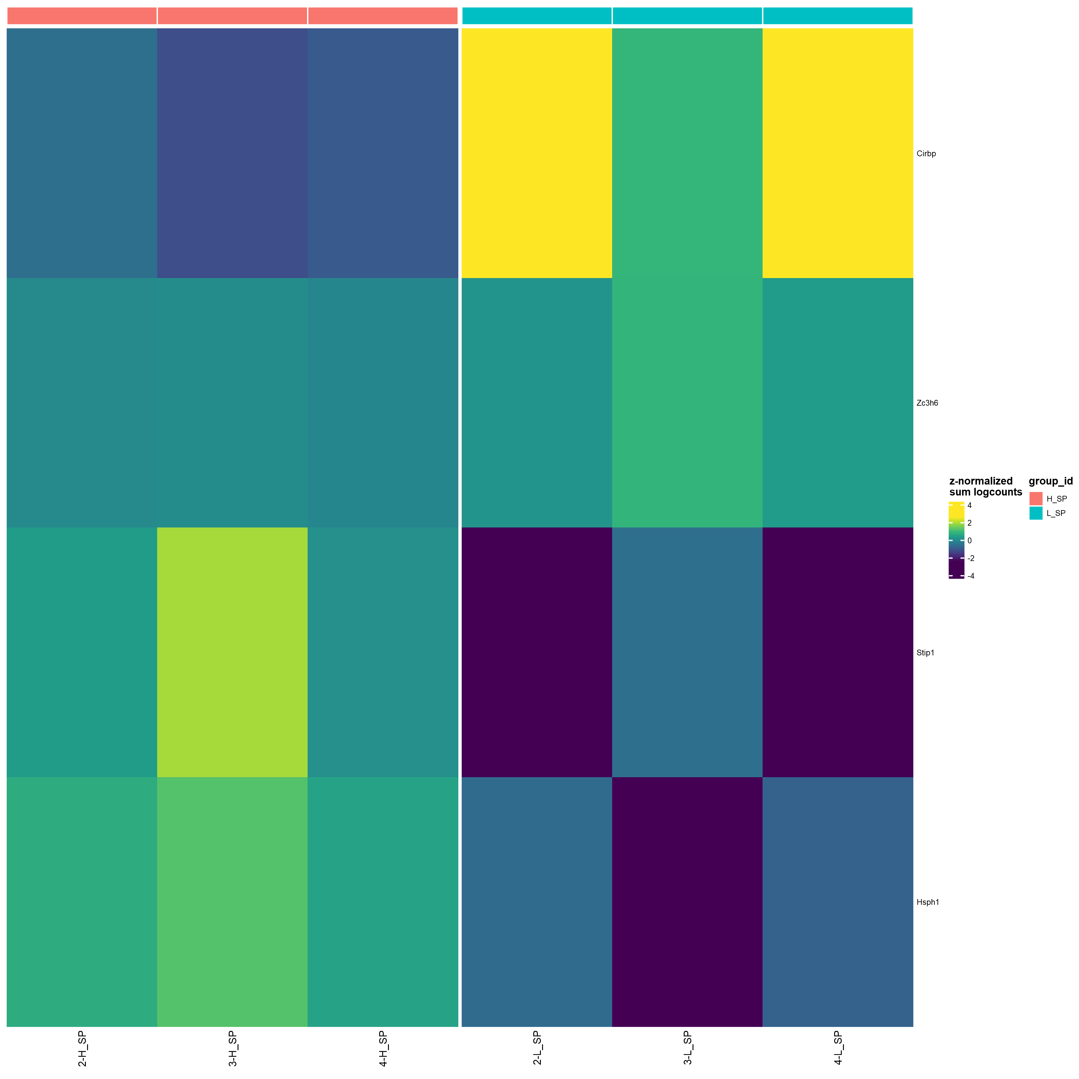
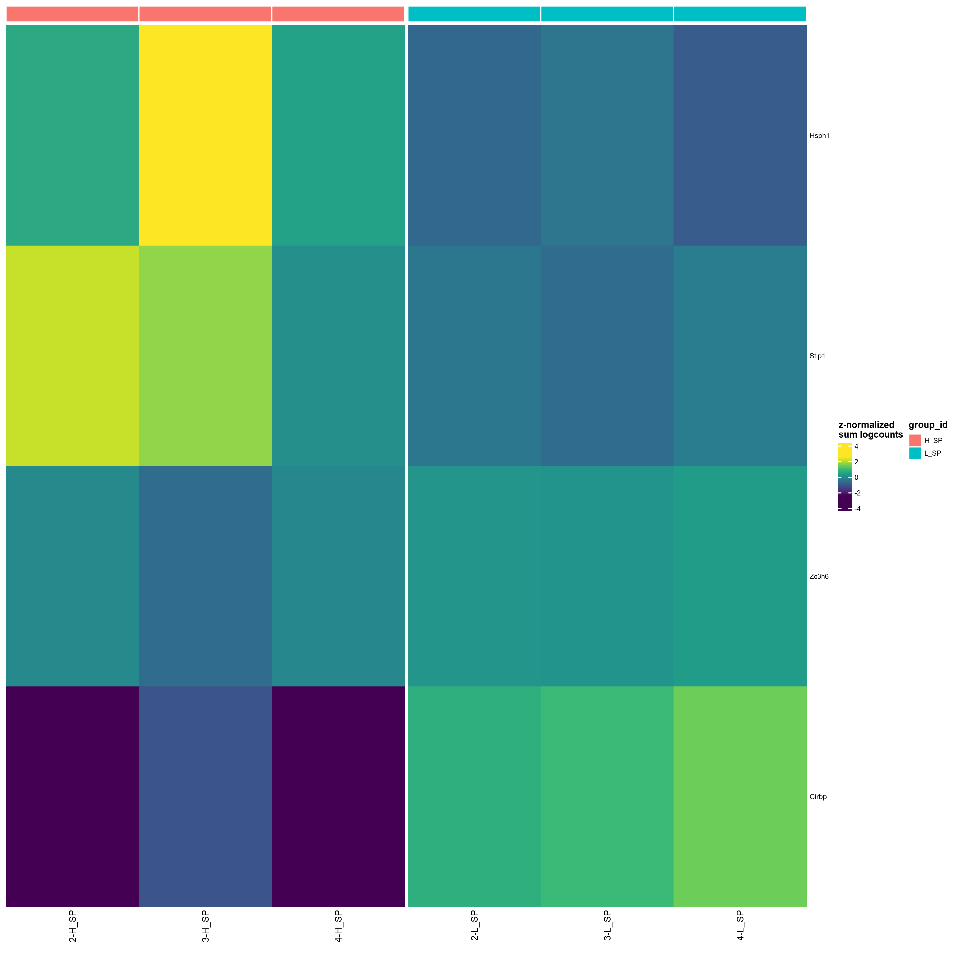
Pseudo-bulk(sum) for SP, colored by condition
Sorted by logFC ( FDR < 0.05 )
top30

