Slide 1

Boids Simulation
How complex behavior can arise from simple rules.
by Huang Yuebin

Slide 2
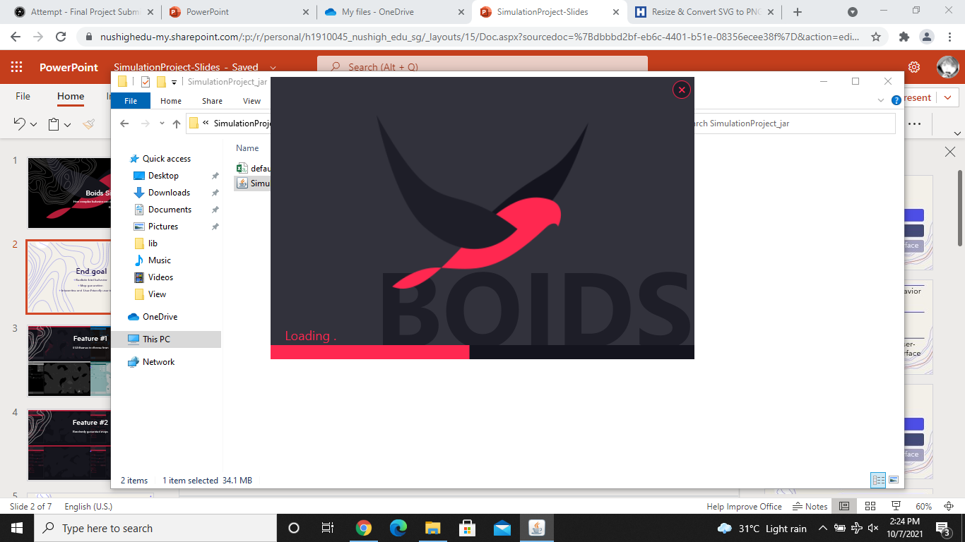
What is Boids?
Boids is an artificial life program that is design to simulate the flocking behavior of birds

Slide 3
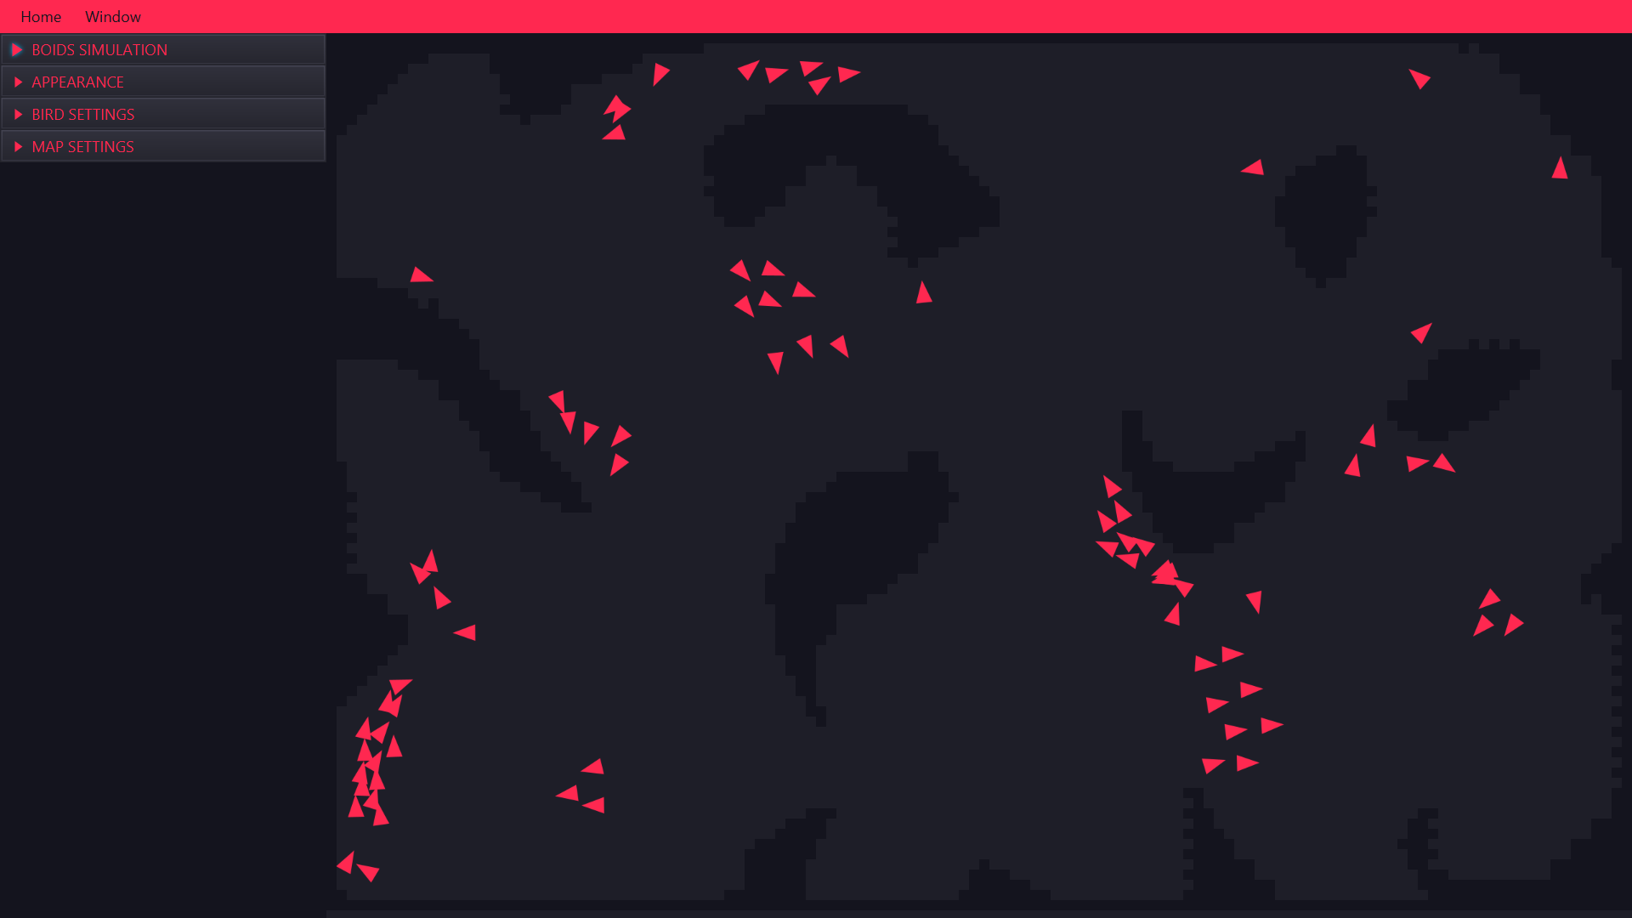
What am I looking at?
The left side is the controls for the simulation, and the right side is the simulation itself.
The triangles represent the birds, and the darker areas being the walls of the imaginary 2D terrain that the birds can fly around with the lighter areas being the empty space.

Slide 4
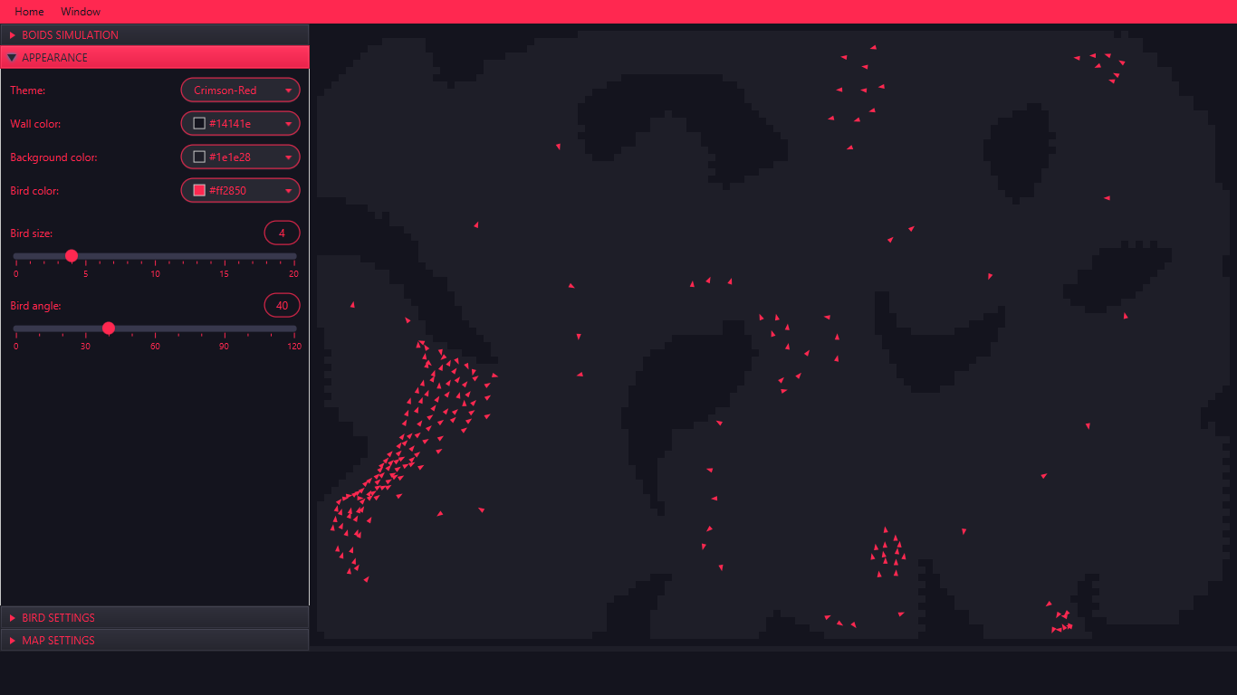
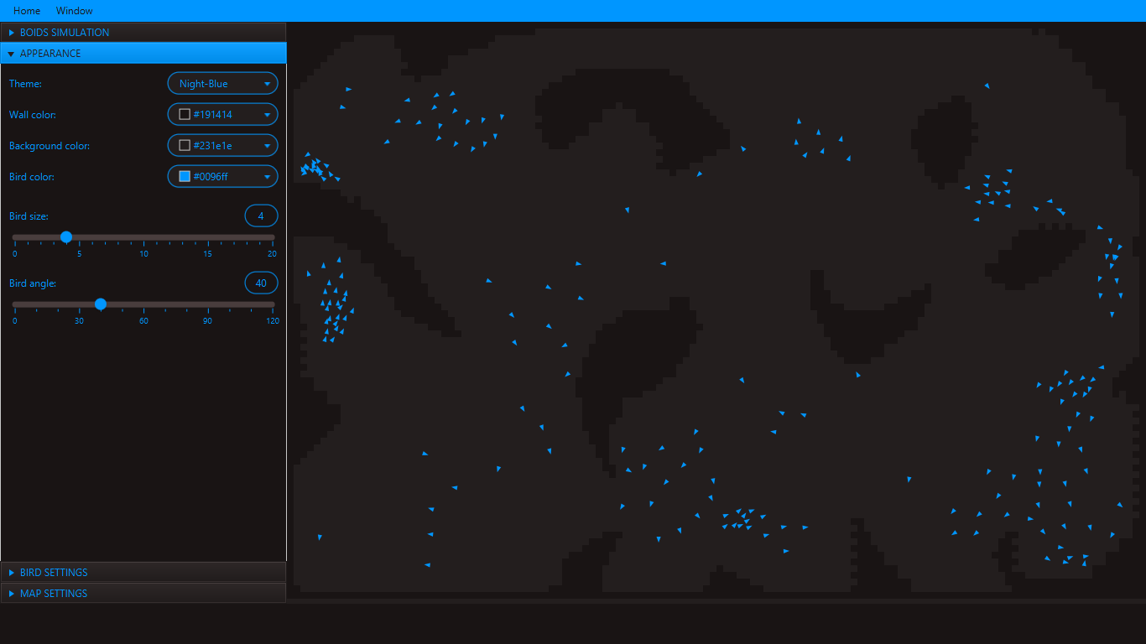
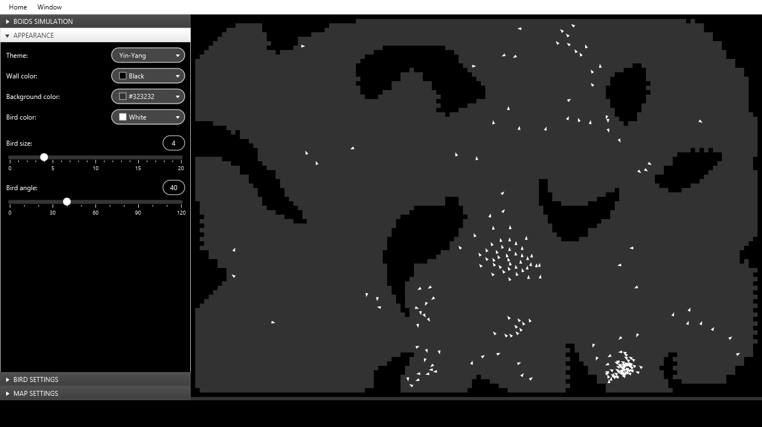
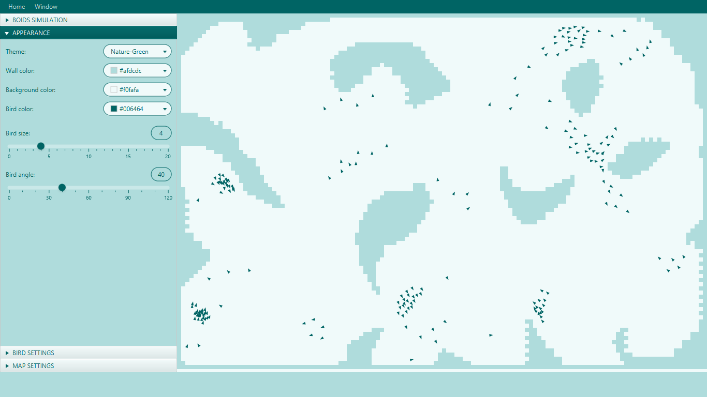
Feature #1
4 UI themes to choose from

Slide 5
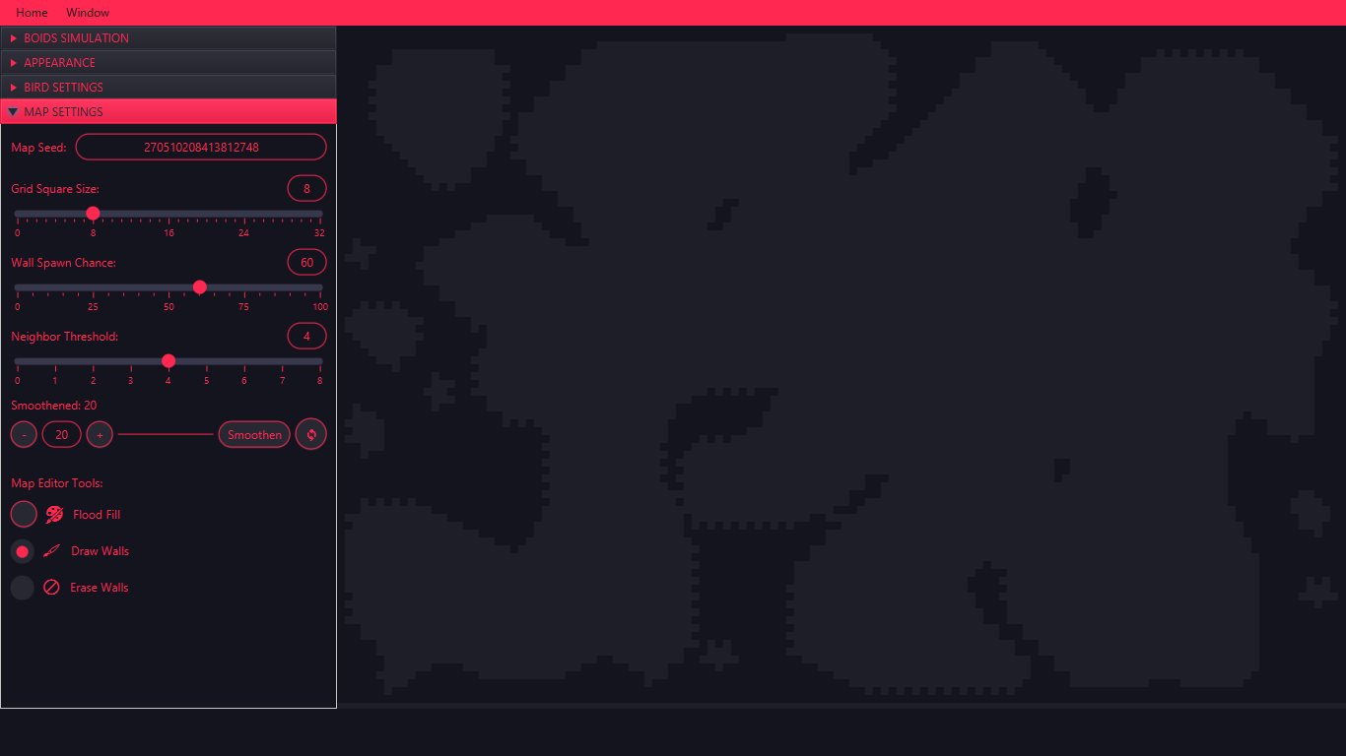
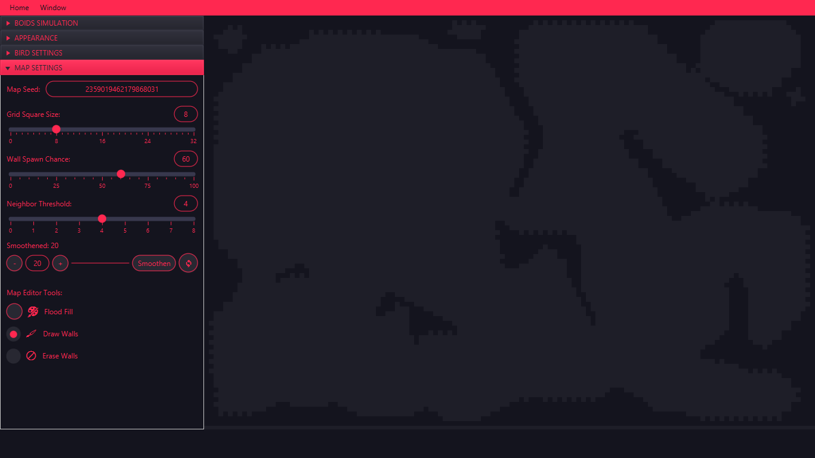
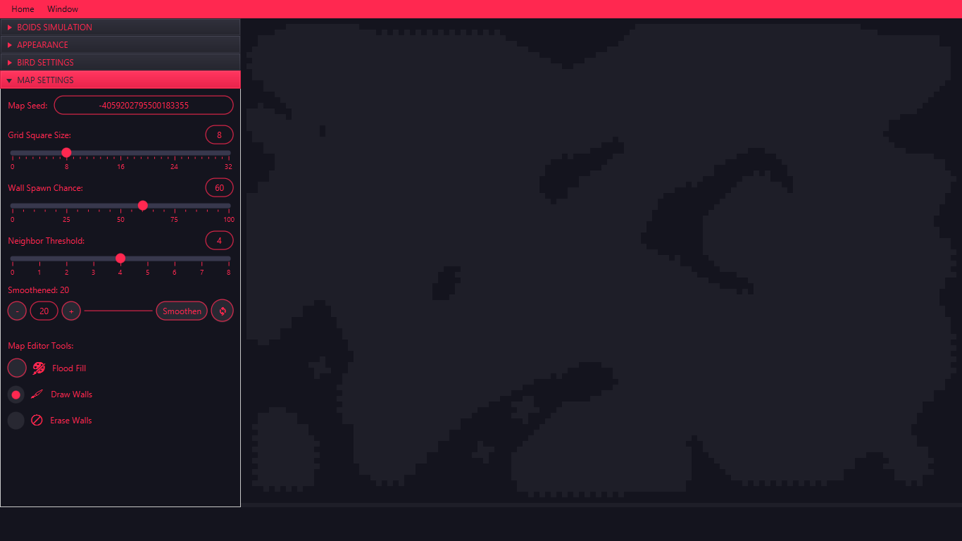
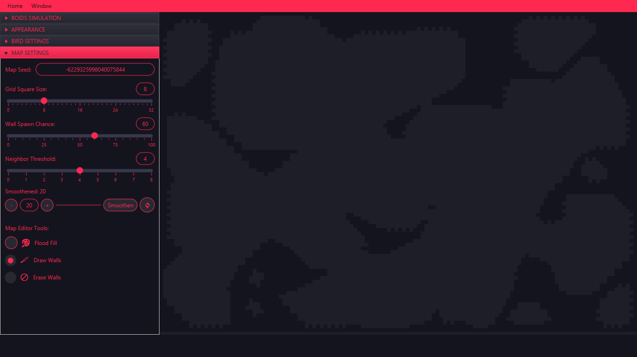
Feature #2
Randomly generated maps

Slide 6

Feature #3
Map editor tools

Slide 7
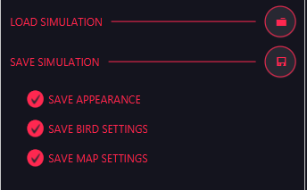
Feature #4
Save/load a simulation

Slide 8
Algorithms used
Boids algorithm
Alignment, Coherence, Separation, Avoid Collisions
Cellular Automata
Like Conway's Game of Life
Used for map generation
Flood Fill
Breadth-First Search (BFS), Queue data structure
Used in the fill function for map editing

Slide 9
Optimisations
For collision, each bird only needs to check through all walls that are adjacent to an empty space. This list of “edge walls” is updated every time the map is changed.
Flood fill implemented using BFS and Queue instead of recursion to avoid StackOverflowError when large areas are filled.
A Canvas control is used to render the simulation because its more efficient than a Pane control.

Slide 10
Difficulties
Handling collisions and avoiding collisions
01
Balancing of the alignment, coherence, separation and collision avoidance factors.
02
Notes:
Handling collisions and avoiding collisions was the harder part because there was little online documentation of such an algorithm to handle this, as most boids simulations were done in an area where the birds will reappear on the opposite side when it touches one edge, or with flat and straight walls on the edges to push the birds away with low quality code that can’t be applied in my case of a grid with blocked off areas that are inconsistent.
Smart workaround: reuse the separation factor code but use it to separate from the walls itself, which gives a nice turning effect that takes the curve of the wall into account. AFAIK this is the best possible way to design the collision avoidance factor.
Balancing of the various factors also need to be editable during the simulation itself, so how I chose to do it is to calculate the unit vector (magnitude = 1) of each factor (which gives an acceleration vector) which is then multiplied by how much it influences the bird itself.

Slide 11
Live demo time!

