Slide 1
De voorstellen
EAP-TTLS Client & NAS
Kerberos

Slide 2

EAP-TTLS Client & NAS

Slide 3
Content
Overview
Advantages
Disadvantages

Slide 4
Overview
OpenSSH server also provides a EAP-TTLS daemon
Custom, form-based client connects to EAP-TTLS daemon
Implementations according to RFC 5281 / EAP-TTLSv1 Internet Draft
On Access-Accept, NAS sends pool accunt password and username

Slide 5
Advantages
Using EAP-TTLS
Private information is only readable by client and AAA/H server
Flexible authorization options by making the NAS evaluate outer-tunnel attributes
Much of the code is already available as various open source projects
One client authenticates for many applications
Pool account is exclusively used by one user

Slide 6
Disadvantages
Custom client application is required
Outer-tunnel information is readable between client and NAS
  However: SSL / TLS
Fairly sizable development project
  However: much of the critical code is already available

Slide 7
Kerberos

Slide 8
Contents
Description
Challenges
Advantages
Disadvantages

Slide 9
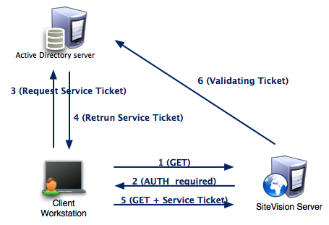
Description
Network Authentication Protocol
Works on the basis of “tickets”
Allows communication over non-secure network
Relies on client-server model
Mutual authentication
Server and client verify each others identity

Slide 10
Challenges
Create an IT infrastructure that provides the following:
  Security
  Share distributed resources
  Access granting and revoking
  Single sign on

Slide 11
Advantages
Single sign on
GSSAPI standardized in Kerberos
Backhand can be FreeRadius and OpenLDAP

Slide 12
Disadvantages
Originally relies on basic trust relationships (shared keys)
  Possible solution (Cross-realm authentication)
Check if a default realm like the FreeRadius implementation exists in Kerberos
  If this is not the case, create a program/script that will pull the configuration files from a master server
In cross-realm authentication, the KDC can learn the session key
  Possible solution (PKINIT)

