Slide 1
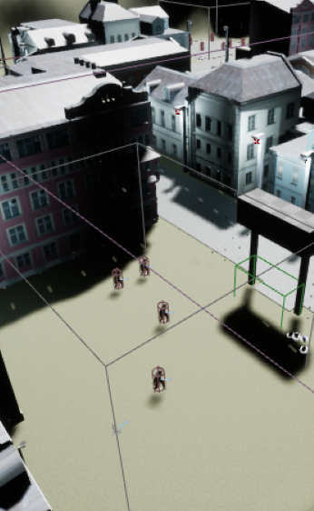
IMAT3001_501 Advanced games engine P2595371 Ricardo Monteiro
FPS in Unreal C++

Slide 2
Key features
Character movement
Projectiles
Projectile pickups
Health system
Animation
AI
Interactables
Crouching
Sprinting
Door

Slide 3
C++
Character Movement
Projectiles
Projectile/Health system
Crouching
Sprinting
Door

Slide 4
Blueprints
Projectile pickups
Health pickups
Animation
Interactables
Others

Slide 5
Animations and others
All of them were done with the help of blueprints since they allowed easier and faster production.
HUD

Slide 6
Worldmap and levels
Level 1 consists of shooting aliens, when killing all enemies the player will be able to advance to the next level.
Level 2 is a parkour level, when reaching the end the player will go to the next level without needing any kills.
Level 3 is a café outdoor where the player can drink tea from the teacup on top of the table and finish the game.

Slide 7
Links
https://www.mixamo.com
https://www.turbosquid.com/3d-models/max-buildings-town-houses-pack/976924#
https://www.turbosquid.com/3d-models/caferestaurant-free-model-1759254#
https://www.cgtrader.com/free-3d-models/exterior/street-exterior/cobblestone-ground-raw-scan-and-gameready-lowpoly
https://www.cgtrader.com/free-3d-models/furniture/chair/dinning-table-1bb0c13a-bf1c-4e76-a019-424406e25e07
https://www.cgtrader.com/free-3d-models/furniture/tableware/coffee-cup-f522792f-5960-4222-acdf-7bf99665119b
https://www.cgtrader.com/free-3d-models/character/fantasy-character/game-ready-health-life-resource-crate-asset
https://www.cgtrader.com/free-3d-models/architectural/fixture/electric-box-c927d0db-21ea-4344-86f9-58034c0a93a7
https://3dtextures.me/2022/05/21/stylized-stone-floor-005/
https://3dtextures.me/2020/08/28/grass-005/
https://3dtextures.me/2018/10/01/chain-link-002/

