Slide 1

Social Gate
Mid-Project Follow-Up
BABOURI Samy
JANGRA Lalit
DO NASCIMENTO RODRIGUES BARBOSA Helton
Mid-Project Follow-Up — May 2026

Slide 2
Status + Technical Progress
Completed
✓ Module Login (back + front) end-to-end
✓ BST keyed by user_id (LAB 8) + hash maps (LAB 1)
✓ SHA-256 + per-user salt, constant-time check
✓ Sessions in hash map, HttpOnly cookies
✓ JSON persistence (Lecture 3 — type File)
✓ 31 unit tests + adversarial E2E (all green)
✓ Pseudo-code per Lecture 1 rules
✓ Repo & PR workflow on GitHub
Planned vs. delivered
• Foundation: Login + persistence (delivered)
• Social graph (Lecture 8 / LAB 6) (next)
• BFS friends-of-friends (LAB 6 ex.3) (next)
• Timeline ranking (Lecture 9 — MergeSort) (next)
• Friend suggestion (LAB 8 BST + LAB 6) (next)
• Confidence threshold filter (next)
Overall progress: ~30 %
Foundation done: design → implementation has started.

Slide 3
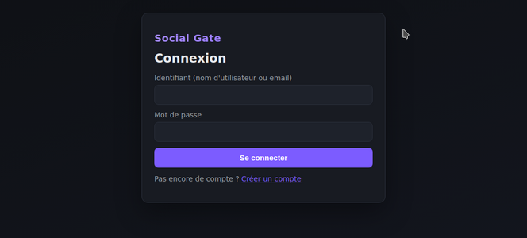
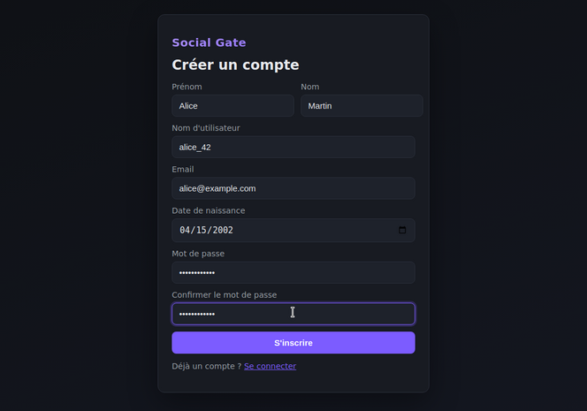
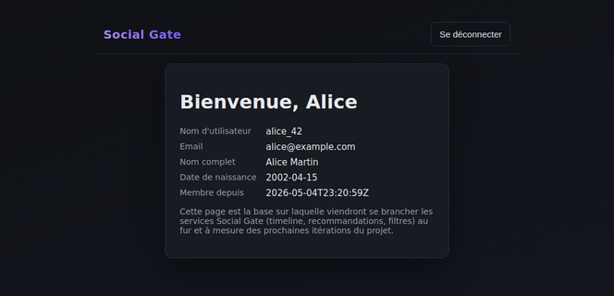
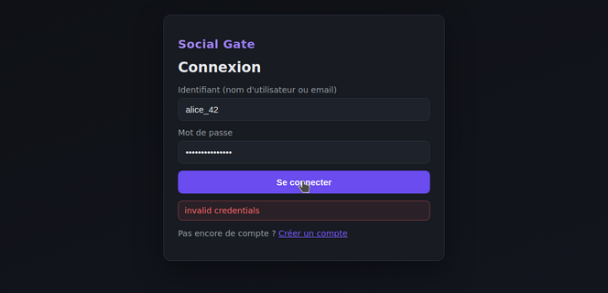
Demo — Screenshots
Login form
Register form
Home / profile
Invalid credentials

Slide 4
Algorithms + One Key Challenge
Algorithms implemented
• BST.search / insert / delete (Lecture 10)
user_id key, iterative search, predecessor-replacement delete
• Password hash (SHA-256 + salt)
constant-time verification (hmac.compare_digest)
• Hash-map session lookup (LAB 1 ex.6)
username, email and token → user_id
• JSON load/save
atomic write via tmp file (Lecture 3 — File type)
Complexity (n users)
Search by user_id → O(log n) avg, O(n) worst
Search by username/email → O(1) avg
Insert new user → O(log n) + O(n) write
Key challenge
• Course constraint: no SGBD
Lecture 3 only ships the File type — MySQL is out of the course scope.
• Course constraint: no web framework
Flask / FastAPI are not taught — ruled out for authenticity.
• How we solved it
Stack rebuilt with stdlib only: http.server + BST + hash maps + JSON. Every data structure is mapped to a precise lecture / lab citation.
• Trade-off
Sessions are in-memory (lost on restart) and reads scan the BST. Acceptable today; will migrate to MySQL once the course covers it.

Slide 5
Risks + Next Steps
What is not going well
• MySQL not yet integrated
Course has not covered SQL — currently stored as JSON.
• No HTTPS / production deployment
Out of scope for the course; plain HTTP for the demo.
• BFS / sorting / scoring not started
Only the foundation (Login + storage) is shipped.
Main risk for final delivery
Underestimating the integration cost between the social-graph module (BFS) and the timeline-ranking module (MergeSort) — need to freeze the User / Post data contract early.
Next steps (priority order)
1. Social graph — Lecture 8 / LAB 6
Adjacency list + BFS friends-within-k-hops.
2. Friend suggestion — LAB 8 + LAB 2
BST traversal + mutual-friends Jaccard.
3. Timeline ranking — Lecture 9
MergeSort by Proximity Score (slide 6).
4. Confidence threshold filter
Hide posts under N likes from friends.
5. Web UI integration
Connect frontend to the new endpoints.
Realistic, not optimistic

