Slide 1
Regression - Fitting Equations To Data
228.371 Statistical Modelling
Presented by Jonathan Godfrey in 2014

Slide 2
Introduction
We will start with some revision of work from 228.271.
If there is anything in this introductory material that is not familiar DO SOMETHING ABOUT IT.
We will use software that should not be new to any of you for regression in this course.
R is free and downloadable. All handout notes have the necessary R code required for this part of the course.
An additional introduction guide is available for R (download not print).
We will have tutorial sessions together in the lab on Thursday and Friday.

Slide 3
Our Aim
An equation (mathematical model) describing relationship between a response variable and one or more explanatory variables.
Fitting the model, estimating the unknown coefficients (parameters) in the model.
Our model may represent a straight line, or a curved function (using polynomial functions for example).

Slide 4
Terminology
Y Response Variable (dependent)
x₁, x₂,...x_{p} Explanatory (predictors), Regressor Variables (independent)
Regression Models
  We will only consider Y~ normal (m,s²)
  Y~normal(b₀ + b₁x,s²) or equivalently
  Y= b₀ + b₁x + e e~normal (0, s²)

Slide 5
Mechanistic Models
V = IR
Ohm's Law is an example of a mechanistic model.
In a mechanistic model, the form of the relationship is known.
If resistance (b) is unknown y= b x.
Where y = voltage and x = current.
Fitting the model, estimating b.

Slide 6
Empirical Models
If there is no pre-conceived notion of the form of the relationship find an empirical model.
Insight into the underlying physical mechanism?
Predict the response as accurately as possible, e.g. instrument calibration curves.
Usually try linear model first, then ...

Slide 7
Errors
Response and explanatory variables rarely satisfy a mathematical equation exactly.
Experimental situation: measurement errors.
additional unrecorded factors
Observational data: even more unrecorded factors

Slide 8
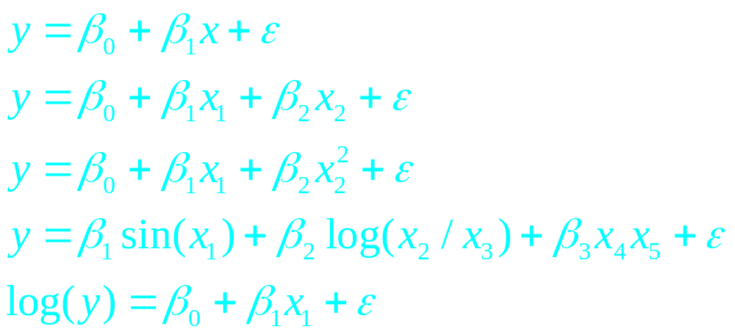
Linear Models
In a linear model, the mean response is linear in the parameters, e.g.

Slide 9
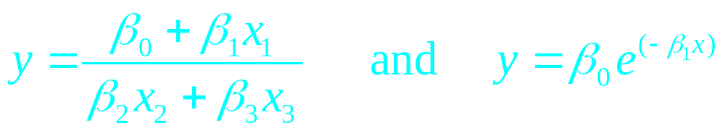
Non-linear Models
The above are examples of non-linear models.
Parameter estimation is much easier for linear models (often used for empirical models).
Mechanistic models are often non-linear.
Try to linearize equation by taking logs, etc. ?

Slide 10
Example 1
Response: Monthly steam consumption in chemical plant.
Explanatory: Average operating temperature.
Data is in the file steam.csv.

Slide 11
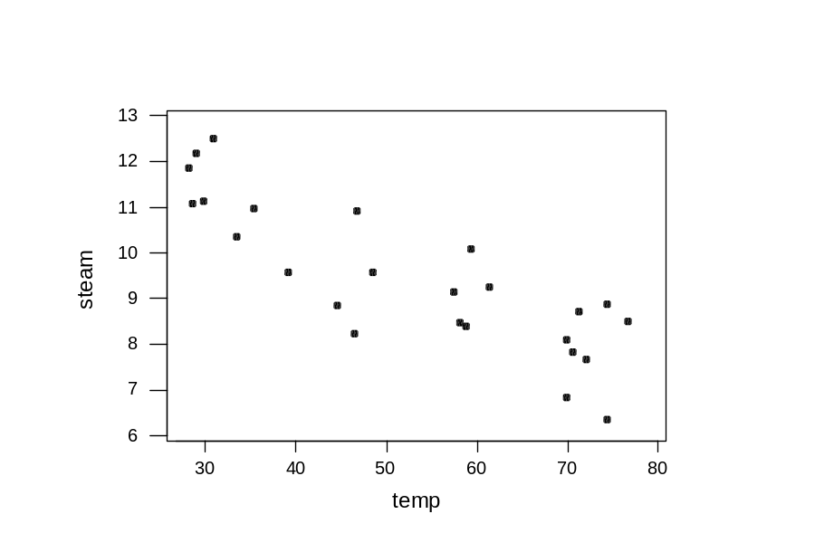
Example 1 cont’d
First plot data. A straight line is a tentative model:
y_{i} = b₀ + b₁x_{i} + e_{i}

Slide 12
Example 2
Manufacture of new type of particleboard.
Attempt to model the relationship between density & stiffness.
30 sheets were manufactured and measured.
Data can be found in stiffness.csv.

Slide 13
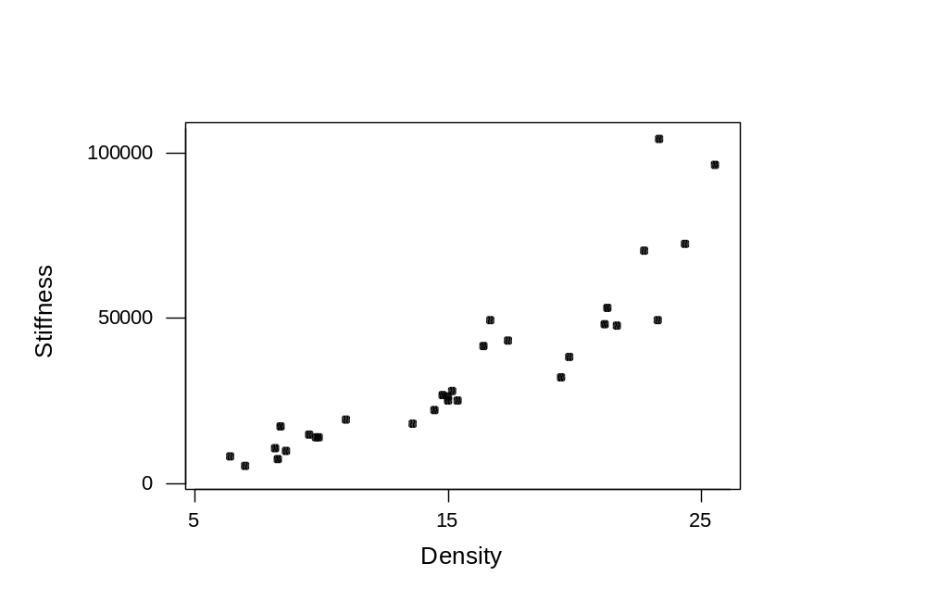
Example 2 cont’d

Slide 14
Example 2 cont’d
No known physical law so we are in need of an empirical model.
Try y = β₀ + β₁x + ε
or perhaps y = β₀ + β₁x + β₂x² + ε
Empirical models are not advised for extrapolation.

Slide 15
Least-Squares concept
Unknown parameters (e.g. b₀, b₁ and s²) must be estimated using data. (Calibration of the model).
y_{i} = b₀ + b₁x_{i} + e_{i} for i = 1,…, n
Where e_{i} ~ independent normal (0, s²)

Slide 16
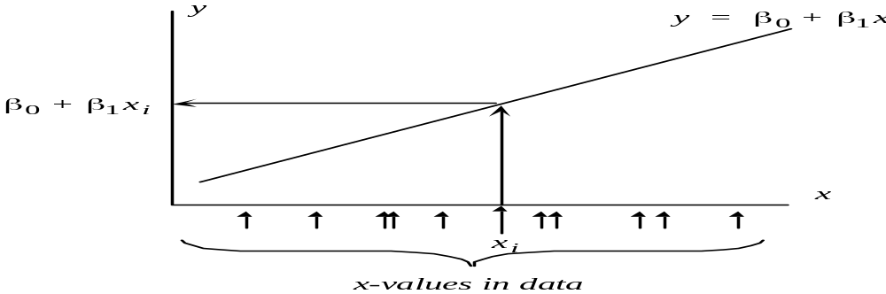
Least-Squares concept cont’d
Since E[y] = b₀ + b₁x
And we knew x, but not y, then we would predict y to be b₀ + b₁x

Slide 17
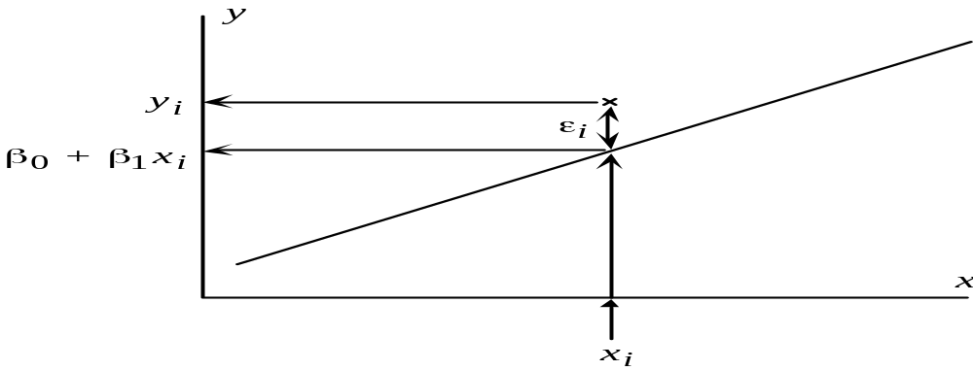
Least-Squares concept cont’d
The actual y_{i} ~ normal (b₀ + b₁x_{i}, s). So the prediction errors are e_{i} = y_{i} – (b₀ + b₁x_{i}).

Slide 18
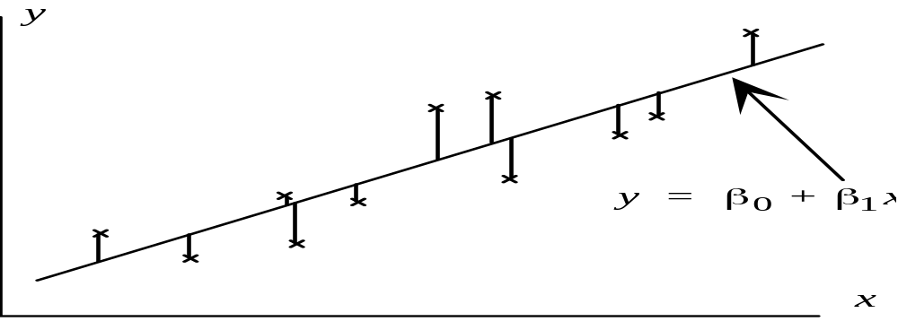
Least-Squares concept cont’d
For the complete data set, the errors are

Slide 19
Least-Squares concept cont’d
In practice, since b₀ or b₁, are unknown, so are the errors.
We estimate them with values b₀ and b₁ that make the prediction errors ‘as small as possible’.

Slide 20
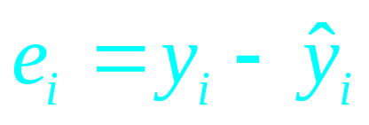
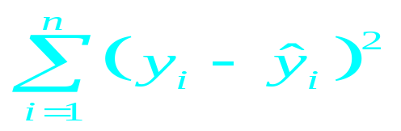
residuals vs errors
The residuals of the model are
They are estimates of the unknown errors _{i}.
Therefore use b₀ and b₁ that minimize the residual sum of squares,
SS_{Residual}=
The values b₀ and b₁ obtained by this method are called the least squares estimates.

Slide 21
Important Concepts
      Errors _{i} - random variables whose values cannot be determined exactly
      Fitted Values - which predict y_{i} from x_{i} using b₀, b₁
      Residuals - which approximate the errors
      Least Squares - choosing b₀, b₁ to minimize sum of squared
      residuals

Slide 22
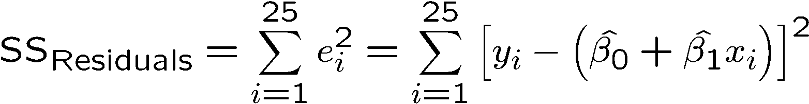
Example 1: Least Squares Estimates
The sum of squared residuals is:
To minimize,

Slide 23
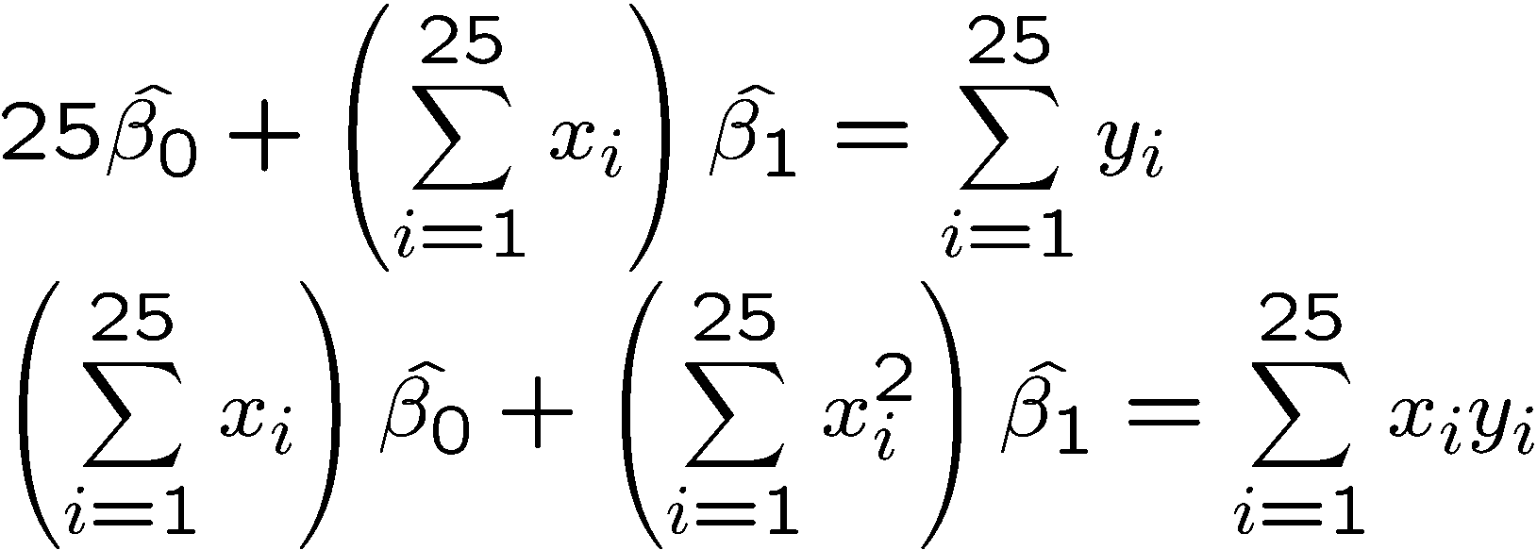
Example 1: Least Squares Estimates cont’d
This leads to two simultaneous equations — the normal equations:

Slide 24
Example 1: Least Squares Estimates cont’d
b₀ = 13.6 and b₁ = –0.0798
So the least squares line is:
y = 13.6 – 0.0798x

Slide 25
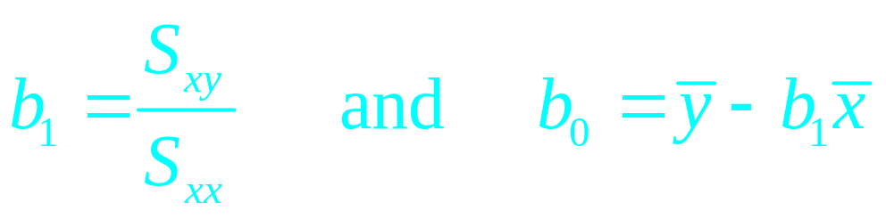
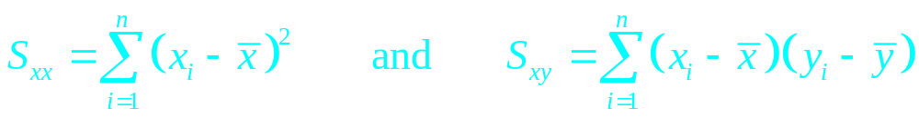
General Results
Where
You will not need these formulae because the software will do the calculations for you.

Slide 26
Interpretation of Parameter Estimates
Intercept
Expected response when x = 0.
Steam production example:
    Expected steam use at 0°F.
    Estimate steam use at = 13.6 lb/month at 0°F.

Slide 27
Interpretation of Parameter Estimates cont’d
Slope
Expected increase in the response when x increases by 1.
Steam production example:
    Estimate that steam use will increase by –0.0798 lb/month for each increase in average temperature of 1°F.
So we are predicting a decrease in steam use as the average temperature increases which makes sense and matches the plot.

Slide 28
The General Linear Model
The models dealt with so far only include one explanatory variable. We will now extend the model to include more than one explanatory variable.
We will use a matrix notation because it simplifies the written form of the model considerably.

Slide 29
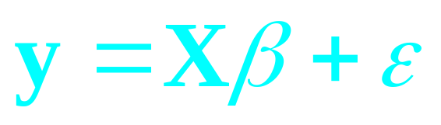
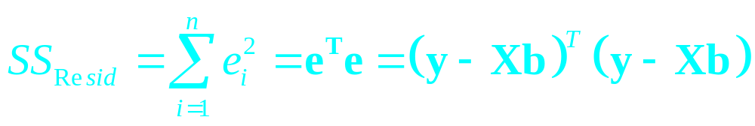
Matrix Notation for the Simple Linear Model
The Simple Linear model can be written:
y_{i} = b₀ + b₁x_{i} + e_{i}
or as:

Slide 30
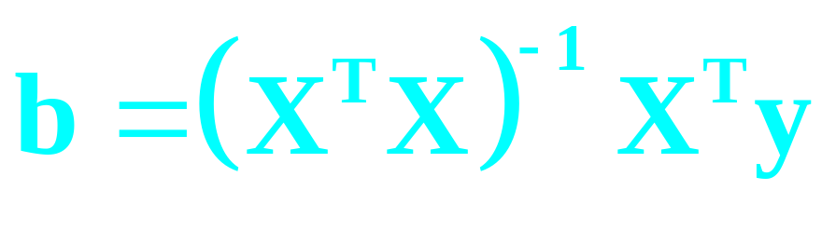
The General Linear Model cont’d
Including additional variables does not change the matrix representation.
The Least Squares Solution is:

Slide 31
Assumptions
The x_{i} are recorded without error.
The relationship between the variables is linear.
The variance of the response is constant.
The errors are uncorrelated.
The distribution of the errors is normal.

Slide 32
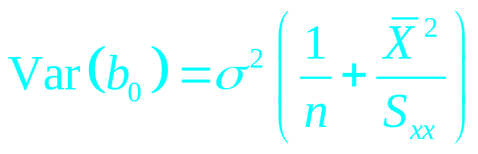
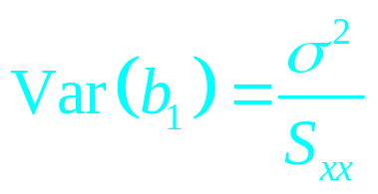
Properties and Inference for Least Squares Estimates
  The estimators are unbiased:
  E[b₀] = b₀ and E[b₁] = b₁
  The estimators have variances:
  and
  The estimators have normal distributions.

Slide 33
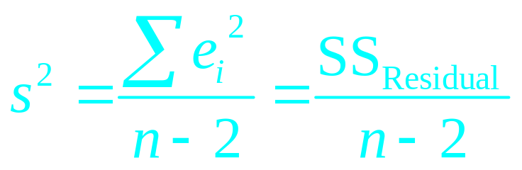
Estimating σ²
Formulae for Var(b₀) and Var(b₁) involve s², so it too must be estimated. The best estimate is:
In this case we have estimated two parameters.
More generally, we use df = n-(p+1).

Slide 34
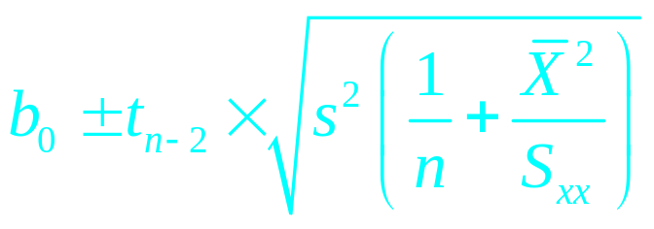
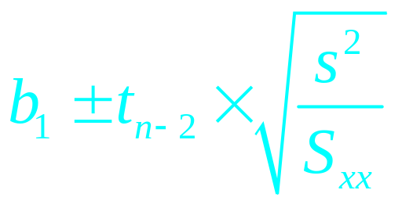
Confidence Intervals
and
Where t_{n–(p+1)} is from the t distribution with
n – (p+1) degrees of freedom.

Slide 35
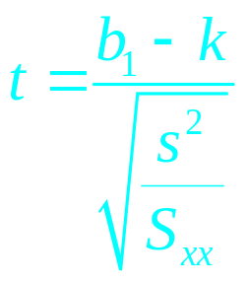
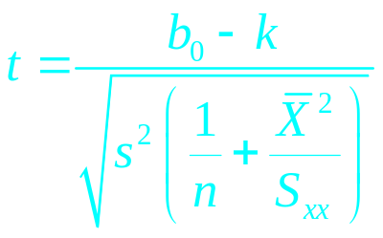
Hypothesis Tests
To test whether b₀ = k or b₁ = k
or
Compare with t distribution with n – (p+1) degrees of freedom.
If b₁ = 0, the expected response does not depend on x, so testing this asks whether the response depends on x.

Slide 36
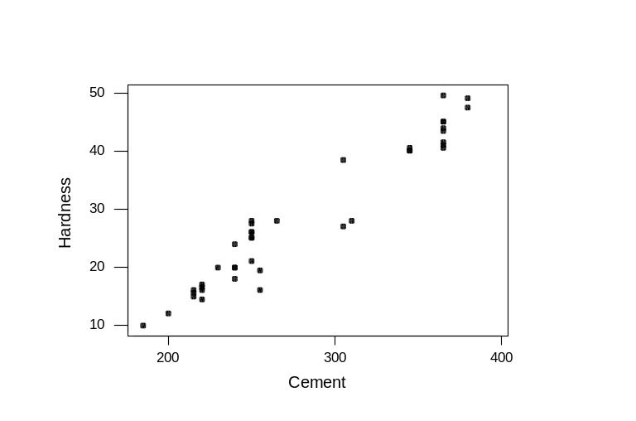
Example 3
How does concrete hardness depend on cement used?
Forty batches were mixed with varying amounts of cement - the hardness of each batch was measured after 7 days.
Data can be found in the file cement.csv.
A scatterplot shows that a linear relationship seems reasonable.

Slide 37
Some R code and output
> Cement.lm = lm(Hardness~CementUsed, data=Cement)
> summary(Cement.lm)
Call:
lm(formula = Hardness ~ CementUsed, data = Cement)
Residuals:
Min 1Q Median 3Q Max
-7.4835 -1.3085 -0.2659 2.2679 5.6929
Coefficients:
Estimate Std. Error t value Pr(>|t|)
(Intercept) -24.066558 2.297903 -10.47 9.3e-13 ***
CementUsed 0.186471 0.007974 23.38 < 2e-16 ***
---
Signif. codes: 0 '***' 0.001 '**' 0.01 '*' 0.05 '.' 0.1 ' ' 1
Residual standard error: 3.106 on 38 degrees of freedom
Multiple R-squared: 0.935, Adjusted R-squared: 0.9333
F-statistic: 546.8 on 1 and 38 DF, p-value: < 2.2e-16

Slide 38
Interpretation of parameters
Our intercept (b₀) = -24.067 ! That is we estimate the concrete hardness to be -24.067 when there is zero cement in the concrete!
Negative hardness?
Our linear model is clearly inappropriate for small x.
We could try a model that is non linear in x (and with more data).

Slide 39
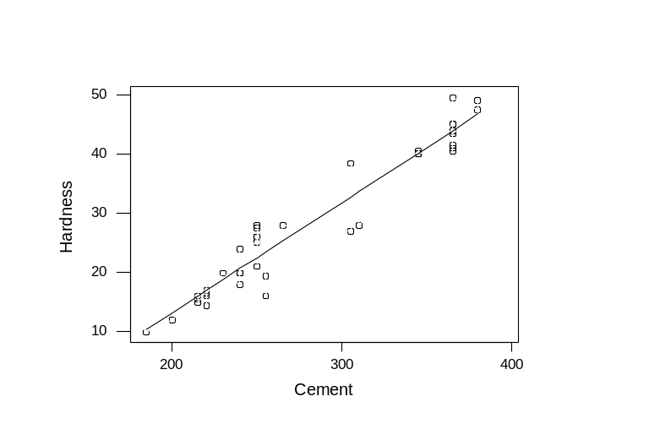
Interpretation of parameters cont’d
The linear model may however still be useful for predicting the hardness of concrete with ‘normal’ amounts of cement.
    Slope, b₁ = 0.186 so we estimate that hardness will increase by 0.186 for each increase of 1 unit in the amount of cement in the mix (between roughly 200 and 400).

Slide 40

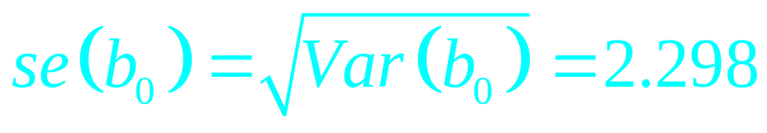
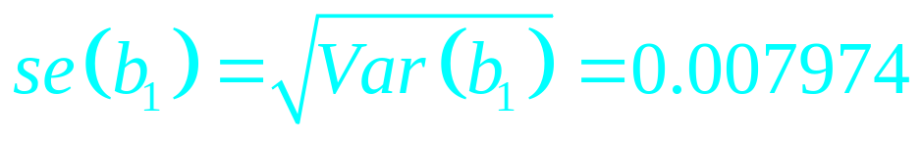
Comparing output & formulae
Least squares estimates are:
b₀ = –24.067 and b₁ = 0.186471

Slide 41
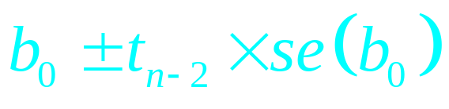
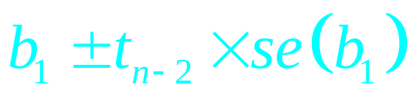
Finding confidence intervals
95% confidence intervals for b₀ and b₁ are:
and
Since t_{n-2} = t₃₈ = 2.02
b₀:
b₁:

Slide 42
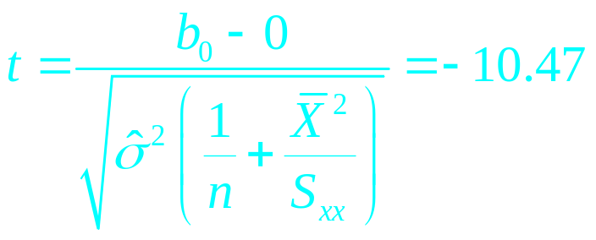
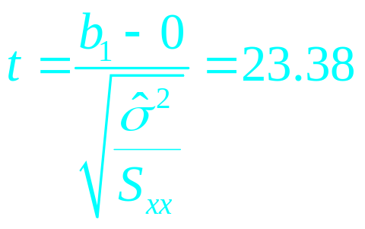
… and hypothesis tests
To test whether b₀ = 0 or b₁ = 0
and
Minitab gives p-values for the two tests; both are reported as “p = 0.000” — really “p < 0.0005”.
Extremely strong evidence in the data that both b₀ ≠ 0 and b₁ ≠ 0.

Slide 43
Confidence Intervals for Predictions
There are two intervals that we can use:
  Prediction of the mean value at a particular x
  Prediction of a new value at a particular x
The latter interval will be larger as it includes the uncertainty in the mean value.
Both intervals get larger as x gets further from its mean.
AVOID EXTRAPOLATION.

Slide 44
Assessing and Correcting Lack of Fit
Assumptions:
  The relationship is linear,
  Variance of the response is constant,
  The errors are uncorrelated, particularly serially,
  Errors are normally distributed.
We will look at ways in which the validity of these assumptions can be assessed.

Slide 45
Distribution of Residuals
Given the normally distributed model errors 5% should be ± 2s and almost none outside ± 3s. However we do not know those errors.
Estimate with e_{i}’s. But these have unknown variance which differs according to the scenario.
We therefore standardize the errors.

Slide 46
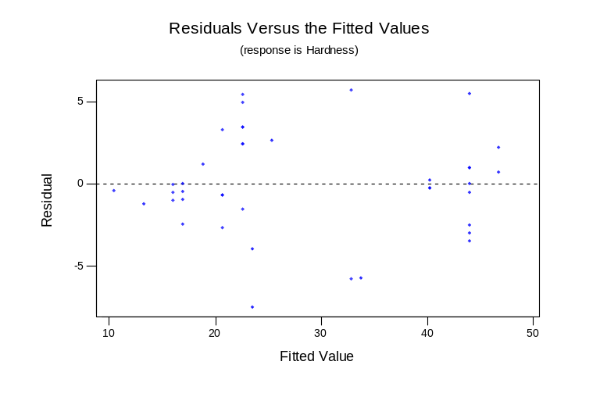
Residual Analysis
We can create a plot of residuals versus fitted values.
It is easier to see trends or problems with the model using this graphic than using the original scatter plot.
Graph is for Example 3, and shows no problems.

Slide 47
Non-linearity
Step one - plot the data.
Step two - plot the errors vs the explanatory variable.
Patterns in the plots suggest some form of non-linearity.
Either add polynomial terms (dealt with later), or transform the data.

Slide 48
Non-Constant Variance
As the x variable increases, the variability of y also commonly) increases.
This may be detected in the scatterplot y vs x it will be clearer in the scatterplot of residuals vs fits.
Some variance stabilising transformations exist.
If error standard deviation proportional to x, try taking logs.

Slide 49
Correlated Errors
Most often violated when the observations collected sequentially.
There may be a variable, not included in the model, which changes over time.
Plot the residuals vs their ‘order’ and look for unusual runs.
Durbin - Watson test.

Slide 50
Non Normal Errors
The model errors should be normally distributed however some violation of this assumption will make little difference to conclusions.
The measured residuals may be non normal for smaller sample sizes.
Normal probability plots will show problems.

Slide 51
Leverage and Influence
Outliers are not necessarily influential.
High leverage observations are not necessarily influential.
Influential observations are not necessarily outliers.
Minitab flags points having “Large Influence” but this should be “Potential Large Influence”.
In R we find the leverages ourselves. Points with more than twice the average leverage are having undue influence. This is a rule of thumb.

Slide 52
h_{ii}, DFITS, Cook’s D
h_{ii} measures leverage or the potential influence.
DFITS measures influence - it depends on both the residual and leverage.
Cook’s distance also measures influence and depends on the residual and leverage.
You will not use all of these, but should know that these rigorous tests (and others) exist.

Slide 53
What to do with Outliers?
Is there an error in measuring / transcribing?
  Delete from the dataset
Is there auxiliary information to describe its differentness?
  Delete from the dataset
If neither of the above proceed with caution.
Plot the residuals.

Slide 54
Multiple Regression
We can put more than one explanatory variable into the model.
R will alter its output only slightly, adding more detail into the tables in the output.
You will need to know what variables are appropriate to put in the model though.
Generate plots of the response variable against all predictors.
For example, use the steam.csv data.

Slide 55
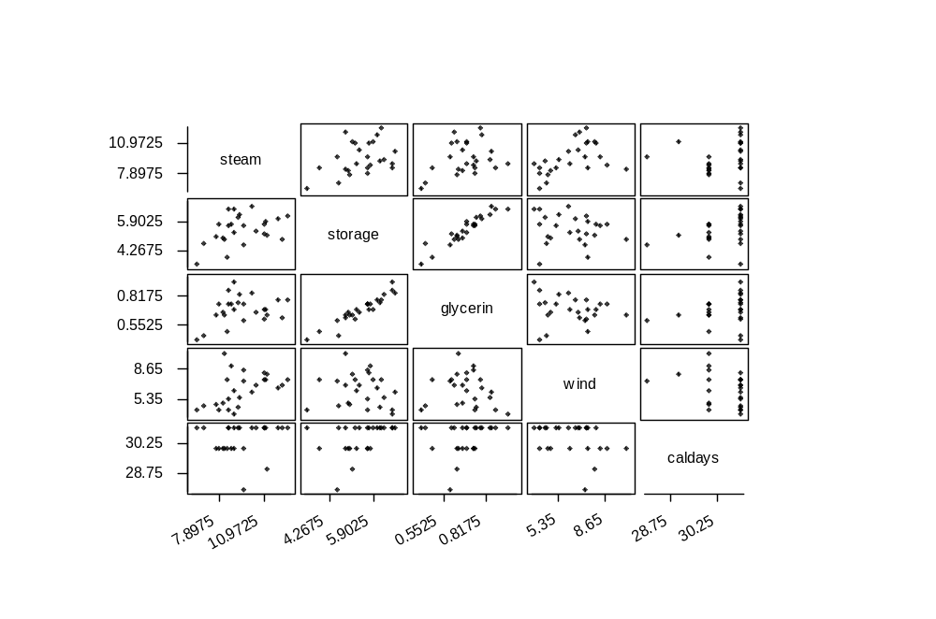
Matrix Plot

Slide 56
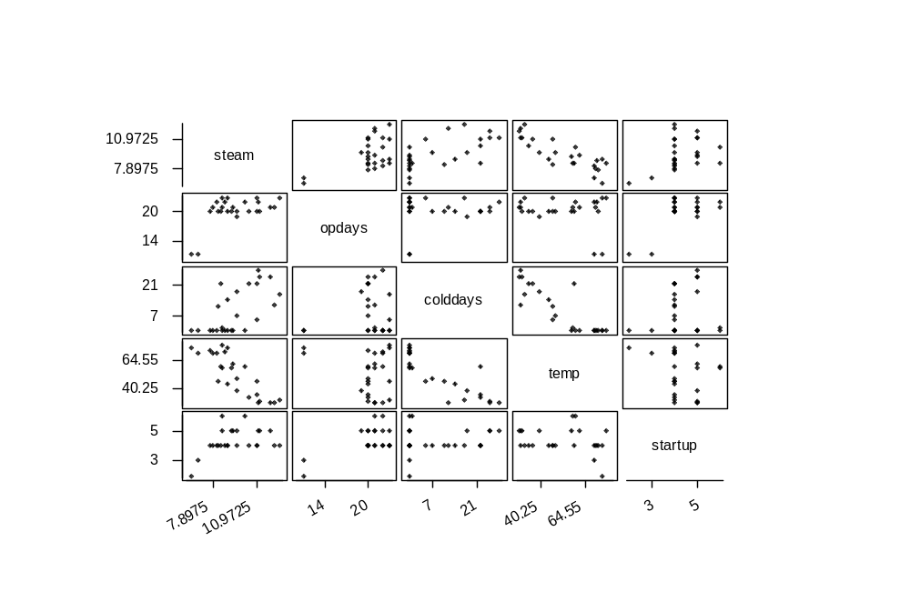
Matrix Plot cont’d

Slide 57
Matrix Plot cont’d
The variable Temp was used in a simple regression previously. It has the most linear relationship of all variables.
Many variables have quite discrete values. This is not usually good for regression.
Some variables have little relationship with Steam.
The next best candidate for an explanatory variable is Wind.
We can now look at the multiple regression of Steam on Temp and Wind.

Slide 58
Inference about Single Parameters
Confidence intervals and hypothesis tests for individual parameters can be carried out using the standard error for that parameter as defined earlier.
A t-distribution with n-(p+1) degrees of freedom is used.

Slide 59
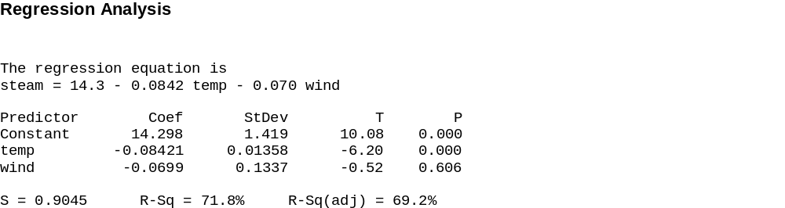
Minitab Output
The addition of Wind is of little use, given that Temp is already in the model.
What happens if only one of these variables was used?

Slide 60
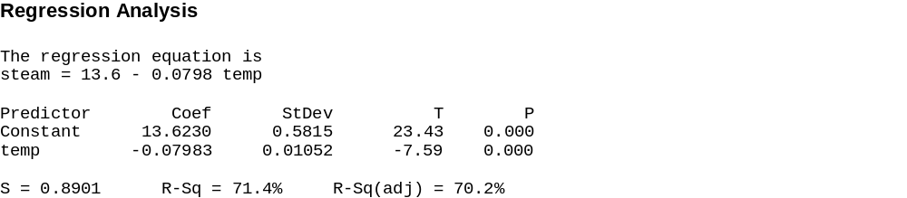
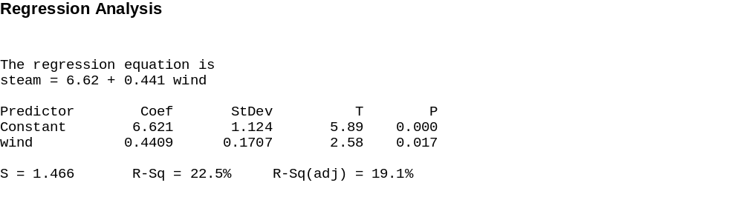
Two Single Regressions
Both models work, but the first is better.

Slide 61
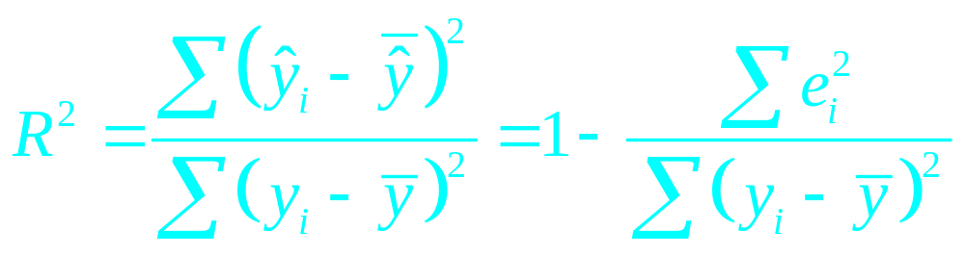
Coefficient of Determination
Correlation coefficient, R, is a measure of the strength of a linear relationship.
R² can be expressed as :
The proportion of the total variability explained by the model.

Slide 62
Extra variables no substitute
Don’t fall into the trap of deciding to assume you can fix all your problems by adding variables to your model.
Each time you add a variable you are making assumptions.

Slide 63
Model Specification Errors
It is possible to include variables in the model that are empirically valuable but theoretically irrelevant.
It is also possible to leave theoretically relevant variables out of the model.
These “lurking” variables may interact with the current variables and impact on the parameters found.

Slide 64
Replicates
Often in experimental situations, you’ll have more than one observation of a particular combination of treatments.
  This is not the same as taking multiple readings for the same experimental run.
Proper replicates allow better testing of hypotheses.
They can be used to identify curvature in the data.

Slide 65
Curvature
Often data are not normally distributed.
Consider the difference between plots of y~x and y~x2.
Think about the marginal distributions of variables.
These will affect the joint distribution also.
We will use marginal plots to illustrate various points.

Slide 66
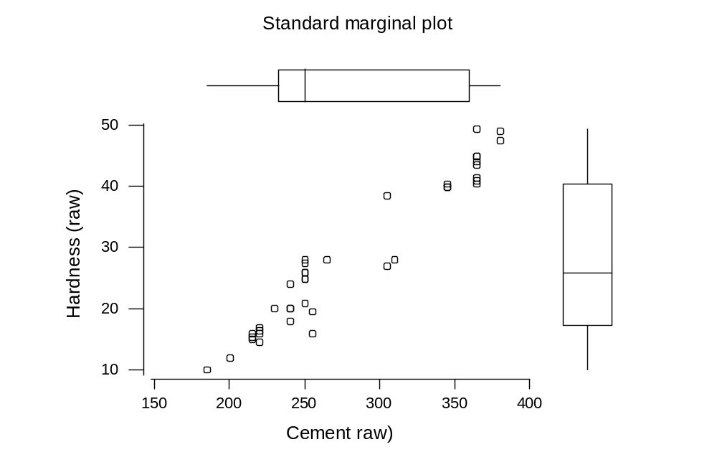
Marginal plots

Slide 67
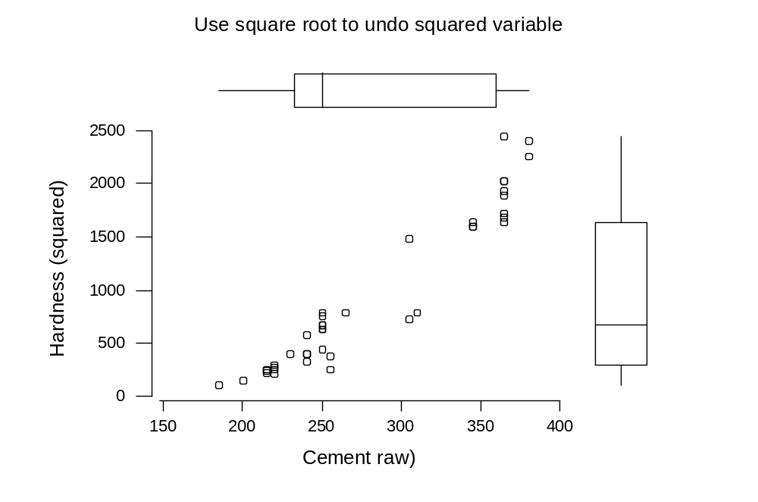
Consider transforming a variable
The response is squared for illustration..

Slide 68
Transformations
A number of common transformations exist to linearize relationships.
If x alone is transformed then if y started normal with constant variance it will remain so.
If y is transformed the error structure will change.
Often if the relationship is curved then skewness and non constant variance also exist and a transformation may cure all!

Slide 69
Possible transformations
You can use any powers between 0 and 1 to reduce positive skewness.
Taking logs can do this too.
Powers greater than 1 reduce negative skewness.
Negative powers can be useful if hyperbola type curvature is present.

Slide 70
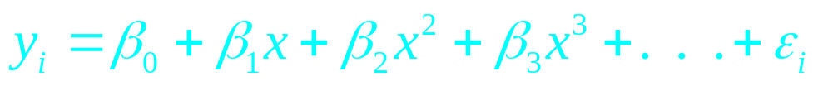
Polynomials
Additional powers of x can be included in a linear model.
Assumptions of normality and constant variance still need to be satisfied by y.
The powers of x are entered in order and are tested for significance in that order.
In practical terms additional variables equal to x², x³ etc are calculated and added to the model.

Slide 71
Comparing polynomial models
Each model needs to be fitted in turn.
You will always include every term of lower order in each model. In a cubic you must include quadratic and linear terms.
Compare using residual error, adjusted R², and the standard residual analysis graphics.

Slide 72
Significance of terms
It’s easy to test the significance of individual terms added to a model assuming all other preceding terms are significant using t-ratios.
The F-test printed by R in regression output is testing the combined effect of adding all the terms into the model at the same time.
An F-test is a generalization of a t-test.
We can test a set of added terms using an F-test.
We’ll look at a polynomial regression example to illustrate this approach.

Slide 73
Extrapolation
Polynomials are, in general, very poor for extrapolation. They rapidly become large and, positive or negative.
They may be good for prediction within the range of the x values.
Prediction intervals get larger outside the range of x values but they still assume that the model is correct!

Slide 74
Discrete valued variables
These include situations where experimental data is used.
Binary variables such as gender were collected.
An identifier of a person in an experiment who is used in multiple runs
Patterned data is present, such as month or day of week.
Sometimes these are numeric, sometimes text.

Slide 75
One-way ANOVA
Can be used to extend a two-sample t-test to three or more groups.
Forms an F-ratio for the sum of squared differences between group means and within-group variability.
The null hypothesis being tested is that all group means are equal.

Slide 76
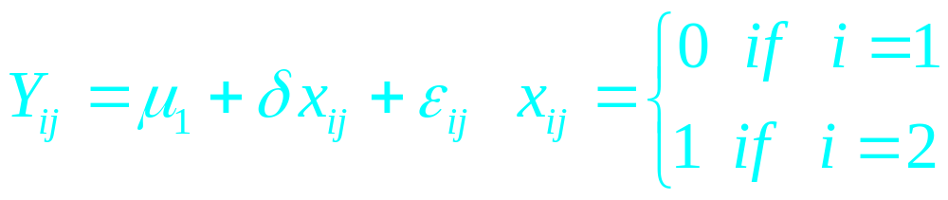
Indicator variables
Indicator variables can be used to indicate membership of a group or not.
Two Group Analysis. The simple t test can be expressed as a linear model.
The group one mean is the intercept and the difference in the means is the x coefficient

Slide 77
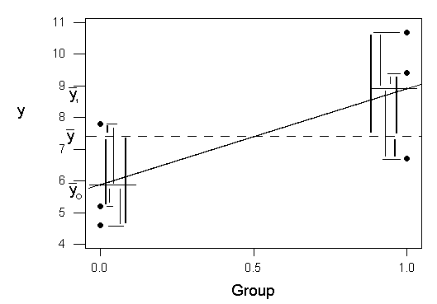
Two Group Analysis
Look at the graphical approach
  With only used 3 points in each group to simplify the graph.

Slide 78
Binary Variables
An indicator variable can also be used to denote a categorical variable with two classes.
E.g sex, pass/fail, took the drug/didn’t etc.
y_{i} = α + βx_{i} + γz_{i} + ε_{i} z_{i} is an indicator variable.
We can now consider a model that has an indicator and an explanatory variable.
Consider two groups with different means, but the same response pattern to the explanatory variable.
Note that this will give a model with parallel lines for fitted values.

Slide 79
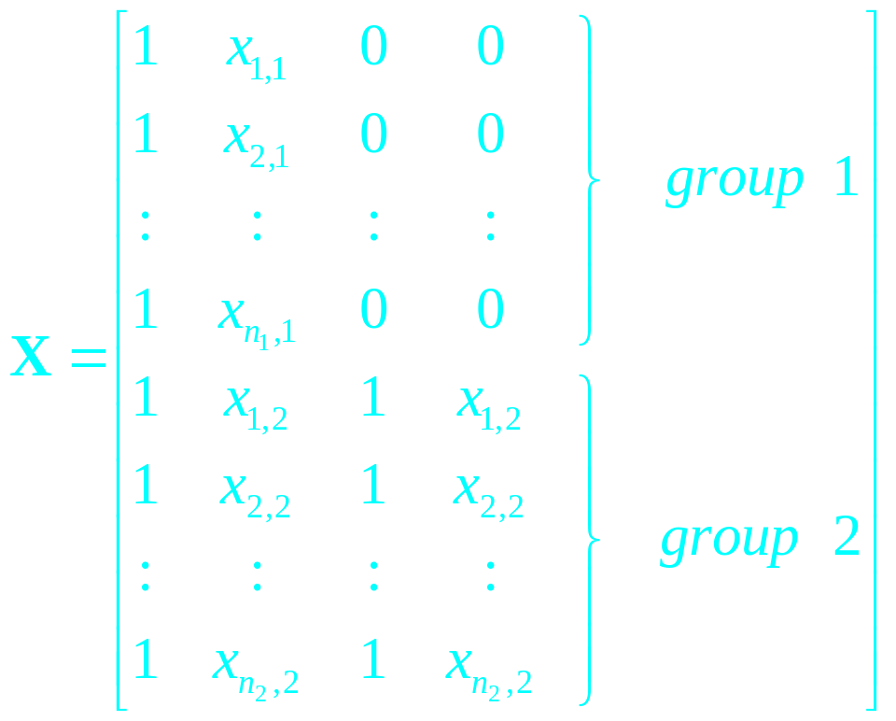
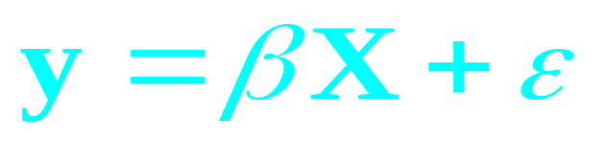
Different Slopes
where

Slide 80
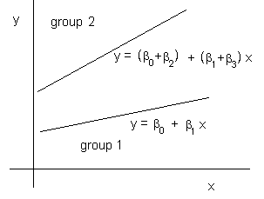
Different Slopes cont’d
This regression line has different intercepts and different slopes.
The effect of x on y is different for each group.
This is called an interaction.

Slide 81
Fitting different slope models
This is really simple in R.
For parallel lines you have a model
lm(Y~X1+X2)
where one of the X’s is an indicator.
To fit the interaction, replace the + with a *.

Slide 82
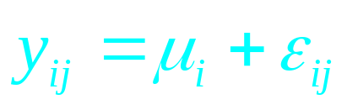
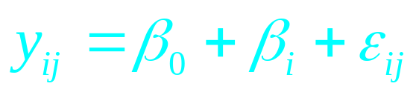
One Factor, Multiple Groups
We considered earlier Two Groups with one Factor.
Now we extend this to a number of groups.
The model can be expressed as :-
Or as :-
Columns of Indicator Variables are needed.

Slide 83
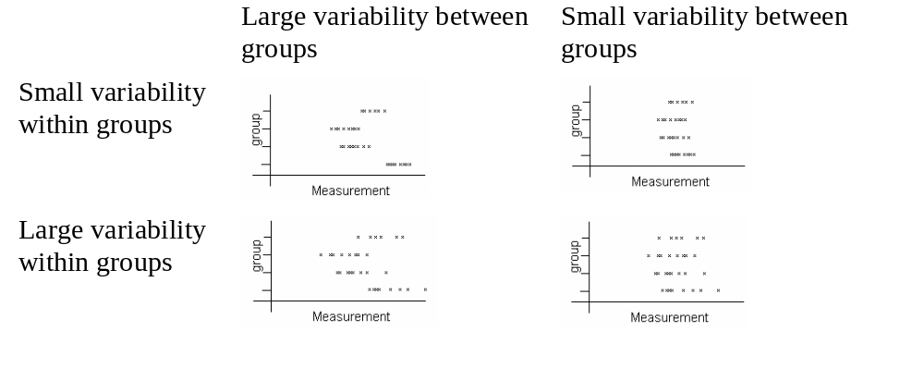
Graphically speaking
We want to consider the circumstances when a difference in the means will be significant. Consider the 4 graphs below:-

Slide 84
Seasonal Patterns
Data is often collected which exhibits some regular cycles, daily, weekly monthly annually.
Indicator variables can be introduced to distinguish between the days weeks months etc.
In R, we don’t need to do this. We just use the variable that is for the days, weeks etc.
When it goes into the linear model, it will be given the necessary degrees of freedom.

Slide 85
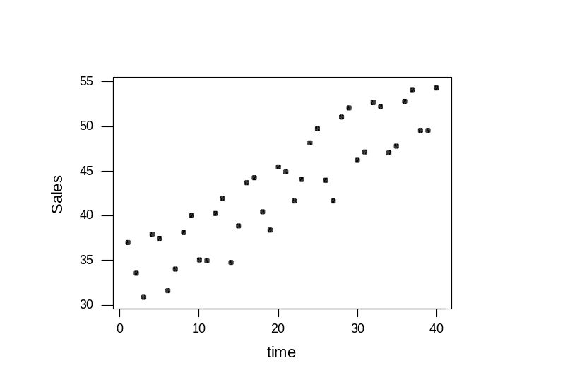
Plot the Data
There may be an obvious pattern visible in a simple plot.
In this case we can see the linear trend but not much else.

Slide 86
Two factors and Interaction
Many experiments have two categorical explanatory variables. E.g. types of paint and different surfaces in a paint adhesion experiment.
We can fit a model with the two factors.
There may also be an interaction one paint may stick to surface A best but another paint may stick to surface C best.

Slide 87
Interaction and Main Effects
We can add the main effects in different orders to see if both are significant.
The interaction can also be investigated
  If the interaction is included then both main effects also must be included.
  The interaction should be independent of the order of the two main effects.
  Graphing the main effects may help to explain any interaction.

Slide 88
Remember the interaction.
Whenever we have two or more factors to concern ourselves with, the interaction of factors must be considered.
If you can prove to yourself that no interaction exists, then (and only then) you can compare factors independently.

Slide 89
Interactions Plot
This plot uses a separate line (trace) for each level of one factor.
Each line has a mean response y for each level of the x axis factor.
Use R: interaction.plot() to do this.
Parallel lines show no interaction.

Slide 90


An Example

Slide 91
Covariates
Both factors and quantitative variables can be combined in an analysis.
Often the quantitative variables may be important but of less interest. They may be uncontrollable variables in the experiment.
The quantitative variables are called Covariates.
In the paint example the atmospheric temperature during drying may affect the adhesion This could be measured and included in the analysis.

Slide 92
Factors vs Polynomials
If you fit a variable as a factor, it uses up degrees of freedom.
In effect the mean of each level is fitted. To do this using the regression ideas, you would need to fit a high order polynomial.
We always want parsimony to guide our model selection.
Factors cannot be interpolated, polynomials can. If the order is too high, the interpolations will be rubbish.

Slide 93
Pure error
Replicates can be used to test the appropriateness of a linear or other function to explain the data.
We can perform a “lack of fit” test.
A simple example uses data from a corrosion experiment.
Fit the straight line using as.numeric().
Fit the factor-based model using as.factor().
Combine both to get the linear and nonlinear effects separately.

Slide 94
Piecewise Polynomials
Most commonly piecewise linear models.
A series of connected, or not, straight lines.
If the lines meet the joins are called knots otherwise they are discontinuities.
Both forms can be parameterised and quadratic and higher order models can also be formulated. Some sections may be linear and others curved etc.
These forms are very flexible.

Slide 95

Linear Piecewise Functions
The knots are assumed to be known.
₂ and ₃ are compared to zero to see if different gradients are required.
Discontinuities can also be modeled as in the second example.

Slide 96
Variable Selection
When selecting variables you must adhere to the principle of parsimony.
You should ask yourself whether the model is for description or prediction.

Slide 97
In the Real World!
We do not know which variables are important.
With a high number of potential explanatory variables, considering all possible models is time consuming and pretty tedious.
We will look at a number of criteria to decide which models appear to be reasonable.
There may be alternative models which are acceptable and preferable based on practical considerations.

Slide 98
Criteria Based on Sums of Squares
R² and R²_{adj} can be used. R² should only be used when comparing models with the same number of parameters.
Maximising the R² minimises the SS_{error}.
Maximising the R²_{adj} minimises the MSS_{error}.

Slide 99
Akaike Information Criterion (AIC)
An index used as an aid to choose among competing models.
It trades the goodness of fit of the model off against the number of parameters used to create the model.
Lower values indicate the preferred model.

Slide 100
Sequential Variable Selection
Stepwise regression is an iterative approach which adds or deletes single variables to/from the model at a time as decided by a particular criterion.
Highly correlated explanatory variables can cause some problems. Statistical software can avoid these by ignoring one of them.

Slide 101
Backward Elimination
This algorithm fits all of the explanatory variables and then deletes the variable with its t value closest to zero.
This new model is then used and the process is repeated.
Many models are not considered, e.g. all models with the first deleted variable but less than p-2 variables.

Slide 102
Backward Elimination con’t
The process can continue till there is only one explanatory variable left (or none if you really want to!)
Often, however, a stopping criterion is added, usually using an F value to give a certain level of significance for the variables being dropped.
Again we need to assess the information to decide on the “best” model.

Slide 103
Forward Selection
This effectively reverses the backward elimination process.
All variables are tried in a model with a single explanatory variable and the one with minimum residual sum of squares is chosen.
Additional variables are added until either a predetermined level of significance is reached, or all variables are in the model.
As underspecified models overestimate σ the level of significance is generally low.

Slide 104
Stepwise Regression
This final algorithm is a combination of the other two.
Forward selection is used but at each step the variables are considered to see if one should now be dropped.
The level of significance for adding is generally lower than for eliminating.

Slide 105
Orthogonality and Collinearity
The two extremes are:
  Orthogonality - no correlation between the two explanatory variables.
  Collinearity - correlation coefficient of 1 between the two explanatory variables.

Slide 106
Orthoganal Data
If two variables are uncorrelated they are said to be orthogonal. It can be proved that:
  The least squares estimates b₁ and b₂ are independent of each other.
  The order of adding the variables does not effect the sums of squares in the ANOVA table.
Orthogonal variables are therefore easier to interpret and are a goal in experimental design.

Slide 107
Collinear Data
Collinear variables are the other extreme and happen rarely in practice EXCEPT:
  Where the model has been incorrectly specified in particular in using dummy variables.
Good software will warn you of collinear variables and remove variables where appropriate.

Slide 108
Multicollinear Data
Most data sets arise somewhere between the two extremes. The results are that:
  The least squares estimates b₁ and b₂ are correlated.
  The least squares estimates b₁ and b₂ have higher variances than if x₁ and x₂ had been uncorrelated.
  The order of adding variables has a definite but unknown effect on the values of the sums of squares.

Slide 109
Resolving Multicollinearity
Collinearity arises when one explanatory variable is a linear function of others.
Multicollinearity arises when this is approximately true.
We may need to select one or more variables to delete from the model. These may explain a significant proportion of the variability on their own but in combination with others are not useful.
The effect of these variables is to increase the variance of the parameter estimates.

Slide 110
Variance Inflation Factors
VIFs can be calculated for each variable in the current model.
They show how the inclusion of that variable affects the variances of the other parameter estimates.
Large VIFs (>10) indicate that a variable should be dropped from the model.
These rules should not be applied to polynomial terms in a model which should be considered as a group of terms, not individually.

