Slide 1
How to pretend you know Shakespeare

Slide 2
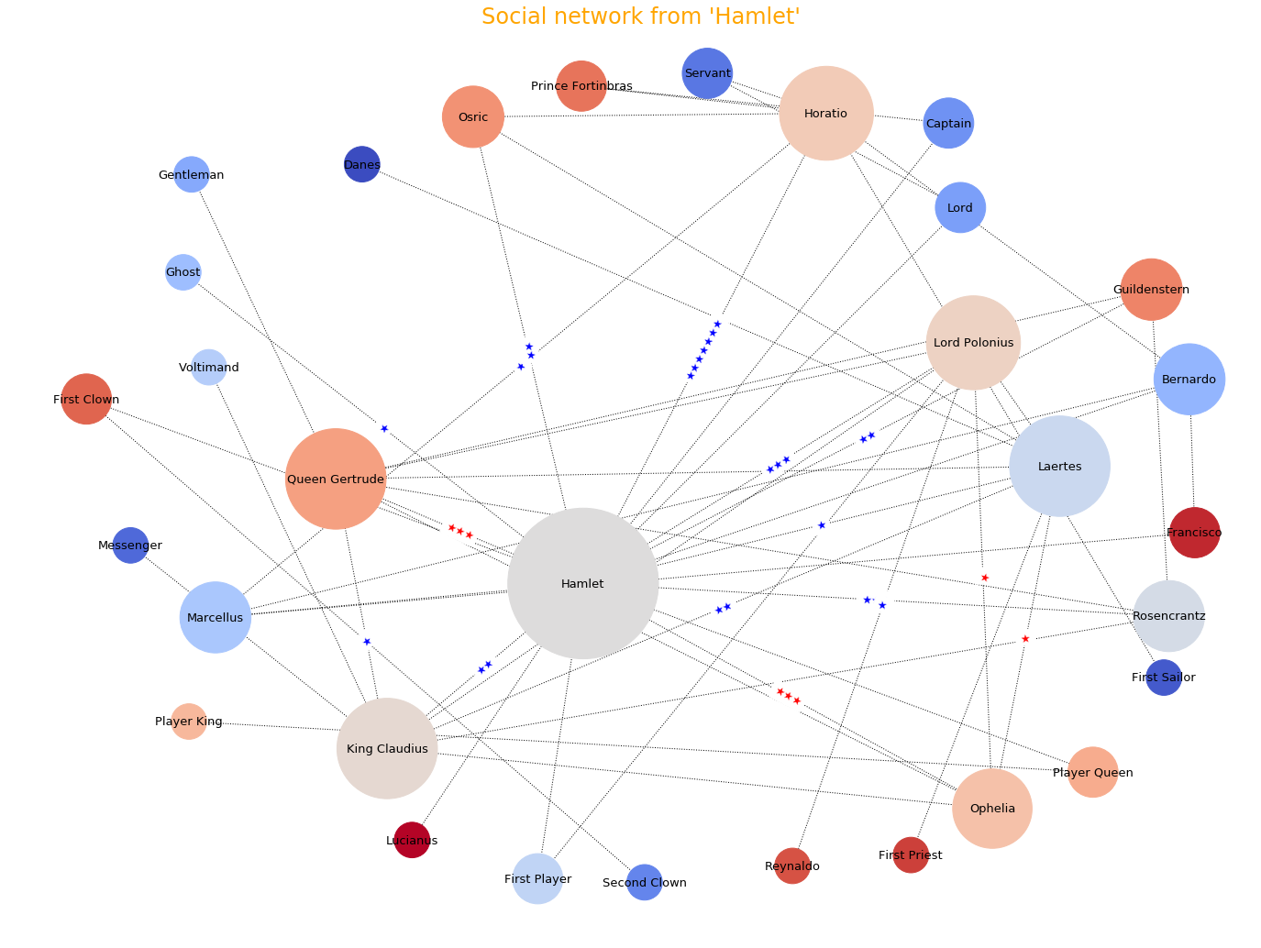

Slide 3
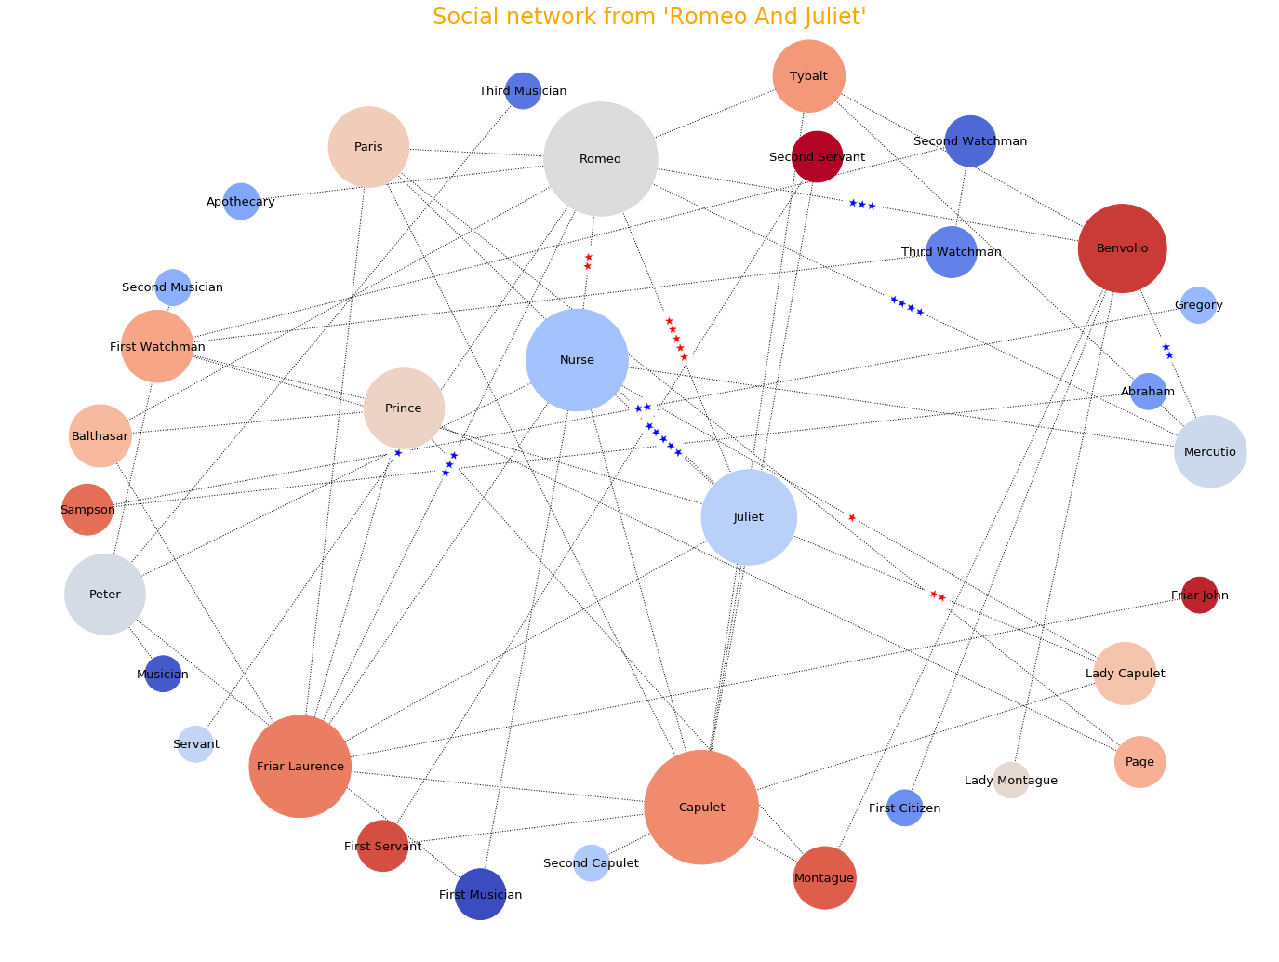

Slide 4
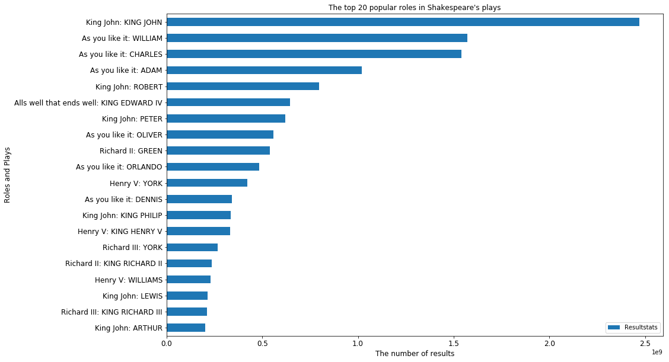

Slide 5
Any questions?

