Slide 1
PROJECT 2
Manual vs. Navigation-Guided
Neurosurgical Procedure Analysis
Cranial neuronavigation systems, workflow, instruments, and accuracy considerations
Internal review | October 2026
Notes:
Cranial neuronavigation only. This deck excludes spine procedures and uses vendor product pages and direct official media for platform-specific information.

Slide 2
Review scope and deliverables
Cranial neurosurgical workflows only
Scope
Expected outputs
Compare manual and navigation-guided neurosurgical procedures.
System-by-system procedure coverage.
Document supported cranial procedure types across major navigation platforms.
Step-by-step navigation workflow.
Map navigation workflow from patient registration through tracked instrument use and procedure completion.
Tracked and conventional instrument taxonomy with purpose.
Manual versus navigation comparison, including accuracy limitations.
Evidence policy: official vendor sources for system capabilities and media; no universal numerical accuracy claim
Project 2 | Manual vs. Navigation-Guided Neurosurgical Procedure Analysis
2
Notes:
Project scope and deliverables as supplied by the requester. Platform-specific statements appear only with cited official vendor sources in notes and the sources slide.

Slide 3
Navigation systems and cranial procedure coverage
Official descriptions indicate supported applications, not a recommendation or a complete indication list
System
Cranial procedures documented
Workflow or feature focus
Official source
Medtronic
StealthStation S8
Tumor resection; cranial biopsy; ventricular catheter placement; depth electrode, lead, and probe placement
Optical and electromagnetic tracking; imaging and visualization integrations
StealthStation S8 Navigation Platform
Stryker
Q Guidance
Cranial guidance; EM-navigated catheter placement; Precision Targeting System for brain biopsy
Hybrid optical tracking; optional EM components; CT auto-registration integration
Q Guidance System
Globus
ExcelsiusGPS
Cranial stereotactic procedures, including biopsies and DBS
Planning, tracking camera, robotic navigation, and imaging compatibility
ExcelsiusGPS
Brainlab
Cranial Navigation
Cranial planning and image-guided navigation workflows
Navigation software, image fusion, and tracked instrument visualization
Brainlab Cranial Navigation
Sources: official Medtronic, Stryker, Globus Medical, and Brainlab cranial-navigation pages
Project 2 | Manual vs. Navigation-Guided Neurosurgical Procedure Analysis
3
Notes:
Medtronic: https://www.medtronic.com/en-us/healthcare-professionals/products/surgical-navigation-imaging/surgical-navigation-systems/stealthstation-s8-navigation-platform.html. Stryker: https://www.stryker.com/us/en/spine/products/q-guidance-system.html (cranial capability section). Globus: https://www.globusmedical.com/musculoskeletal-solutions/excelsiustechnology/excelsiusgps/. Brainlab: https://www.brainlab.com/surgery-products/overview-neurosurgery-products/cranial-navigation/. Accessed October 2026.

Slide 4
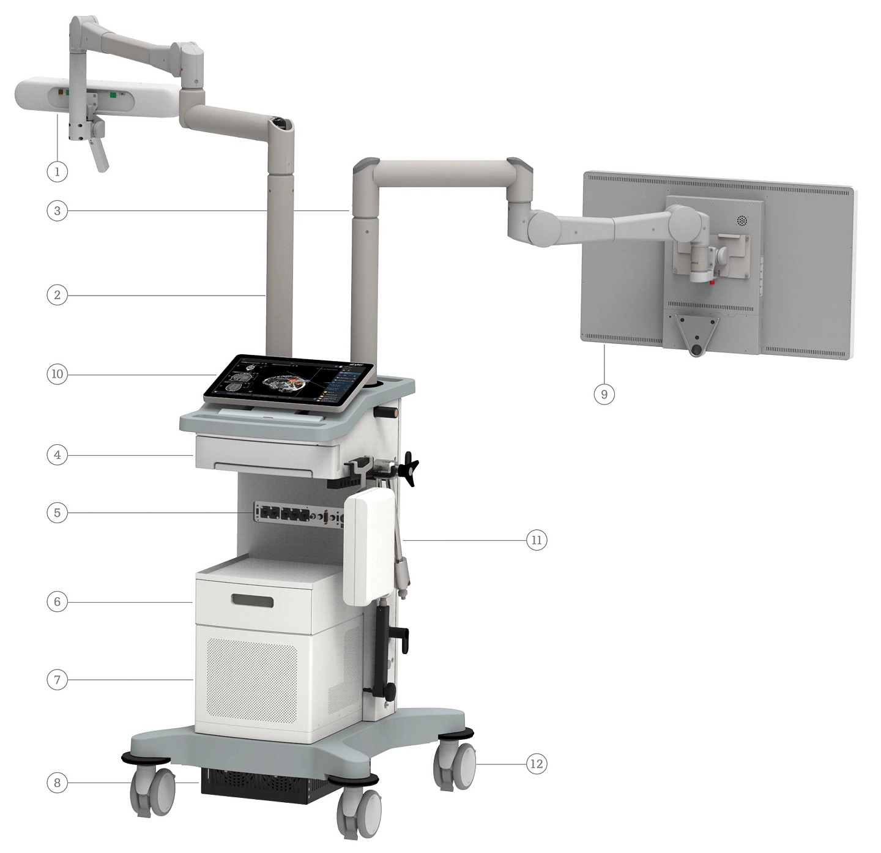
System-specific cranial navigation features
The systems share core workflow stages while differing in tracking, registration, and targeting implementations
Medtronic
Optical and EM tracking; imaging and visualization integrations.
Globus
Cranial stereotactic workflow from biopsy through complex DBS.
Brainlab
Cranial planning, image fusion, and tracked instrument visualization.
Stryker Q Guidance
Cranial Guidance Software, optional EM catheter placement, and a targeting option for brain biopsy.
Official image: Stryker Q Guidance product page | Feature descriptions: cited official product pages
Project 2 | Manual vs. Navigation-Guided Neurosurgical Procedure Analysis
4
Notes:
Image: https://media-assets.stryker.com/is/image/stryker/Q-guidance-cranial-components?$max_width_1440$. Sources: Medtronic StealthStation S8 official page, Stryker Q Guidance official page, Globus ExcelsiusGPS official page, Brainlab Cranial Navigation official page. URLs listed in slide 3 notes.

Slide 5
Manual neurosurgical workflow
Representative non-navigated sequence used as the comparison baseline
1
Preoperative review
Review diagnostic imaging, target, approach, landmarks, and contingencies.
2
Exposure and localization
Use clinical anatomy, direct visualization, and procedure-specific imaging where available.
3
Conventional instrument use
Advance instruments using the operative field, tactile feedback, and the planned approach.
4
Procedure completion
Confirm the intended result with surgeon assessment and procedure-specific verification.
Manual workflows differ by procedure, anatomy, available imaging, and surgical team practice.
Project 2 | Manual vs. Navigation-Guided Neurosurgical Procedure Analysis
5
Notes:
Analytical baseline for comparing workflow elements. This slide does not claim that any manual approach is universally appropriate. It reflects the procedure-level comparison requested.

Slide 6
Navigation-guided cranial procedure workflow
Step-by-step sequence from patient registration to tracked instrument use and completion
1
Acquire and import
imaging
2
Plan target and
trajectory
3
Position patient and
attach reference
4
Register image to
patient anatomy
5
Verify registration
accuracy
6
Calibrate or connect
tracked instrument
7
Navigate and re-check
during the procedure
8
Complete procedure
and verify result
Registration verification and stable patient reference are control points before and during image-guided navigation.
Project 2 | Manual vs. Navigation-Guided Neurosurgical Procedure Analysis
6
Notes:
Workflow synthesized from official descriptions for Medtronic StealthStation S8, Stryker Q Guidance, Globus ExcelsiusGPS, and Brainlab Cranial Navigation. URLs listed in slide 3 notes.

Slide 7
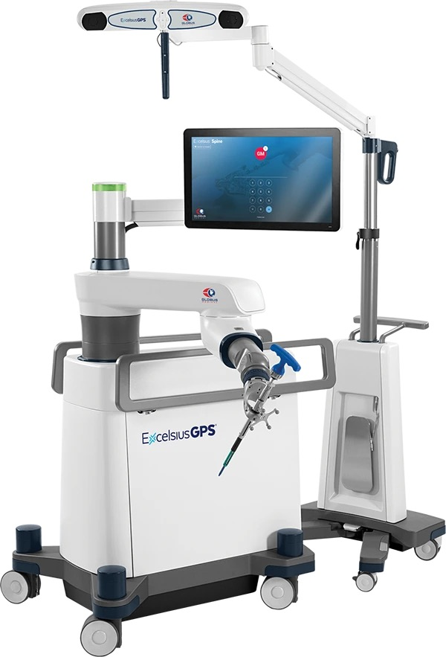
Navigated instruments and components
Tracked equipment provides image-linked position information after registration
Patient reference frame or array
Establishes the patient coordinate reference for tracking.
Navigation probe or pointer
Localizes anatomy and helps verify registration.
Tracked biopsy needle or guide
Displays target and planned trajectory during sampling.
Tracked suction or instrument adapter
Enables compatible surgical instruments to be displayed in the navigation system.
Calibration tool
Associates the instrument tip and geometry with the tracking system.
Configuration note
Compatible instruments and adapters vary by platform, software application, and approved use.
Official image: Globus Medical ExcelsiusGPS product page
Project 2 | Manual vs. Navigation-Guided Neurosurgical Procedure Analysis
7
Notes:
Official image: https://www.globusmedical.com/wp-content/themes/globus/images/scrollers/egps/EXCL_GPS_1801_TECH_FINALCONSTRUCT_ExcelsiusGPS_C.webp. Categories synthesize official platform descriptions. Exact compatibility must be confirmed in the relevant Instructions for Use and hospital protocol.

Slide 8
Conventional neurosurgical instruments
Navigation complements, rather than replaces, the core operative instrument set
Category
Representative conventional instruments
Purpose
Exposure
Scalpel, scissors, forceps, retractors
Create access and maintain the surgical corridor.
Hemostasis
Bipolar forceps, suction, hemostatic tools
Control bleeding and keep the field visible.
Bone work
High-speed drill, rongeur, curette
Perform procedure-specific cranial bone work.
Dissection
Dissectors, elevators, microinstruments, graspers
Mobilize tissue and protect surrounding anatomy.
Closure
Needle holder, forceps, sutures
Close tissue layers after the procedure.
Representative taxonomy for workflow analysis. Instrument selection depends on procedure, anatomy, surgeon preference, and hospital protocol.
Project 2 | Manual vs. Navigation-Guided Neurosurgical Procedure Analysis
8
Notes:
Representative conventional cranial surgical instrument taxonomy for internal workflow analysis. It makes no platform-specific compatibility claim.

Slide 9
Manual versus navigation-guided procedures
Comparison of workflow, information available to the surgeon, and limitations
Dimension
Manual / non-navigated
Navigation-guided
Localization
Direct visualization, known anatomy, and available procedure-specific imaging.
Registered imaging plus position display for compatible tracked instruments.
Planning
Plan reviewed outside a linked navigation display.
Target and trajectory can be recorded in the navigation plan.
Setup
No patient registration or tracking hardware.
Requires reference, registration, verification, and compatible tracking hardware.
Instrument position
No real-time instrument display on the image dataset.
Image-linked display while registration remains valid.
Limitations
Depends on anatomy, imaging availability, and operator experience.
Depends on registration validity, reference stability, tracking conditions, imaging currency, and training.
Workflow comparison derived from the cited official platform descriptions; outcome claims require procedure-specific evidence
Project 2 | Manual vs. Navigation-Guided Neurosurgical Procedure Analysis
9
Notes:
Workflow comparison synthesized from official product descriptions cited on slide 3. This slide does not claim clinical superiority for any system or procedure.

Slide 10
Accuracy considerations and safety checks
Cranial navigation accuracy depends on the validity of the image-to-patient relationship throughout the procedure
Registration error
The initial image-to-patient match can be inaccurate. Verify it at known landmarks before instrument use.
Reference movement
Movement of the patient reference can invalidate the displayed relationship to imaging.
Tracking conditions
Optical line of sight, camera positioning, or EM environment can affect tracking performance.
Anatomic change
Brain shift and tissue deformation can reduce correspondence with preoperative imaging.
Imaging and plan currency
Navigation displays the loaded images and plan. Update strategy when intraoperative conditions change.
No single numerical accuracy value applies across systems or cranial procedure types. Use system-specific validation and procedure-specific evidence.
Project 2 | Manual vs. Navigation-Guided Neurosurgical Procedure Analysis
10
Notes:
Medtronic describes navigation accuracy checks and warns users to stop navigation if accuracy cannot be restored. Medtronic also documents brain-shift monitoring/compensation through SonoNav. Sources: StealthStation S8 official page and https://www.medtronic.com/se-sv/healthcare-professionals/products/neurological/surgical-navigation-imaging/neurosurgery-imaging-surgical-navigation/systems-software-instruments.html.

Slide 11
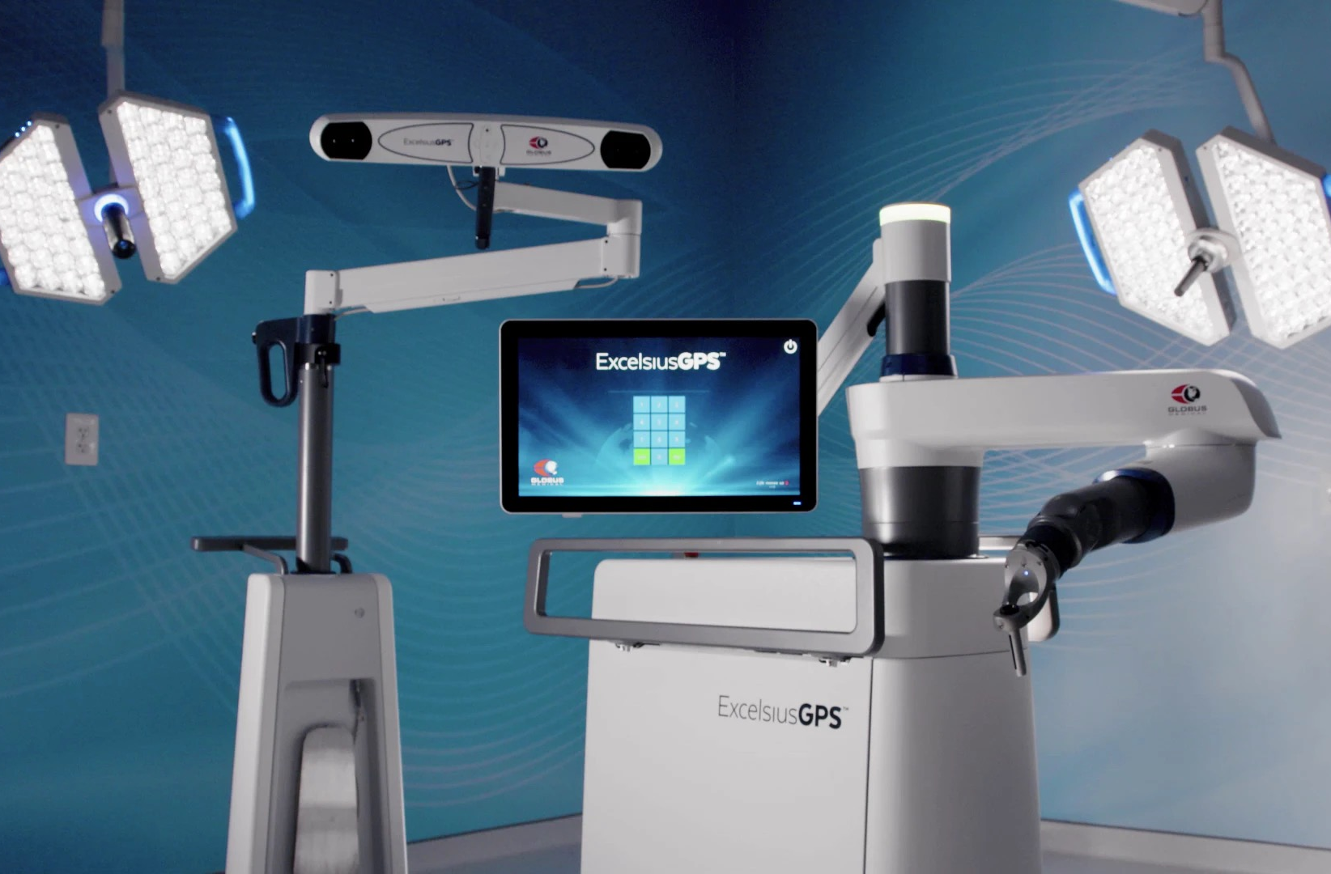
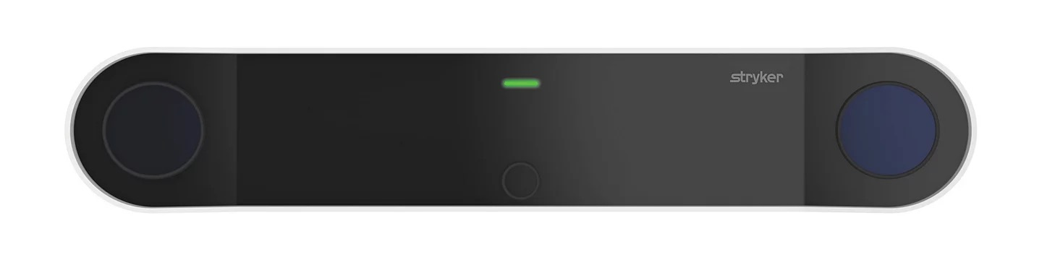
Competitor media and official demos
Images use PowerPoint-compatible JPEG files derived from official vendor page assets
Globus Medical
Stryker
Medtronic
ExcelsiusGPS official product page includes a Virtual Demo.
Q Guidance official product page and cranial guidance material.
StealthStation S8 official product page with navigation resources.
Video links remain external rather than embedded so the deck stays portable and opens reliably in desktop PowerPoint.
Project 2 | Manual vs. Navigation-Guided Neurosurgical Procedure Analysis
11
Notes:
Official assets: Globus header https://www.globusmedical.com/wp-content/themes/globus/images/posters/EGPS/EGPS-header-intro.webp; Stryker camera https://media-assets.stryker.com/is/image/stryker/front_20200414-1?$max_width_1440$; Stryker cranial components https://media-assets.stryker.com/is/image/stryker/Q-guidance-cranial-components?$max_width_1440$. Official product pages: Globus https://www.globusmedical.com/musculoskeletal-solutions/excelsiustechnology/excelsiusgps/; Stryker https://www.stryker.com/us/en/spine/products/q-guidance-system.html; Medtronic https://www.medtronic.com/en-us/healthcare-professionals/products/surgical-navigation-imaging/surgical-navigation-systems/stealthstation-s8-navigation-platform.html.

Slide 12
Findings for internal review
The review delivers the requested comparison, workflow, procedure coverage, and instrument taxonomy
What the review establishes
Scope coverage
Each reviewed platform describes a cranial navigation offering, though procedure coverage and terminology differ.
✓
Procedure types per system
Navigation adds planning, registration, tracking, and verification tasks to the operative workflow.
✓
Navigation workflow
✓
Navigated instruments and purpose
✓
Conventional instruments and purpose
Tracked components provide image-linked location information; conventional instruments remain essential for exposure, dissection, hemostasis, and closure.
✓
Manual versus guided comparison
✓
Accuracy limitations and safety checks
Accuracy requires continuous attention to registration, reference stability, tracking conditions, and intraoperative anatomic change.
✓
Official competitor media and sources
Scope coverage reflects requested Project 2 deliverables
Project 2 | Manual vs. Navigation-Guided Neurosurgical Procedure Analysis
12
Notes:
Summary slide. Details and source citations appear in the preceding slides and sources slide.

Slide 13
Sources and media credits
Official product information and media accessed October 2026
Medtronic
StealthStation S8 Navigation Platform
https://www.medtronic.com/en-us/healthcare-professionals/products/surgical-navigation-imaging/surgical-navigation-systems/stealthstation-s8-navigation-platform.html
Stryker
Q Guidance System
https://www.stryker.com/us/en/spine/products/q-guidance-system.html
Globus Medical
ExcelsiusGPS
https://www.globusmedical.com/musculoskeletal-solutions/excelsiustechnology/excelsiusgps/
Brainlab
Cranial Navigation
https://www.brainlab.com/surgery-products/overview-neurosurgery-products/cranial-navigation/
Medtronic
Neurosurgery imaging and navigation systems / brain-shift information
https://www.medtronic.com/se-sv/healthcare-professionals/products/neurological/surgical-navigation-imaging/neurosurgery-imaging-surgical-navigation/systems-software-instruments.html
Media asset URLs appear in the speaker notes for the slides that contain them. All vendor names and media remain the property of their respective owners.
Project 2 | Manual vs. Navigation-Guided Neurosurgical Procedure Analysis
13
Notes:
The slide lists all primary sources used in the deck. Image-specific direct asset URLs are included in notes for slides 4, 7, and 11.

