Slide 1
Head Detection using AdaBoost
By Matt Schmittle and Jake Papineau

Slide 2
Process
Capture candidates to run through Adaboost algorithm.
Use our training data to configure Adaboost with images containing heads and images without heads.
Create arbitrary thresholds for Adaboost to capture as many true positives as possible.
Apply our trained Adaboost algorithm to our candidates to classify them as heads or non-heads.

Slide 3
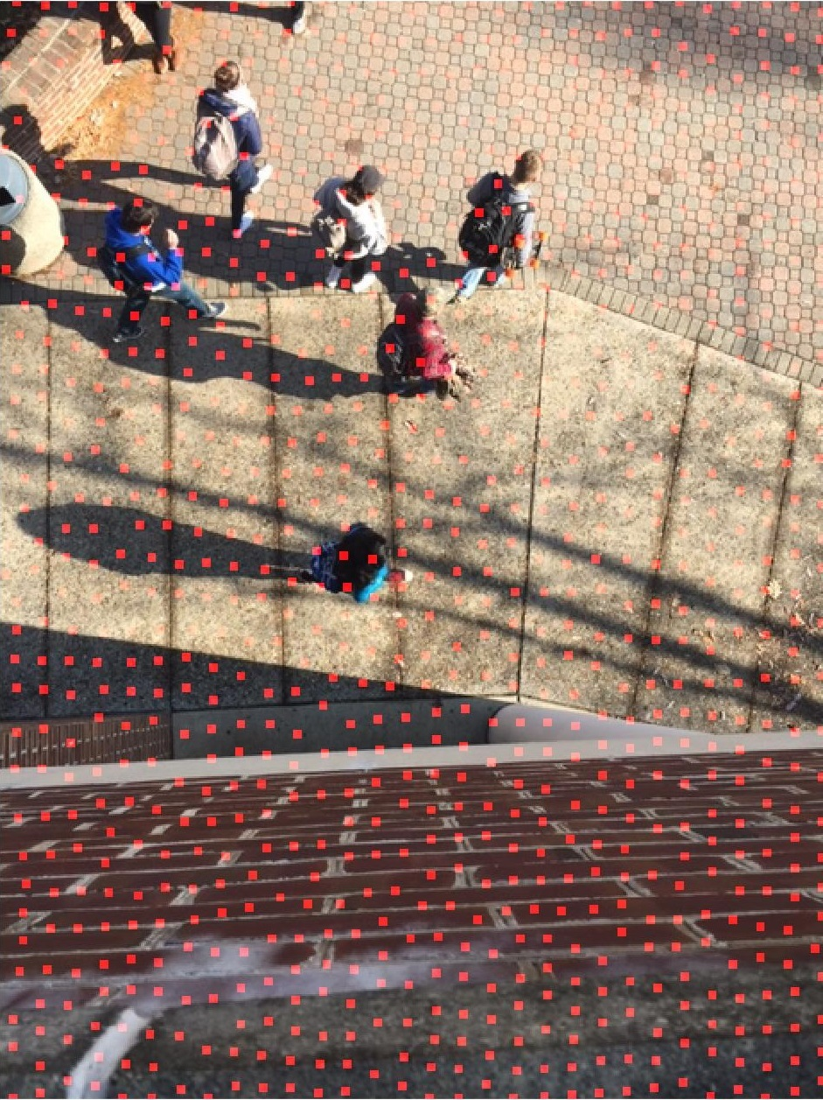
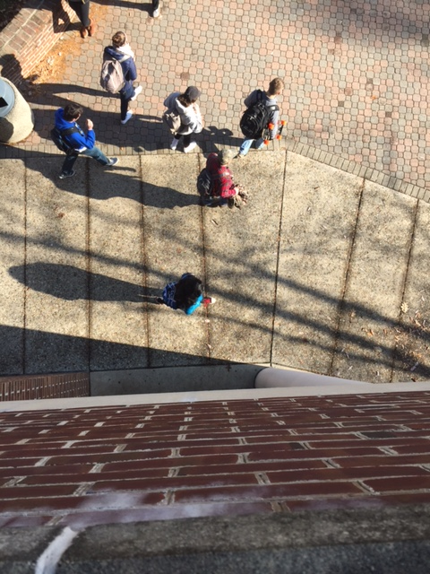
Candidate selection

Slide 4
The Adaboost Algorithm
Machine learning Classification algorithm
Combines many weak classifiers into an ensemble
Each classifiers impact is weighted based off correctness
Classifiers are created based off feature space results

Slide 5
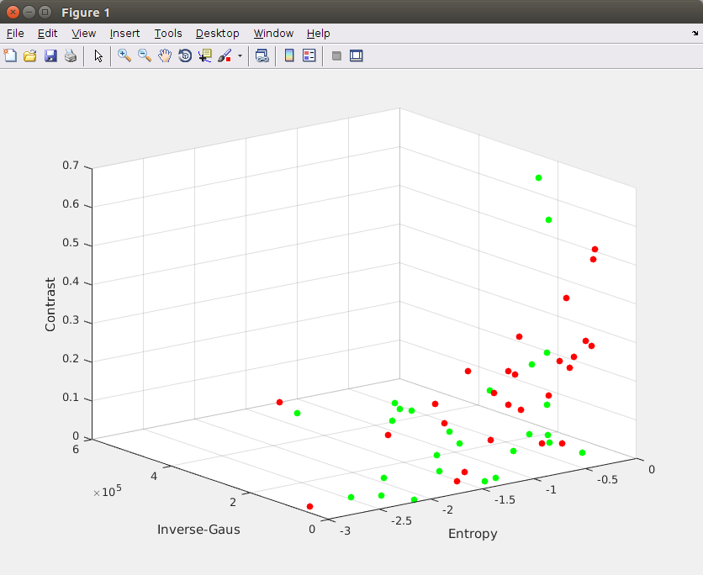
Feature Space

Slide 6
Attempted Features
SSD best and mean match to baseline head images
SSD match to Gaussian and inverse Gaussian
Attempted with various ways to simplify/filter image
Number of circles in image
Texture of center of image using Canny
Surf and Harris features
Entropy
Contrast

Slide 7
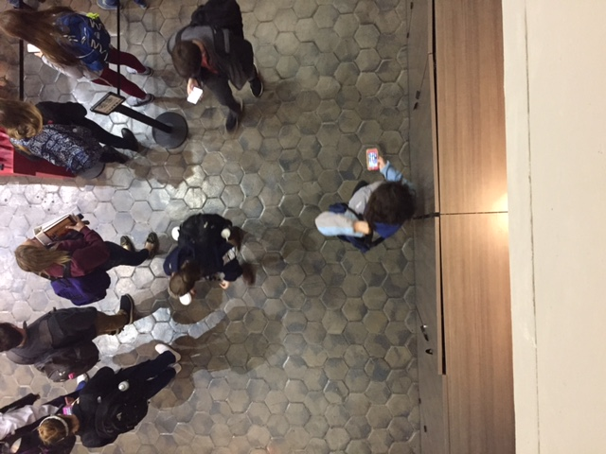
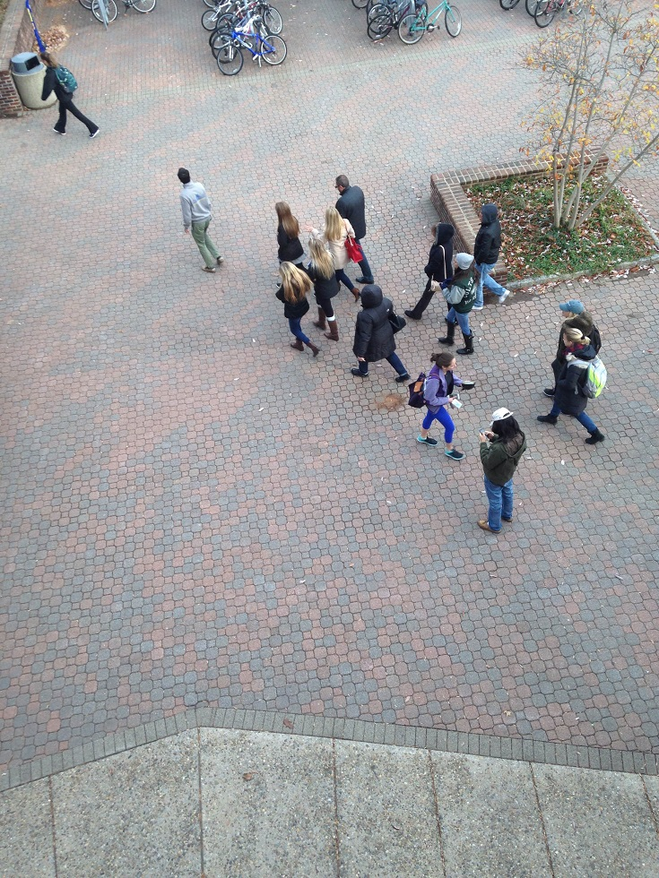

Results
Number of Heads:
461
Number of Heads:
494
Number of Heads:
455

Slide 8
Second Approach: FD Background Subtraction
- FDBS: Subtract each frame from previous
-last frame is the frame you wish to analyze
-performs better during camera motion
- 2xErosion: for segmentation, noise reduction
- Median filter: noise reduction
- Label connected components
- Fast

Slide 9

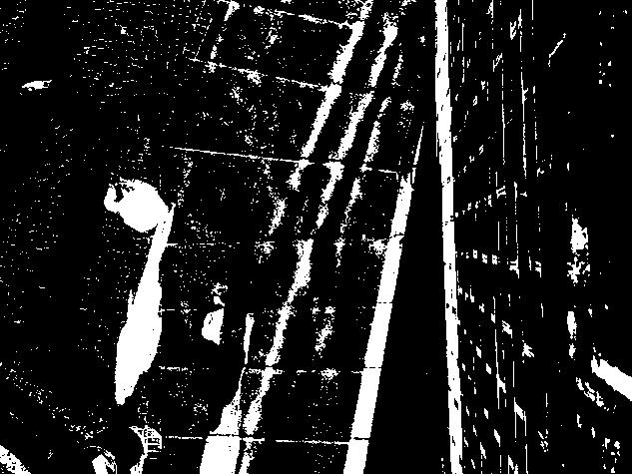

Second Approach: FD Background Subtraction

Slide 10
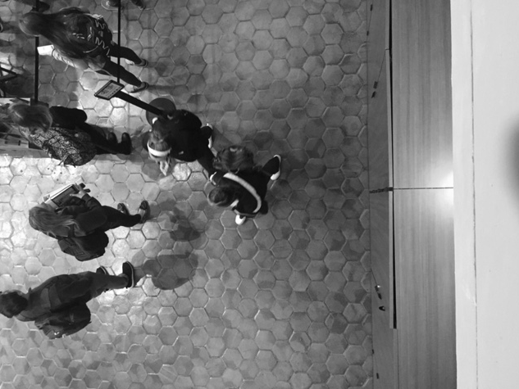
FD Background Subtraction Results
Number of Heads:
3
Number of Heads:
5
Number of Heads:
494

Slide 11
Conclusions
A strong feature space is required for Adaboost to work correctly
Tops of heads are a particularly difficult problem
Heads have different colors
Heads can be smooth or edge filled based on style
Head backgrounds can potentially be similar uniform colors
Background subtraction is still a superior approach.

Slide 12
Resources
https://www.microsoft.com/en-us/research/wp-content/uploads/2011/02/Alvaro_Soto.pdf
http://crcv.ucf.edu/projects/crowdCounting/index.php
https://www.youtube.com/watch?v=TPjmsha6gWY
https://www.ics.uci.edu/~dramanan/teaching/cs117_spring13/lec/bg.pdf
http://www.vanaheim-project.eu/assets/BalaSubburamanDescampsCarincotte-PETS-2012.pdf

