Slide 1
EPS Design Update

Slide 2
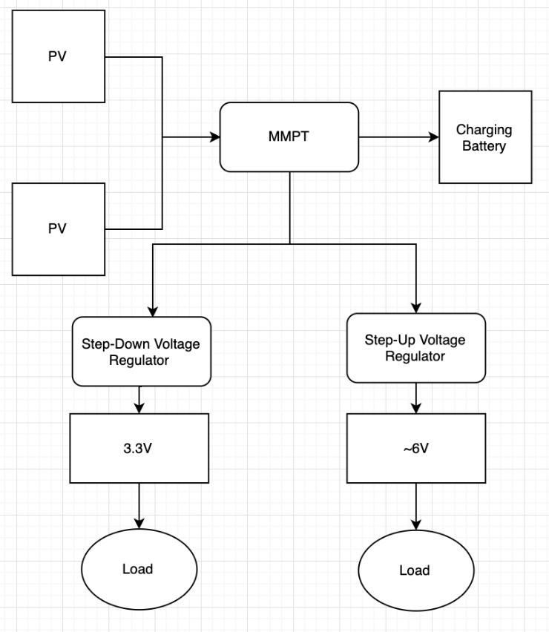
Schematic
Solar Panel on each side
MPPT Charge Controller
Battery
Step Down Voltage 3.3V
Step Up Voltage 5 (currently using 6)
Notes:
The design consists of six solar panels, mounted on each side of the cubesat. The each solar panel is connected to an MPPT charge controller that as the name suggest, control the charging process of the battery and prevents any overcharging. Then, Of course, comes the battery. All goes to the voltage regulators. We have step down voltage regulator of 3.3V and a Step Up regulator of 5V. Currently we’re using a 6V because we had that on hands. And now we have busses to connect our loads to. and two busses for the subsystems. These are the main components of the our system. Other components are current sensors that give us data of the status of the system, and protection components to prevent any overcurrent or overvoltage.

Slide 3
Solar Cells
panel on each side
Currently working on a 9V panel
Consumption?!
Notes:
The plan is to use six solar cells on each side of the cubesat. Currently working with a 9V panel as we didn’t want to wait for the one we want. Due to size constraints, we are still looking for the right solar panel. But this one have worked fine for us to at least verify the design.
Since we don’t have a power budget, we relied on other papers of cubesats to have a range we work according to. Then we’ll reach a narrow range according to input from our subsystems and calculations. But we have some references here, for example one cubesat have a minimum power of 5W and a max of 10W. It was a 1U cubesat.
We know now that the solar panel can’t be small than 6V.

Slide 4
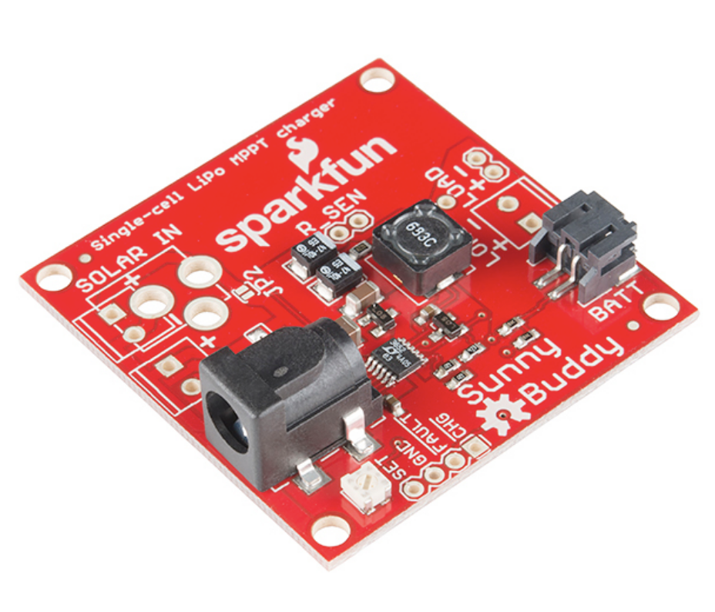
MPPT Charge Controller
Charges the battery
MPPT
Maximum power point tracking
Purpose: Help get the maximum power out of panels.
The Board: Sunny Buddy
Input voltage: 6-20V
What is the power path?

Slide 5
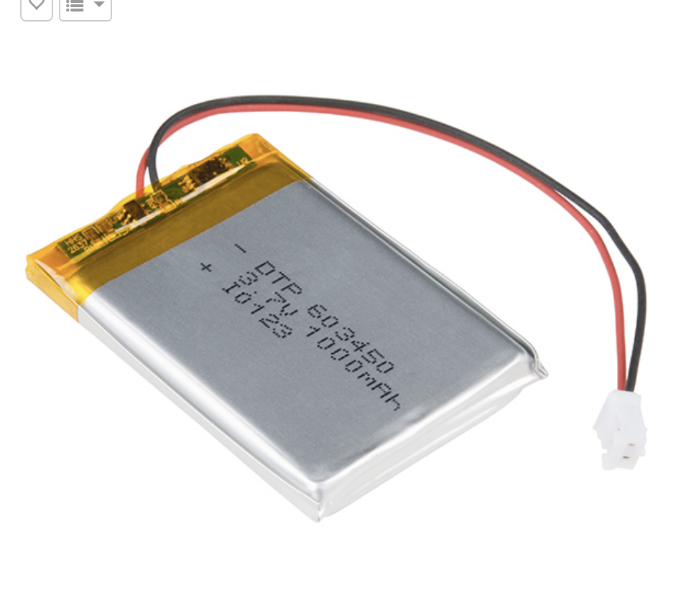
Batteries
3.7V
1100Ah
Might use 2000Ah instead of 1100Ah

Slide 6
Converters
Sensors
Two converters:
3.3V
5V
Now using 6V
Subsystems
After MPPT
Battery
Notes:
So we’re using two converters for now. One is 3.3V and the other is 5V. We didn’t have a 5V regulator before so we used a 6V regulator. Again, We wanted to verify the design. And It worked. The design was tested and it I believe we can build on it.
So the current sensors are positioned in several nodes in the system. There is one connected to each subsystem, and one connected to the input power. I say input power in general, because we are still deciding wether to connect it to the solar panel before the MPPT, or just connect it after the MPPT which is basically the power to be delivered to the rest of the system. I’m more leaning toward having it after the MPPT. Also, we’ll need one after the battery too.

