Slide 1
Income Prediction Analysis
CSCI 396 - Artificial Intelligence
Dr. Sherine Antoun
By Hector Ramirez

Slide 2
Introduction
- Predict income levels based on demographics & occupation
- Use Random Forest model for prediction
- Analyze factors affecting income prediction
- Assess potential model biases

Slide 3
Methodology
- Dataset: Adult Census Income dataset
- Data preprocessing: Remove missing values, binarize income
- Model: Random Forest Classifier (80% train, 20% test)
- Preprocessing: Standardization, One-hot encoding, Feature selection

Slide 4
Feature Importance Analysis
- Compute feature importance scores
- Generate correlation heatmap
- Key predictors: Education level, Capital gain, Work hours

Slide 5
Fairness Evaluation
- Train two models: Original & Bias-Reduced
- Original: Includes race, gender, and nationality
- Bias-Reduced: Excludes sensitive features
- Compare accuracy, precision, recall, F1-score

Slide 6
Results
- Education level: Highest correlation (0.34)
- Capital gain (0.22) & Work hours (0.23) important
- Race & nationality had negligible impact
- Bias-reduced model had similar accuracy to full model

Slide 7
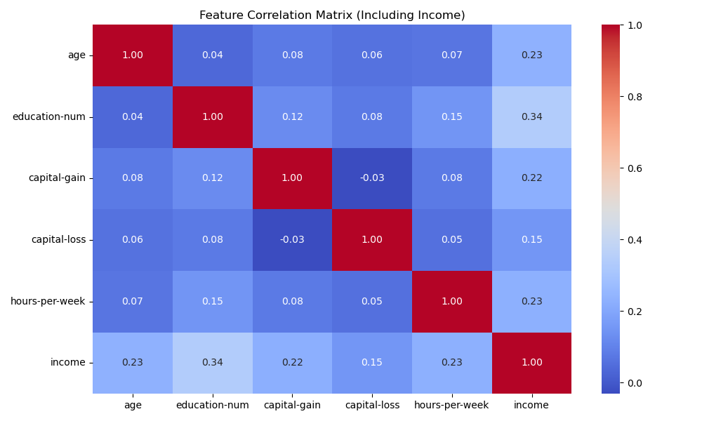
RESULTS (continued)

Slide 8
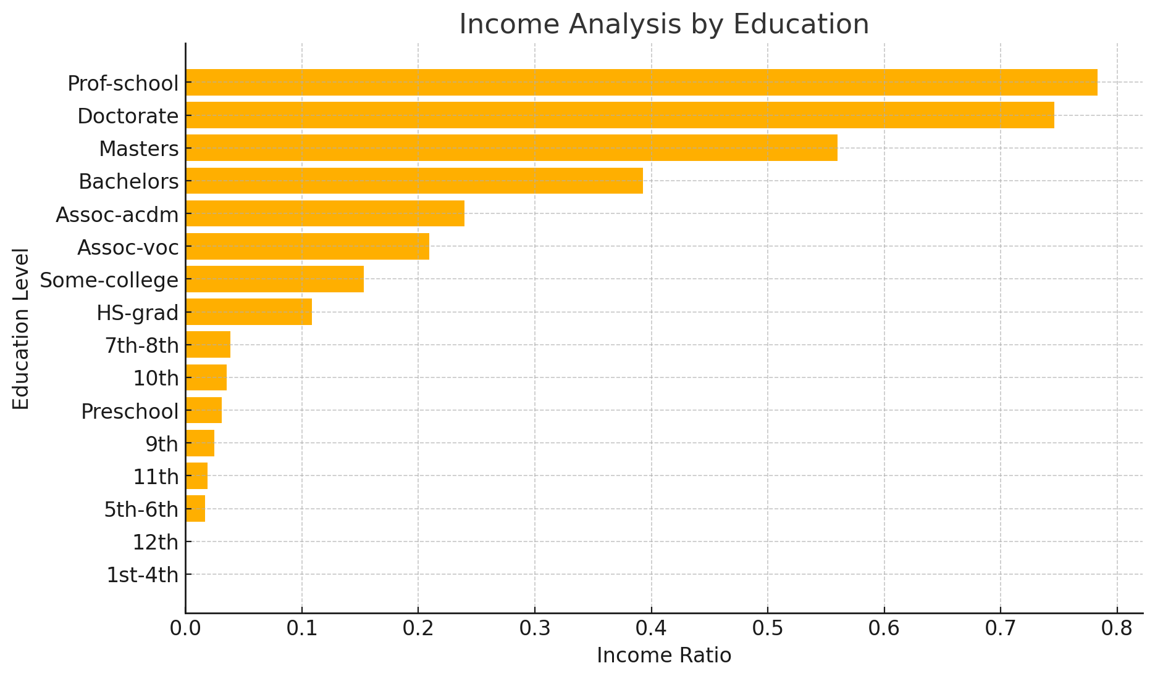
RESULTS (continued)

Slide 9
Model Performance Comparison
- Original Model Accuracy: 84.54%
- Bias-Reduced Model Accuracy: 84.34%
- Minor accuracy drop suggests race/gender/nationality not critical

Slide 10
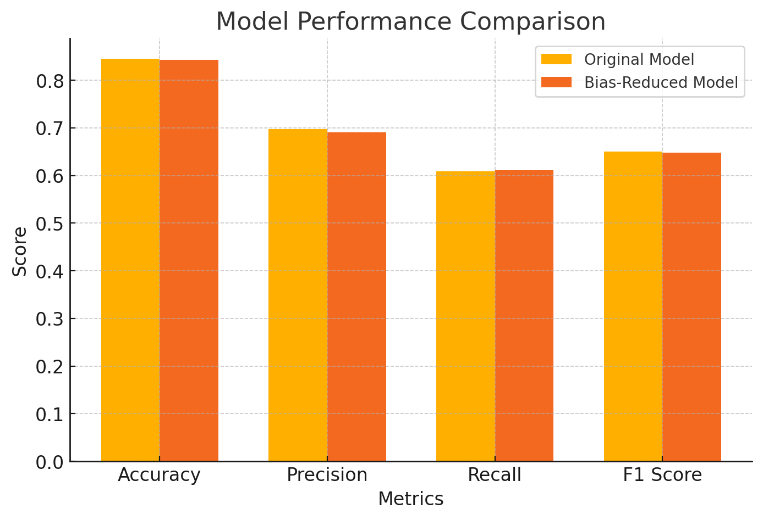
Model Performance Comparison (continued)

Slide 11
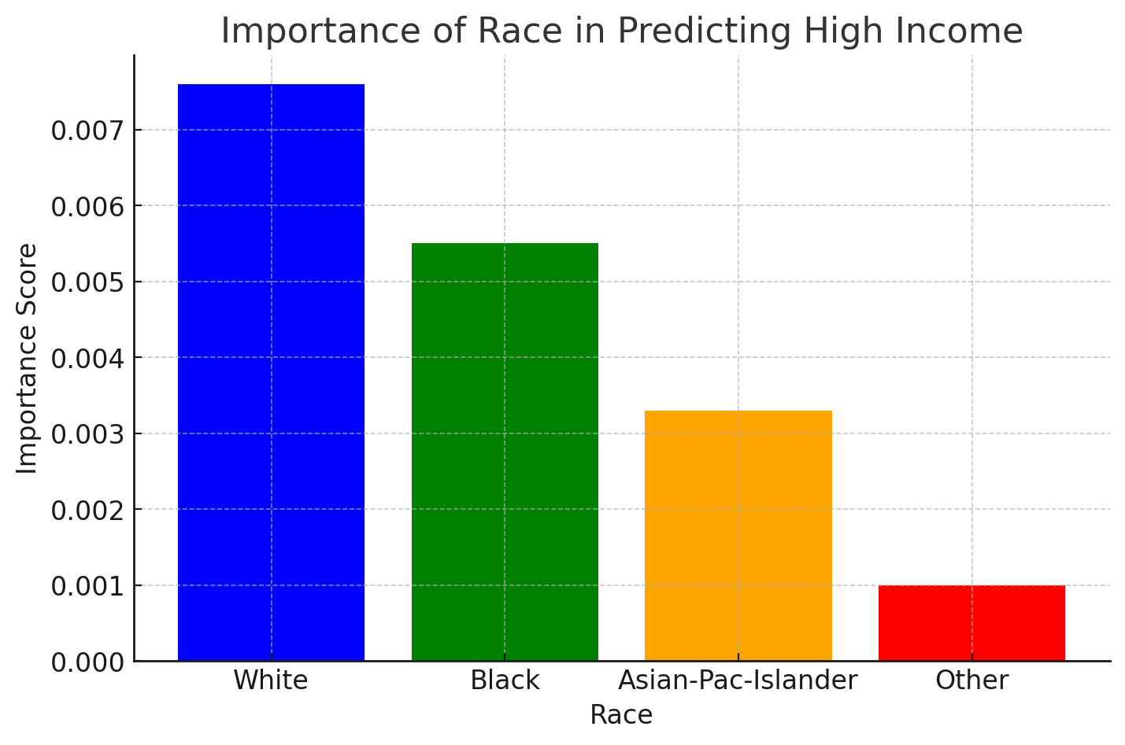
Model Performance Comparison (continued)

Slide 12
Fairness Analysis
- Race: Minimal effect (highest importance: 0.0076)
- Native Country: Low importance (0.0082)
- Occupation: Strongest predictor

Slide 13
Ethical Considerations
- Bias Mitigation: Remove race/gender/nationality
- Transparency: Justifiable decisions using interpretable features
- Societal impact: Supports education policies for income improvement

Slide 14
Conclusion
- Education & Occupation key predictors
- Bias-reduced model performs similarly to original
- Future work: Improve recall, refine features, use Explainable AI

