Slide 1
Python Scipy.Stats
2017/04/20
Mooyoung Lee

Slide 2
Statistical functions (scipy.stats)
A complete function list can be found from below.
<https://docs.scipy.org/doc/scipy-0.19.0/reference/stats.html#module-scipy.stats>

Slide 3
How to install/load
To install via pip on Mac or Linux, first upgrade pip to the latest version:
>>> python -m pip install --upgrade pip
To load packages/functions
>>> from scipy import stats
>>> from scipy.stats import norm
>>> from scipy.stats.stats import pearsonr

Slide 4
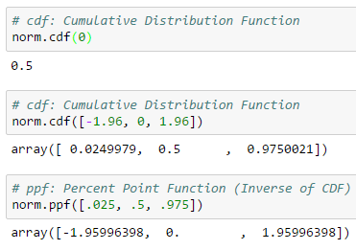
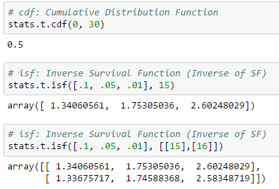
Critical value vs. Probability

Slide 5
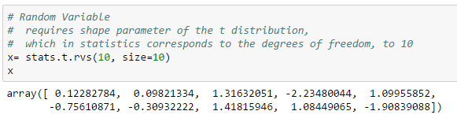
Random sample generation

Slide 6
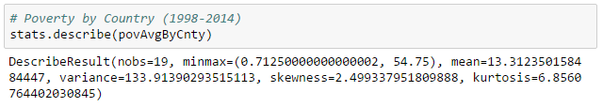

One sample t-test
Data source: "http://povertydata.worldbank.org" data

Slide 7
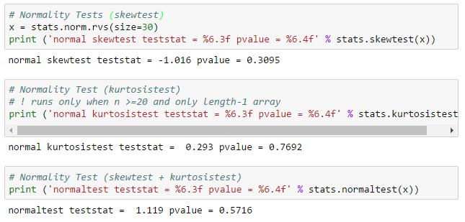
Normality Tests

Slide 8
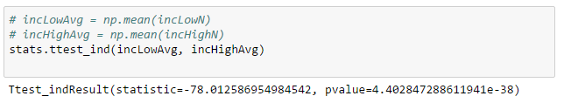
Two sample t-test

Slide 9
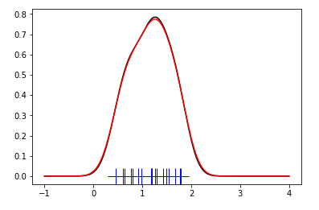
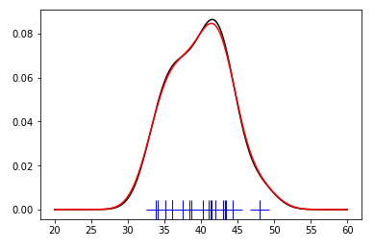
Kernel Density Estimation
Income Share Bottom 10%
Income Share Top 10%
kde1 = stats.gaussian_kde(x1, bw_method=‘scott’)
kde2 = stats.gaussian_kde(x1, bw_method='silverman')

Slide 10
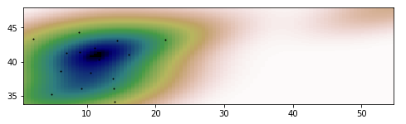

Multivariate Estimation
Income Share Top 10%
Poverty Rate, percent

