Slide 1
Capacitance Measurement
Electronic Measurements and Instrumentation -- EE3400

Slide 2
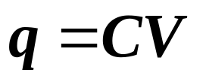
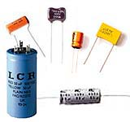
Capacitance
Is a measure of the stored electric charge between two objects in an electric field
Where C is the capacitance of the capacitor, q is the amount of stored charge and V is the potential across the capacitor
A capacitor consists of two conducting electrodes which are insulated from each other by a dielectric. It stores charge
The capacitance of a conductor depends on its physical geometry and its dielectric properties
It is measured in Farads. Large unit hence microfarad or picofarad mostly used
Electronic Measurements and Instrumentation -- EE3400

Slide 3
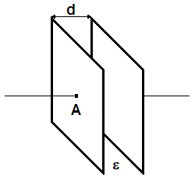
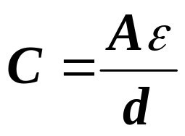
Capacitors
One common example of a capacitor arrangement is the parallel-plate capacitor
It consists of two parallel electrodes separated by some form of dielectric medium
The capacitance of this arrangement is:
This relationship does not take into account fringing effects at the edges of the capacitor
Where:
A is the area of one plate,
d is the distance between them
ε is the permittivity of the dielectric material between them
Electronic Measurements and Instrumentation -- EE3400

Slide 4
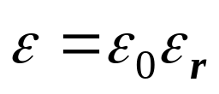
Permittivity
Describes how an electric current effects a dielectric
It gives and indication of how easily a material polarizes in the presence of an electric potential
It is defined in terms of the permittivity of free space ε₀ and a relative permittivity of a material ε_{r}
ε₀ is 8.85 x 10⁻¹² F/m
Electronic Measurements and Instrumentation -- EE3400

Slide 5
Approximate Values of Permittivity for Common Dielectrics
Vacuum 1
Air 1.0006
Water ~78
Paper ~2.5
Plastics, Oils and Alcohols ~2-6
Glass ~7.5
Ferroelectric Ceramics ~7500
Permittivity is dependant on temperature and compositional variations, which provides a useful basis for some sensors
Electronic Measurements and Instrumentation -- EE3400

Slide 6
Capacitance Measurements
We can capacitively measure any variable that causes a change in A, d or ε
Variations in A or d and be measured:
  Linearly
  Angularly
Variations in ε result from a change in the composition between the plates, which could also be temperature dependant
Electronic Measurements and Instrumentation -- EE3400

Slide 7
Where Can We Use Capacitance?
Linear or Angular Motion:
  Temperature
  Strain
  Size
  Proximity
  Force
  Acceleration
  Vibration → Sound Level
  Pressure
Compositional Variation:
  Depth
  Moisture Content
  Continuity
  Phase Composition
Electronic Measurements and Instrumentation -- EE3400

Slide 8
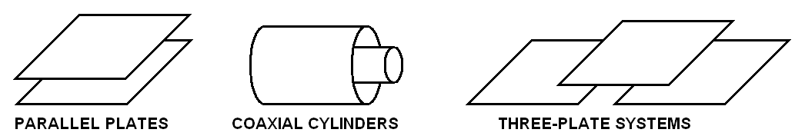
Sensor Arrangements
We try to make all capacitance measurements differential in order to null out variations in the variable we are trying to measure
Arrangements include:
Electronic Measurements and Instrumentation -- EE3400

Slide 9
Factors to Consider When Measuring Capacitance
There are many different ways of measuring capacitance. The method used will depend on a number of aspects:
Is a differential plate arrangement possible?
Are both capacitor plates available to the circuit, or must one be grounded?
Is the capacitance large with respect to stray capacitance?
What is the bandwidth of measurement?
What type of output is desired?
Must the circuit work automatically, or can it be manually adjusted?
Electronic Measurements and Instrumentation -- EE3400

Slide 10
Circuits for Measuring Capacitance
The circuits we use fall into four basic categories:
  Bridge Types
  Resonance Systems
  Oscillator Systems
  Charge Pumps
Electronic Measurements and Instrumentation -- EE3400

Slide 11
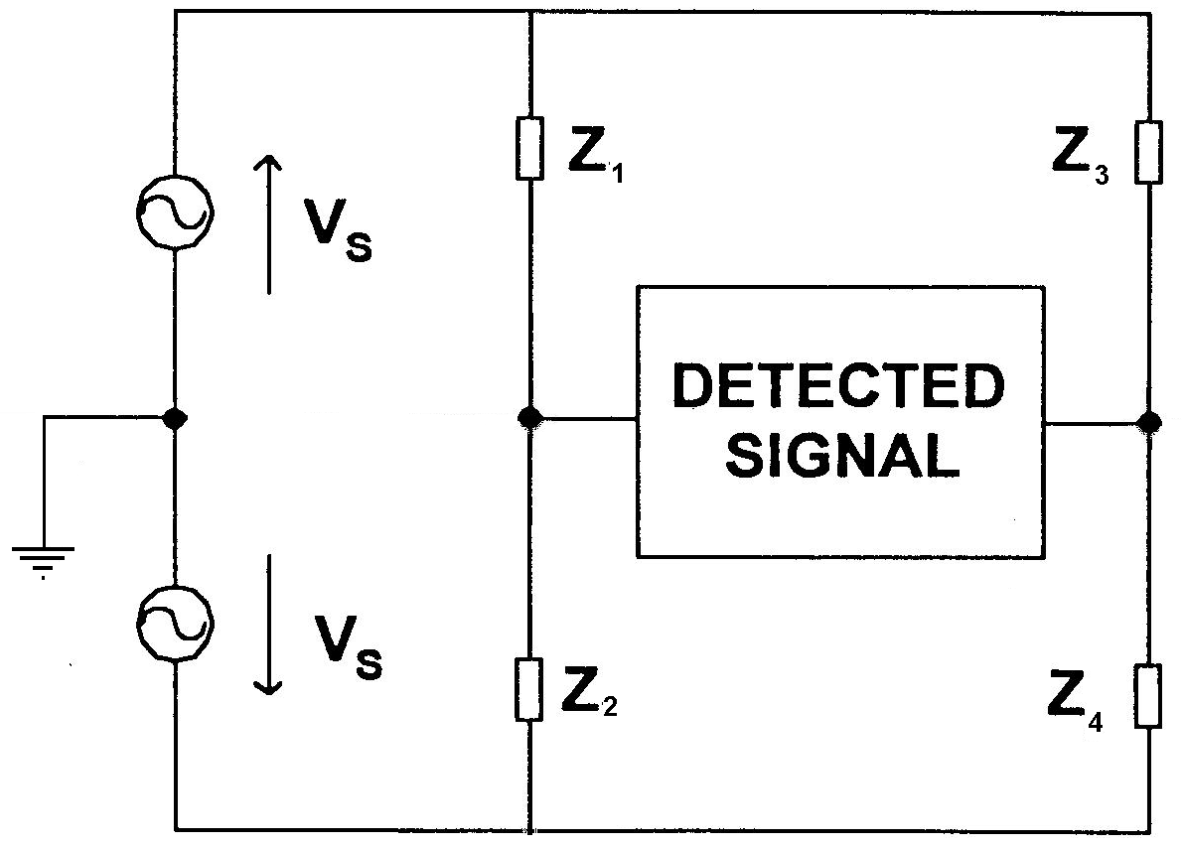
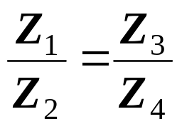
Bridge Circuits
Used traditionally in systems with differential electrode arrangements
Considered to be most accurate but require both capacitor plates to be accessible
If all ratio of impedances is the same size and the voltage sources are the same then the net current flow in the detected signal loop is zero
If all impedances are the same size then no voltage will be developed across the signal detector
If one of the impedances is different then a voltage will be developed
Electronic Measurements and Instrumentation -- EE3400

Slide 12
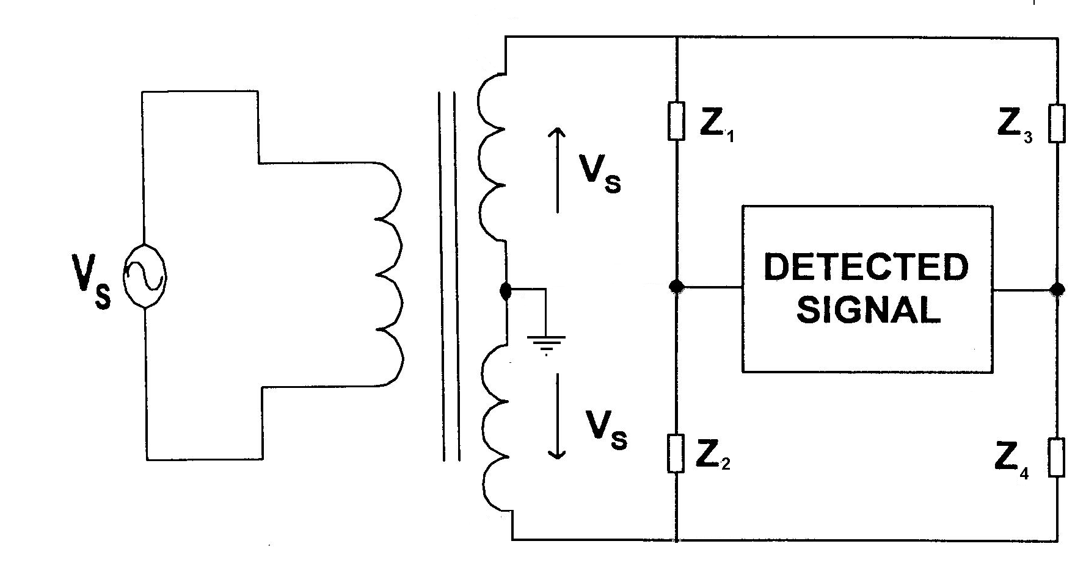
Bridge Circuits
Each voltage source must be as well matched as possible
This is usually implemented with a bifilar-wound transformer
This arrangement works well up to the limits of the transformer which is between 30kHz – 100kHz
Electronic Measurements and Instrumentation -- EE3400

Slide 13
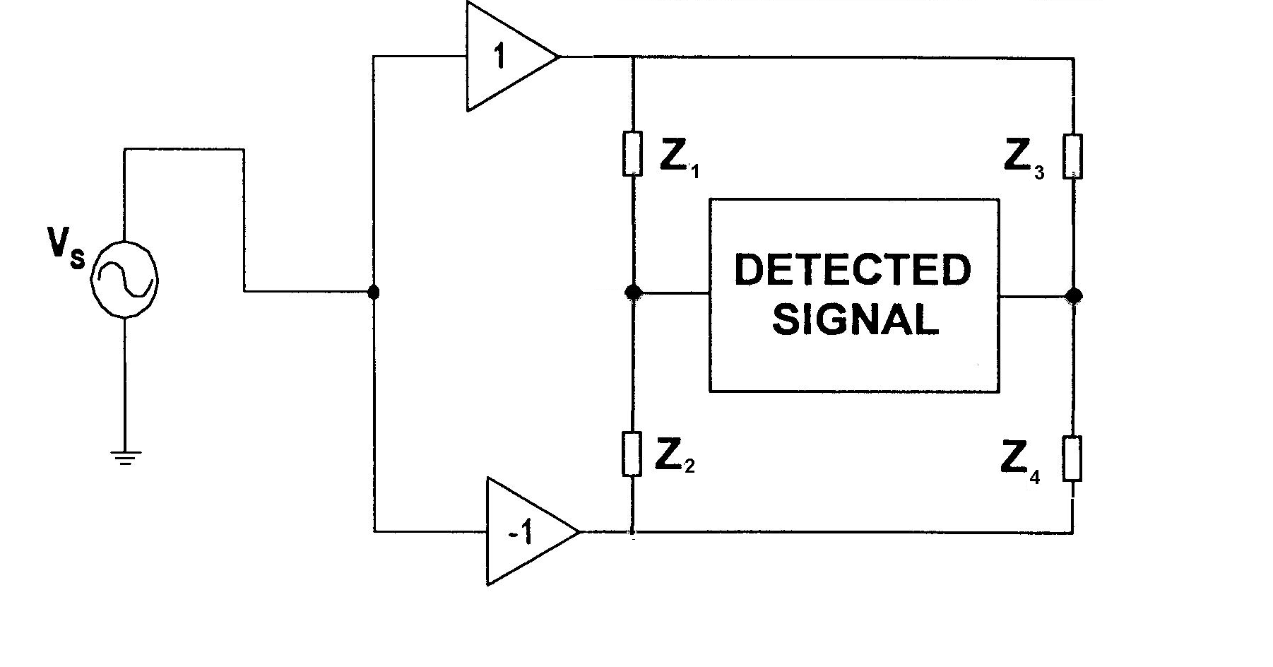
Bridge Circuits
The transformer can be replaced with power amplifiers
Electronic Measurements and Instrumentation -- EE3400

Slide 14
Bridge Circuits
The detected signal is most easily measured as a voltage
This has several problems :
  The relationship between voltage and capacitance is non-linear
  The system is not stray immune
  The measurement is degraded if the dielectric is lossy (it dissipates more energy than it should)
Electronic Measurements and Instrumentation -- EE3400

Slide 15
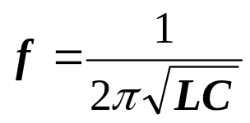
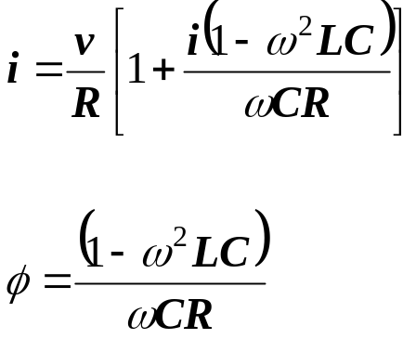
Resonance Methods
Resonance methods work by putting an unknown capacitance in series or parallel with an inductor, so that they form a resonant circuit
The resonant frequency for a series RLC circuit is:
Shifts in the resonant peak can be detected in terms of the resonant frequency, where the amplitude of the current or the phase is:
Electronic Measurements and Instrumentation -- EE3400

Slide 16
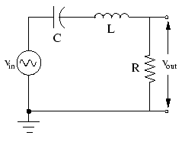
Resonance Methods
Advantages include allowing one plate of the capacitor to be grounded and they are very sensitive for detecting shifts in capacitance rather than absolute values of capacitance
Disadvantages are that they require careful set up in order to avoid stray capacitance and are not normally automatically adjustable
Electronic Measurements and Instrumentation -- EE3400

Slide 17
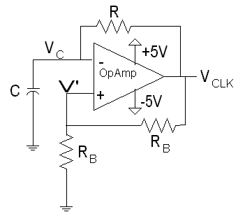
Oscillator Methods
Use a capacitor as one of the timing elements in an oscillator circuit (Relaxation Oscillator)
This means a change in capacitance will alter the timing constant of the circuit and therefore the period of the output
Advantages are that they are simple, automatically adjusting and have a directly accessible output
Disadvantages are that they are not immune to stray capacitance and are therefore not accurate at very small capacitance values
Electronic Measurements and Instrumentation -- EE3400

Slide 18
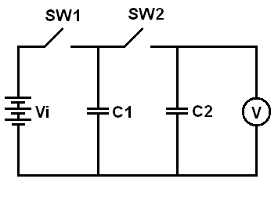
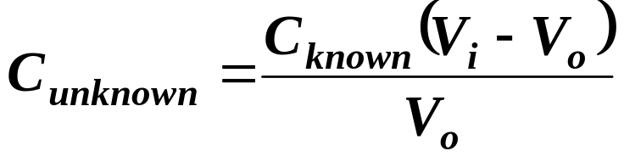
Charge Pump Techniques
They are becoming a more common capacitive measurement
The make use of the principle of comparing a known capacitance to an unknown one by means of charge transfer
They have the advantage of being stray-immune, automatic and are reasonably good at measuring low values of capacitance
They give good accuracy in measuring absolute capacitance
Electronic Measurements and Instrumentation -- EE3400

