Slide 1
Capacitors; Inductors; Dependent Sources; KVL
Notes:
Dr. Holbert
F06-Lect2
EEE 202

Slide 2
Energy Storage Elements
Capacitors store energy in an electric field
Inductors store energy in a magnetic field
Capacitors and inductors are passive elements:
  Can store energy supplied by circuit
  Can return stored energy to circuit
  Cannot supply more energy to circuit than is stored

Slide 3
Capacitance
Capacitance occurs when two conductors (plates) are separated by a dielectric (insulator)
Charge on the two conductors creates an electric field that stores energy
+ + + + + + + +
– – – – – – – – – –

Slide 4
Capacitance
The voltage difference between the two conductors is proportional to the charge:
q = C v (charge and voltage are linearly related), therefore
i = dq/dt = C dv/dt
The proportionality constant C is called capacitance.
  Units of Farads (F) = Coulomb/Volt
  For two parallel plates: C = ε₀ A / d
Since q=Cv, the plate charge increases as the voltage increases. The electric field intensity between two plates increases.

Slide 5
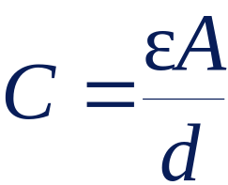
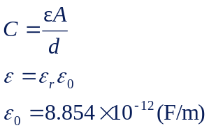
3 factors affecting the value of capacitance:
Area: the larger the area, the greater the capacitance.
Spacing between the plates: the smaller the spacing, the greater the capacitance.
Material permittivity: the higher the permittivity, the greater the capacitance.
Why Are Capacitors Important?
The capacitor is a widely used electrical component. It has several features that make it useful and important:
Can store energy, so capacitors are often found in power supplies.
Has a voltage that is proportional to the charge (the integral of the current) that is stored in the capacitor, so a capacitor can be used to perform interesting computations in op-amp circuits, for example.
Circuits with capacitors exhibit frequency-dependent behavior so that circuits that amplify certain frequencies selectively can be built.

Slide 6
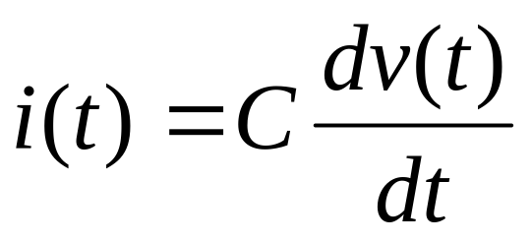
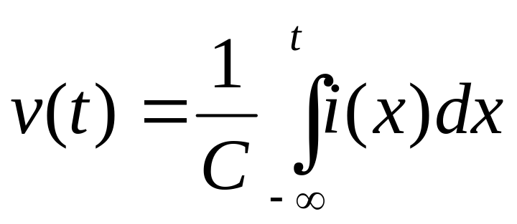
Capacitor
The
rest
of
the
circuit
+
i(t)
v(t)
–
The charge on a capacitor is an integration of current through the capacitor. Hence, the memory effect counts

Slide 7
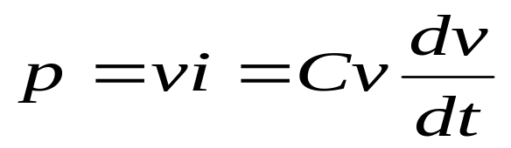
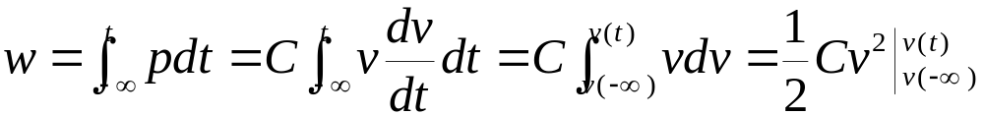
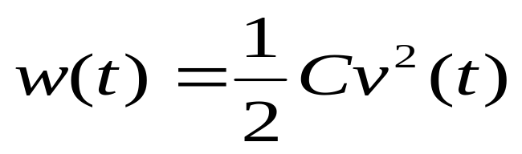

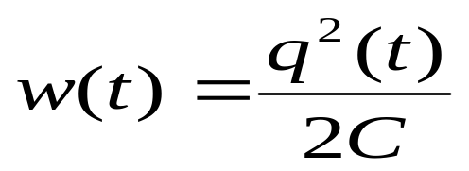
Energy Storing in Capacitor
+
i
v
C
-

Slide 8
Inductance
Inductance occurs when current flows through a (real) conductor
The current flowing through the conductor sets up a magnetic field that is proportional to the current: Φ ∝ I
The voltage difference across the conductor is proportional to the rate of change of the magnetic field: V ∝ dΦ/dt

Slide 9
Inductance
The voltage difference across the inductor is proportional to the rate of change of the current: V ∝ dΦ/dt ∝ dI/dt
The proportionality constant is called the inductance, denoted L, such that
V = L di/dt
Units of Henrys (H) = V·s/A

Slide 10
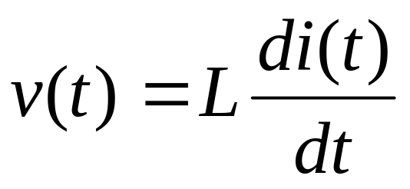
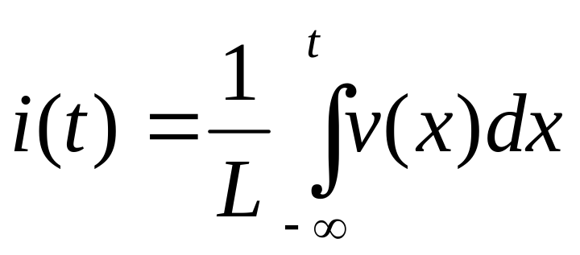
Inductor
i(t)
The
rest
of
the
circuit
+
H
v(t)
–

Slide 11
Independent vs. Dependent Sources
An independent source (voltage or current) may be DC (constant) or time-varying, but does not depend on other voltages or currents in the circuit
The dependent source magnitude is a function of another voltage or current in the circuit
+
–

Slide 12
Dependent Voltage Sources
+
–
6V_{x}
+
–
6000I_{x}
Voltage-Controlled Voltage Source (VCVS)
Current-Controlled Voltage Source (CCVS)

Slide 13
Dependent Current Sources
0.006V_{x}
6I_{x}
Voltage-Controlled Current Source (VCCS)
Current-Controlled Current Source (CCCS)

Slide 14
Kirchhoff’s Laws
Kirchhoff’s Current Law (KCL)
  sum of all currents entering a node is zero
  sum of currents entering node is equal to sum of currents leaving node
Kirchhoff’s Voltage Law (KVL)
  sum of voltages around any loop in a circuit is zero

Slide 15
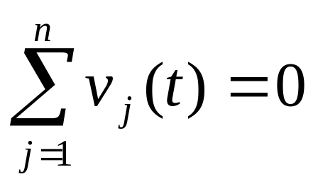
KVL (Kirchhoff’s Voltage Law)
+
–
v₂(t)
+
+
–
v₁(t)
v₃(t)
–
The sum of voltages around a loop is zero:
Analogy: pressure drop through pipe loop

Slide 16
KVL Polarity
A loop is any closed path through a circuit in which no node is encountered more than once
Voltage Polarity Convention
  A voltage encountered + to – is positive
  A voltage encountered – to + is negative

Slide 17
Electrical Analogies (Physical)
 | Electrical | Hydraulic
Base quantity | Charge (q) | Mass (m)
Flow variable | Current (I) | Fluid flow (G)
Potential variable | Voltage (V) | Pressure (p)
Power | P = I V | P = G p
Junction/Node Law | KCL: Σ I = 0 | Σ G = 0
Loop Law | KVL: Σ V = 0 | Σ Δp = 0

