Slide 1
Instrumentation Amplifiers
Electronic Measurements and Instrumentation – EE3400

Slide 2
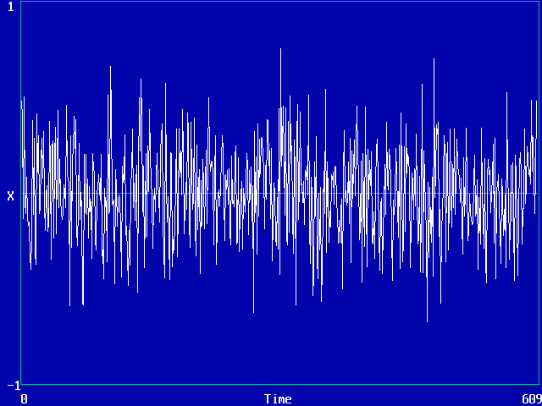
Sensor Signals
Most signals from sensors are:
  Small (~mV)
  Contain unwanted common mode signals which include:
    Noise
    DC Offsets
    Unwanted frequency components
Electronic Measurements and Instrumentation – EE3400

Slide 3
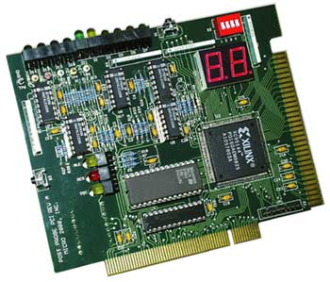
Signal Interfacing
When interfacing a signal to an analogue to digital converter it is important to remember the following:
  Buffering
  Amplification
  Filtering
Electronic Measurements and Instrumentation – EE3400

Slide 4
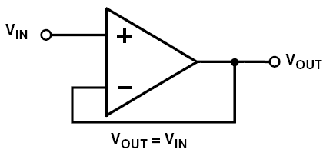
Buffers
Has high input impedance
Output voltage follows input voltage
Provides some form of isolation between sensor and following circuit
Typical buffers include:
  Voltage Followers
  Non-inverting Amplifiers
Electronic Measurements and Instrumentation – EE3400

Slide 5
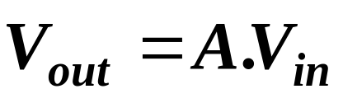
Amplification
As sensor signals are very small they often need to be amplified
The signal is multiplied by a gain factor (A)
Electronic Measurements and Instrumentation – EE3400

Slide 6
Filtering
Necessary to filter signal to ensure that is:
  Nyquist Criterion is satisfied
  Improve Signal to noise Ratio by reducing noise frequencies
  Filter out unwanted frequency components such as 50Hz from mains
Electronic Measurements and Instrumentation – EE3400

Slide 7
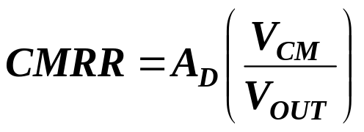

Common – Mode Rejection (CMR)
A common mode signal is a signal which appears at both inputs of a device
CMR is the property of a device which cancels out any signals that are common between both inputs while amplifying signals that are differential between both inputs
The common mode rejection ratio is the ratio of the differential gain (A_{D}) to the common-mode gain
From this we can define the common mode rejection as
Electronic Measurements and Instrumentation – EE3400

Slide 8
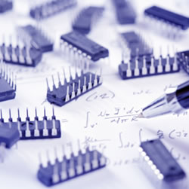
Instrumentation Amplifier
A very common and useful concept in instrumentation design
It amplifies differential signals while rejecting common-mode signals
It can be made using discrete op amps or available as a monolithic chip
It is a closed loop gain block that has differential inputs and a single output
Electronic Measurements and Instrumentation – EE3400

Slide 9
Properties of In Amps
High AC and DC Common-Mode rejection
Low offset voltage and offset voltage drift
Matched, high input impedance (~10⁹ Ω)
Low input bias current (1nA - 50nA)
Low noise
Low non linearity
Simple gain selection
Good bandwidth
Rail to rail output voltage swing
Electronic Measurements and Instrumentation – EE3400

Slide 10
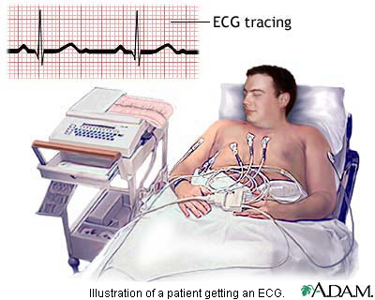
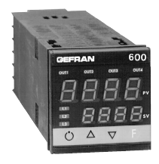
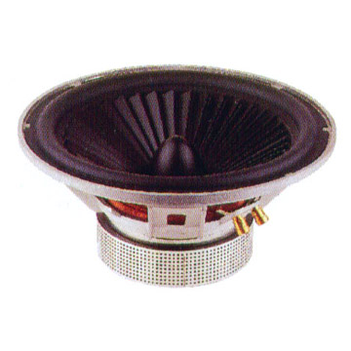
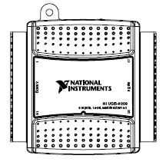
Uses of In Amps
Data acquisition
Medical instrumentation
Monitor and control electronics
Signal conditioning
Audio applications
Video applications
Electronic Measurements and Instrumentation – EE3400

Slide 11
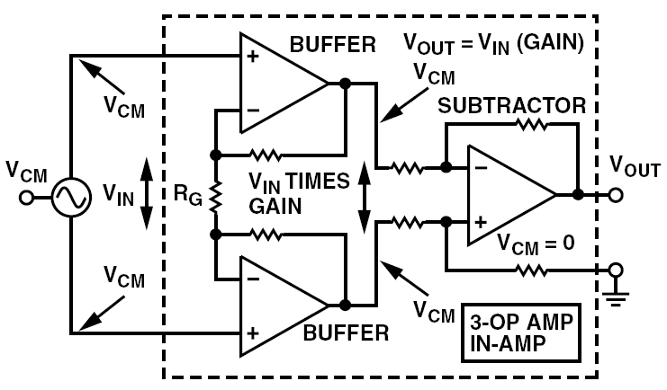
Instrumentation Amplifier Diagram
Taken from Kitchin, C. & Counts, L. (2006)
Electronic Measurements and Instrumentation – EE3400

Slide 12
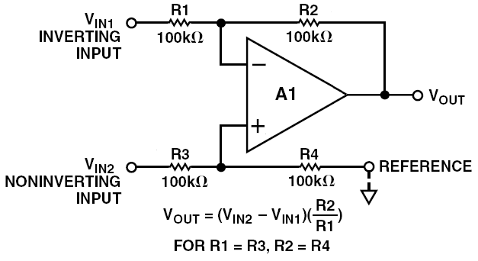
Subtractor
Adapted from Kitchin, C. & Counts, L.
(2006)
It amplifies differential signals while rejecting common-mode signals
Problems include unmatched input resistances
Electronic Measurements and Instrumentation – EE3400

Slide 13
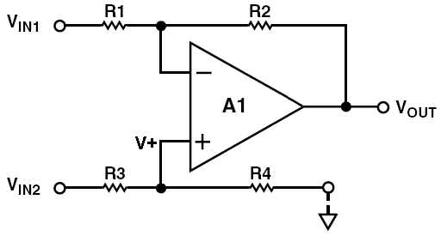
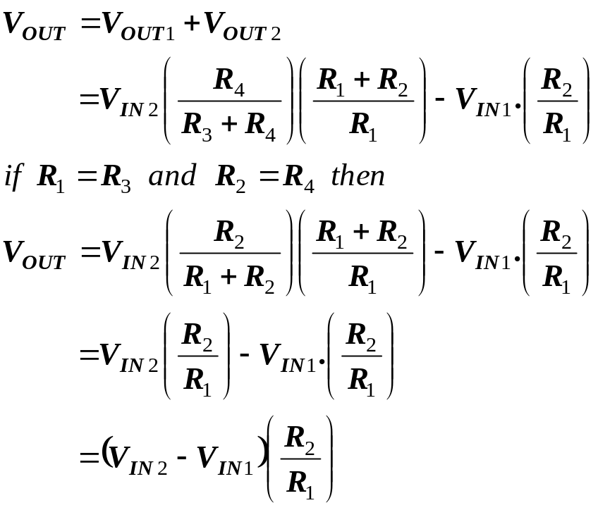
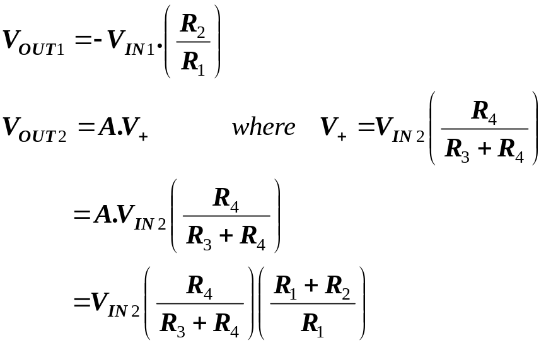
Subtractor Proof
Electronic Measurements and Instrumentation – EE3400

Slide 14
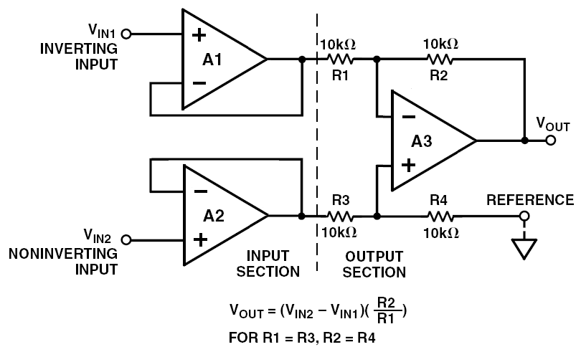
3 Op Amp In Amp with Buffering
Adapted from Kitchin, C. & Counts, L. (2006)
Electronic Measurements and Instrumentation – EE3400

Slide 15
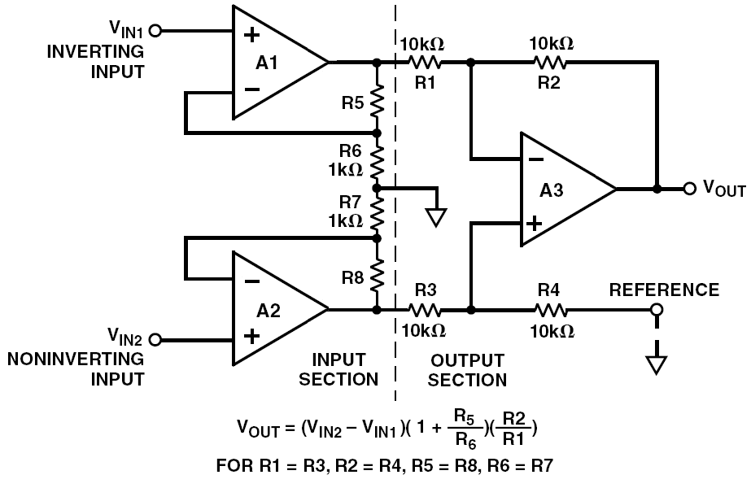
3 Op Amp In Amp with Gain
Adapted from Kitchin, C. & Counts, L. (2006)
Electronic Measurements and Instrumentation – EE3400

Slide 16
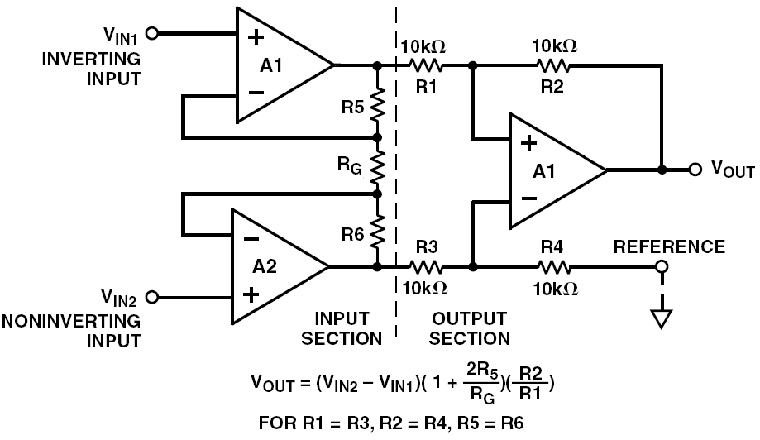
Classic 3-Op Amp In Amp
Electronic Measurements and Instrumentation – EE3400

Slide 17
Points to Remember
3 opamp in-amps can be built out of:
  Bipolar input opamps
  FET input opamps
FET input opamps have:
  Low bias currents
  Lower CMR, higher offset voltage and offset drift than Bipolar input opamps
Good precision opamps often work well (OP07)
Electronic Measurements and Instrumentation – EE3400

