Slide 1
Instrumentation Filters
Electronic Measurements and Instrumentation -- EE3400

Slide 2
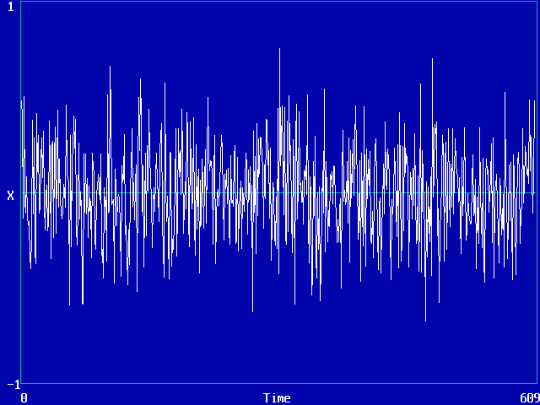
Analogue Filters
Described by their pass band
Filter's pass band is the range of frequencies over which it will pass an incoming signal
Signal frequencies lying outside the pass band are attenuated
Electronic Measurements and Instrumentation -- EE3400

Slide 3

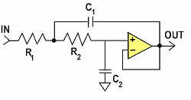
Types of Filters
Passive Filters
  Do not contain amplifying devices to strengthen the signal
  the output signal has a smaller amplitude than its corresponding input signal
  Does not need power
Active Filters
  contain amplifying devices to increase signal strength
  Need to be powered to work
Electronic Measurements and Instrumentation -- EE3400

Slide 4
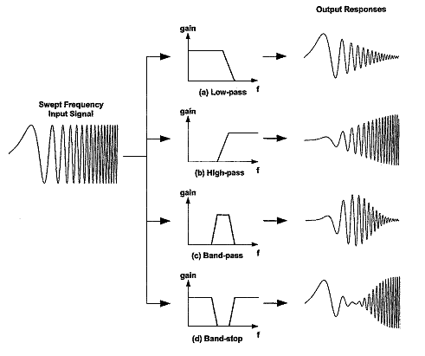
Filters classification
Low-pass filters
  pass low-frequency signals while blocking high-frequency signals
  The pass band ranges from DC (0 Hz) to a corner frequency F_{C}
High-pass filters
  pass high-frequency signals while blocking DC and low-frequency signals
  The pass band ranges from a corner frequency (F_{C}) to infinity
Electronic Measurements and Instrumentation -- EE3400

Slide 5
Filters classification(Cont…)
Band-pass filter
  pass only signals between two given frequencies, blocking lower and higher
  The pass band lies between two frequencies, F_{L} and F_{H}. Signals between DC and F_{L} are blocked, as are signals from F_{H} to infinity
Band-stop filters
  Also known a notch filters
  block signals occurring between two given frequencies, F_{L} and F_{H}
Electronic Measurements and Instrumentation -- EE3400

Slide 6
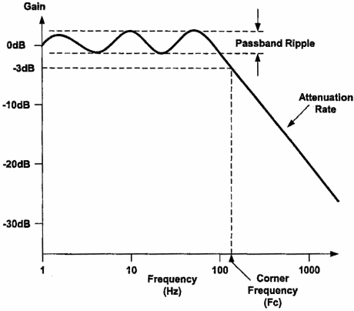
Bode Plots
Mostly used to plot filter response
describe the behavior of a filter by relating the magnitude of the filter's response (gain) to its frequency
The decibels of gain of a filter relate to the ratio between input and output voltages:
The horizontal axis represents frequency, measured in hertz (Hz), and the vertical axis is measured in decibels (dB).
Electronic Measurements and Instrumentation -- EE3400

Slide 7
Bode Plots (Cont…)
Corner (Cut-off ) Frequency
  the frequency at which the response is 1/2 (0.707) of that in the pass band
  also referred to as the –3 dB point.
Attenuation Rate
  The transition between the pass band and the stop band is a continuous function, and the rate at which this transition occurs
Pass-Band Ripple
  The magnitude of the response may vary inside the pass band
Electronic Measurements and Instrumentation -- EE3400

Slide 8
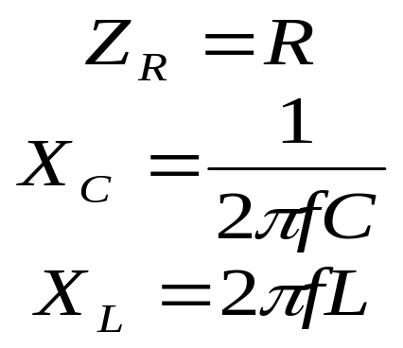
Design of Passive Filters
The designed are based on the fact that:
  Resistor has a constant impedance over frequency,
  The impedance of a capacitor decreases with increasing frequency
  The impedance of an inductor increases with increasing frequency
Electronic Measurements and Instrumentation -- EE3400

Slide 9
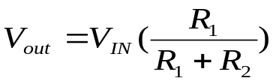
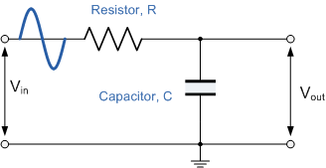

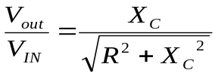



Low pass Filter (1st order)
In series connection the output voltage is given by
But total impedance for resistor and capacitor in series is given as
Cut-off frequency happen when
Low pass Example
Electronic Measurements and Instrumentation -- EE3400

Slide 10
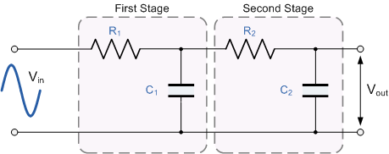
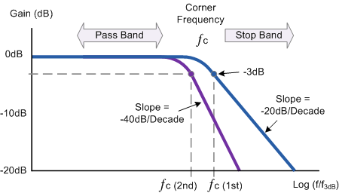
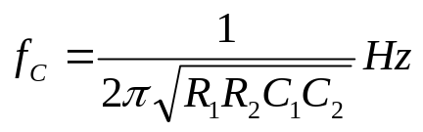
Low pass Filter (2nd order)
A first-order low pass filter can be converted into a second-order type by simply using an additional RC network
If a number (n) of such filters are cascaded together, the resulting filter circuit would be known as an "n^{th}-order" filter with a slope of n x -20dB/decade
Cut-off frequency then becomes
Electronic Measurements and Instrumentation -- EE3400

Slide 11
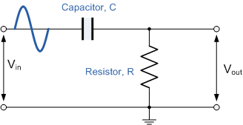
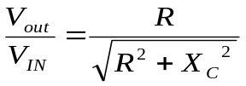
High pass Filter (1st order)
The exact opposite to the low pass filter
Only passes signals above the selected cut-off point, ƒc eliminating any low frequency signals
Application:
  audio amplifier in speaker systems
Cut-off frequency happen when
Electronic Measurements and Instrumentation -- EE3400

Slide 12
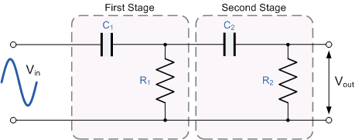
High pass Filter (2nd order)
Two first-order high pass filters connected or cascaded together to form a second-order or two-pole filter network
Cut-off frequency then becomes
Electronic Measurements and Instrumentation -- EE3400

Slide 13
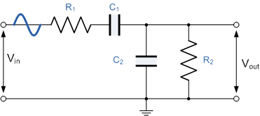

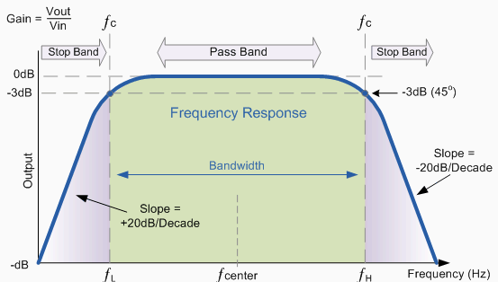

Cascaded Band pass Filter
Formed by cascading together a single low pass filter with a high pass filter
Has a pass band known as Bandwidth given by
Resonant or Centre Frequency
  Frequency where the output gain is at its maximum or peak value
Band pass Example
Electronic Measurements and Instrumentation -- EE3400

Slide 14
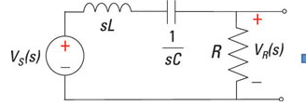



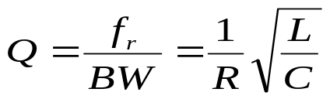

RLC Band pass Filter
Formed by connecting RLC in series
The cut-off frequencies are at the –3 dB half-power points
The Quality factor, Q, is defined as the ratio of center frequency against bandwith
The resonant frequency
Electronic Measurements and Instrumentation -- EE3400

Slide 15
Design of Active Filters
Uses similar concepts as in passive design
Introduces the use of operational amplifiers
Hence can amplify input signals
Electronic Measurements and Instrumentation -- EE3400

Slide 16
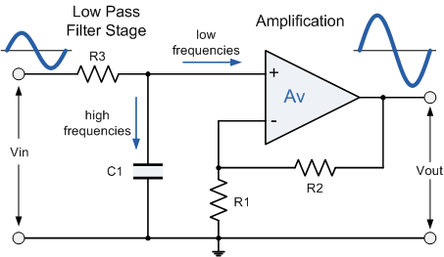
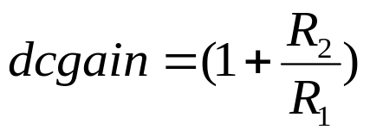
Active Low pass Filter
Frequency response is exactly the same as low-pass passive filter
uses an op-amp for amplification and gain control
For a non-inverting amplifier circuit, the magnitude of the voltage gain for the filter is given as
Active low pass example
Electronic Measurements and Instrumentation -- EE3400

Slide 17
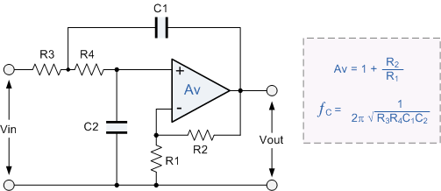
Second-order Low Pass Active Filter
Formed by adding another RC network in the input path
Similarly roll-off will be twice the first-order filters
Sometimes called Salley-key Butterworth Filters
EE3300 Lab (EMI 3)
Electronic Measurements and Instrumentation -- EE3400

Slide 18
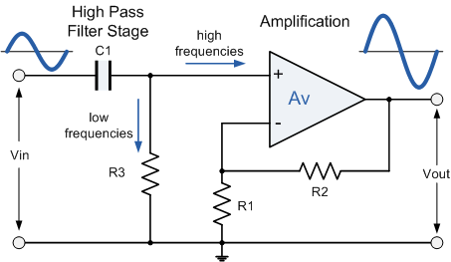
Active High pass Filter
Frequency response is exactly the same as high-pass passive filter
Attenuates low frequencies and passes high frequency signals
For a non-inverting amplifier circuit, the magnitude of the voltage gain for the filter is given as
Electronic Measurements and Instrumentation -- EE3400

Slide 19
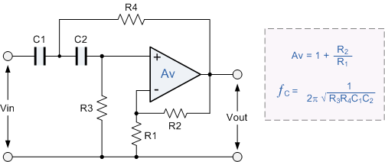
Second-order High Pass Active Filter
Formed by adding another RC network in the input path
Similarly roll-off will be twice the first-order filters
Also called Salley-key Butterworth Filters
EE3300 Lab (EMI 3)
Homework
  Draw a circuit for 3rd order high pass filter
Electronic Measurements and Instrumentation -- EE3400

Slide 20

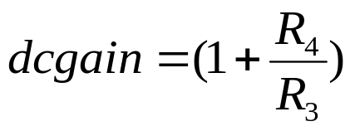
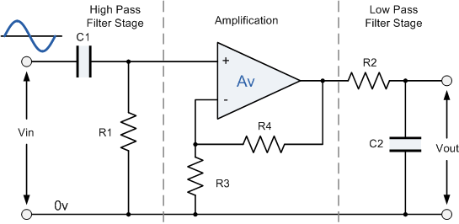
Active Band pass Filter
Frequency response is exactly the same as band-pass passive filter
Electronic Measurements and Instrumentation -- EE3400

