Slide 1

IT Community Project
Jeremiah Mein

Slide 2



Introduction

Slide 3
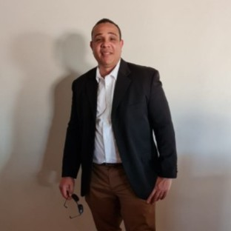
A bit about me…
I am a part time mature age student currently working for Bunnings Technology as a Release Coordinator. I started studying to enhance my technical skills and enhance my knowledge in the industry. During the five years I have been through Digital Transformations including supporting an API program and kept up with industry best practice through additional learnings to gain knowledge on cloud technologies, infrastructure, Application Programming Interfaces (API) and agile ways of working. As the world transformed through the pandemic as did I, leveraging off learnings and embracing technologies that enabled society. Opportunities arose as did threats with society impacted in different ways. I continued my part time studies as my full-time role transformed and maintained a high-grade average. In semester 2 of 2022 I reached my capacity with full time work and studies but endeavored to complete what would be the most challenging semester in the five years. Maintaining the high grade average I was nominated for the Australian Computer Science (ACS) Dennis Moore award for 2023. I now have one unit remaining and am hoping to apply the skills I have learned to try and address problems that exist in business and the community using technology.

Slide 4

Examples of my work

Slide 5
My skill set…
I am often considered a jack of all trades as I am driven by curiosity to constantly learn and apply. Whilst I have been involved in several projects I am bound by confidentiality for the organisations that I worked for who own the intellectual property and unable to share examples although I can discuss.
However, the following slides will give some examples of practical application of my skills at Curtin University.

Slide 6
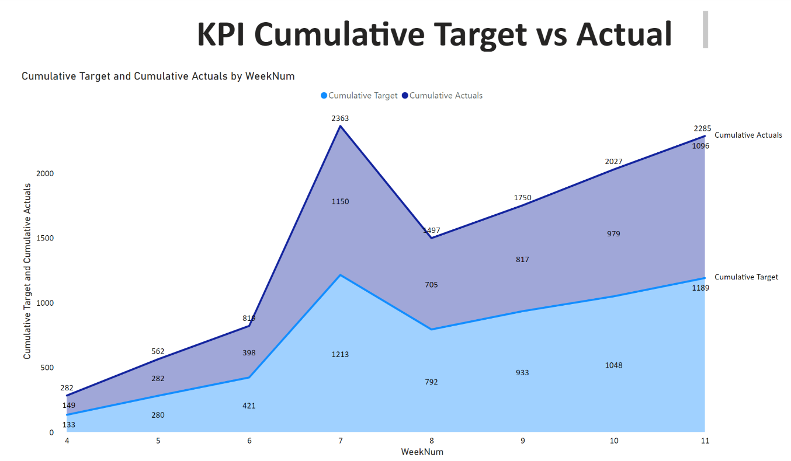
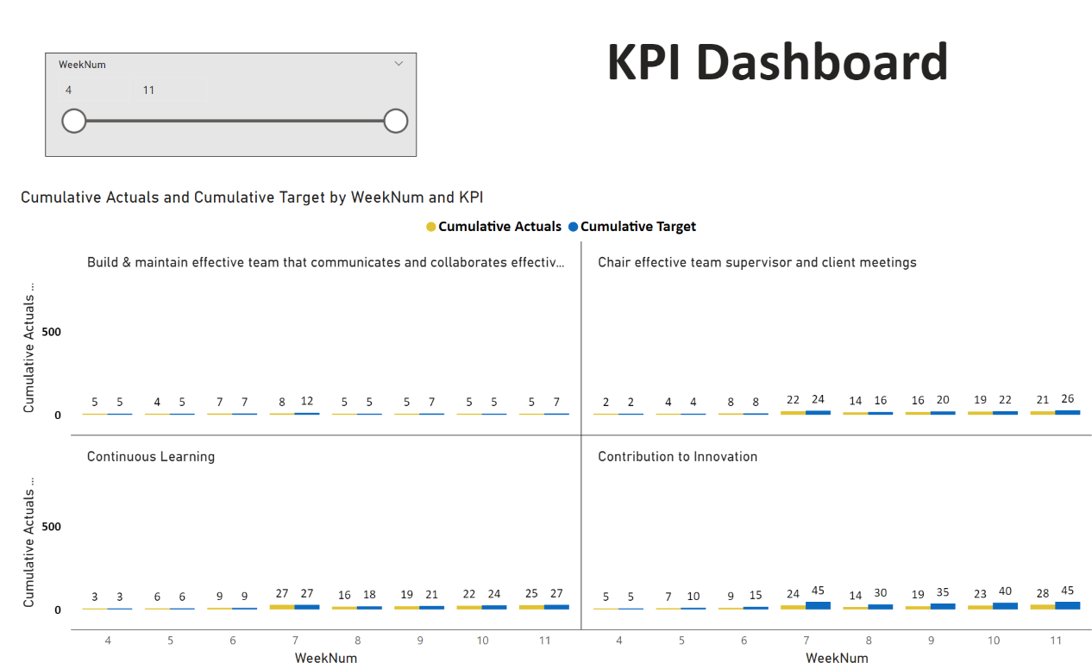
Dashboards
With large amounts of data that exist and are being generated daily, dashboards are key to data driven decision making. The below is a simplified example of a Power BI dashboard connected to raw data stored in excel on my personal KPIs in semester 2 2022.

Slide 7
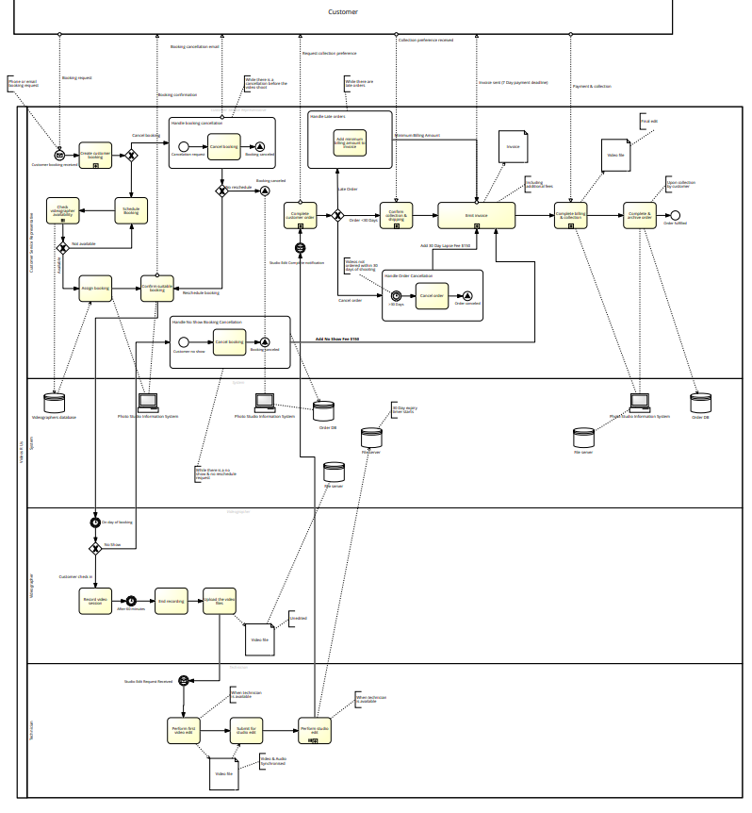
Business Process Management (BPM)
Understanding business processes and capturing activities involved in a process to define a current state can help understand issues in a process including where losses are being made, time is being wasted and identify ways to improve resulting in a future state enhanced process model and better ways of doing things. This can relate to business or specific business activities but if applied to the community could help map the current state of a number of public services and any issues that may be passing to the public. It could help simplify these process and find ways to improve how the public use these services.

Slide 8
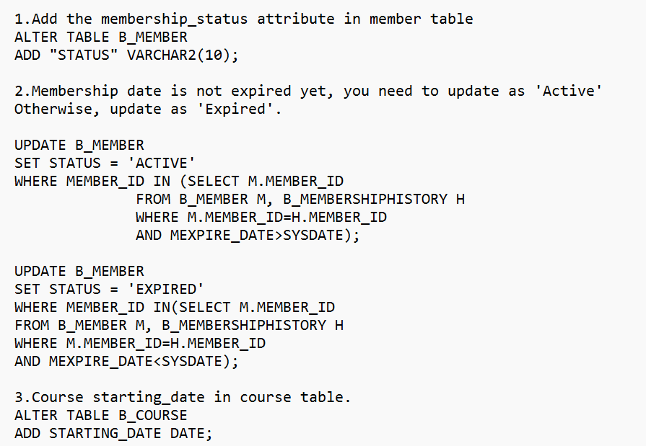
Reporting & Structured Query Language (SQL)
As previously mentioned, understanding data leads to better decision making. Data has become a nontangible element with a high value in society. Using SQL to extract data held in databases via Oracle Database Management System (DBMS), data can be collected and analyzed to identify trends. Combing SQL and dashboards can help give the SQL extracted data a better visual aid for users to easily interpret and understand current trends.

Slide 9
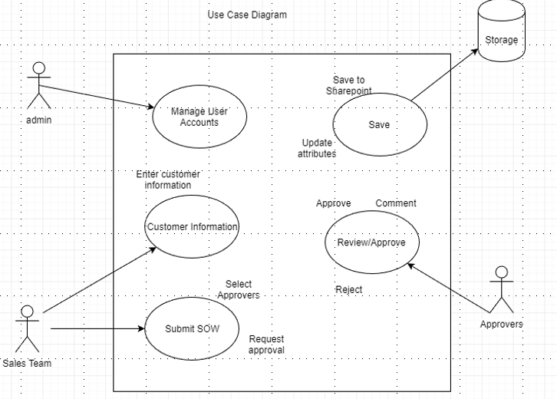
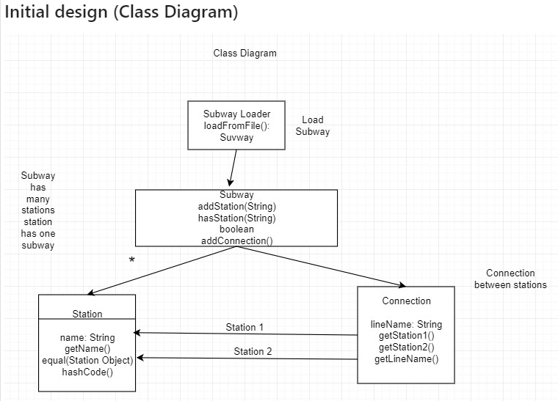
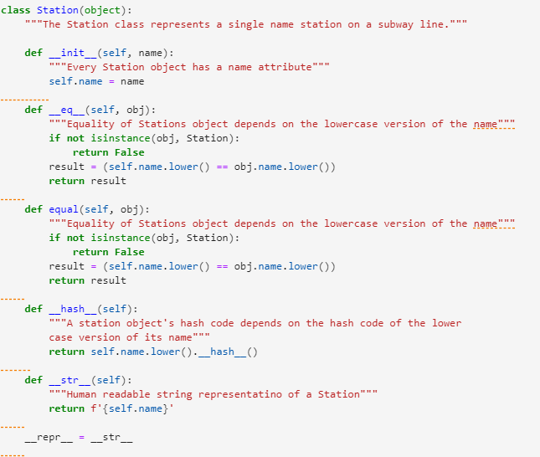
Object Orientated Programming
With many open source code now available online, OOP simplifies the way developers design, build and implement a program and publish to working application via a user interface. The below examples are some of my design work which led to my code written in Python. Eventually this can be wrapped in a user interface and published in a form of a website or Mobile App.

Slide 10
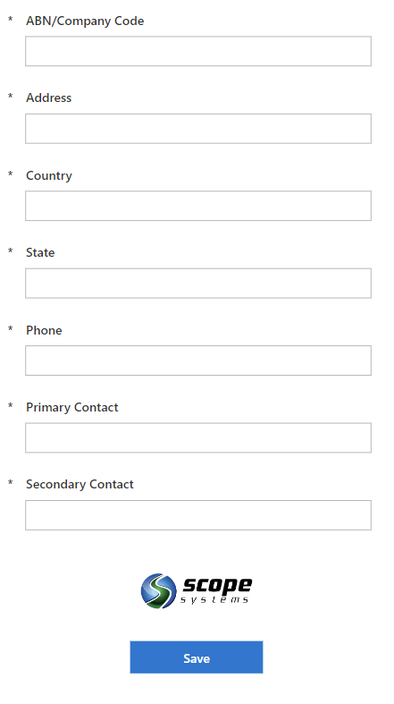
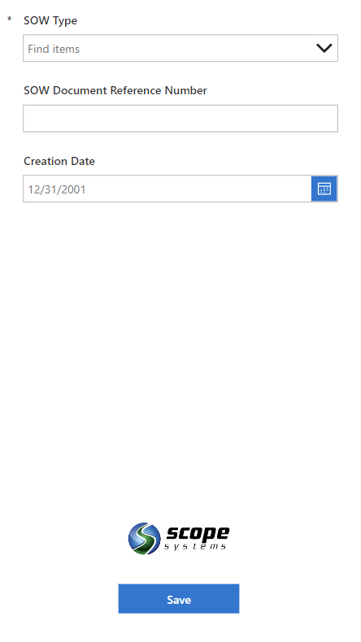
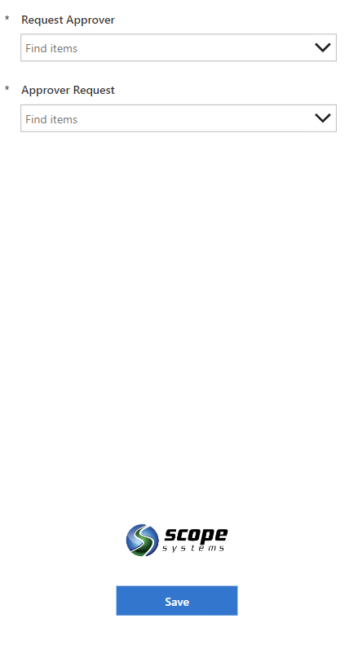
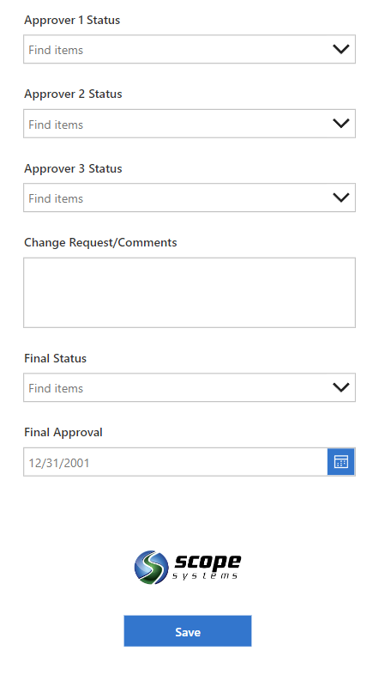
Microsoft
Recently I have worked with a team to deliver them a working MVP solution to solve a problem they were having with using a spreadsheet for statement of work approvals. The project was only to deliver a business case and recommendations however as Team leader I led the team to deliver a working solution. With the client already working in a Microsoft eco system we built this using Sharepoint interfacing with Microsoft Power Apps and flows.

Slide 11
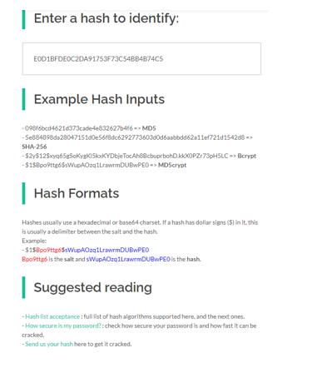
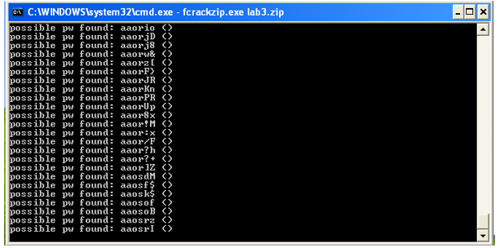
Cyber Security
With the recent attacks, Cyber security awareness is critical. As part of the security unit we explored ethical hacking tools to understand how easily passwords can be hacked. As code and applications are built and released they need to be tested in case of any weaknesses that may result in a user being hacked.

Slide 12
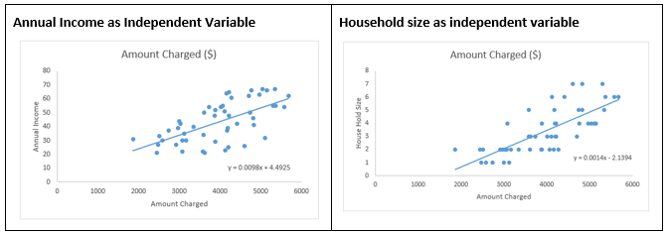
Descriptive Statistics
Data data data…
Data is only useful when it is processed and provides meaning to eventually become information and later knowledge. During the pandemic data became critical in retail to understand consumer behaviors as they became empowered through technology. Data also became critical in understanding COVID clusters, vaccinations, contact tracing and the populations behaviors in response to the pandemic. Descriptive statistics is the interpretation of data as variables are used to identify and analyze trends and patterns.

Slide 13


Thank You

