Slide 1
Project
Target: http://meesho.com

Slide 2
Summary
This project includes following processes:
1 Footprinting
2 Scanning
3 Exploitation
4 Mitigation

Slide 3
FOOTPRINTING

Slide 4
Footprinting
The process of collection of information about targeted system/application/website is known as footprinting . It includes the subdomain collection , finding URL’s , Filteration , Port Scanning , SQl Scan etc.
This process is also known as Recon.
Footprinting can be done by following ways:
1 Manual
2 Kali linux tools

Slide 5
Footprinting- Manual
Manually, footprinting can be done with the use of various websites . It includes the searching of target on these websites that results the subdomains of the targeted website/application .
The websites are:
1 http://web.archive.org
2 https://www.virustotal.com

Slide 6
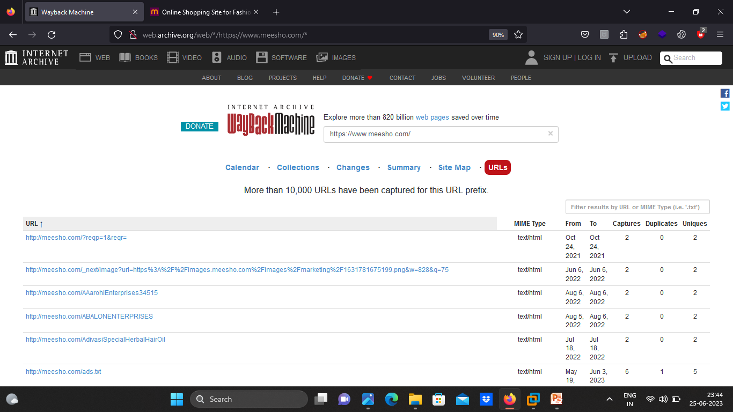

Slide 7
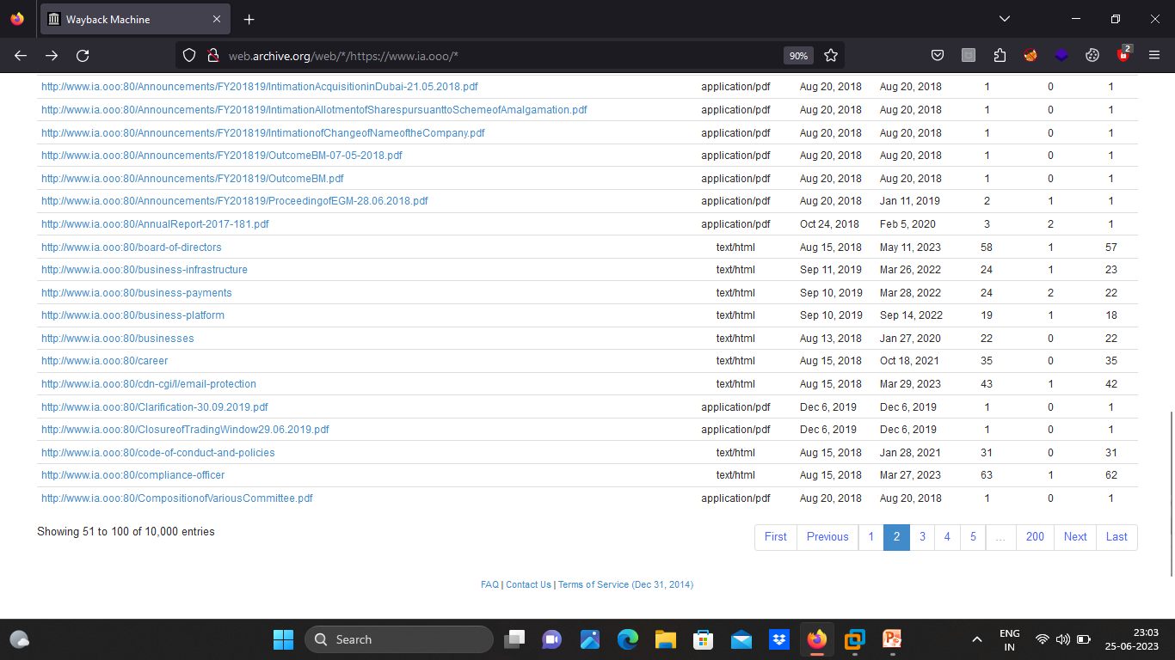

Slide 8
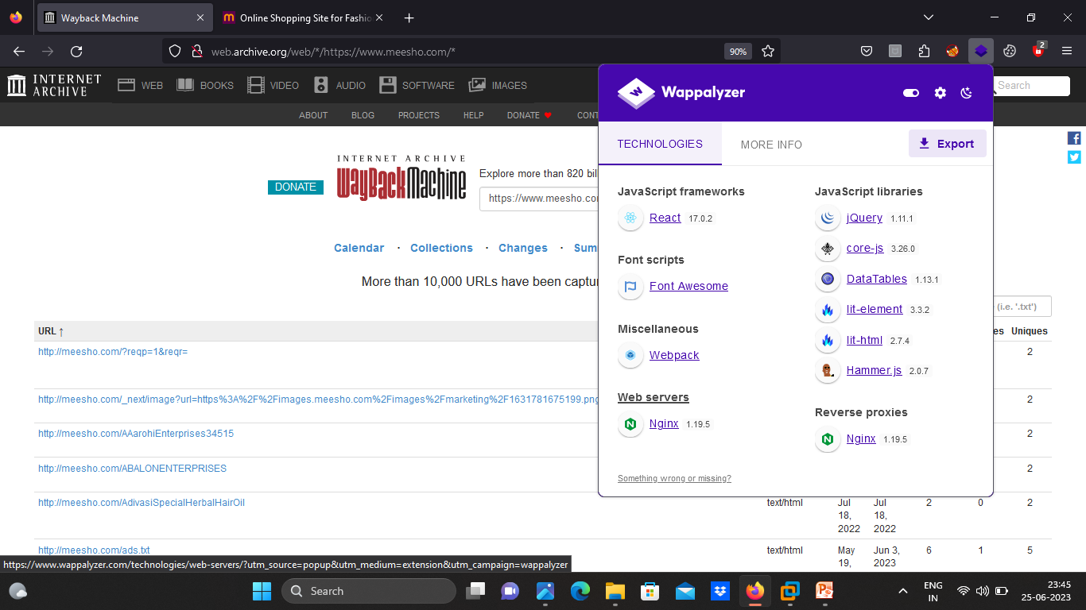

Slide 9
Continuee..
Recon includes the information like DNS , subdomain collection , links , ports , SSL , IP address , Emails , services , visuals , Technology the system/application is using , Reverse IP ,JS files .
Above information can be collected with use of websites , commands , addons etc.
Websites for finding above details:
1 For DNS records-www.nslookup.io

Slide 10
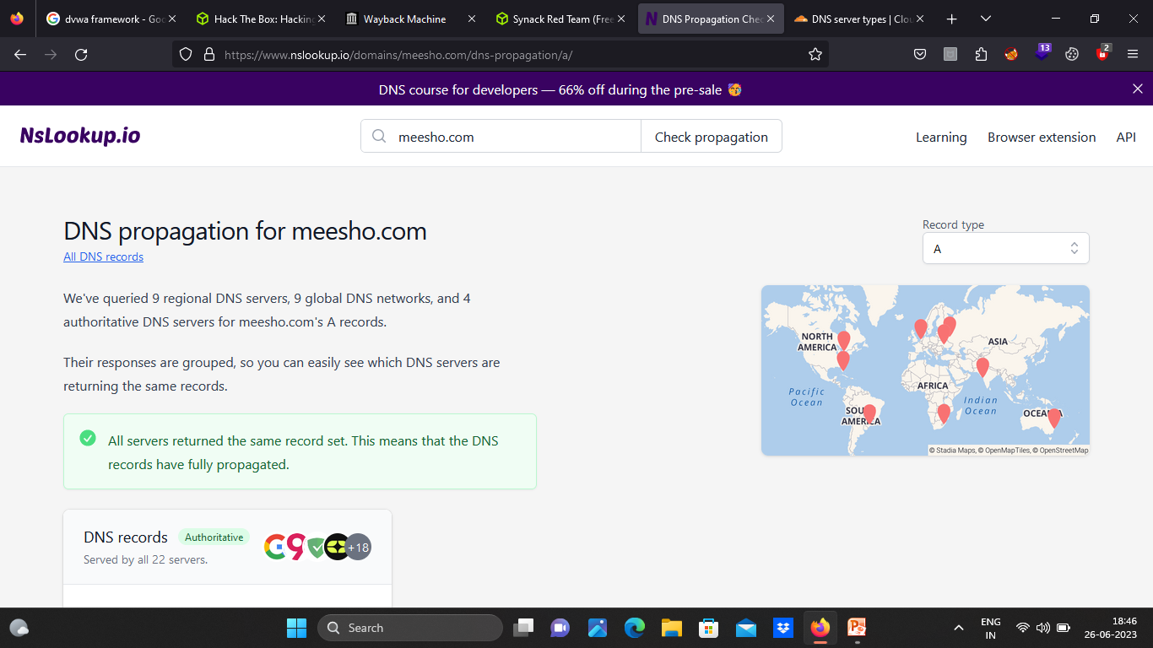

Slide 11
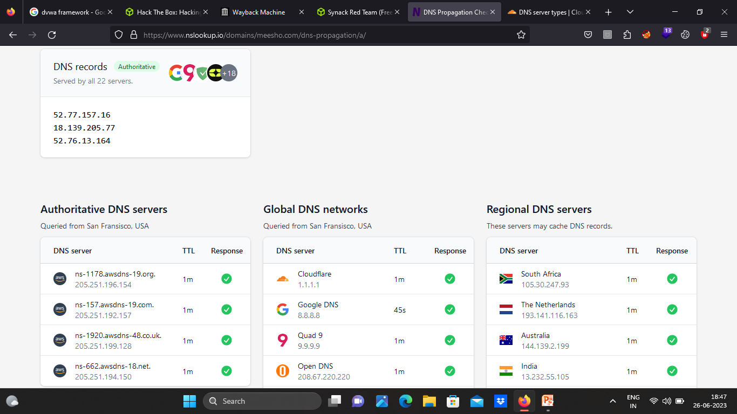

Slide 12
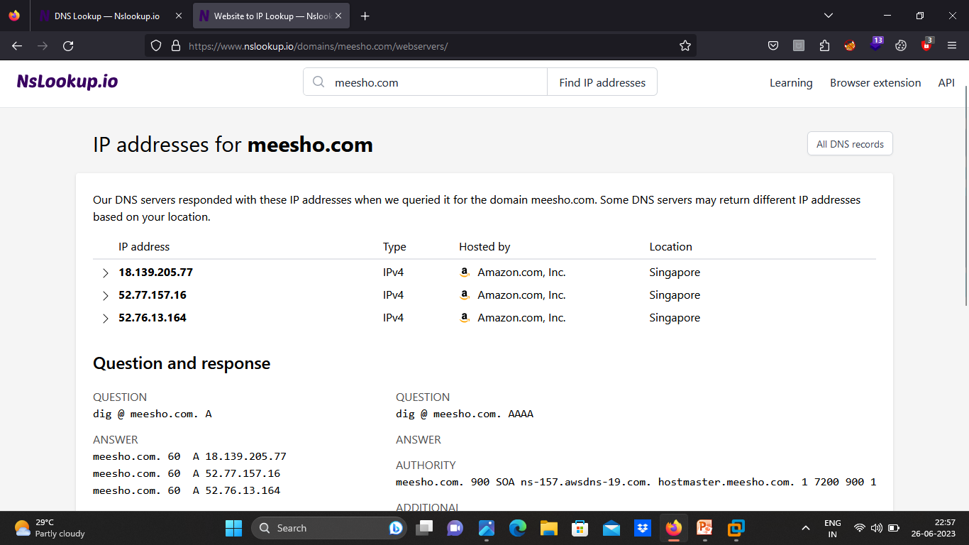
IP Location : www.nslookup.com www.ip2location.com

Slide 13
Visuals : www.visualsitemapper.com

Slide 14
Emails : www.hunter.io

Slide 15
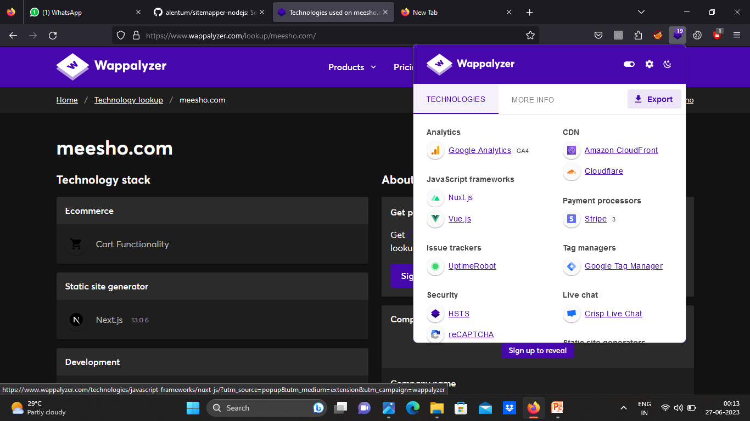
Technology : www.wappalyzer.com www.builtwith.com

Slide 16
Reverse IP : www.nslookup.com

Slide 17
Footprinting – Using Kali linux tools
There are many tools available for collecting information of target system in Kali linux that are used to find subdomains , URL’s , SQL Scan , Port Scanning etc.

Slide 18
Kali Linux Tools
The tools are:
For Subdomain collection : assetfinder , subfinder , sublister , amass , knockpy etc.
For URL’s : Katana , gau , webbackurls etc
For Port Scanning : nmap , nabbu etc
For SQL Scan : sqlmap , ghauri etc
All above tools are based on Python and Go based Scripts.

Slide 19
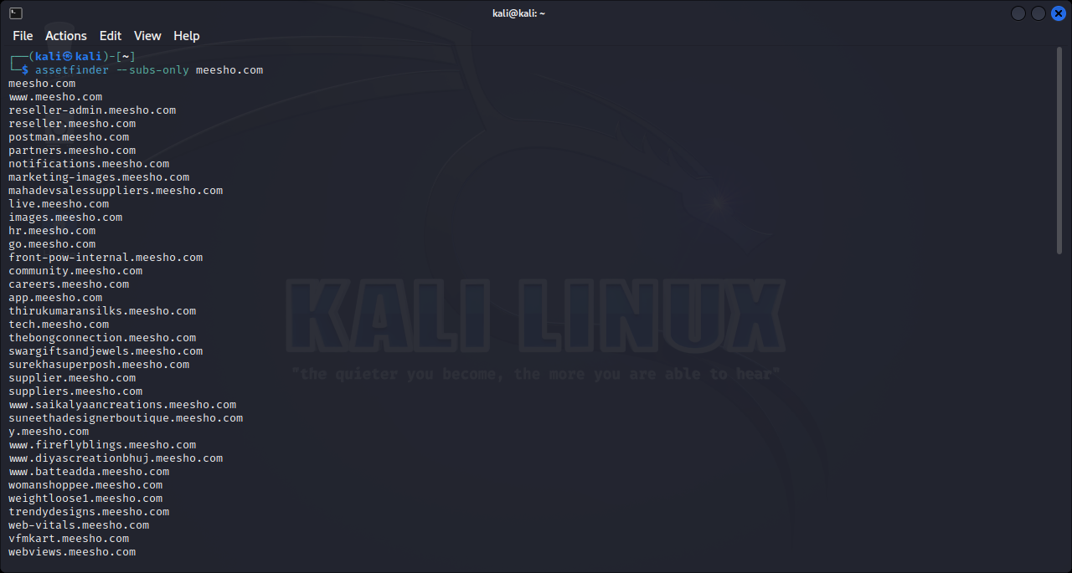
Assetfinder : The fastest tool to return the subdomains of the target domain.

Slide 20
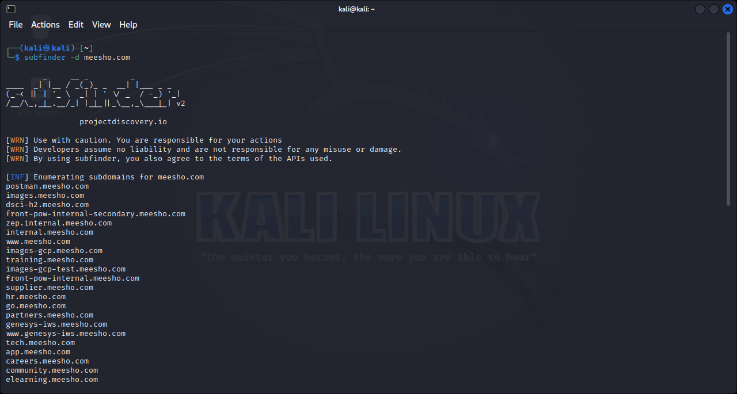
Subfinder : It is used for discovering passive subdomains of websites by using digital sources .

Slide 21
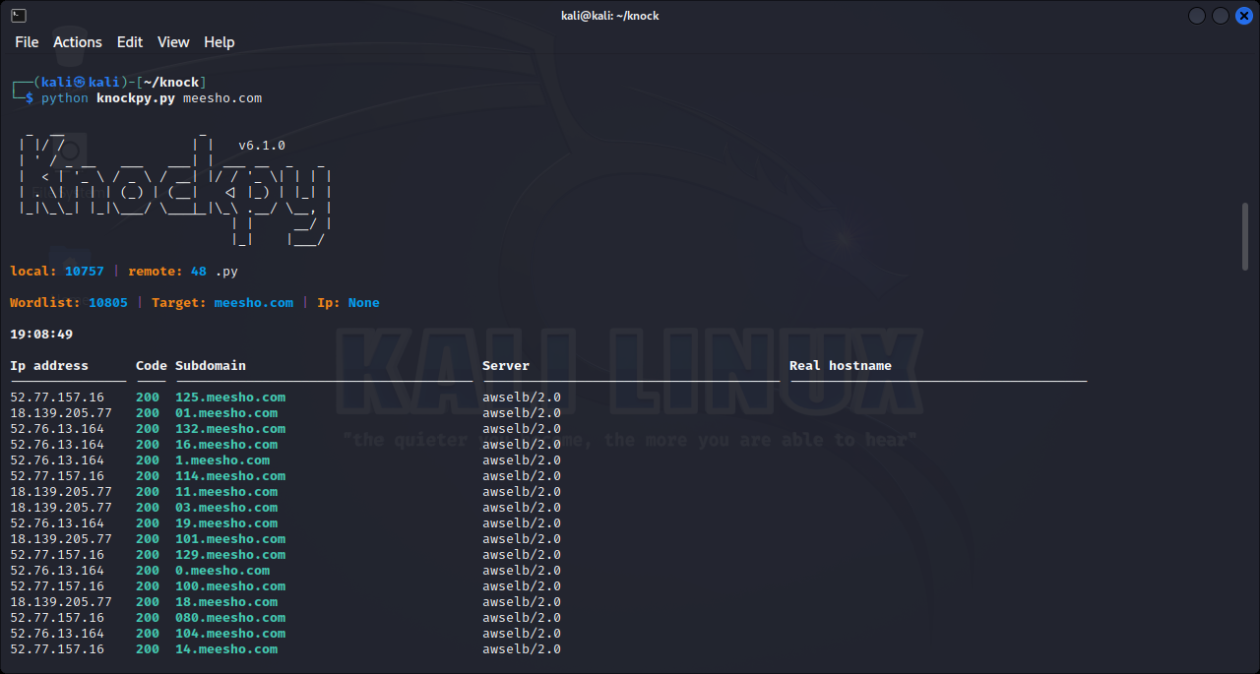
Knock is a tool written in Python and is designed to enumerate subdomains in a target domain through a wordlist.

Slide 22
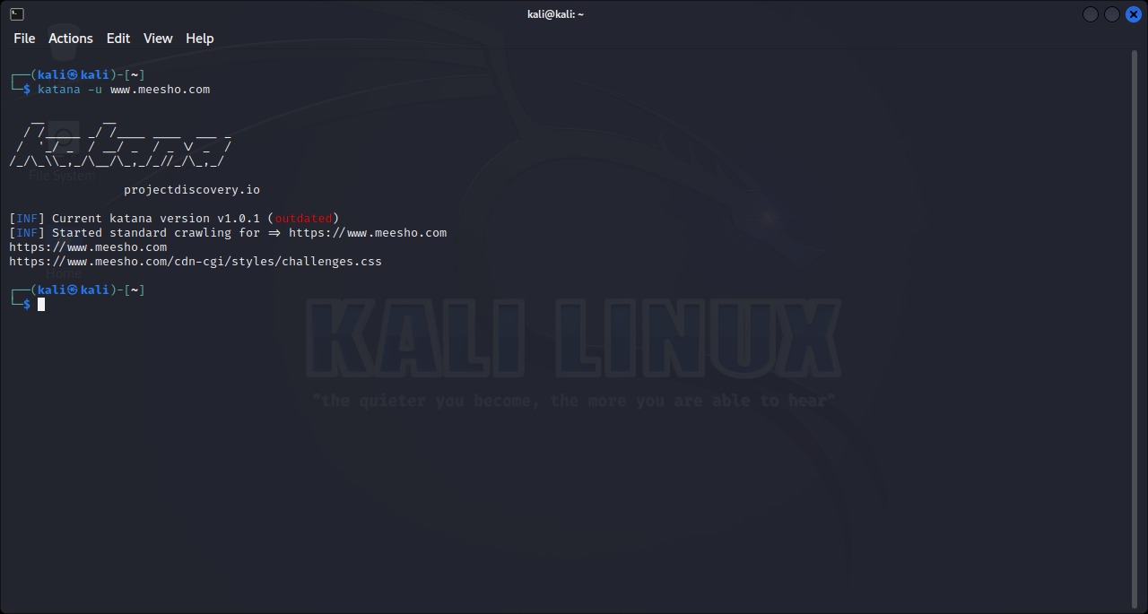
Katana is a fast crawler focused on execution in automation pipelines offering both headless and non-headless crawling.

Slide 23
SQL Map/Injection
Sqlmap goal is to detect and take advantage of SQL injection vulnerabilities in web applications.
Once it detects one or more SQL injections on the target host, the user can choose among a variety of options to perform an extensive back-end database management system fingerprint, retrieve DBMS session user and database, enumerate users, password hashes, privileges, databases, dump entire or user’s specific DBMS tables/columns, run his own SQL statement, read specific files on the file system .

Slide 24
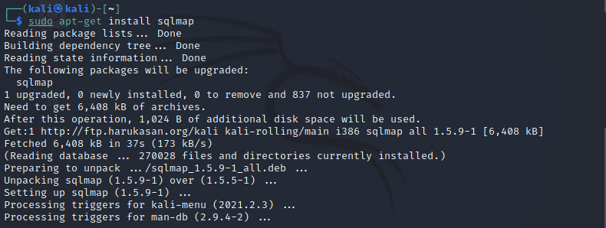

Slide 25
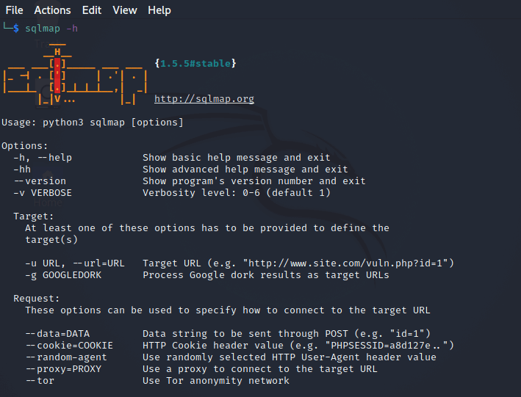

Slide 26
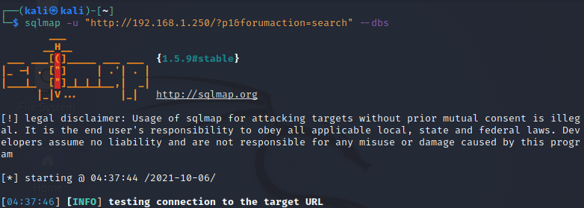

Slide 27
Scanning
Scanning is the second step in ethical hacking. It helps the attacker get detailed information about the target.
Scanning could be basically of three types:
1 Port Scanning : Detecting open ports and running services on the target host.
2 Network Scanning : Discovering IP address, topology.
3 Vulnerability Scanning : Scanning to gather information about known vulnerabilities in a target.

Slide 28
SCANNING
Tools used in scanning:
1 Nmap:
i) Real time information of a network
ii) Detailed information of all the IPs activated on network
iii) Number of ports open in a network
iv)Provide the list of live hosts
v) Port, OS and Host scanning

Slide 29
Scanning
Nikto:
i)Find SQL injection, XSS, and other common vulnerabilities
ii)

