Slide 1
eduMatrix
Inspiring the generation
www.eduMatrix.org.edu

Slide 2



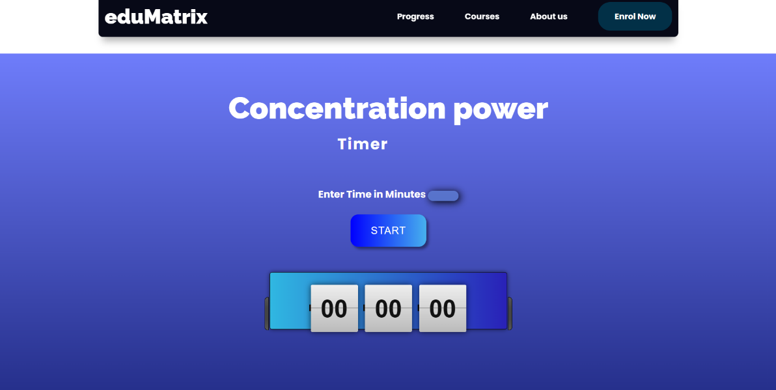

Slide 3
Our moto in one line:-
eduMatrix:- Inspiring the generation
Our Company
Four founding members all establishing for the greater good of the society
Our Team
A centralized web server that serves all the needs of the students 24X7
Technology
Our moto is to provide this facility at every corner of our nation regardless of the race , cast , and financial status
Scope

Slide 4
What we are trying to resolve?
To enhance concentration among students for better performance in the given task . Concentration is the ability to focus on the task at hand while ignoring the object distractions in the environment. Sub themes 1. Identifying the reasons for lack of concentration 2. Steps to enhance concentration Ways to enhance concentration 1. Mindfulness 2. Cognitive training 3. Exercise 4. Following a daily routine 5. Short break between activities 6. Nothing your distractions Outcome It will help the students to develop concentrations which will in turn help them to learn better and realize their full potential. Target Group (stage wise) [3.] School level a. Foundational stage b. Preparatory stage c. Middle stage d. Secondary stage [4.] College / University level a. Youth

Slide 5
Scope and future technology
eduMatrix is trying to give quality education to the student of are nation regardless of caste religion race and financial status.
Soon eduMatrix will be available for every student whether they are rich or poor. The upcoming features of this platform where parents will have a tab on their wards will make this platform like no other.
eduMatrix is hustling to make this platform more reliable and less complex where every student can access it
In future this platform will be using WEB3 technology that will decentralize the data of individual student where no one other then parents teachers and the student himself will have the scores and progress over the time unlike schools where students get shy while asking questions and reveling their scores

Slide 6
How are we trying to resolve
What we trying to do with the help of eduMatrix is emerge all the concentration of students which is lacking.
Our website is designed in a way that it keeps the track of student’s day to day routines .
Many features of our site helps student to eliminate distractions like:-
A timer that is set and locked for a time being that restricts the background activities and let student focus.
Our elite courses are like super factual and built to boost interest.
We have implemented some games that will increase concentration and improve motor skills.
At eduMatrix students can have a track on their progress and statistics that provides with the information to where put efforts next time
The more progress students achieve at eduMatrix the more resources and goodies they can unlock.

Slide 7



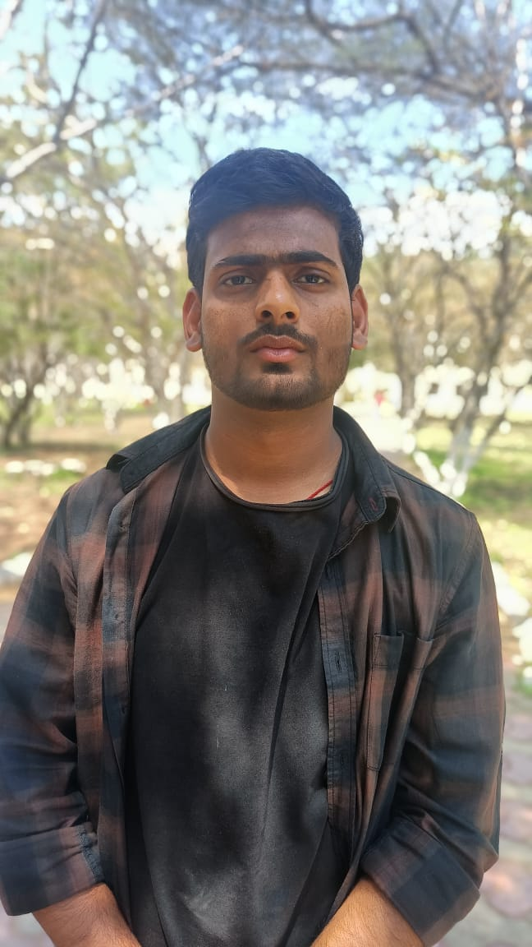
FOUNDING FATHERS
Ajay Singh
Designer, eduMatrix
Abhinav kumar Yadav
Developer, eduMatrix
Shubham Kumar
Developer, eduMatrix
Shashwat raj
Developer, eduMatrix

Slide 8
Thank You!

