Slide 1

Face Recognition Python Project
Elias Assy - 206609919
Morad Hnef - 207340183

Slide 2

"What Does the Software Do?"
The face recognition software utilizes advanced algorithms to identify and authenticate individuals based on their facial features.
It offers immediate identification of known individuals and labels unknown faces for further inspection.

Slide 3
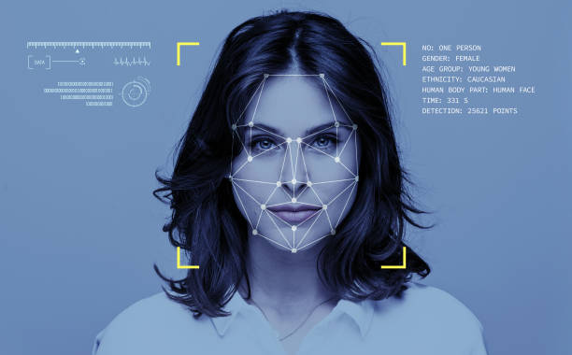
Input:
The software requires input data in the form of images or video frames.
Sources of Input Data:
Webcam Frames: Real-time face recognition from video streams.
Images: Static images for face detection and recognition.

Slide 4

Output:
The output of the software consists of live frames from the camera.
Detected faces are highlighted with bounding rectangles, and recognized faces are labeled with their corresponding names.

Slide 5

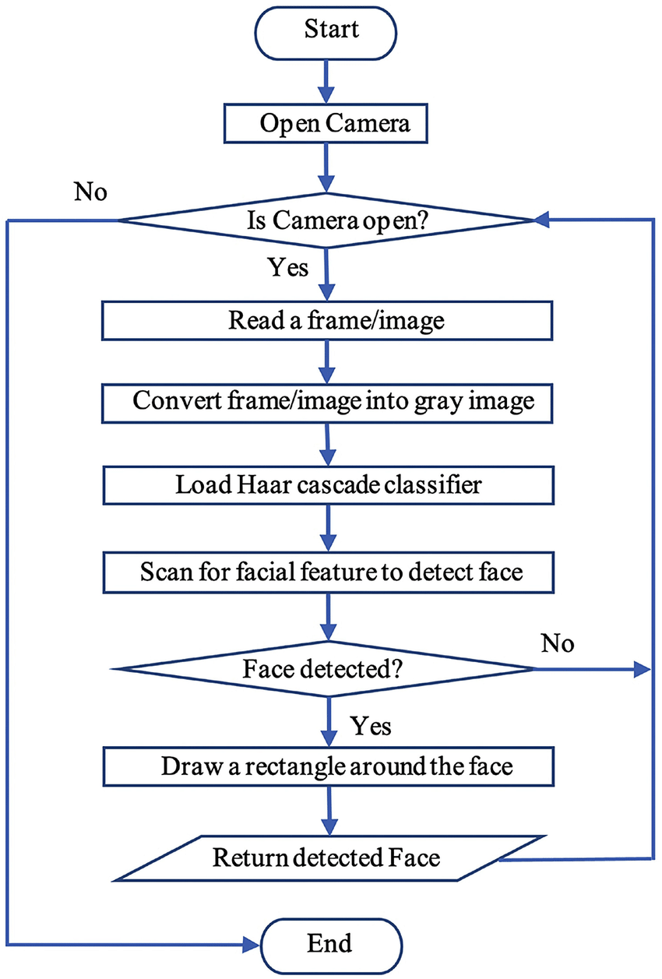
Implementation Plan - Graphic Scheme:
Flow Chart
This graphic scheme illustrates the key steps of our software’s implementation:
Loading face encodings from a specified folder.
Capturing frames from the camera.
Detecting and recognizing faces.
Displaying the annotated frames.

Slide 6
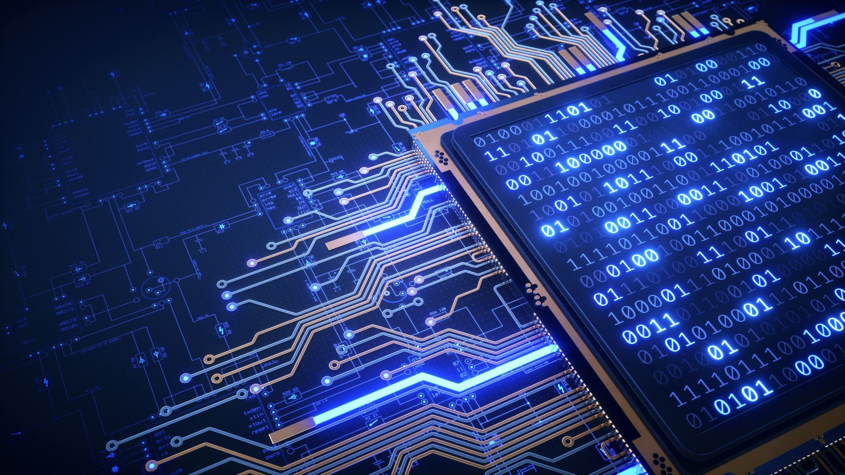
Tools Used and Links:
OpenCV: Open-source computer vision library used for face detection and image processing.
Python: Programming language used for implementing the face recognition algorithms.
TechVidvan: A comprehensive tutorial on implementing the face recognition project in Python and OpenCV.
Source Link: https://techvidvan.com/tutorials/face-recognition-project-python-opencv/

Slide 7
A list of things we developed ourrselves, why and how were they developed? Custom Face Recognition Module: why Devloped? To enhance code organization. How Developed: Created a custom Python module using classes and functions to abstract tasks such as face encoding, comparison, and annotation. Benefits: Code Reusability, Abstraction, Modularity.

Slide 8
What did we not open, what did we take from other sources? explain and detail.
Face Recognition Algorithm from Face Recognition Library:
What Was Taken: The core face detection and recognition algorithm.
Why Chosen: The library offers a robust and established solution for accurate face recognition.
How Integrated: Installed the library using a package manager.
Benefits: Reliability, Time Efficiency, Community Support.
OpenCV for Image Processing and Visualization:
What Was Taken: OpenCV library functionalities for image capture, processing, and visualization.
Why Chosen: OpenCV is a powerful tool for real-time image processing and graphical annotation.
How Integrated: Imported OpenCV functions for frame capture, drawing, and text overlay.
Benefits: Feature-Rich, Efficiency.

Slide 9

Ideas for Possible Improvements:
Integration with a Database: Improve face recognition accuracy and enable face storage for future identification.
Real-time Face Recognition: Extend the software to perform face recognition in real-time on video streams.
Facial Expression Recognition: Enhance the software to detect and analyze facial expressions.
Gender or Age Estimation: Implement additional features like estimating gender or age from detected faces.

Slide 10

Bibliography:
Here are the references and sources used during the project:
"Face Recognition with Python using OpenCV" by PyImageSearch:
https://pyimagesearch.com/2018/06/18/face-recognition-with-opencv-python-and-deep-learning/"Facial Recognition with Python and OpenCV" by Real Python
OpenCV documentation:
https://docs.opencv.org/3.4/da/d60/tutorial_face_main.html
Datagen:
https://datagen.tech/guides/face-recognition/face-recognition-with-python/
Youtube videos:
https://www.youtube.com/results?search_query=face+recognition+python+and+opencv

Slide 11
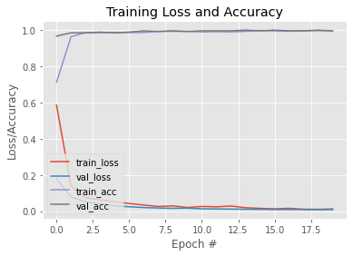
LOSS Graph:
The loss function reflects how well the model is learning and converging towards accurate predictions.

Slide 12
Recall, Precision, and Accuracy:
Recall: Recall, also known as True Positive Rate or Sensitivity, measures the ability of the software to correctly identify known faces. It's the ratio of correctly recognized faces to the total number of actual known faces.
Formula: Recall = True Positives / (True Positives + False Negatives)
Example Interpretation: If the recall is 85%, it means that the software identified 85% of all known faces correctly.
Precision: Precision quantifies the software's reliability in labeling a recognized face as a known face. It's the ratio of correctly recognized faces to the total number of recognized faces.
Formula: Precision = True Positives / (True Positives + False Positives)
Example Interpretation: If the precision is 92%, it means that 92% of the recognized faces were indeed known faces.
Accuracy: Accuracy provides an overall measure of the software's correctness, considering both correct and incorrect predictions.
Formula: Accuracy = (True Positives + True Negatives) / Total Instances
Example Interpretation: An accuracy of 88% indicates that 88% of all predictions (recognized and unrecognized faces) were correct.

Slide 13
Github + Youtube links:
Github: https://github.com/EliasAndry/Face-Reco
Youtube: https://youtu.be/zBbC1Ss_mUM

