Slide 1
Module2: Yelp Reviews
By Xiaohan Wang, Tiannan Huang and Siyu Wang
Tues Group3

Slide 2
Outline of the Analysis
Data Preprocessing
Tokenizing
Stemming
Feature Selection
Document Frequency
Chi-square Test
Information Gain
Pointwise Mutual Information
Model Fitting
Linear Model
Naïve Bayes
…
Business Analysis

Slide 3

Tokenizing
Basic idea: Text Sentences Words
Small piece of text are easier to deal with
Steps:
Gently clean the text
Delete words from stopword list
Delete / Correct some meaningless punctuations and symbols
Deal with negation
Add ’_neg’ to following words: from negative signal to the next punctuation.
Manually create some features
attitude score, like (“AMAZING”, “!!!!!????”,etc.)
Pos / Neg words counter: Use a pos / neg words set without prior score.

Slide 4
Stemming
Transform all words to their basic forms (stems)
Sample text:
before | after
normalize / normality / normally | normal
approximately | approxim
takes / took / taken | take
interesting_neg | interesting_neg
Original Text | I don't like this &%^$#)_.;'> place,,, but my father told me not to GIVE UP !!!! I felt very good "
After | ['not', 'like_neg', 'place', 'father', 'tell', 'not', 'give_neg', 'up_neg', 'felt', 'veri', 'good', 'happi']

Slide 5
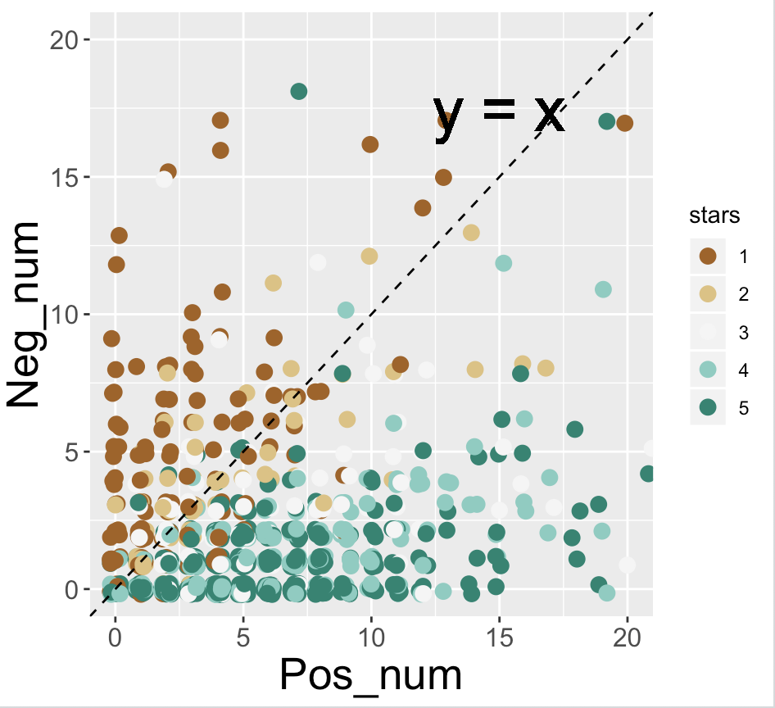
Feature Example
“ I love this FANTASTIC restaurant !!! ”
feature | result
attitude | 1+2=3
pos_num | 1+1=2
neg_num | 0
stems | “love”, “fantast”, “restaur”

Slide 6
Feature Selection
Intuition: Reduce the amount of variables and get some inspiration from the most important stems.
Methods:
Document Frequency
Based on the occurrence of a word in all documents
Chi-square Test
Test if the occurrence of a word is independent of the star distribution
Information Gain
Calculate the change of Entropy before and after the word occurs
Pointwise Mutual Information
An Information-based chi-square test

Slide 7
Feature Selection Example
We select 500 reviews and run those four methods. And then select top 9 with each method.
 | DF | CHI | IG | PMI
1 | not | disappoint | disappoint | disappoint
2 | food | no | bad | bad
3 | buffet | dri | dri | best
4 | ! | salti | best | dri
5 | dessert | buffet | worth_neg | !
6 | good | bad | ! | noth
7 | go | best | noth | worth_neg
8 | vega | ! | no | no
9 | like | least | mediocr | mediocr

Slide 8
Modeling
Features:
After some comparison, we decide to use the features selected by Information Gain
Attitude, good_count and bad_count.
Before real modeling, several ways to weight the text…
Directly use frequency matrix
Use TF-IDF as weight
Boolean version (occur or not)
Model:
Linear Regression
Naïve Bayes

Slide 9
Results
Split the train / test data with the ratio of 0.8 : 0.2
 | Linear | Linear_tfidf | Linear_boolean | Naïve-Bayes | NB_tfidf | NB_boolean
Precision | 0.461 | 0.490 | 0.492 | 0.502 | 0.439 | 0.459
Recall | 0.366 | 0.397 | 0.403 | 0.494 | 0.415 | 0.445
F1 | 0.356 | 0.398 | 0.402 | 0.494 | 0.423 | 0.447
RMSE | 0.923 | 0.854 | 0.839 | 0.919 | 0.970 | 0.988

Slide 10
Business Analysis
Pick a specific restaurant
Find out its weakness from its attributes
Analysis from customers review
Come up with suggestion on its business

Slide 11
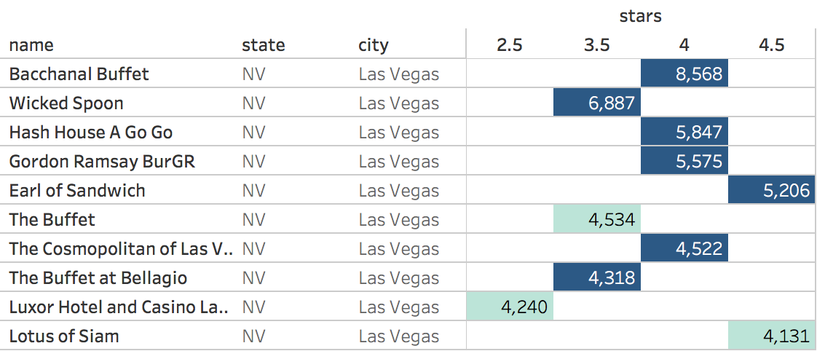
Top 10 Restaurant with most reviews
Table below shows numbers of reviews.

Slide 12
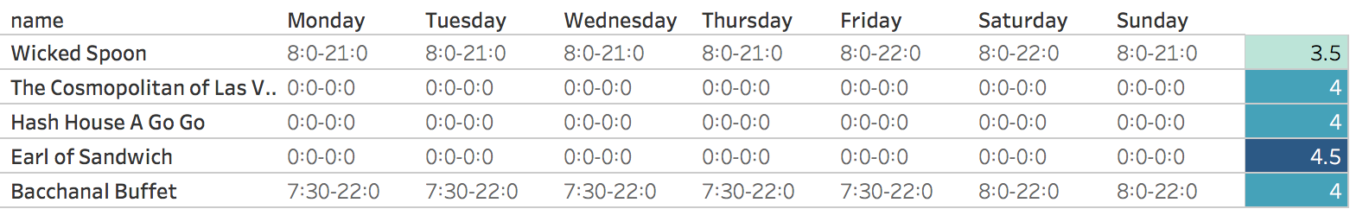
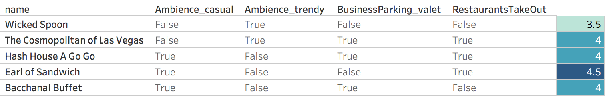
Information from business_train.json
Opening Hour
Other Factors

Slide 13
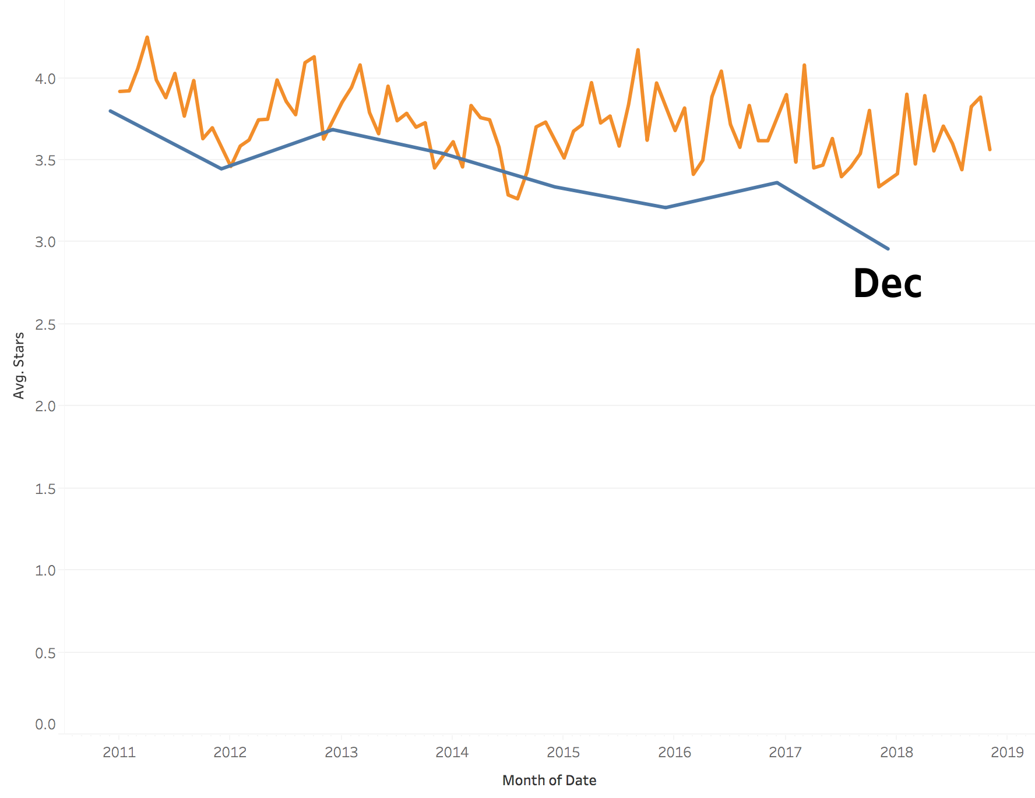
Information from review_train.json

Slide 14
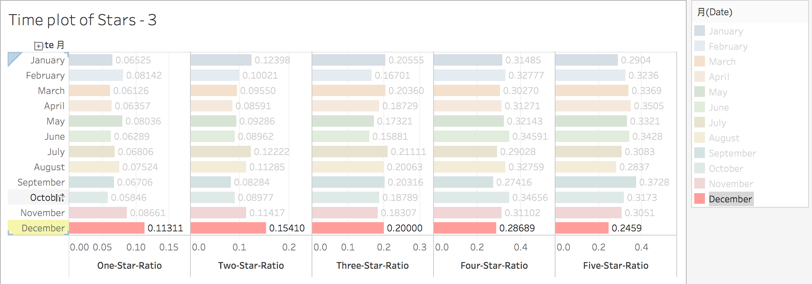
Time Plot 3
Ratio of different stars in each month

Slide 15
Keywords in reviews
We select some exclusive and representative words in each categories (1-5)
ONE STAR | diarrhea, nobodi, ignor, doctor, yuck, cleared_neg, last_neg, ate_neg, wtf, shit, spit, crap, joke, refilled_neg, complain, piss, embarrass, hell, ask_neg, free_neg, refund, bleh, returning_neg, vomit, clean_neg, sit_neg, sick, apolog, choose_neg, shame, nope, forever
TWO STAR | help_neg, cooked_neg, delicious_neg, able_neg, cocktail_neg, expecting_neg, available_neg, liked_neg, found_neg
THREE STAR | somewhat, weak, expectations_neg, thin, memorable_neg, overhype, super_neg, classic, chinese_neg
FOUR STAR | divers, gorgeou, standout, balanc, wild, cheesi, crowded_neg, large_neg, healthi, carb
FIVE STAR | prompt, fabul, chic, gold, divin, superb, detail, spectacular, heart, dream, exactli, god

Slide 16
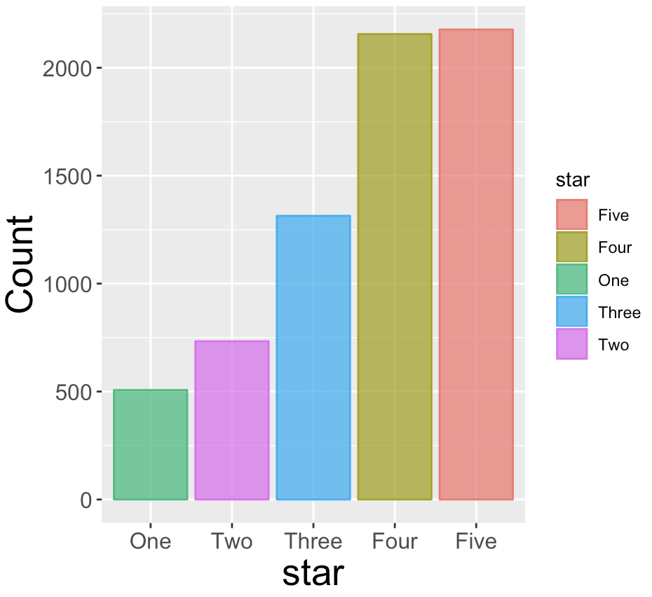
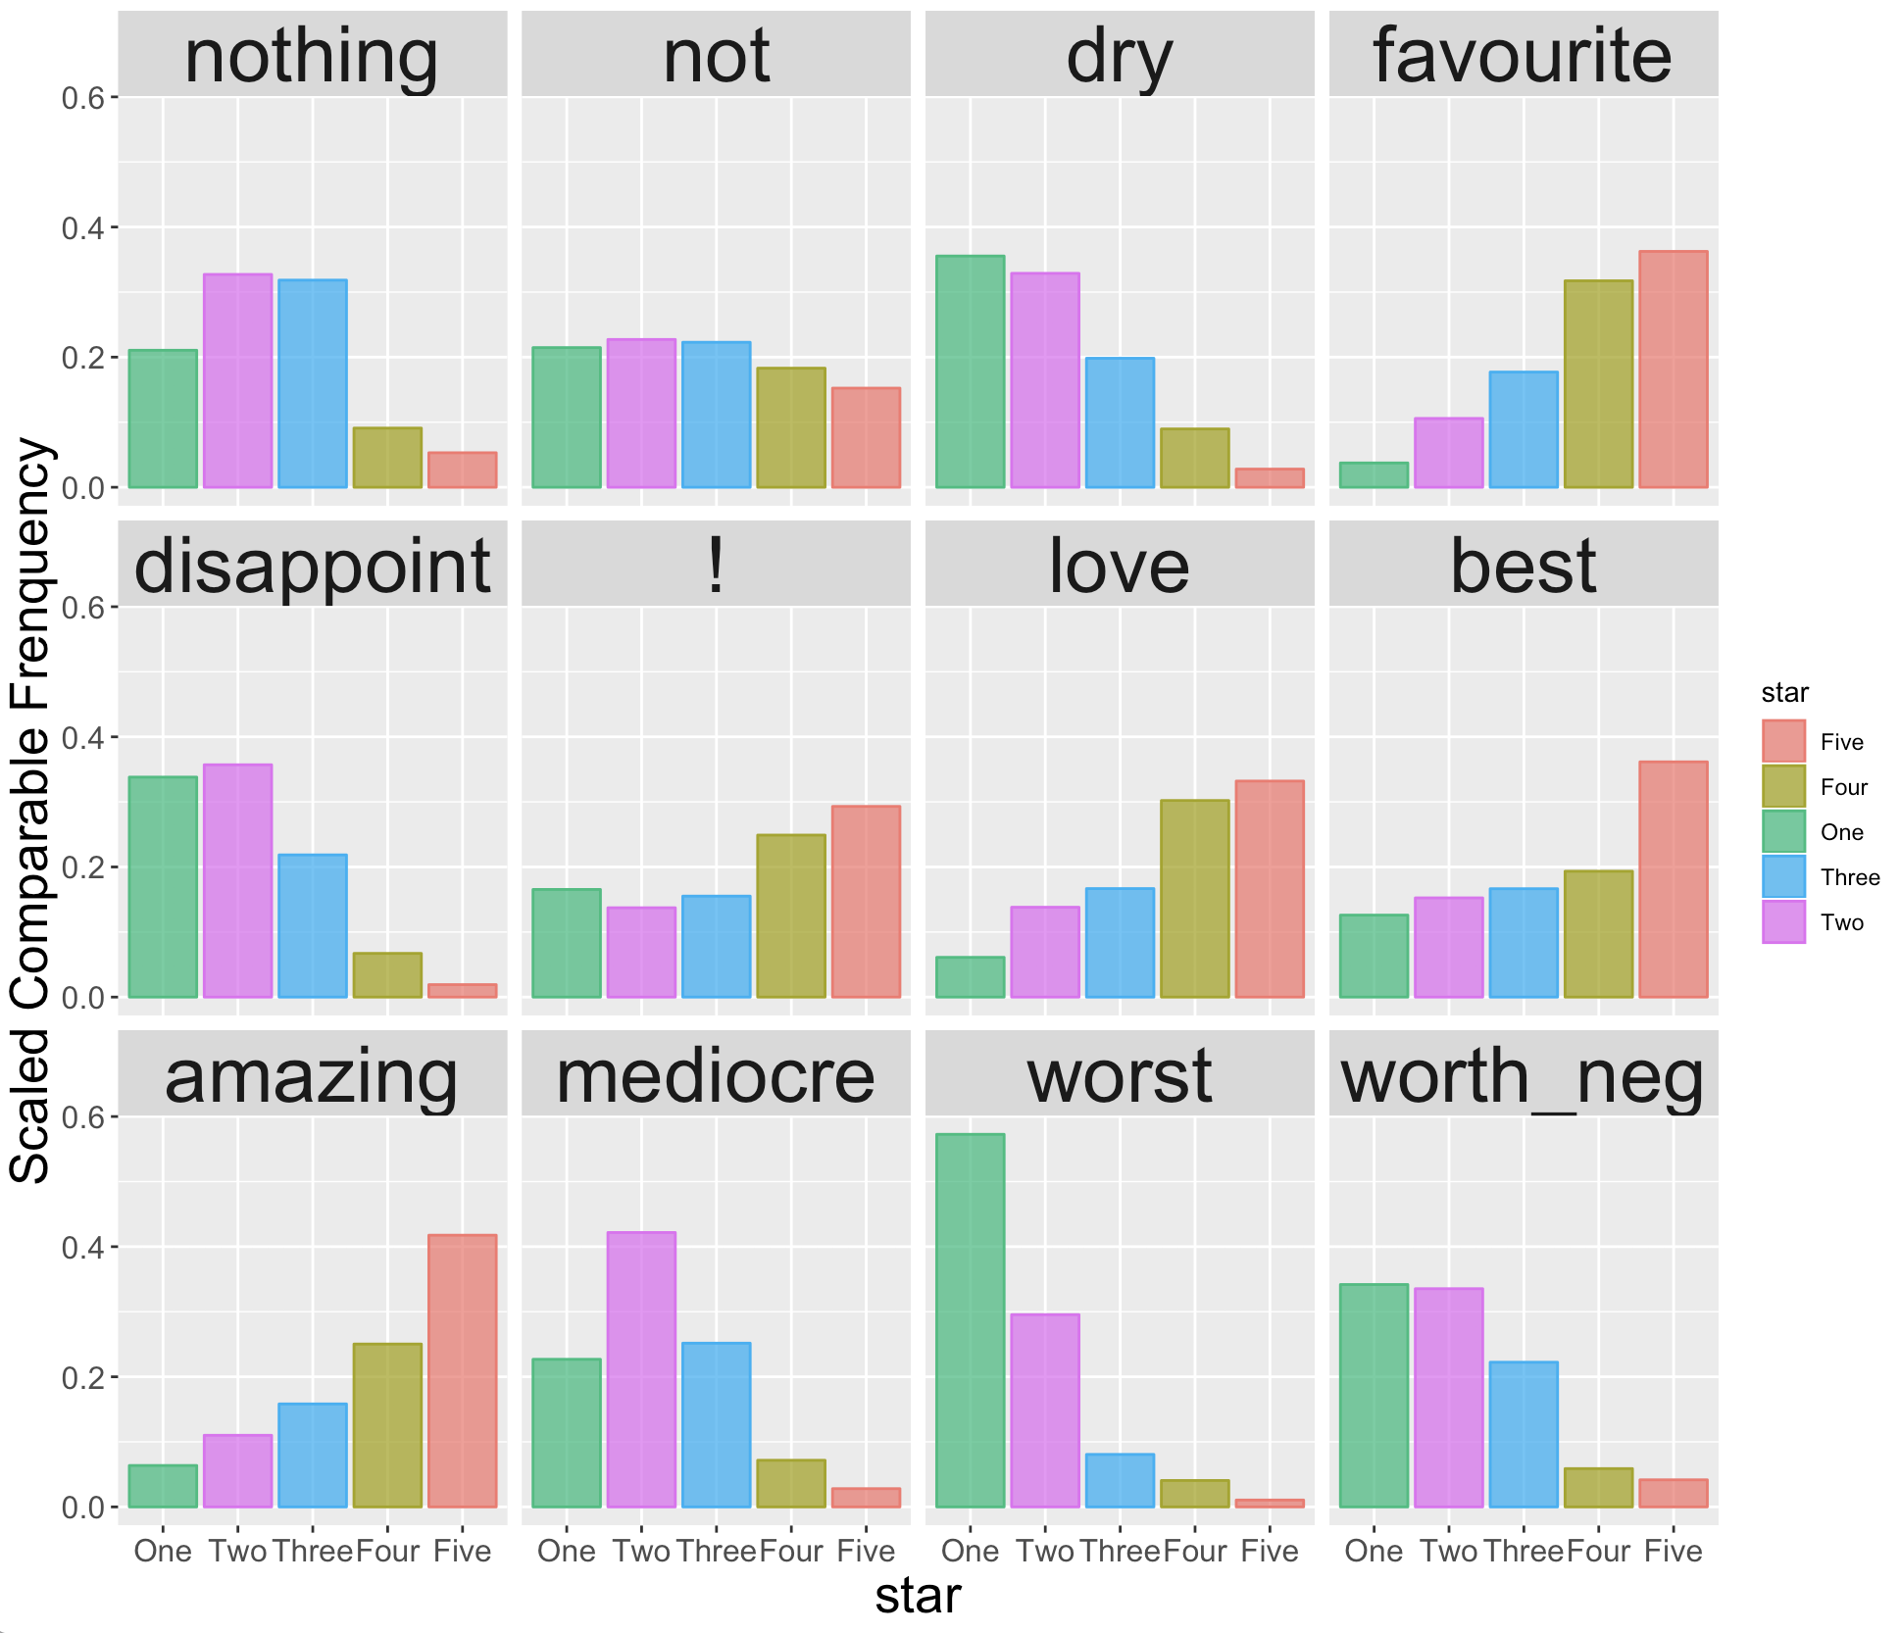
Distribution Plot (IG)
Top 12 significant variables selected by Information Gain

Slide 17
Future Work
Business Part:
Find out what happens in December
Extract keywords with the aspects / attributes they describe
Kaggle Part:
Try other preprocessing steps like Word2Vec…
Spend more time on tuning hyperparameters
Use more accurate models like SVM, MaxEnt, LSTM…

