Slide 1
Module2: Yelp Reviews
By Xiaohan Wang, Tiannan Huang and Siyu Wang
Tues Group3

Slide 2
Outline of this presentation
Kaggle prediction on stars of reviews
Bag-of-words Model
Deep Learning Model
Business analysis of the Wicked Spoon restaurant
Attributes Analysis
Pre-defined Season Analysis
Detect Seasonal Trend
Suggestions

Slide 3
Bag-of-words model
Using Linear / Naïve Bayes / Logistic / SVM
None of them reach the threshold on test data.
Below is result using 10k data
 | Frequency-RMSE | TF-IDF RMSE | Boolean RMSE
Naïve Bayes | 0.986 | 1.056 | 0.975
Linear Model | 0.964 | 0.892 | 0.961
Logistic | 1.101 | 0.933 | 0.953
SVM | 1.000 | 0.909 | 0.959

Slide 4
Deep Learning
One layer LSTM (Input - Embedding - LSTM - Output)
Embedding：Keras built-in
LSTM: Tune the number of hidden_nodes
Final result on Kaggle: 0.81

Slide 5
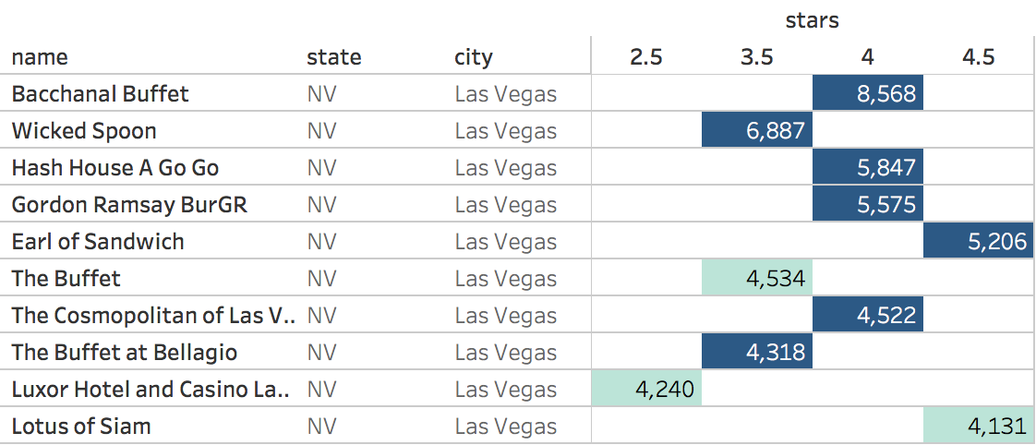
Business Analysis --- Recap
Pick a specific restaurant: Wicked Spoon

Slide 6
Aspect Term Extraction (ATE)
Why use review.json rather than business.json ?
Use spacy (a package) to find the root in a sentence and its dependency
The table below shows the most meaningful roots and its dependency in 2177 five-star reviews
Word | Ratio of No. Mentioned | Some reviews
desserts | 20.2% | a wide variety of desserts / look totally fresh and custom made / overall very pretty but unique looking.
cheese | 16.8% | Devils Mac and cheese, soooo gooood!!!
marrow | 13.3% | The bone marrow is a must try.
salad | 10.7% | mini / beet / kale / caesar salad
chicken | 13.0% | Fried chicken / the king pao chicken was exceptional.

Slide 7
Aspect Term Extraction (ATE)
The table below shows the most meaningful roots and its dependency in 507 one-star reviews
Word | Ratio of No. Mentioned | Some reviews
line | 28.8% | Ate at 6pm, waited in line to pay, waited in line to get seated then waited in line to serve myself.
legs | 21.1% | Crab legs tasted like water / cold / frozen / broken / …
selection | 18.9% | Limited selection / sucked / pitifull / joke / diminished
sushi | 17.4% | there was no sushi worth mentioning / weird / hard
rib | 12.8% | The prime rib was salty / fat / SO tough, I could not cut it with a knife.

Slide 8
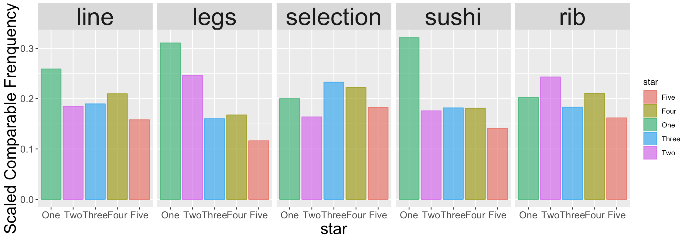
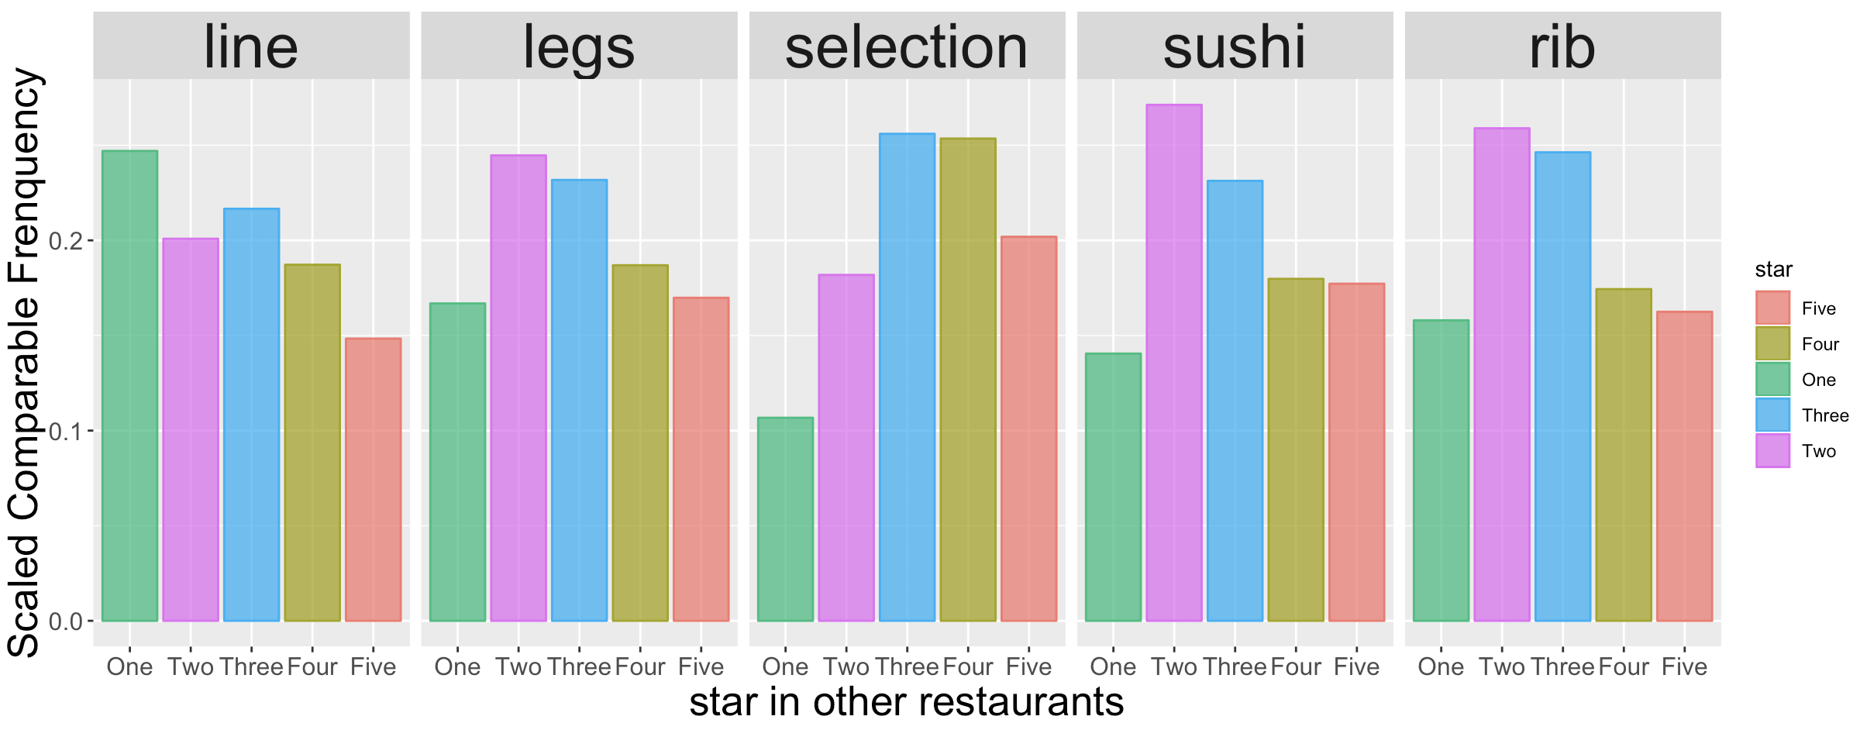
Distribution Plot of Attributes
Wicked Spoon:
Other Restaurants:

Slide 9
Hypothesis Testing on Attributes
If we care more about the distribution of the stars in reviews, we could use chi-square test.
H0: The distribution of reviews with negative attributes is different from the distribution of reviews without negative attributes.
If we care more about the average (median) score, we could use Wilcoxon two-sample test.
H0: The median of reviews with negative attributes is larger than the median of reviews without negative attributes. (One - Sided)

Slide 10
Chi-Square Test
Take line as an example:
 | ONE-STAR | TWO-STAR | THREE-STAR | FOUR-STAR | FIVE-STAR
line appears | 68 | 70 | 129 | 234 | 178
line does not appear | 439 | 663 | 1185 | 1922 | 1999
 | Line | Legs | Selection | Sushi | Rib
P-value | 0.002 | 0.000 | 0.010 | 0.000 | 0.208

Slide 11
Wilcoxon two-sample test
Take line as an example:
X = (1…1, 2…2, 3…3, 4…4, 5…5) The count of (1,2,3,4,5) is (68,70,129,234,178)
Y = (1…1, 2…2, 3…3, 4…4, 5…5) The count of (1,2,3,4,5) is (439, 663, 1185, 1922, 1999)
 | ONE-STAR | TWO-STAR | THREE-STAR | FOUR-STAR | FIVE-STAR
line appears | 68 | 70 | 129 | 234 | 178
line does not appear | 439 | 663 | 1185 | 1922 | 1999
 | Line | Legs | Selection | Sushi | Rib
P-value | 0.003 | 0.000 | 0.182 | 0.000 | 0.046

Slide 12
Result
Combine the previous results:
 | Line | Legs | Selection | Sushi | Rib
P-value from Chi-Square | 0.002 | 0.000 | 0.010 | 0.000 | 0.208
P-value from wilcoxon | 0.003 | 0.000 | 0.182 | 0.000 | 0.046

Slide 13
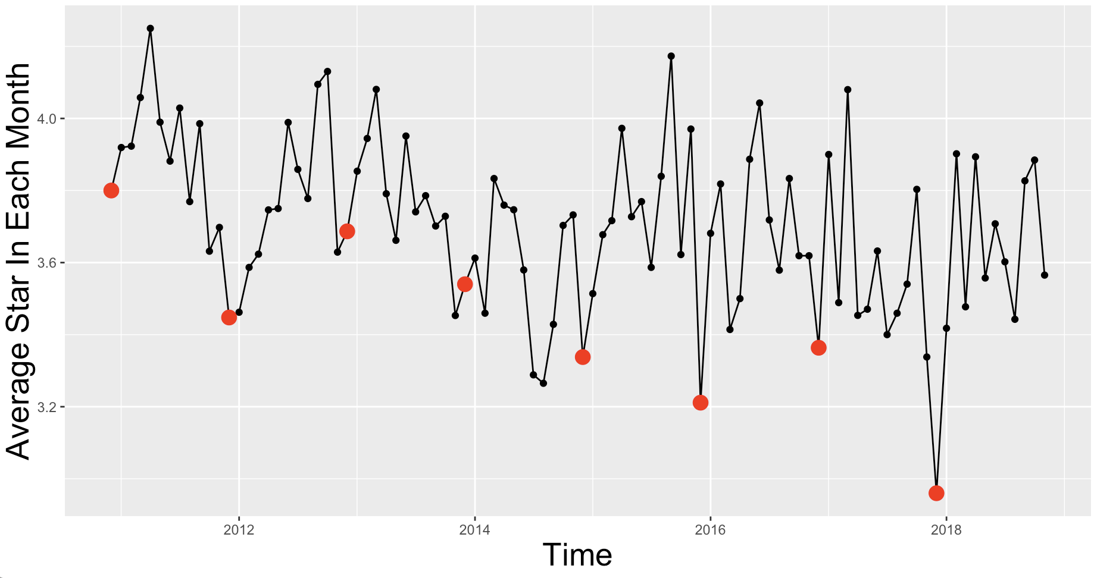
Seasonal Trend - Recap
Red dots denote average stars in december

Slide 14
Pre-defined Season
Spring (3 - 5), Summer (6 - 8), Autumn (9 - 11), Winter (12 - 2)

Slide 15
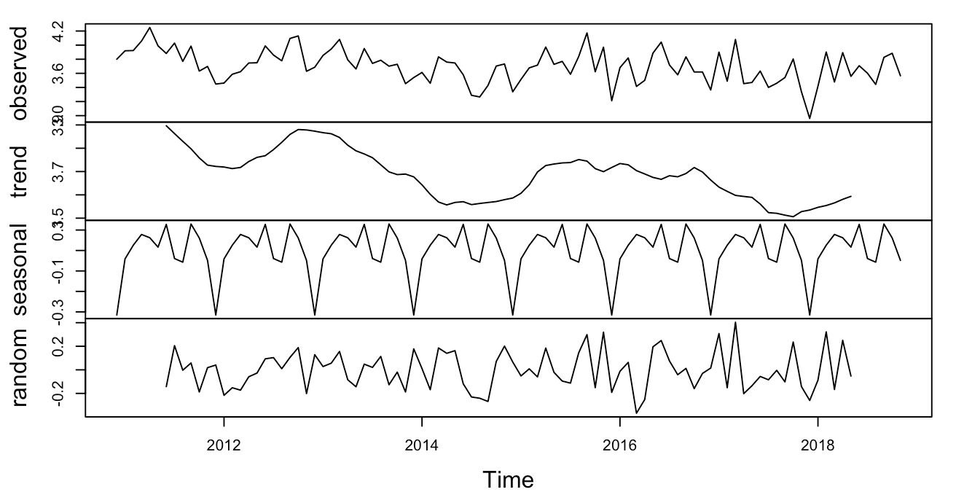
Time Series Analysis
Decompose the time series using MA model.
P-value from adf.test is 0.0173 Stationary

Slide 16
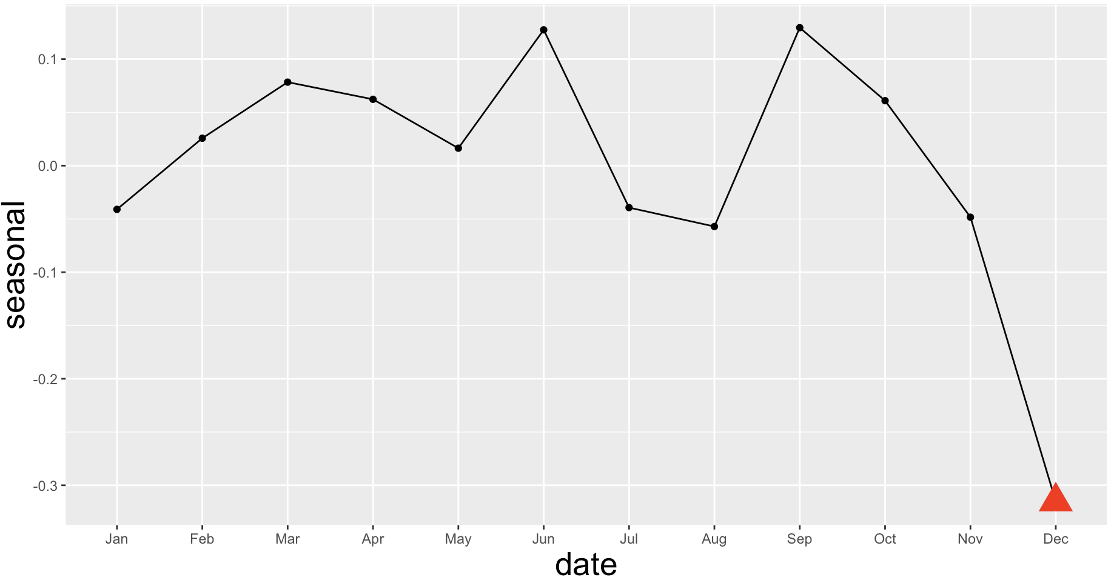
Seasonal Trend
We can see Dec is significant lower than other months, we will discuess the reason later.

Slide 17
Future Work
Business Part:
Find out what happens in December
Extract keywords with the aspects / attributes they describe
Kaggle Part:
Try other preprocessing steps like Word2Vec…
Spend more time on tuning hyperparameters
Use more accurate models like SVM, MaxEnt, LSTM…

