Slide 1

Group 9 Contact Manager
“Dystopian Realty”

Slide 2
Team Members/Roles
Ashwin Jegatheesan: API Endpoint
Richard Morand: Database
Joseph Badio: API Front-End
Nader Hesham Abd El Rasol : Front-End
Sebastian Salazar: Project Manager

Slide 3
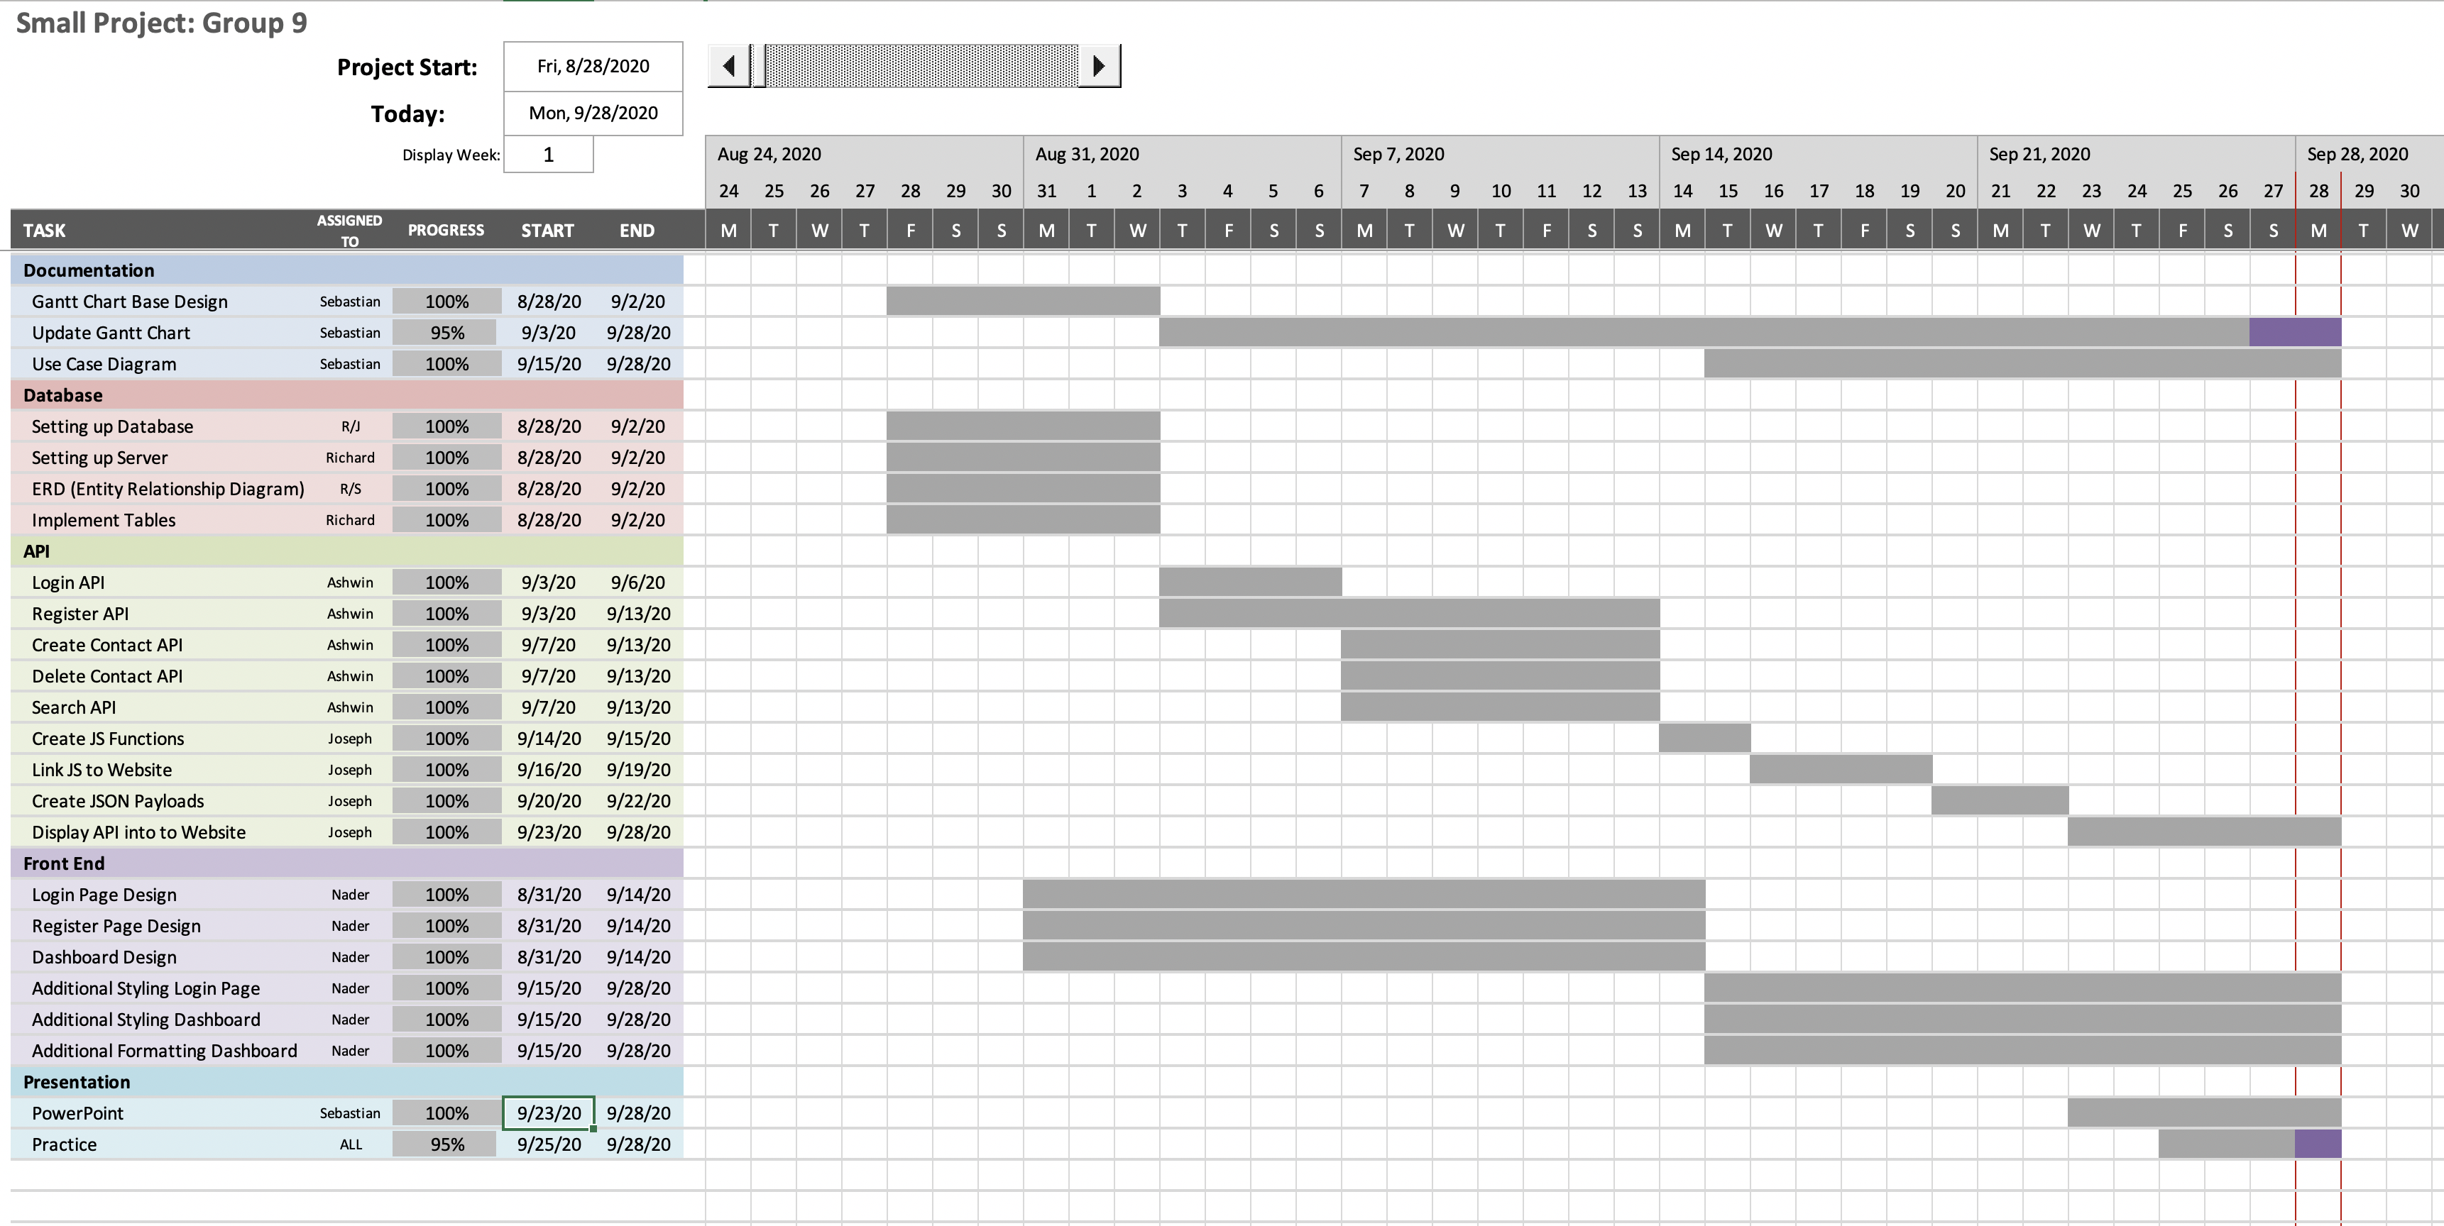
Gantt Chart

Slide 4
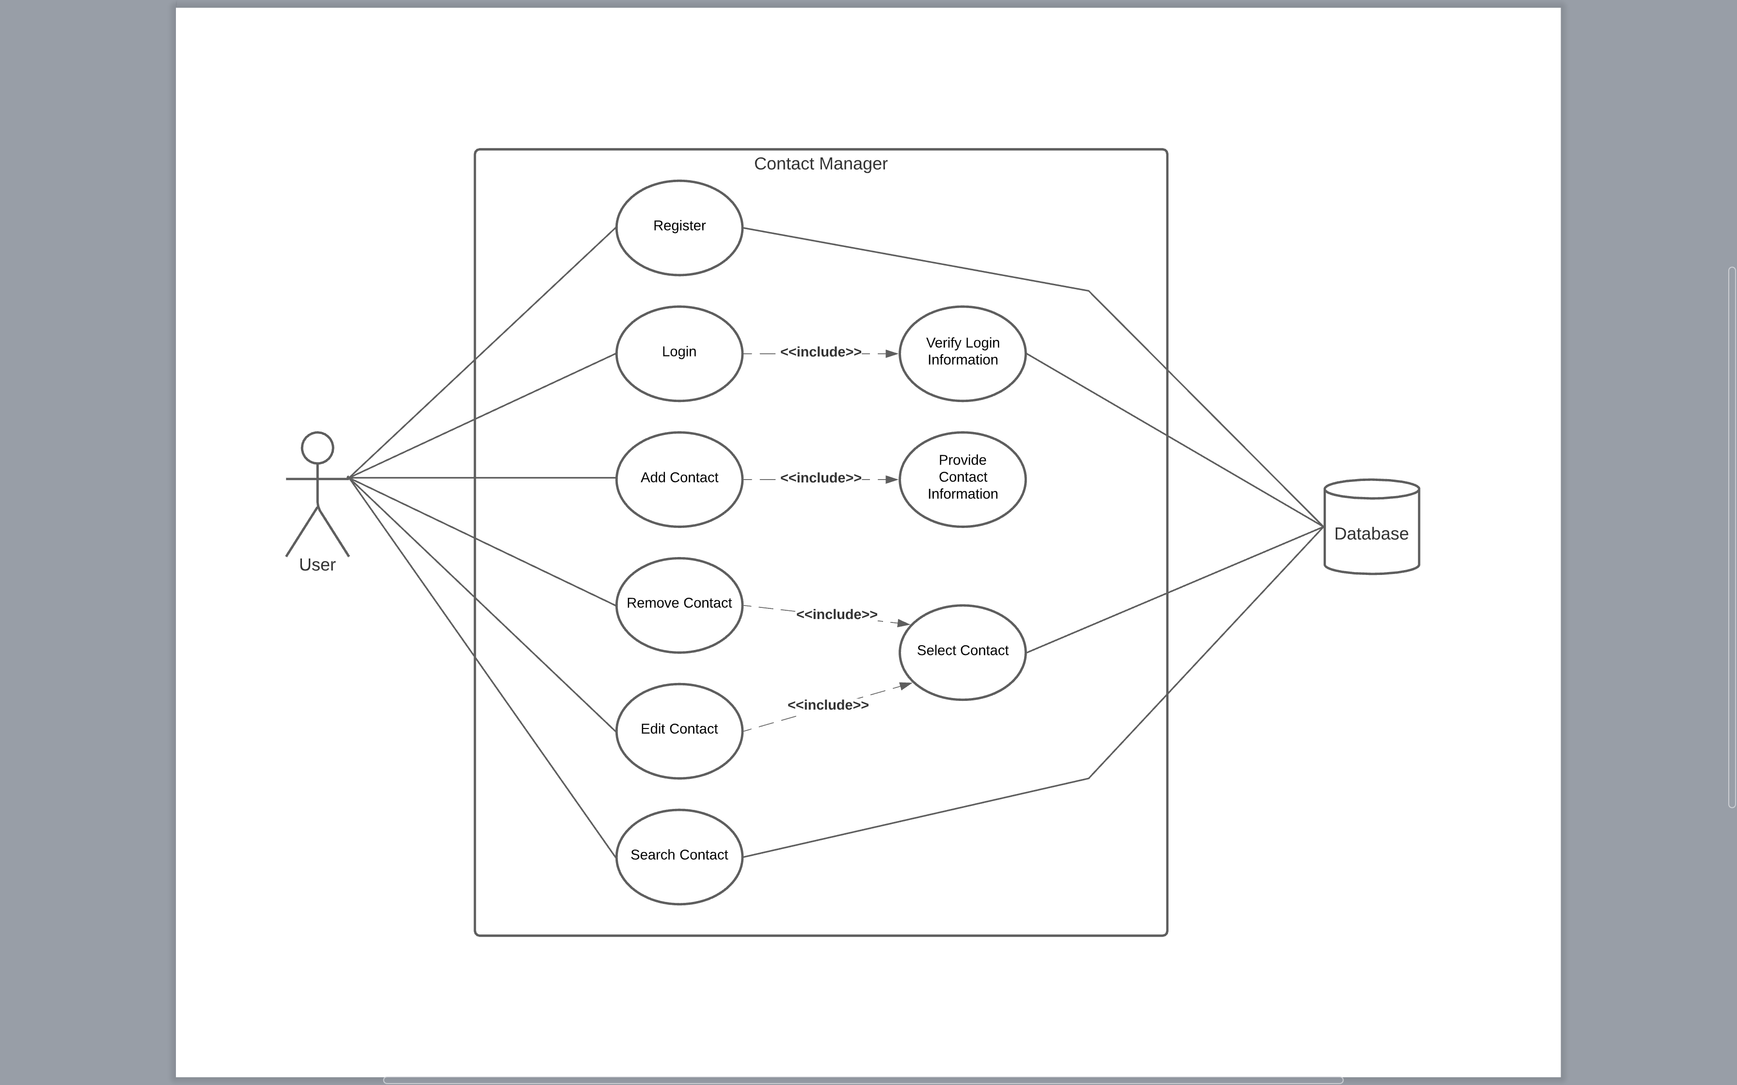
Use Case Diagram

Slide 5
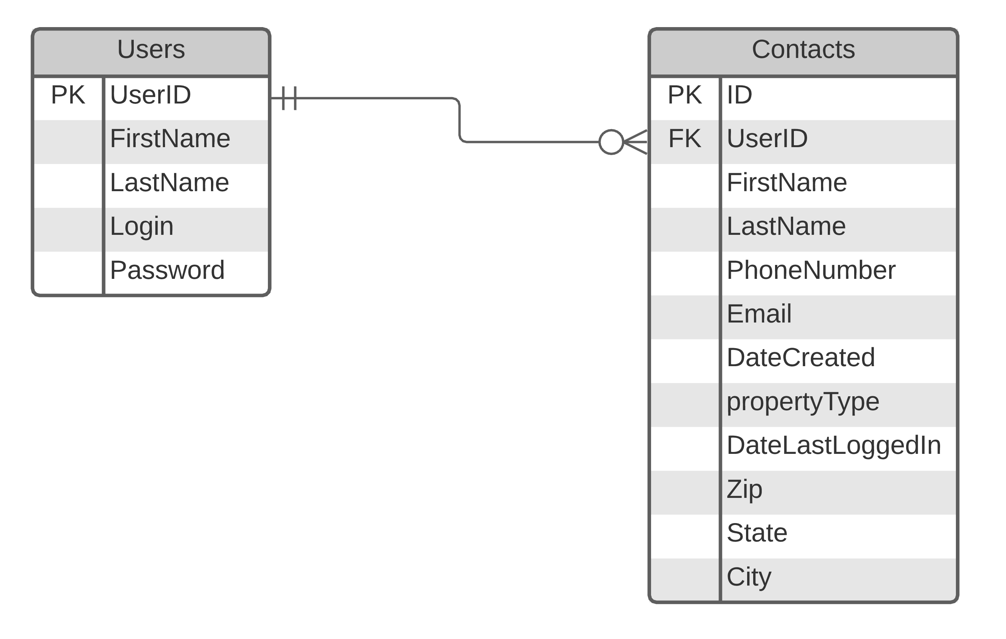
Entity Relationship Diagram

Slide 6
Technologies Used

Slide 7
Teamwork Technologies
Discord (Communication/Updates)
GitHub (Repository)

Slide 8
Management Technologies
Microsoft Excel (Gantt Chart)
Microsoft PowerPoint (Presentation)
LucidChart (Use Case Diagram)

Slide 9
API Technologies
JavaScript (JSON)
Swagger Hub (Testing)
ARC (Testing)

Slide 10
Front-End Technologies
HTML/CSS
Bootstrap (Framework)

Slide 11
Back-End Technologies
PHP (Server Scripting Language)
MySQL (Database Management)
Cpanel (Database Management)

Slide 12
Things that went well
Everyone Attended All Meetings
Nobody Ghosted
Suggested deadlines met

Slide 13

Things that did NOT go well
JSON Payload Capitalization Issues
Redirection Issues within JavaScript

Slide 14
API Demo

Slide 15
Website Demo

Slide 16
Questions?

