Slide 1
Machine learning
A Quantum K-Means implementation

Slide 2
TABLE OF CONTENTS
01
02
PROBLEM
K-Means
03
04
Quantum Calculus
Comparative

Slide 3
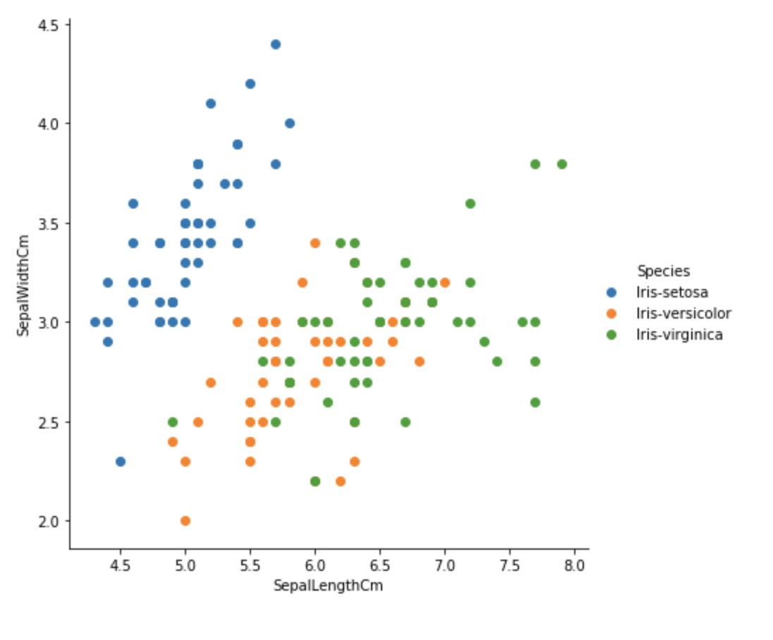
Problem to solve
Notes:
Is a classification problem, in this example from the iris dataset there are 3 clases, but what do u do when you dont know the classiofication of the classes, you use clustering algorithms

Slide 4
How do you solve it?
Notes:
and how do you solve it, you use machine learning algorithms like k-means, an algorithm that finds groups based on the proximity of the points lets see how it works

Slide 5
Notes:
first we initialize randomly k centroids being k the number of classes do u want to have and using the euclidean distance u find the nearest points to the centroids and move the centroids using the mean of the measures

Slide 6
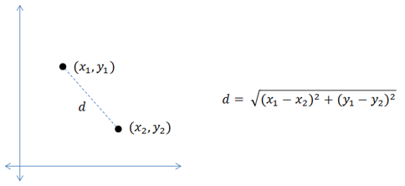
Euclidean Distance
Notes:
for those who dont know what’s the euclidean distance about, is the lowest distance between 2 points

Slide 7
Where is the quantum here?
Get ready for the maths :)

Slide 8

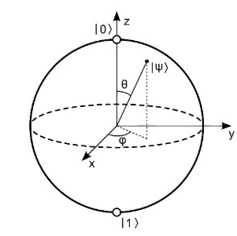




Slide 9
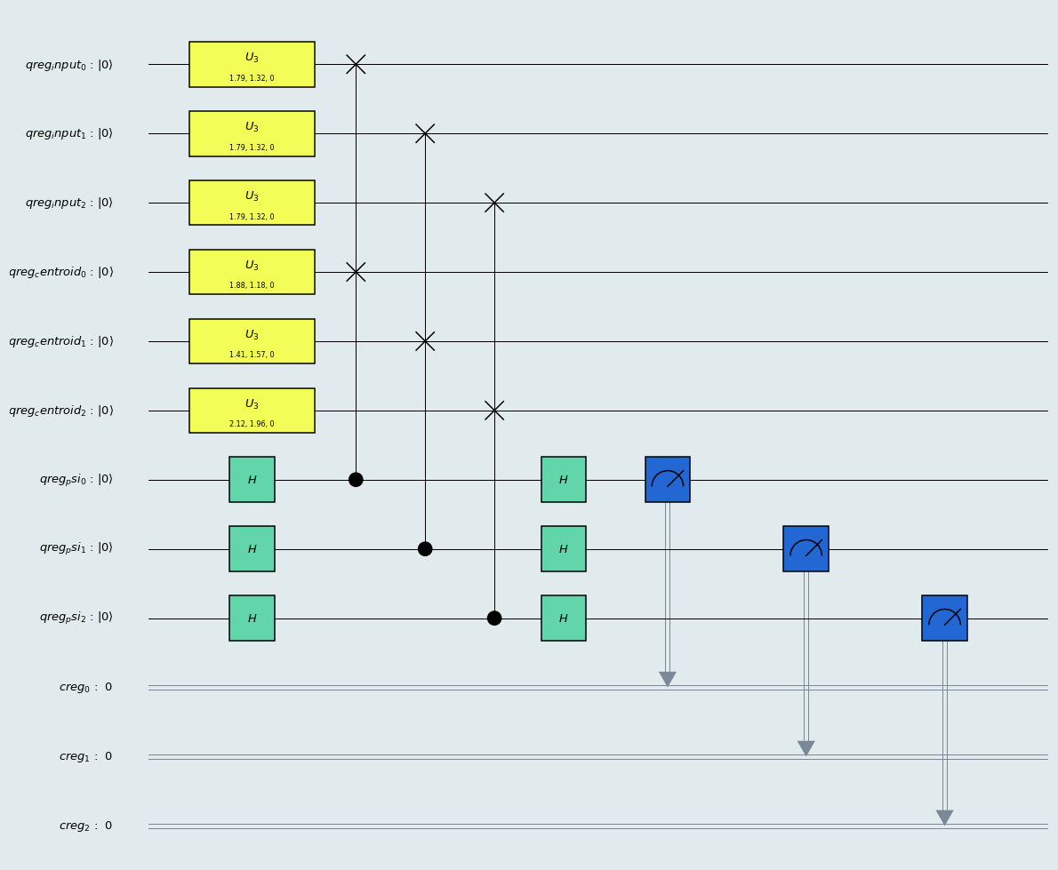
Notes:
This circuit allows us to have an observable from this circuit proportional to the distance between the data and centroids

Slide 10


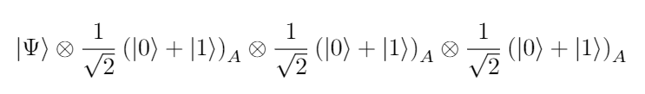
Notes:
Initialize the circuit on 0 and a rotation is aplied to the data and centroids → the X psi is built → the data is repeated 3 times with the k centroids and 3 auxiliars qbits
Then a hadamar gate is aplied to the auxiliaries to keep them in a superposition state

Slide 11
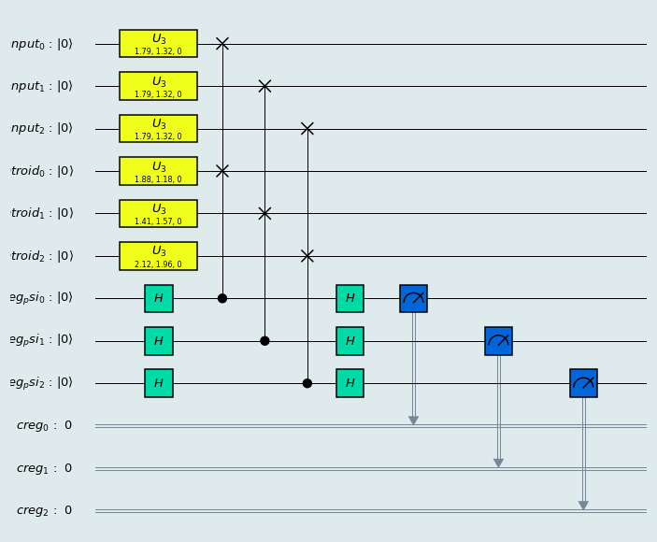
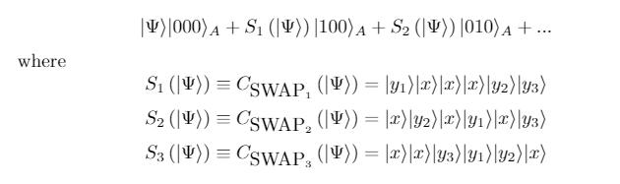
Notes:
Have the superposition in the auxiliaries we aply controled swaps to connect each qbit with 1 centroid and an auxiliar qbit

Slide 12

Notes:
Apliying hadamar again to the auxiliaries we get that the possibilities of gettin a 1 on each auxiliar qbit is proportional to the distance from the data to the centroid. Where the euclidean distance is defined by that formula

Slide 13

CLASSICAL
QUANTUM

Slide 14
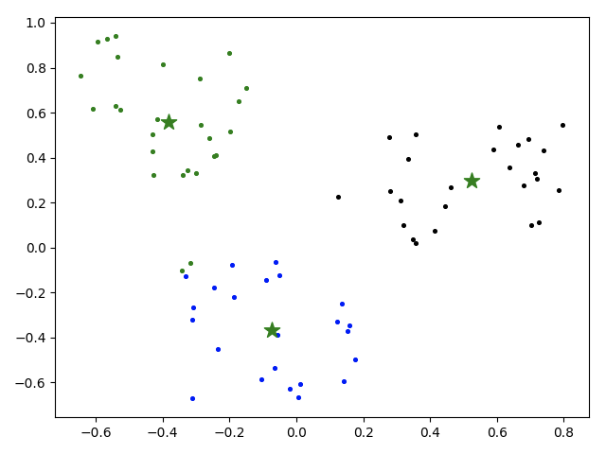
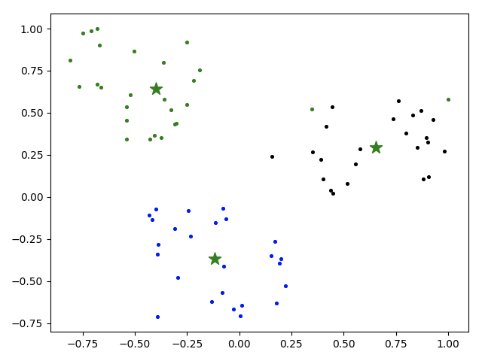
K-Means
Q-Means
Mean 1000 it
Time euclidean_distance: 2.020096778869629e-05
Time quantum_distance_efficient: 0.07817067694664001

Slide 15
Contribs
There isn’t any not-supervised algorithm in qiskit-aqua
Upcoming qiskit-aqua implementation
Improvements on the quantum K-means algorithm (https://arxiv.org/pdf/1812.03584.pdf)
Not sequential only with one measurement

Slide 16
https://github.com/Morcu/q-means
David Morcuende
Pablo
Díez
Thanks!
Carlos Villacampa
Carlos García
Boris Villazón

