Slide 1



Our exam project:
Tides Of Envy
Dombi Levente
Petri Áron
Havasi Máté

Slide 2
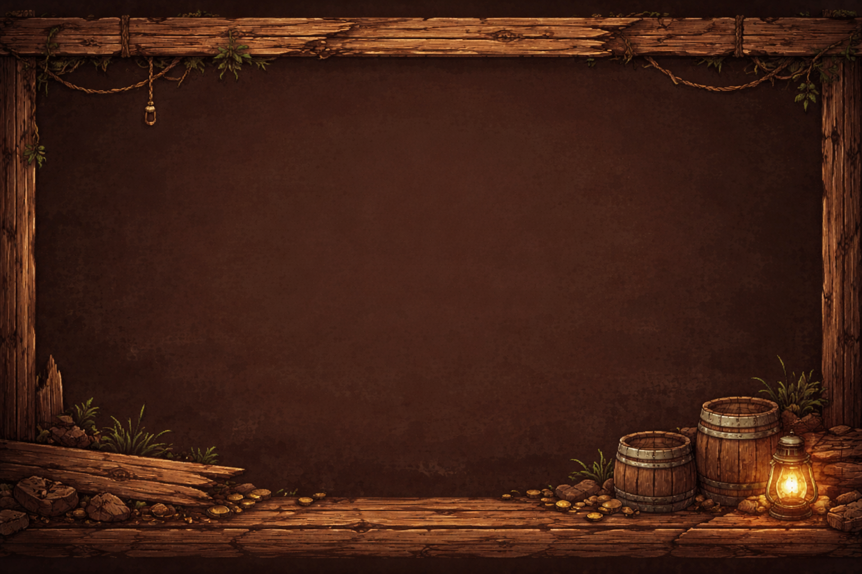


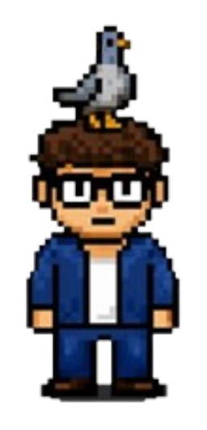
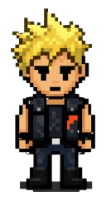
The Team
Áron
Levente
Team Leader
Máté
Frontend/Game
Backend
Database/Game

Slide 3

Our reason :
Levis’s reason
Máté’s reason
Áron’s reason

Slide 4
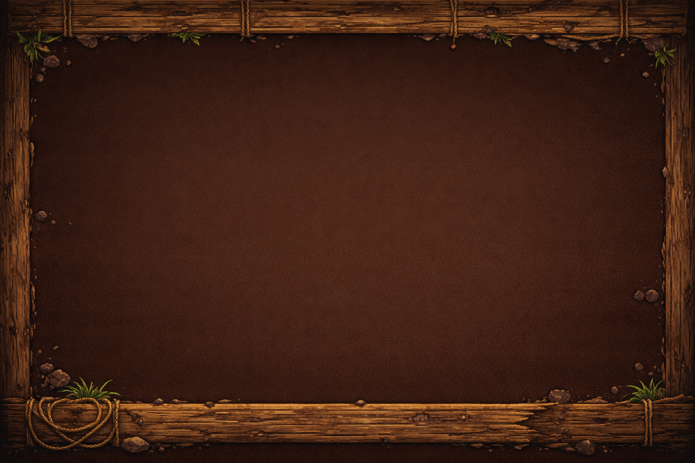

Name explaination
Tides Of Envy
Tides -> waves
Envy-> enemies feelings

Slide 5
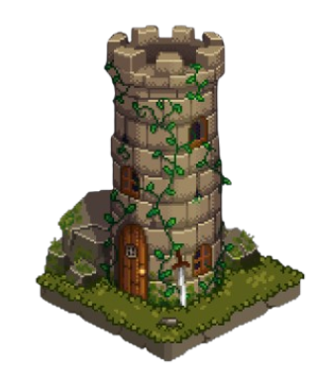


Project’s structure
2 different part:
Game -> Tower defense
Webpage

Slide 6










Programs we used

Slide 7


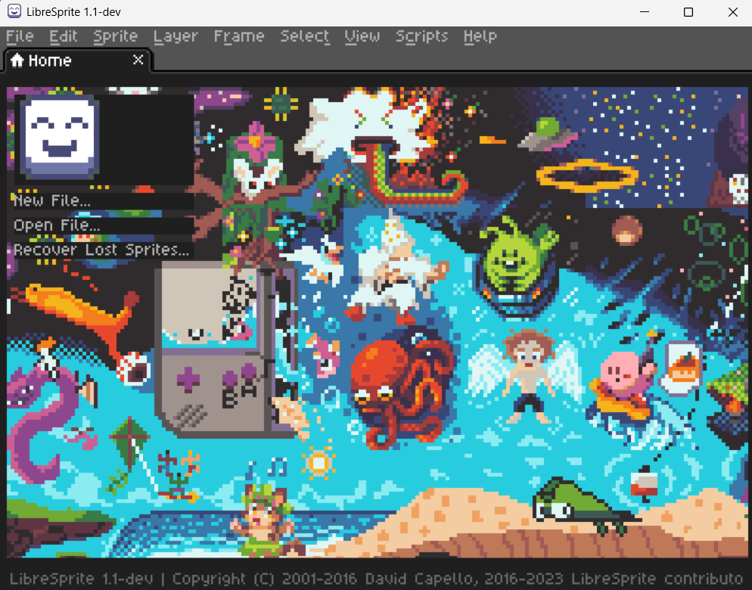

Animation and draw
Character design and animations.
„LibreSprite”

Slide 8
Rackhost
FileZilla
Upload Download Editing Managment
Domain Virtual Server Web Hosting

Slide 9
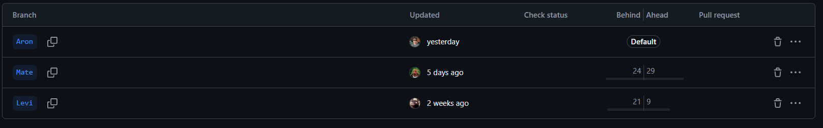
Github

Slide 10
The Website

Slide 11
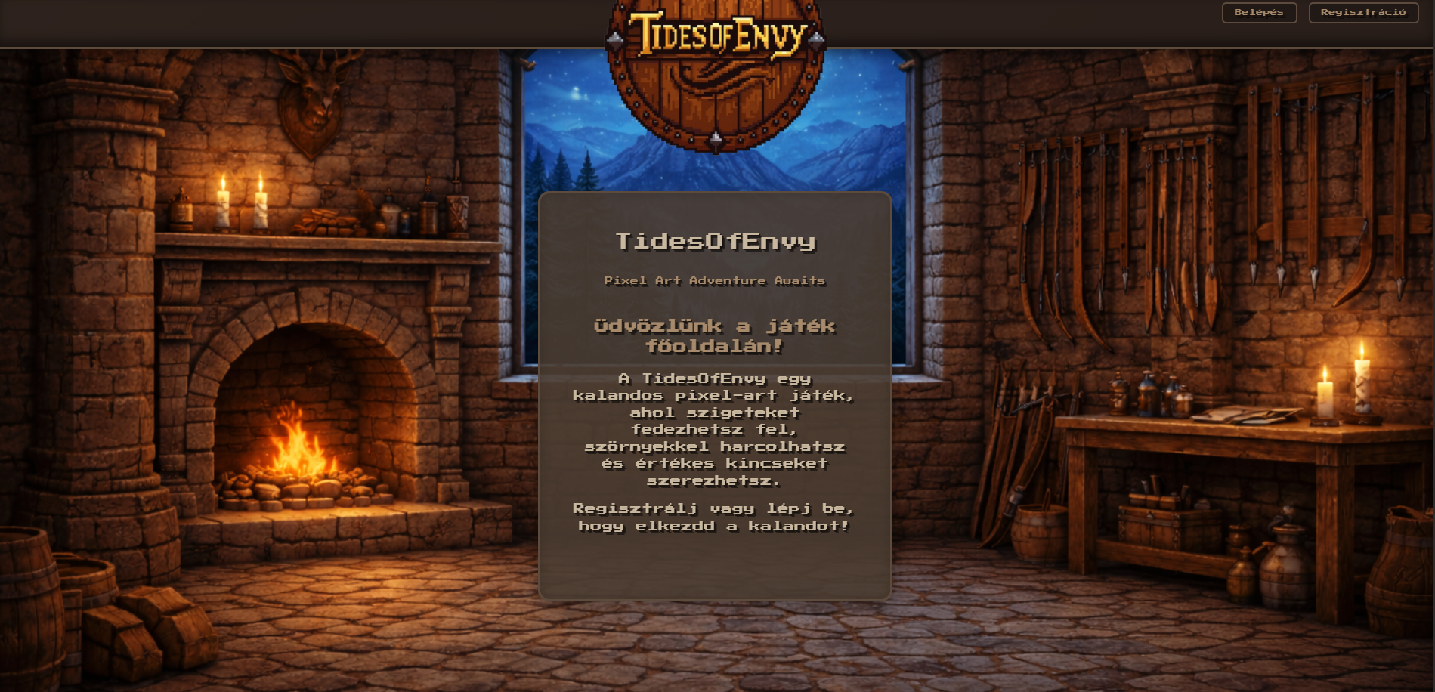
website:
Functions:
-login -registration
-Chat -bg music -profil -Admin prof -dowload
https://tidesofenvy.hu/

Slide 12
Website Demo

Slide 13
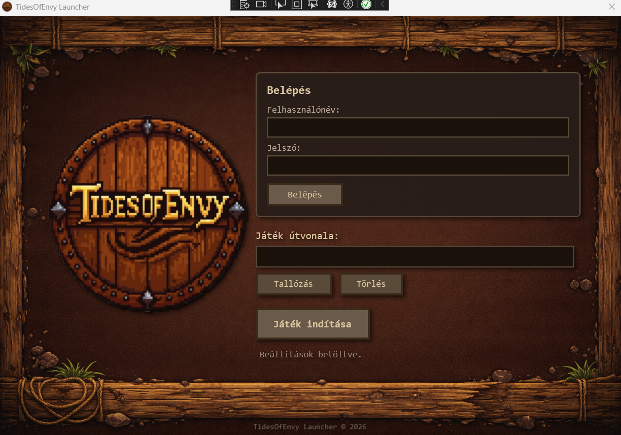
Launcher
C#
WPF Api Php

Slide 14
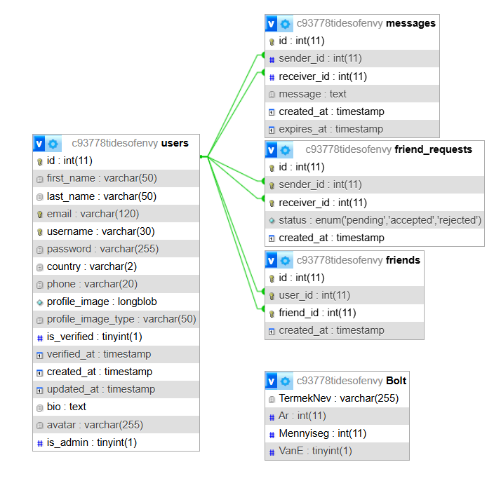
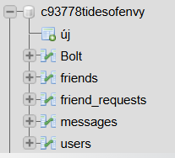
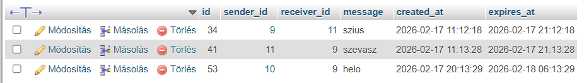
DataBase

Slide 15
The Game

Slide 16
Game engine
Why did we choose this engine ?
Free
Developer-Friendly
2D and 3D Capabilities

Slide 17
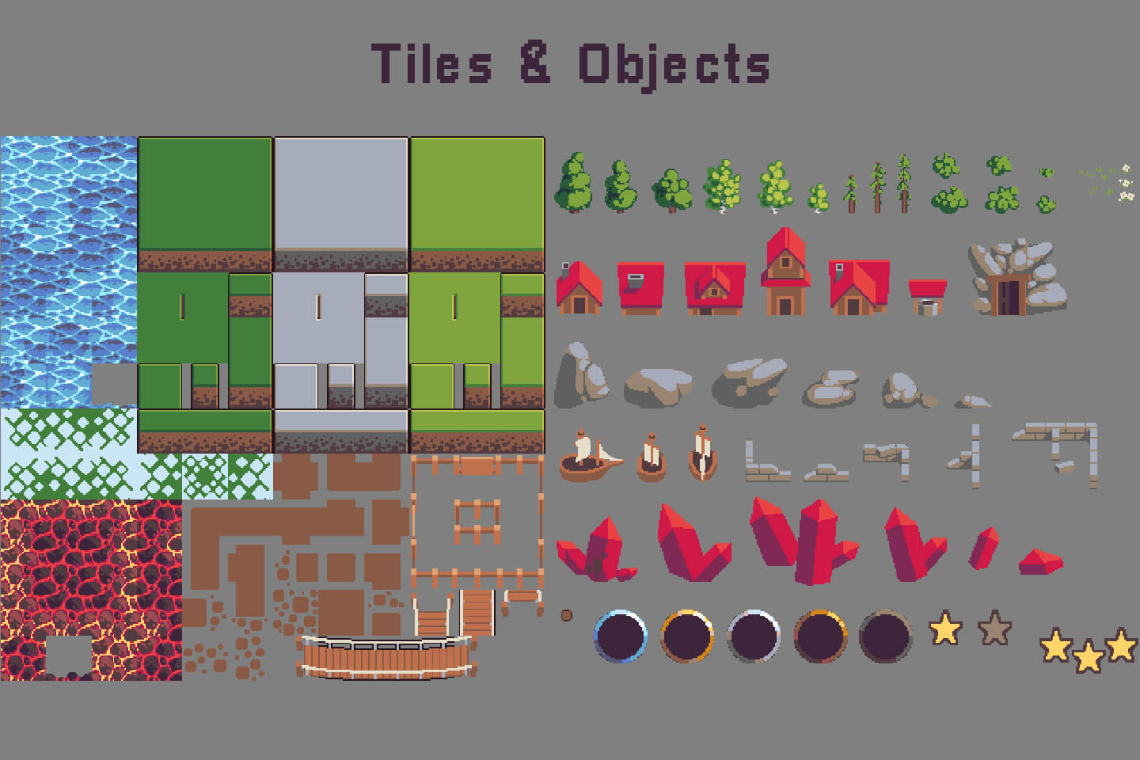
Assets
- map / word - gameplay loop - Characters tesztelés Dia jira github bemutatás projekt managment kicsit rovidités telepít launcher -> jatek

Slide 18
Gameplay
GamePlay:
-Towers
-Defenders
-Wawes
-Resources
Demo

Slide 19
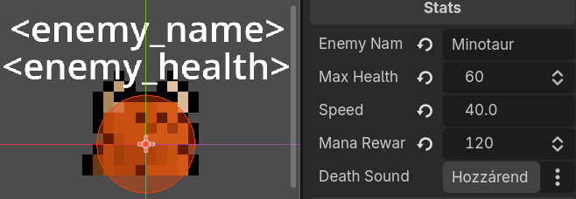
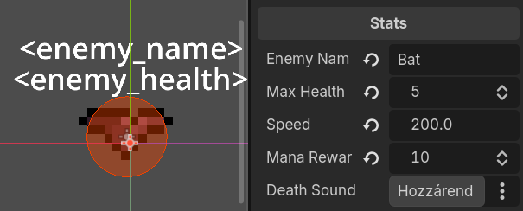
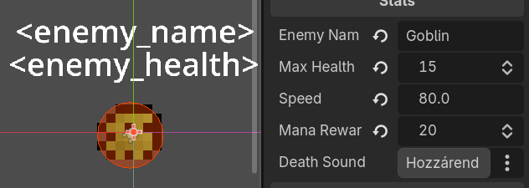
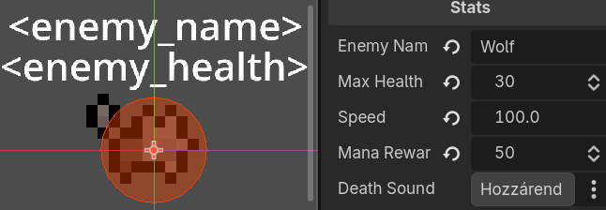
Enemies:
Minotaur
Bat
Goblin
Wolf

Slide 20
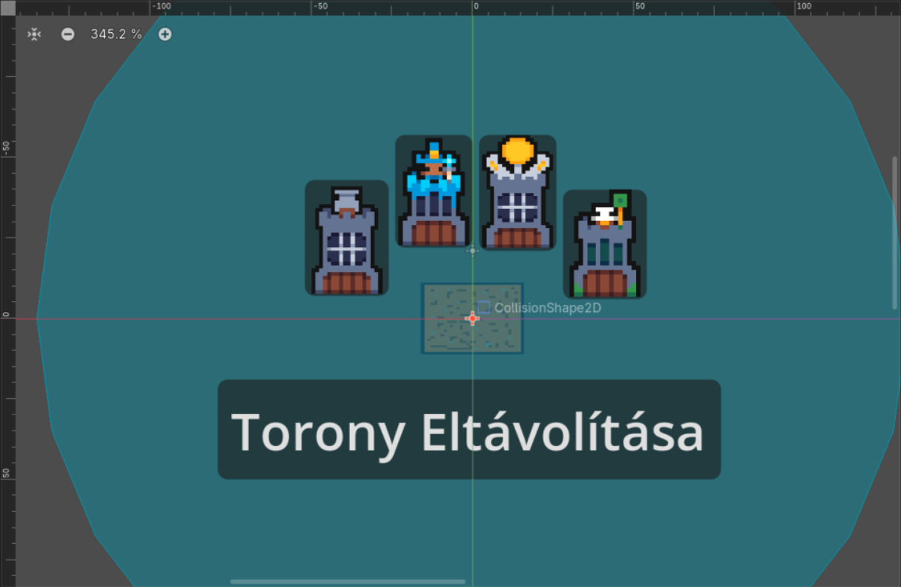
Towers:
Features:
-damage type -effect -cost

Slide 21
Game Demo

Slide 22
Questions

Slide 23
Thank you for your attention !

