Slide 1


INSTITUTE FOR ADVANCED COMPUTING AND SOFTWARE DEVELOPMENT AKURDI, PUNE
“Slot Booking for Charging an EV at Charging Station”
PG-DAC Sept 2021
Presented by:
Group-54
More Sangram Rajkumar - 210941220108
Joshi Sushant Prakashrao - 210941220080
Mrs. Shilpa Pawale Mr. Kashinath Patil
Project Guide Project Guide

Slide 2
Table of Contents
Introduction
Abstract
Technology used
Modules/functionality
Current Scope
Future Scope
ER-Diagram
Page-Navigation

Slide 3
Introduction
An electric vehicle (EV) is one that operates on an electric motor, instead of an internal-combustion engine that generates power by burning a mix of fuel and gases. Therefore, such as vehicle is seen as a possible replacement for current-generation automobile, in order to address the issue of rising pollution, global warming, depleting natural resources, etc. Though the concept of electric vehicles has been around for a long time, it has drawn a considerable amount of interest in the past decade amid a rising carbon footprint and other environmental impacts of fuel-based vehicles.
But with increase in demand of electric vehicles leads to increasing requirement of Charging stations.Also we need to Manage this station.There is need of slot booking system with location detector.

Slide 4
Abstract
As the world is facing an insufficiency in fossil fuels, every nation is moving towards sustainable, admissible, reliable and efficient green resources of energy. The technology supporting Electric Vehicles (EVs) is rapidly developing towards improvement as the cost of EV components are reducing. Electric Vehicles (EV) are gaining more popularity as the conventional vehicles are affecting the environment drastically.
In the proposed work, the State of Charge (SoC) of the EVs battery is displayed constantly and the nearest charging stations are displayed on the screen. From a list of suggested charging stations nearest to the EV driver, the screen in the vehicle will direct the driver to the slot booking website through which all the available slots are displayed. As EVs become more commercial, there will be a need to create an efficient slot booking system as the charging process can be time consuming and the need for more stations will be demanding. The proposed model of the booking system is designed to create a cost effective and efficient system.

Slide 5
Technology used
React (Front End)
React. js is an open-source JavaScript library that is used for building user interfaces specifically for single-page applications. It's used for handling the view layer for web and mobile apps. React also allows us to create reusable UI components.
Spring Boot (Backend)
Spring Boot makes it easy to create stand-alone, production-grade Spring based Applications.
Features
Create stand-alone Spring applications
Embed Tomcat, Jetty or Undertow directly (no need to deploy WAR files)
Provide opinionated 'starter' dependencies to simplify your build configuration
Automatically configure Spring and 3rd party libraries whenever possible
Provide production-ready features such as metrics, health checks, and externalized configuration
Absolutely no code generation and no requirement for XML configuration

Slide 6
Database:MySQL
MySQL is a relational database management system based on SQL – Structured Query Language. The application is used for a wide range of purposes, including data warehousing, e-commerce, and logging applications. The most common use for mySQL however, is for the purpose of a web database.

Slide 7
Modules/functionality
Customer Management
in this Customer can create his profile with give some personal details .and can Login
To his Account.
Slot Booking
Customer can book his charging slot,by log in to it.Can view his booking details.And only slots which are available to book.
Invoice Genration
After booking slot at charging station invoice will be generated and delivered to Customer via email id.
Admin Control
Admin can Manage Bookings,View Bookings,Update,Delete Bookings,he can add some
Updates. He have the control to all the functionality.

Slide 8
Current Scope
With a charging station, you can charge not only quickly and safely, but intelligently and in comfort as well. As well as safe and quick charging, the electric car driver also gains additional comfort.
As increase in demand of EV’s we need more Man Power to Serve The Charging facility.To Manage All these there is need of central slot booking system which can manage slots. Currently many companies have started Mass Production of Electric vehicle.And to day alo there are many vehicles who needs the facility of Charging Station Slot booking facility.

Slide 9
Future Scope
Electric Vehicles:The Trend
Growing Trend:Globally And nationally
Lowers carbon emission
Reduces U.S dependency on foreign oil
Consumer And Commercial Adoption.Increased demand across all types of drivers
Federal Government Goal by 2030
Bharat Petroleum also announced a plan on Wednesday to provide EV charging infrastructure at its 7,000 fuel stations in next few years. In September Hindustan Petroleum Corp. announced a plan to set up 5,000 EV charging stations in the country in three years

Slide 10
Another report by India Energy Storage Alliance (IESA) projects that the Indian EV market will grow at a CAGR of 36 percent till 2026. The EV battery market is also projected to grow at a CAGR of 30 percent during the same period.
In the future, the app will enable EV owners to check real-time availability of EV charging stations, book slots and pay for EV charging using Wallet, UPI, Net Banking, or Debit/Credit Cards.

Slide 11
ER Diagram

Slide 12
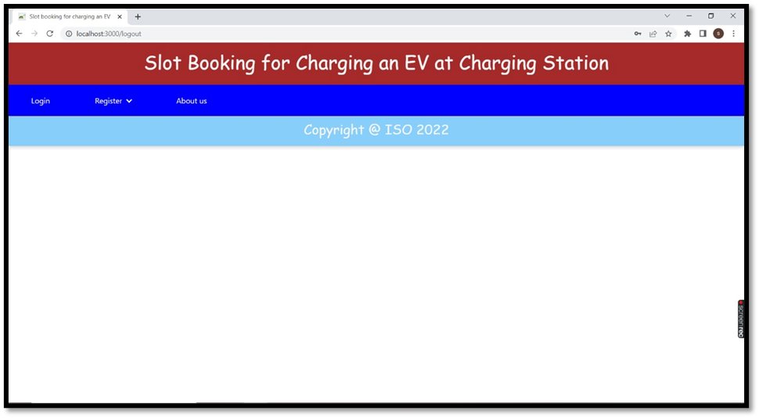
Page Navigation- .Home page

Slide 13
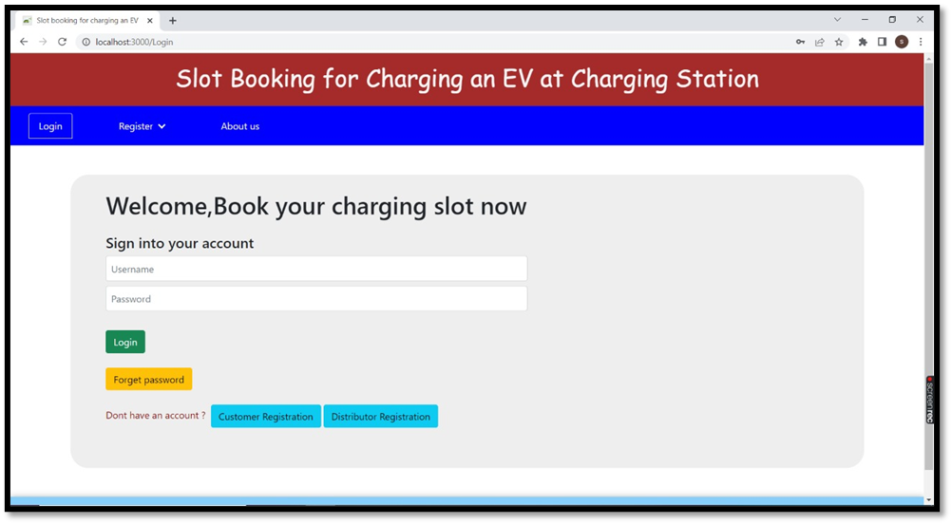
Login Page:

Slide 14
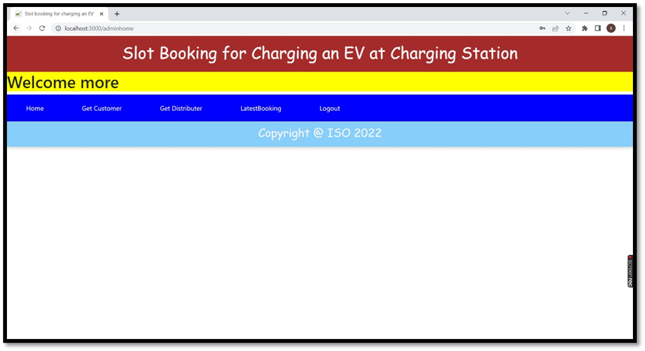
Admin page/Admin Dashboard

Slide 15
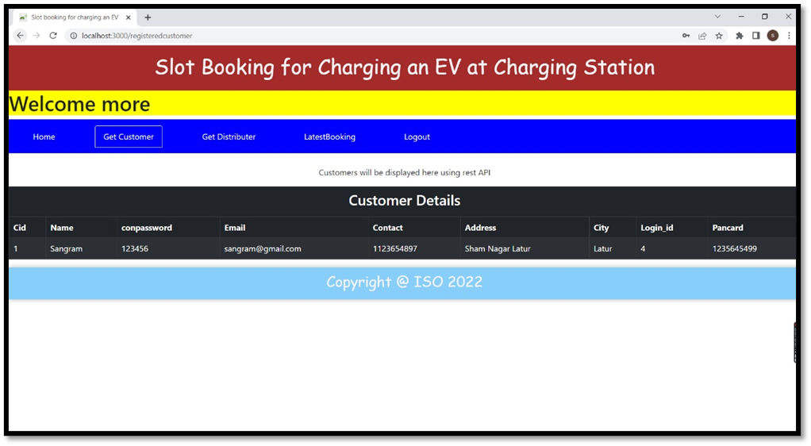
Admin -> get customer page:

Slide 16
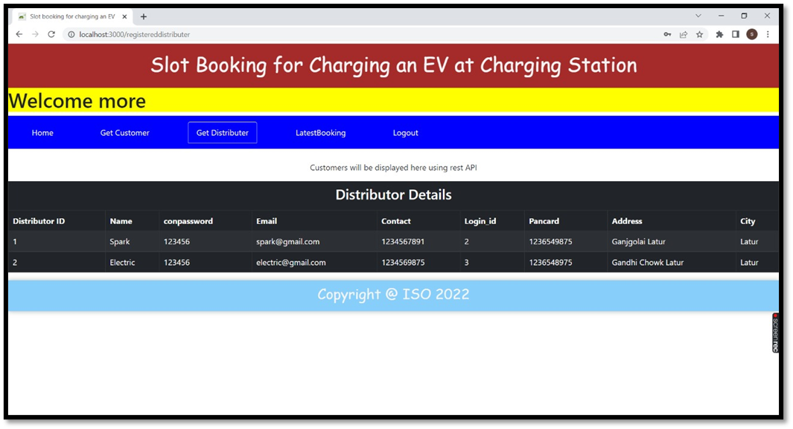
Admin -> get distributer page

Slide 17
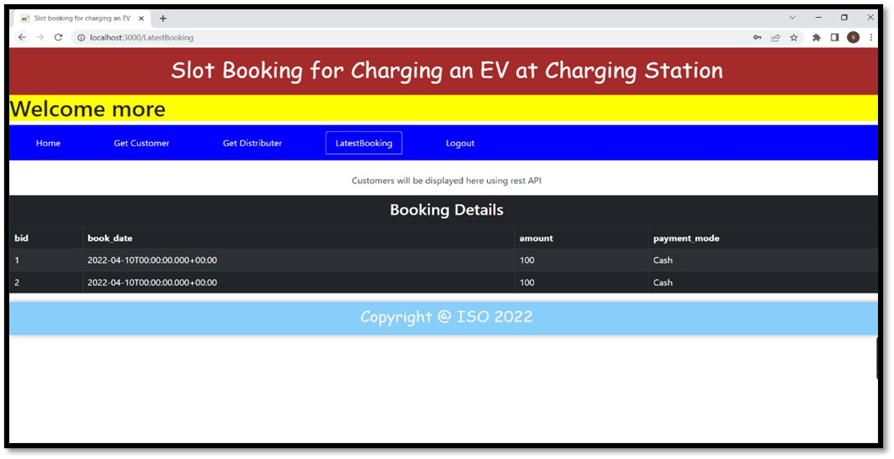
Admin -> latest booking page

Slide 18
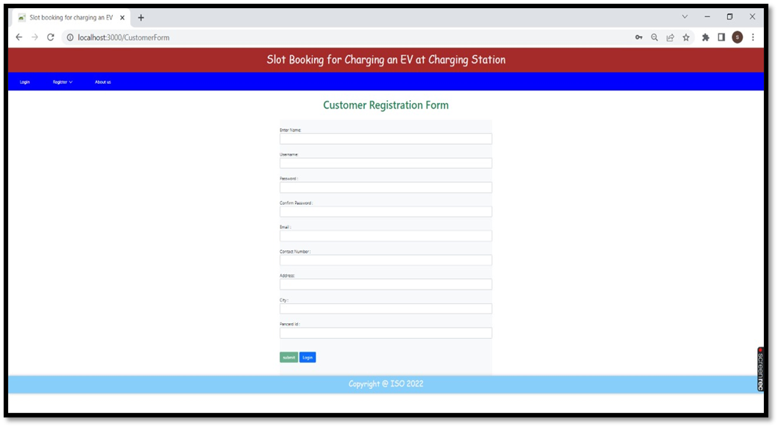
New Customer registeration form:

Slide 19
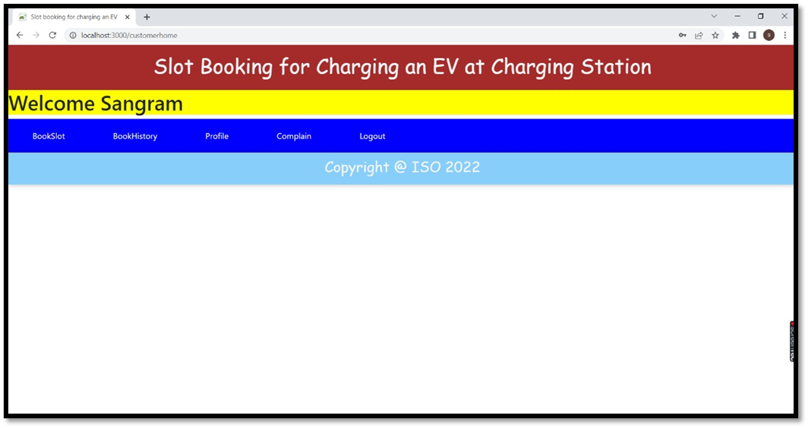
Customer dashboard

Slide 20
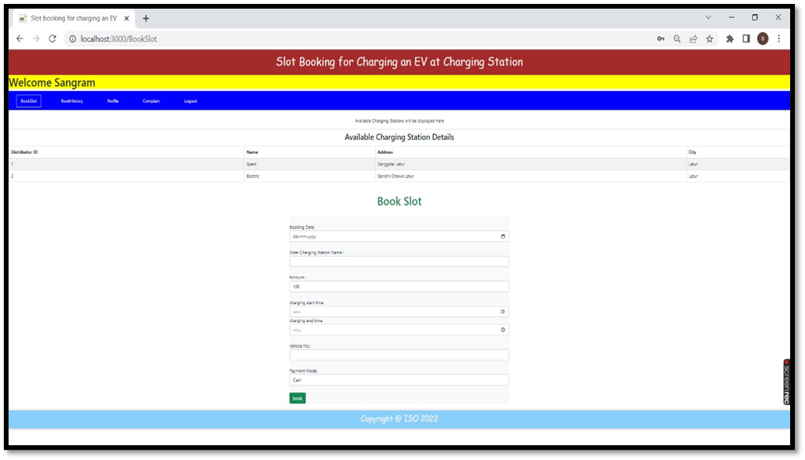
Customer -> book slot page

Slide 21
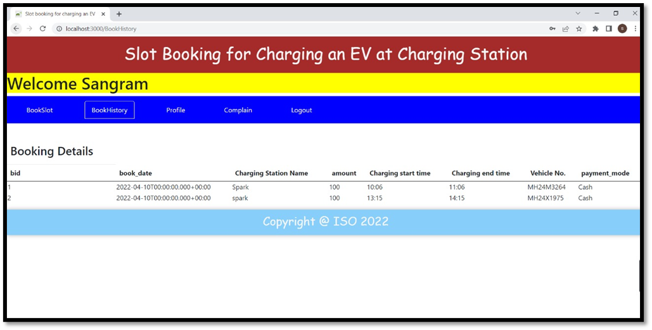
Customer -> book history page

Slide 22
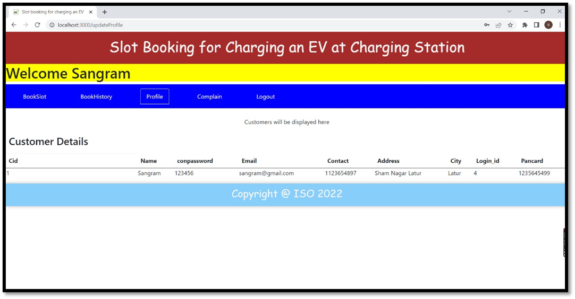
Customer -> profile page

Slide 23
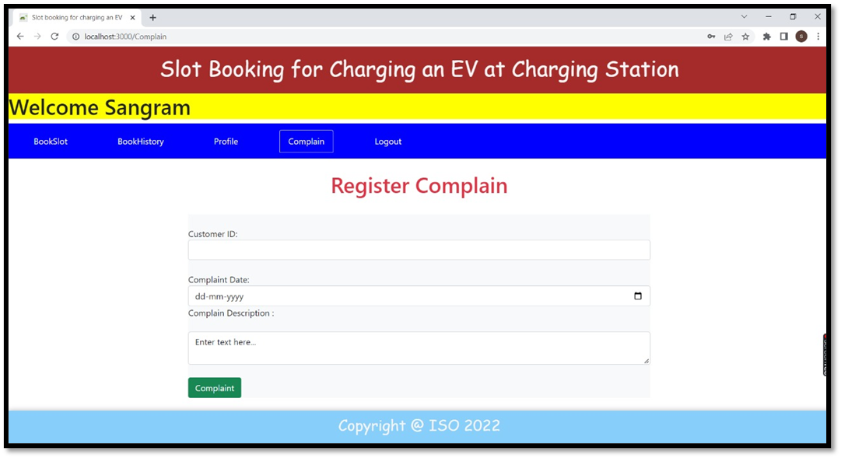
Customer -> complaint page

Slide 24
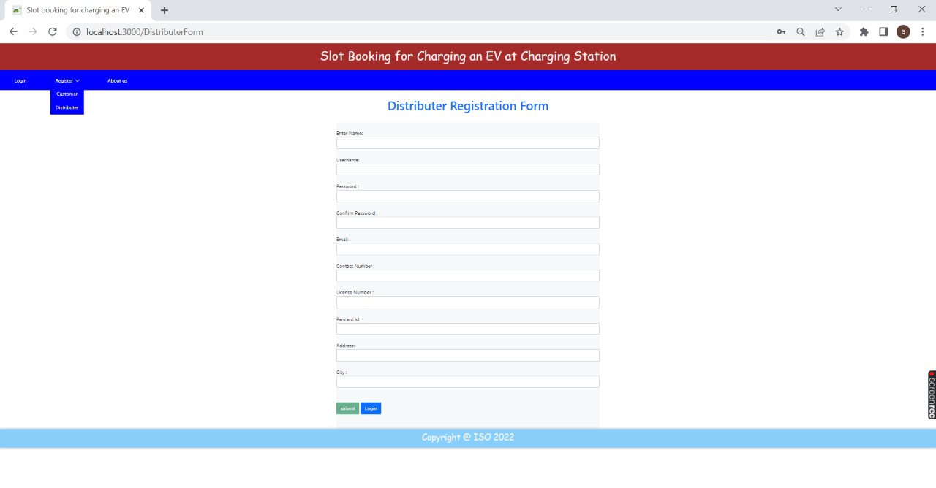
Distributor resistration form

Slide 25
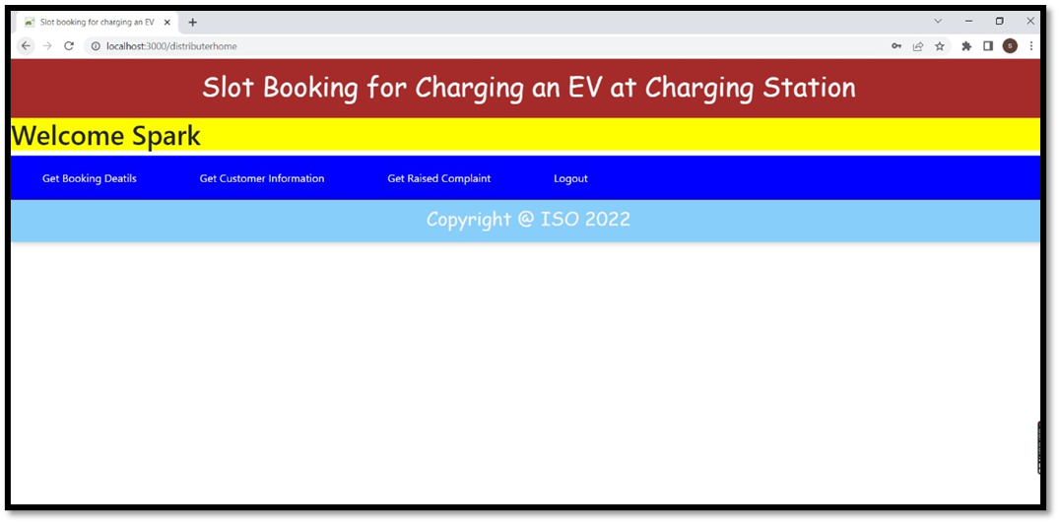
Distributer -> home/dashboard page

Slide 26
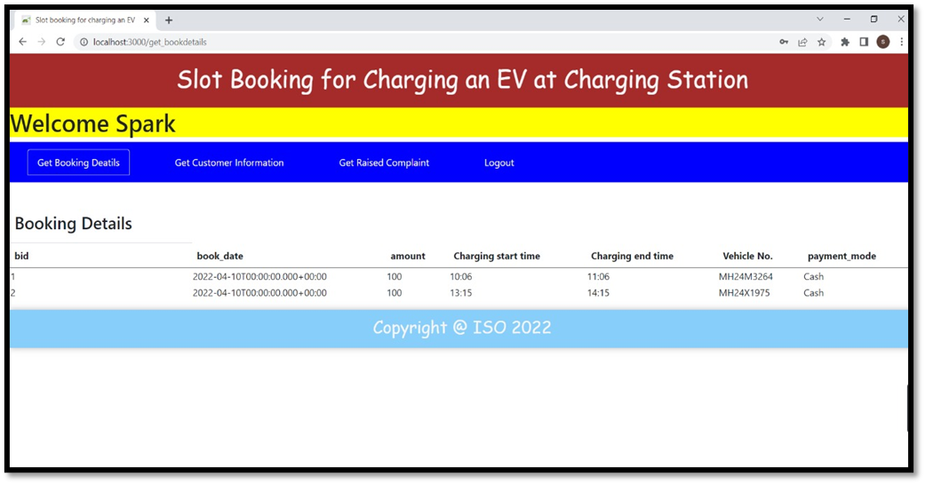
Distributer -> get booking details

Slide 27
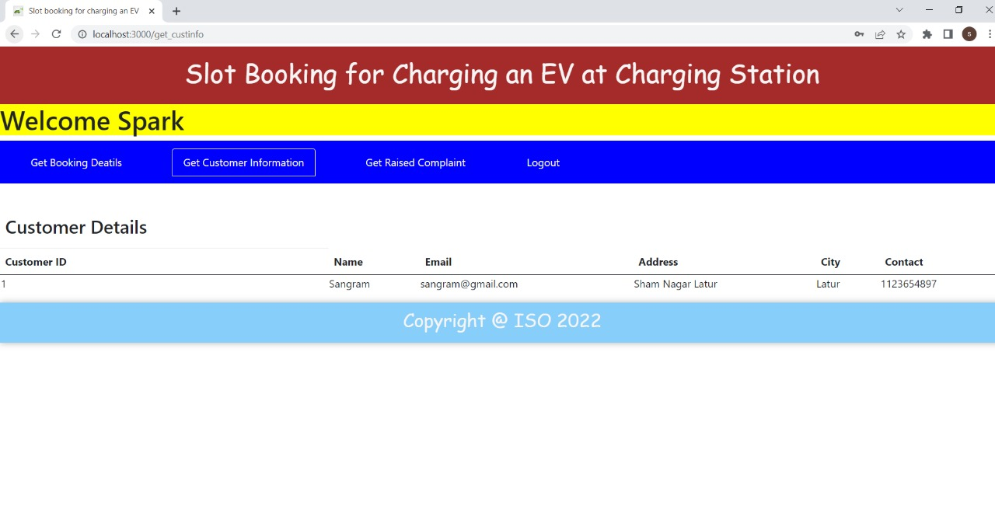
Distributer -> get customer information page

Slide 28
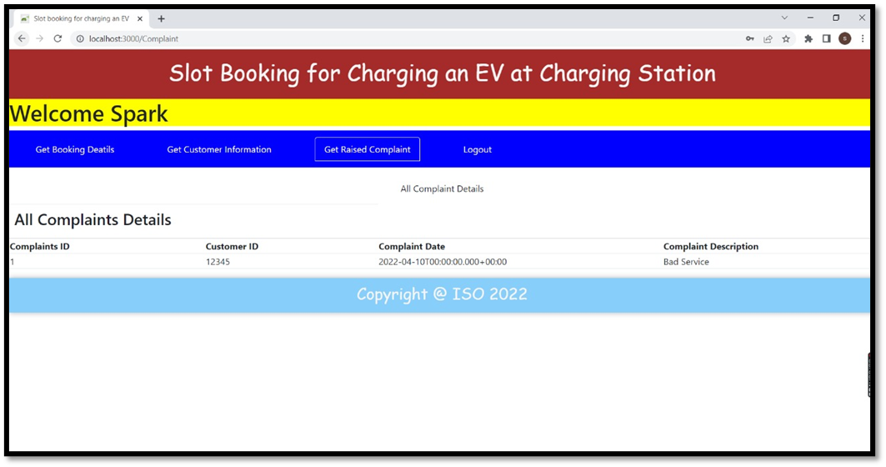
Distributer -> get raised complaint page

Slide 29
Thank you

