Slide 1


FONT CLASSIFICATION
Presentation 3
Davide Morelli & Mattéo Bonvin

Slide 2
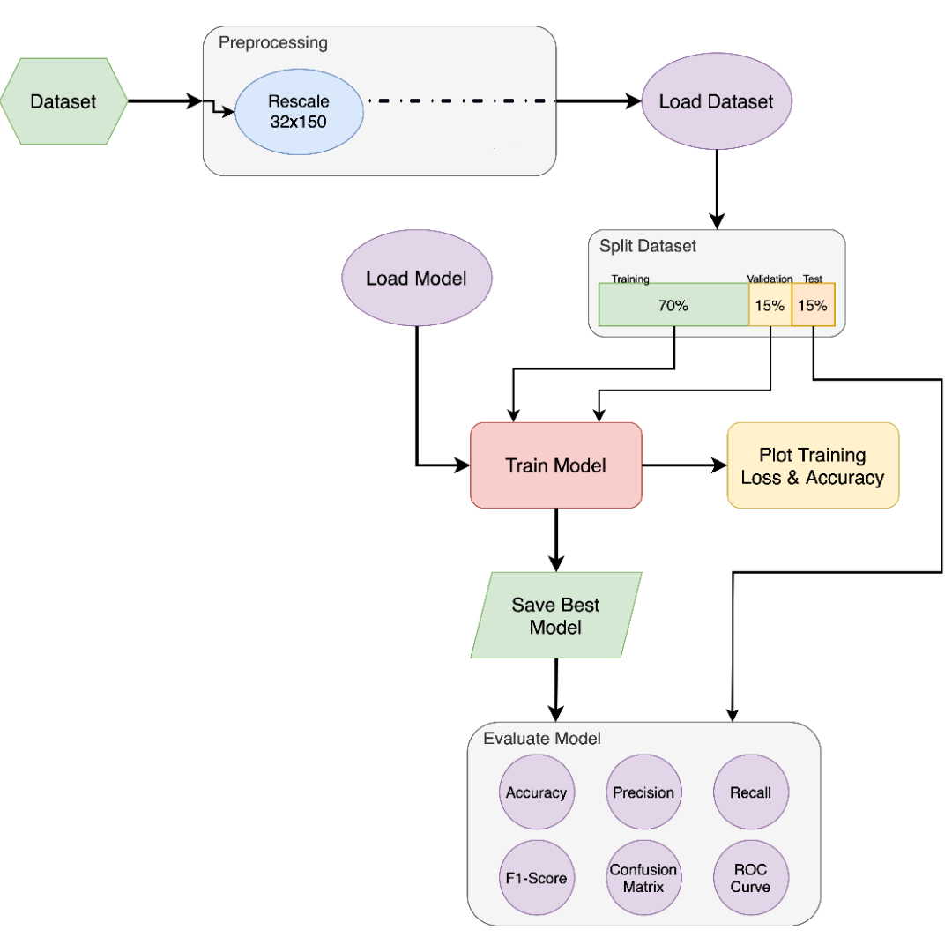
Workflow
General workflow to solve the task

Slide 3
A look at Random_Prediction.ipynb

Slide 4
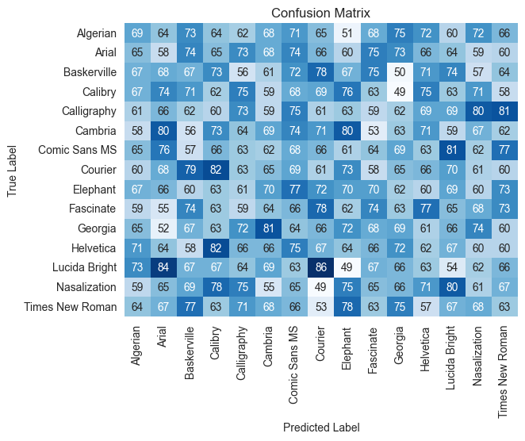
A look at Random_Prediction.ipynb

