Slide 1
Creating and Using an URDF File
Understanding Robot Description, Simulation, and Design
Luca Morello
Notes:
Hello, today's lesson will focus on creating a URdf file, in which we will describe the structure of a robot. The goal is not only to define the structure but also to simulate the robot's behavior and extract useful information for the creation and design of a prototype or a robotic system that is not yet commercially available.

Slide 2
Brief Summary
Notes:
Before we begin with today's lesson, let's have a brief recap of the previous lessons.

Slide 3
First Lesson

Slide 4











Kinematics - Summary
Definition
The study of motion without considering forces.
Types of Kinematics:
Forward Kinematics (FK): Position and orientation of the end-effector from joint angles.
Key Terms:
Degrees of Freedom (DOF): Number of independent movements a robot can make.
Transformation Matrices: Used to describe the position and orientation of the robot’s linkages in space.
Inverse Kinematics (IK): Joint angles required to achieve a desired position and orientation from the end-effector position
Denavit-Hartenberg (DH) Parameters: Standard method to represent the kinematic chain of robotic arms.
Focuses on the relationship between robot's joint parameters and its end-effector position/orientation.
$$L_{5}$$
$$J_{5}$$
$$L_{2}$$
$$J_{1}$$
$$J_{3}$$
$$L_{4}$$
$$L_{3}$$
$$J_{4}$$
$$L_{1}$$
$$J_{2}$$
$$L_{0}$$
Notes:
The first lesson primarily focused on the kinematics, dynamics, and statics of the robot. Let's have a brief recap of kinematics. Kinematics is the study of the motion of the robotic system, considering only the position and orientation of the end effector, completely neglecting the forces acting on the system. There are two types of kinematics: direct kinematics, which, given a set of joint angles, allows us to determine the position of the final end effector, and inverse kinematics, which is the opposite problem: given a desired position of the end effector, we must determine the joint positions that allow us to reach that position.
Key terms for this field are degrees of freedom, which represent the number of independent movements a robot can perform, and transformation matrices (homogeneous transformations), which are used to describe the position and orientation of links and joints in Euclidean space. Specifically, they describe how to move from one reference frame to another.
Finally, we have Denavit-Hartenberg, which is a convention, among several available, to represent these transformation matrix and structure them into a kinematic chain, thereby describing the robot's behavior and structure.

Slide 5
Dynamics - Summary
Definition
study of forces and torques that cause motion in a robot. It involves modeling the physical interactions between the robot's joints, links, and environment.
Key Concepts
Equations of Motion: Describes the dynamic behavior of the robot using Newton-Euler or Lagrangian methods.
Key Terms:
Inertia Matrix: Describes the distribution of mass and its effect on the robot’s motion.
Coriolis and Centrifugal Forces: Forces that arise in rotating systems, affecting the robot's movement.
Gravitational Forces: Forces acting on the robot due to gravity, influencing joint torques and motions.
$$L_{5}$$
$$J_{5}$$
$$L_{2}$$
$$J_{1}$$
$$J_{3}$$
$$L_{4}$$
$$L_{3}$$
$$J_{4}$$
$$L_{1}$$
$$J_{2}$$
$$L_{0}$$
Notes:
Dynamics, on the other hand, studies the forces acting on the robot itself, its links, and the surrounding environment. In this case, dynamics involves modeling the physical interactions to describe the robot's behavior. There are two main methodologies to describe dynamics:
the Lagrangian method, which uses an energy-based approach, focusing on potential and kinetic energy. This method is particularly useful for complex robots, and
the Newton-Euler method, which directly handles the forces and is more convenient for simpler structures.
Regardless of the method used, the resulting equations of motion will take into account the inertia matrix, which describes the distribution of mass and its effect on the robot's movement, the Coriolis matrix to account for centrifugal forces when the robot is rotating, and the gravitational forces, i.e., gravity's force balancing the robot's weight.

Slide 6

Static Equilibrium - $τ=J^{T}F$
What it means
This equation connects the forces on a robot's end-effector to the required torques at the robot's joints.
Key Concepts:
Why It's Important:
Force Control: Helps control the forces the robot applies.
$τ →$ Torques needed at each joint to keep the robot in balance.
τ → Torques needed at each joint to keep the robot in balance.
$J^{T}$→ Matrix that helps translate forces from the end-effector to the joints.
𝐽^𝑇→ Matrix that helps translate forces from the end-effector to the joints.
$F$ → Forces acting on the robot's end-effector (like holding an object or interacting with the environment).
𝐹 → Forces acting on the robot's end-effector (like holding an object or interacting with the environment).
Static Analysis: Determines how much force each joint needs to balance the robot when external forces are applied.
Notes:
Dynamics provides the robot's behavior in terms of joint torques, but it doesn't give any information about external torques, such as those arising from interactions with the environment or with humans. In this case, we need to use statics. Statics converts the forces that our end effector experiences during interactions with external sources and transforms them into joint torques. A simple example of application is force control: in fact, from the formula written above, we can design a control where, by calculating the difference between the desired force and the force currently applied by the end effector, we can manipulate an object, driving the forces to a reference value.

Slide 7
Second Lesson

Slide 8
Robot Simulation
What it means
script was used to simulate a robot, follow a trajectory, and calculate the necessary forces and energy.
Steps in the Script:
Trajectory Following (Inverse Kinematics): The robot follows a desired path by calculating the joint angles needed to reach the end-effector's target position.
Torque Calculation (Inverse Dynamics): Inverse Dynamics is used to compute the torques required at each joint to follow the trajectory.
The torques are determined by considering the robot's mass, acceleration, and forces acting on the system.
Power Calculation:The power required at each joint is calculated using the formula: $P=τ⋅\dot{q}$
Power Calculation:The power required at each joint is calculated using the formula: 𝑃=𝜏⋅𝑞 ̇
Notes:
The second lesson focused on the simulation and application of theoretical concepts. In fact, we imported a robot, made it converge to a trajectory using inverse kinematics, and calculated the required torques based on dynamics to execute the trajectory. We also calculated the total power and the power for each joint.

Slide 9
Introduction to Urdf
Notes:
Today, we will focus on how to create a virtual version of a robot that is not commercially available. This is extremely useful when you want to create something of your own. With a virtual copy, we can determine the required torques, model the necessary parameters, and identify any potential issues before building a physical prototype.

Slide 10
The Challenge of Robot Design and Testing
Scenario
You are designing a robot and need to make important decisions about its components, like motors, joint parameters, and dynamics.
Challenges
Prototyping: Building and testing physical prototypes is time-consuming and costly.
Simplified Calculations: Basic calculations might only consider part of the system (like the payload), leading to inaccurate results.
Complex Analytical Solutions: Trying to solve everything manually with traditional analytical methods can be very difficult and slow.
Notes:
For example, the scenario is to size the motor. Imagine that the goal is to create a manipulator that needs to support a 5-kilogram payload. How do I size the motor? I create the virtual torque of the robot and, through dynamics, compensate for gravity and use statics to consider the torques generated by the static weight force of the 5 kilograms on the robot. I project this information across the entire workspace and extract the maximum torque. This way, I know that I need to find a motor that provides this torque.
To summarize, this process is useful for creating prototypes, simplifying costs, and reducing time. Additionally, it allows us to avoid analytical calculations that can sometimes be extremely complicated if simplifications are not made, leading to potential errors. In this way, we create a numerical solution where we input all the realistic parameters, such as gravity, accelerations, etc., and explore the robot's conditions in its workspace.

Slide 11
The Challenge of Robot Design and Testing
Why Use a Numerical Approach?
Instead of relying on physical prototypes or complex manual calculations, a numerical solution can provide more accurate and faster results.
Question
If your robot has a unique design that doesn’t fit exactly into existing toolboxes, how can you calculate everything you need like motor requirements, forces, and torques?
Rapid Prototyping: Quickly iterate designs to resolve issues before physical implementation.
Risk-Free Testing: Validate robot behaviors and control strategies without risking hardware.
Cost Reduction: Identify potential problems early, saving on material and labor costs.
$$L_{5}$$
$$J_{5}$$
$$L_{2}$$
$$J_{1}$$
$$J_{3}$$
$$L_{4}$$
$$L_{3}$$
$$J_{4}$$
$$L_{1}$$
$$J_{2}$$
$$L_{0}$$
Notes:
In this way, we can immediately gain insight into the limitations of our robot, allowing us to iterate and modify it during the process before creating a physical product. Additionally, this approach is extremely useful when implementing controls that have not been thoroughly tested or are innovative, as it is very easy — and will likely happen — to break the hardware when testing controls for the first time.
To summarize, the advantages are: fast design variations, validation of behavior and control strategies, minimizing hardware damage, and cost reduction, as potential problems are identified right away.
This entire introduction is meant to explain how, when creating a system that is not already present in the various toolboxes, and thus is not a commercial product, this methodology becomes particularly useful.

Slide 12
Solution: Build a Digital Twin with a URDF File
What is a Digital Twin?
A Digital Twin is a virtual model of your robot that allows you to simulate its behavior and test different configurations.
How to Build It
URDF File: Create a detailed model of your robot using a URDF (Unified Robot Description Format) file.
Why URDF?
Advanced Functionality: With this model, you can use functions like inverse kinematics and inverse dynamics to calculate necessary parameters, such as torques, forces, and power requirements.
Compatibility: URDF is widely supported across various systems and simulation tools (e.g., ROS, Gazebo, V-REP).
Flexible: Unlike proprietary formats like rigidBodyTree in MATLAB, URDF is an open format that works seamlessly in multiple environments, making it easier to integrate with other tools and platforms.
$$L_{5}$$
$$J_{5}$$
$$L_{2}$$
$$J_{1}$$
$$J_{3}$$
$$L_{4}$$
$$L_{3}$$
$$J_{4}$$
$$L_{1}$$
$$J_{2}$$
$$L_{0}$$
Notes:
As a result, a Digital Twin is created, which is essentially a virtual model of our robot. The idea is to make it as similar as possible to the real product. Generally, simulated robots are described using a format called URDF (Unified Robot Description Format). This format enables the use of inverse kinematics and dynamics functions, allowing the calculation of torques, forces, and power without the need for analytical calculations. Moreover, this type of file is widely used and supported by various systems and simulation tools.

Slide 13
Summary URDF
Definition: URDF stands for Unified Robot Description Format.
Purpose: Describes the structure of a robot including geometry, kinematics, and dynamics.:
Applications: Used in simulation tools like MATLAB, ROS, and Python frameworks.
Key note: Files .urdf are written in XML, it is possible to edit with any Text Editors, ROS Editors
Notes:
Here is a brief summary of what we've just discussed. The definition of URDF is a format used to describe virtual robots through a combination of links and joints. The purpose of this format is to create simulations that allow testing the robot's behavior and integrating solutions before reaching a finished product. Finally, a key concept is that this type of file can be edited with any text editor.

Slide 14
Key Components of URDF (What Makes Up a URDF)
Kinematics: How Parts Are Connected and Move
Kinematics just means how the parts of your robot are connected and how they can move.
Links are the parts of the robot (like the arm or the base).
Joints are what connect the parts together (like the shoulder joint that connects the arm to the body).
Parent and Child:
Notes:
A URDF file is a combination of links and joints that must be connected to each other. The links will have a certain mass and inertia to describe the dynamic behavior, while the joints will describe the kinematic behavior, in other words how the parts are connected and how they will move. For example, if we have two links connected by a rotational joint, we can define the axis of rotation, rotation limits, and so on.

Slide 15
Key Components of URDF (What Makes Up a URDF)
Dynamics: What the Robot is Made Of (Weight, Balance, etc.)
Dynamics are about the robot's weight and how it behaves physically.
Mass: This tells the computer how heavy each part of the robot is. For example, if the arm is made of metal, it will have a certain weight.
Center of Mass: This is the balance point of the part. Imagine balancing a stick on your finger — the point where it balances is the center of mass.
Inertia: This tells how much the part resists rotating or moving. For example, it’s harder to spin a heavy object than a light one.
Notes:
In addition to kinematics and movement, it is necessary to define the weight of the links, their mass, the position of their center of mass, and their inertia. The dynamic aspect is automatically calculated in the simulation tool

Slide 16
Key Components of URDF (What Makes Up a URDF)
Additional Elements: Extra Details to Help with Simulation
Visualization: Seeing Your Robot Visualization helps you see what your robot looks like in the computer.
Collision: Making Sure the Robot Doesn’t Go Through Things Collision is for checking if the robot runs into things while moving.
It’s like making sure the robot doesn’t walk through walls in a video game.
This helps make simulations realistic and avoids problems in real life.
Think of it like creating a 3D model of the robot.
You can see what the robot’s parts look like (boxes, cylinders, etc.).
Notes:
To make the behavior more realistic, additional elements are generally required, such as collision handling to understand and control any internal or external collisions during the simulation.
Another important aspect is visualization, which involves using 3D models, either simple or complex, to visualize the robot in space.
Several solutions can be used: for example, simple shapes such as cylinders or boxes, or articulated 3D models defined with software like SolidWorks or other 3D modeling tools.
These models can then be used to visualize and render the robot.

Slide 17
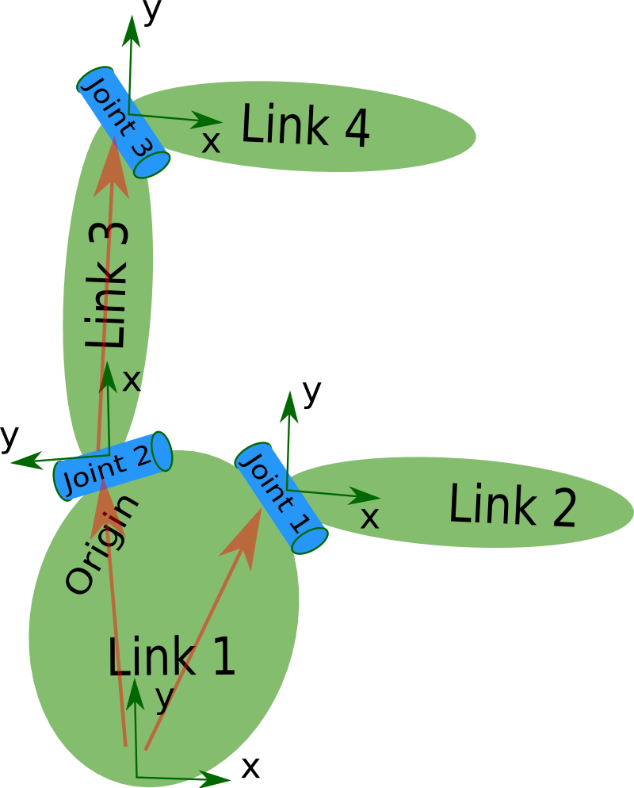
Key Components of URDF (What Makes Up a URDF)
The description of a robot consists of:
A set of link elements
A set of joint elements connecting the links together.
So, a typical robot description looks something like this:
<?xml version="1.0"?>
<robot name="pr2" >
<link> ... </link>
<link> ... </link>
<link> ... </link>
<joint> .... </joint>
<joint> .... </joint>
<joint> .... </joint>
</robot>
Notes:
As we mentioned, a URDF file is a serial structure made up of links that are connected to each other through joints. Therefore, if we were to simplify a URDF file to its core, it would be a structure like this, with the declaration of links and corresponding joints.

Slide 18
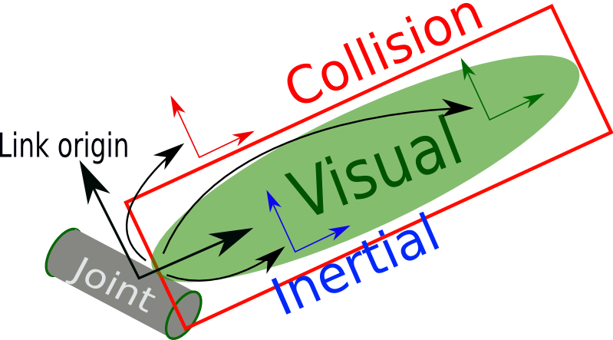
<link> element
<link name="my_link">
<inertial>
<origin xyz="0 0 0.5" rpy="0 0 0"/>
<mass value="1"/>
<inertia ixx="100" ixy="0" ixz="0" iyy="100" iyz="0" izz="100" />
</inertial>
<visual>
<origin xyz="0 0 0" rpy="0 0 0" />
<geometry>
<box size="1 1 1" />
</geometry>
<material name="Cyan">
<color rgba="0 1.0 1.0 1.0"/>
</material>
</visual>
<collision>
<origin xyz="0 0 0" rpy="0 0 0"/>
<geometry>
<cylinder radius="1" length="0.5"/>
</geometry>
</collision>
</link>
The link element describes a rigid body with an inertia, visual features, and collision properties.
Notes:
In the link declaration, the dynamic part is primarily defined.
I highlighted three types of declarations highlighted in blue, green, and red.
In blue, we have the inertial part, which includes the center of mass origin, the mass value, and the inertia.
In green, we find the visualization part, which includes the geometry of the link, the link's shape, color, and the orientation and position of this shape. The visualization does not affect the dynamic part but serves purely visual purposes.
Finally, in red, we have the collision declaration, which typically uses the same parameters as the visualization part.

Slide 19
<link> element
<inertial>
<origin xyz="0 0 0.5" rpy="0 0 0"/>
<mass value="1"/>
<inertia ixx="100" ixy="0" ixz="0" iyy="100" iyz="0" izz="100" />
</inertial>
<inertial> (Defaults to a zero mass and zero inertia if not specified)
The link’s mass, position of its center of mass, and its central inertia properties.
Notes:
Now, let's go through the individual declarations defined in the link.
The first part is the inertial section, which defines the position of the center of mass of the link relative to its origin, the mass of the link in kilograms, and the inertial properties defined in the frame of the center of mass. If this information is not specified, the default values are set to zero.

Slide 20
<link> element
<inertial>
<origin xyz="0 0 0.5" rpy="0 0 0"/>
<mass value="1"/>
<inertia ixx="100" ixy="0" ixz="0" iyy="100" iyz="0" izz="100" />
</inertial>
<origin>
This pose (translation, rotation) describes the position and orientation of the link’s center of mass frame relative to the link-frame
xyz (Defaults to zero vector)
Position vector from link-frame origin to link’s center of mass
rpy (Defaults to identity if not specified)
Represents the orientation of the center of mass frame as a sequence of Euler rotations (r p y) in radians.
Notes:
The origin describes the position and orientation of the center of mass of the link relative to the origin of the link system. We can define the spatial position in XYZ, and its orientation, expressed in Euler angles. Conventionally, the latter is set to match the orientation of our link system, purely for convenience.

Slide 21
<link> element
<inertial>
<origin xyz="0 0 0.5" rpy="0 0 0"/>
<mass value="1"/>
<inertia ixx="100" ixy="0" ixz="0" iyy="100" iyz="0" izz="100" />
</inertial>
<mass>
The mass of the link is represented by the value attribute of this element
<inertia>
This link's moments of inertia ixx, iyy, izz and products of inertia ixy, ixz, iyz respect to the link’s center of mass
Notes:
Finally, we set the mass value, which is the weight of our link, and its inertia.

Slide 22
<link> element
<visual>
<origin xyz="0 0 0" rpy="0 0 0" />
<geometry>
<box size="1 1 1" />
</geometry>
<material name="Cyan">
<color rgba="0 1.0 1.0 1.0"/>
</material>
</visual>
<visual> (Optional)
The visual properties of the link.
This element specifies the shape of the object (box, cylinder, etc.) for visualization purposes. Note: multiple instances of <visual> tags can exist for the same link. The union of the geometry they define forms the visual representation of the link
Notes:
Next, we have the visual properties of the robot, which allow us to visualize and render it in the simulation. They have no impact on the dynamics but serve a practical purpose for the designer. How is this element structured? It specifies the shape of the link, which can be simple or complex, and there can be multiple instances for the same link. The final geometry is the combination of these visual representations.

Slide 23
<link> element
<visual>
<origin xyz="0 0 0" rpy="0 0 0" />
<geometry>
<box size="1 1 1" />
</geometry>
<material name="Cyan">
<color rgba="0 1.0 1.0 1.0"/>
</material>
</visual>
<origin> (Defaults to identity if not specified)
The reference frame of the visual element with respect to the reference frame of the link.
xyz (Defaults to zero vector if not specified)
Represents the x, y, z offset.
rpy (Defaults to identity if not specified)
Represents the fixed axis roll, pitch and yaw angles in radians.
Notes:
Similarly to what was mentioned in the inertial part, the origin is simply the position and orientation, expressed in Euler angles, of our shape relative to the link frame.

Slide 24
<link> element
<visual>
<origin xyz="0 0 0" rpy="0 0 0" />
<geometry>
<box size="1 1 1" />
</geometry>
<material name="Cyan">
<color rgba="0 1.0 1.0 1.0"/>
</material>
</visual>
<geometry> (required)
The shape of the visual object. This can be one of the following:
Notes:
The geometry is the shape that the link will assume, and it can be of various types, as we will now list.

Slide 25
URDF Example - Link
Geometry Elements
Box
Cylinder
Sphere
Defined by:
xyz dimensions
<box size="1 1 1"/>
Defined by:
radius and height.
<cylinder radius="0.2" length="1"/>
Defined by:
radius.
<sphere radius="0.1"/>
Mesh
References an external file for complex shapes
<mesh filename="filename.stl" scale="1 1 1"/>
Notes:
It can indeed be of three simple shapes: a box, defined by the three dimensions (length, width, height), a cylinder, defined by the radius and height, and a sphere, defined by the radius. Finally, we have meshes, which are simply external 3D models and can have a more complex shape.

Slide 26
<link> element
<collision>
<origin xyz="0 0 0" rpy="0 0 0"/>
<geometry>
<cylinder radius="1" length="0.5"/>
</geometry>
</collision>
<collision> (optional)
The collision properties of a link.
Note that this can be different from the visual properties of a link, for example, simpler collision models are often used to reduce computation time.
Note: multiple instances of <collision> tags can exist for the same link. The union of the geometry they define forms the collision representation of the link.
Notes:
Finally, we have collisions, which are closely related to the visual part and the geometry of the robot. In fact, similarly, we can define multiple instances of collisions for the same link, and the final collision is the union of the individual collisions. Lastly, the shape can differ from the link: it can have a simpler form to reduce computational cost, or, in more realistic cases, the exact same geometry is used.

Slide 27
<link> element
<collision>
<origin xyz="0 0 0" rpy="0 0 0"/>
<geometry>
<cylinder radius="1" length="0.5"/>
</geometry>
</collision>
<origin> (Defaults to identity if not specified)
The reference frame of the collision element, relative to the reference frame of the link.
xyz (Defaults to zero vector if not specified)
Represents the x, y, z offset.
rpy (Defaults to identity if not specified)
Represents the fixed axis roll, pitch and yaw angles in radians.
Notes:
Similarly to the visual part, both the origin and the shape are defined. The origin is expressed in terms of position and orientation relative to the link's origin.

Slide 28
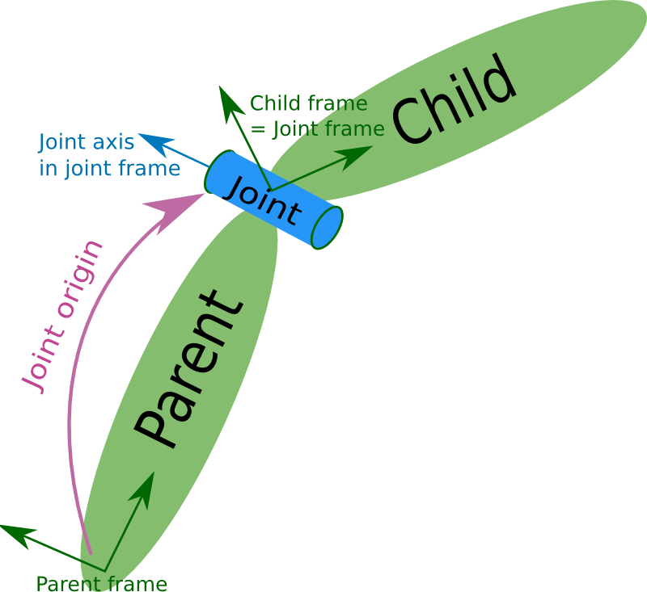
<Joint> element
<joint name="my_joint" type="floating">
<origin xyz="0 0 1" rpy="0 0 3.1416"/>
<parent link="link1"/>
<child link="link2"/>
<dynamics damping="0.0" friction="0.0"/>
<limit effort="30" velocity="1.0" lower="-2.2" upper="0.7" />
</joint>
The joint element describes the kinematics of the joint and also specifies the safety limits of the joint.
Notes:
Now, let's start with the joint element. The joint element describes the kinematic behavior of the robot and connects two links, which are referred to as the parent and child.

Slide 29
<Joint> element
<joint name="my_joint" type="floating">
<origin xyz="0 0 1" rpy="0 0 3.1416"/>
<parent link="link1"/>
<child link="link2"/>
<axis xyz="0 1 0"/>
<limit effort="30" velocity="1.0" lower="-2.2" upper="0.7" />
</joint>
name (required)
Specifies a unique name of the joint
Notes:
Each joint, like each link, must have a unique name to avoid confusion and duplicate declarations.

Slide 30
<Joint> element
<joint name="my_joint" type="floating">
<origin xyz="0 0 1" rpy="0 0 3.1416"/>
<parent link="link1"/>
<child link="link2"/>
<axis xyz="0 1 0"/>
<limit effort="30" velocity="1.0" lower="-2.2" upper="0.7" />
</joint>
type (required) → Specifies the type of joint, can be one of the following:
Revolute — Hinge joint that rotates along the axis and has a limited range specified by the upper and lower limits.
Continuous — revolute with no upper and lower limits.
Prismatic — Sliding joint that slides along the axis, and has a limited range specified by the upper and lower limits.
Fixed — this is not really a joint because it cannot move. All degrees of freedom are locked. This type of joint does not require the <axis>, <calibration>, <dynamics>, <limits> or <safety_controller>.
Floating — Allows motion for all 6 degrees of freedom.
Planar — Allows motion in a plane perpendicular to the axis.
Notes:
Similarly to the link geometry, the joint can be of various types: rotational, prismatic, fixed (locking all degrees of freedom), floating (allowing all six degrees of freedom), and planar (for planar motion).

Slide 31
<Joint> element
<joint name="my_joint" type="floating">
<origin xyz="0 0 1" rpy="0 0 3.1416"/>
<parent link="link1"/>
<child link="link2"/>
<axis xyz="0 1 0"/>
<limit effort="30" velocity="1.0" lower="-2.2" upper="0.7" />
</joint>
<origin> (Defaults to identity if not specified)
This is the transform from the parent link to the child link. The joint is located at the origin of the child link, as shown in the figure above.
xyz (Defaults to zero vector if not specified)
Represents the x, y, z offset. All positions are specified in metres.
rpy (Defaults to zero vector if not specified)
Represents the rotation around fixed axis: roll , pitch ,yaw . All angles are specified in radians.

Slide 32
<Joint> element
<joint name="my_joint" type="floating">
<origin xyz="0 0 1" rpy="0 0 3.1416"/>
<parent link="link1"/>
<child link="link2"/>
<axis xyz="0 1 0"/>
<limit effort="30" velocity="1.0" lower="-2.2" upper="0.7" />
</joint>
<parent> (required)
Parent link name with mandatory attribute:link
The name of the link that is the parent of this link in the robot tree structure.
<child> (required)
Child link name with mandatory attribute:link
The name of the link that is the child link.

Slide 33
<Joint> element
<joint name="my_joint" type="floating">
<origin xyz="0 0 1" rpy="0 0 3.1416"/>
<parent link="link1"/>
<child link="link2"/>
<axis xyz="0 1 0"/>
<limit effort="30" velocity="1.0" lower="-2.2" upper="0.7" />
</joint>
<axis> (optional: defaults to (1,0,0))
The joint axis specified in the joint frame.
Axis of rotation for revolute joints,
Axis of translation for prismatic joints
Surface normal for planar joints.
The axis is specified in the joint frame of reference. Fixed and floating joints do not use the axis field

Slide 34
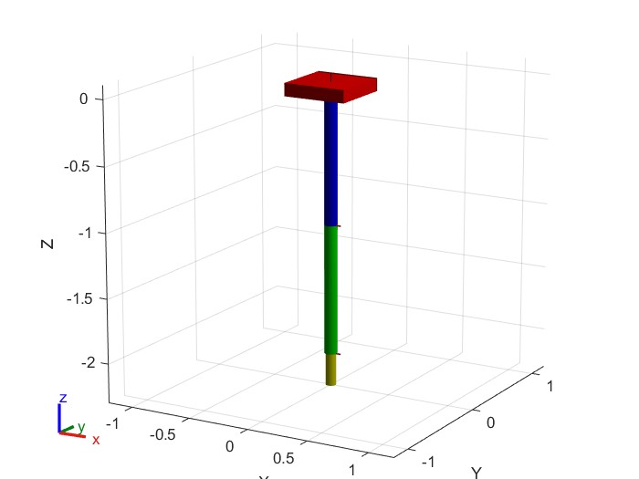
The Linkage System
System Overview:
Link A
Link A: Base link with a red box geometry
Link B: Blue cylindrical link connected via a revolute joint (Joint A)
Link C: Green cylindrical link connected via another revolute joint (Joint B)
Link D: Yellow link connected via a prismatic joint (Joint C) for linear motion.
Link B
Link C
Link D

Slide 35
The Linkage System
Joint Details:
Joint A
Joint A: Connects Link A to Link B; rotates around the y-axis.
Joint B: Connects Link B to Link C; rotates around the x-axis.
Joint C: Connects Link C to Link D; allows translation along the z-axis.
Joint B
Joint C

Slide 36
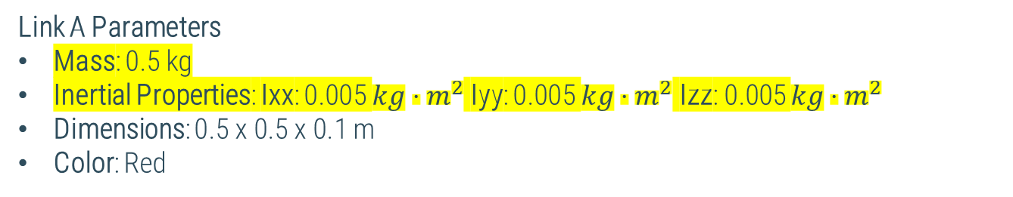
The Linkage System
Link A Parameters
Mass: 0.5 kg
Inertial Properties: Ixx: 0.005 $kg⋅m^{2}$ Iyy: 0.005 $kg⋅m^{2}$ Izz: 0.005 $kg⋅m^{2}$
Dimensions: 0.5 x 0.5 x 0.1 m
Color: Red
$$L_{5}$$
$$J_{5}$$
$$L_{2}$$
<!-- Link A -->
<link name="link_A">
<inertial>
<origin xyz="0 0 0"/>
<mass value="0.5"/>
<inertia ixx="0.005" iyy="0.005" izz="0.005" ixy="0" ixz="0" iyz="0"/>
</inertial>
</link>
$$J_{1}$$
$$J_{3}$$
$$L_{4}$$
$$L_{3}$$
$$J_{4}$$
$$L_{1}$$
$$J_{2}$$
$$L_{0}$$

Slide 37
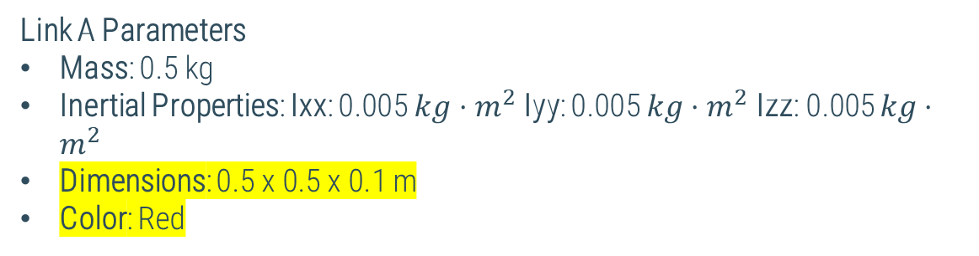
The Linkage System
$$L_{5}$$
<!-- Link A -->
<link name="link_A">
<visual>
<origin xyz="0 0 0"/>
<geometry>
<box size="0.5 0.5 0.1"/>
</geometry>
<material name="red">
<color rgba="1 0 0 1"/>
</material>
</visual>
</link>
$$J_{5}$$
$$L_{2}$$
Link A Parameters
Mass: 0.5 kg
Inertial Properties: Ixx: 0.005 $kg⋅m^{2}$ Iyy: 0.005 $kg⋅m^{2}$ Izz: 0.005 $kg⋅m^{2}$
Dimensions: 0.5 x 0.5 x 0.1 m
Color: Red
$$J_{1}$$
$$J_{3}$$
$$L_{4}$$
$$L_{3}$$
$$J_{4}$$
$$L_{1}$$
$$J_{2}$$
$$L_{0}$$

Slide 38
The Linkage System
$$L_{5}$$
Joint A Parameters
Type: Revolute
Parent Link: link_A
Child Link: link_B
Origin:
Position (XYZ): 0, 0, -0.05 m
Orientation (RPY): 0, 0, 0 rad
Axis of Rotation:
Direction (XYZ): 0, 1, 0 (Y-axis)
Joint Limits:
Lower Limit: -1.57 rad
Upper Limit: 1.57 rad
Effort: 10 Nm
Velocity: 1.0 rad/s
$$J_{5}$$
<joint name="joint_A" type="revolute">
<parent link="link_A"/>
<child link="link_B"/>
<origin xyz="0 0 -0.05" rpy="0 0 0"/>
<axis xyz="0 1 0"/>
<limit lower="-1.57" upper="1.57" effort="10" velocity="1.0"/>
</joint>
$$L_{2}$$
$$J_{1}$$
$$J_{3}$$
$$L_{4}$$
$$L_{3}$$
$$J_{4}$$
$$L_{1}$$
$$J_{2}$$
$$L_{0}$$

Slide 39
The Linkage System
$$L_{5}$$
Joint A Parameters
Type: Revolute
Parent Link: link_A
Child Link: link_B
Origin:
Position (XYZ): 0, 0, -0.05 m
Orientation (RPY): 0, 0, 0 rad
Axis of Rotation:
Direction (XYZ): 0, 1, 0 (Y-axis)
Joint Limits:
Lower Limit: -1.57 rad
Upper Limit: 1.57 rad
Effort: 10 Nm
Velocity: 1.0 rad/s
$$J_{5}$$
<joint name="joint_A" type="revolute">
<parent link="link_A"/>
<child link="link_B"/>
<origin xyz="0 0 -0.05" rpy="0 0 0"/>
<axis xyz="0 1 0"/>
<limit lower="-1.57" upper="1.57" effort="10" velocity="1.0"/>
</joint>
$$L_{2}$$
$$J_{1}$$
$$J_{3}$$
$$L_{4}$$
$$L_{3}$$
$$J_{4}$$
$$L_{1}$$
$$J_{2}$$
$$L_{0}$$

Slide 40
The Linkage System
$$L_{5}$$
Joint A Parameters
Type: Revolute
Parent Link: link_A
Child Link: link_B
Origin:
Position (XYZ): 0, 0, -0.05 m
Orientation (RPY): 0, 0, 0 rad
Axis of Rotation:
Direction (XYZ): 0, 1, 0 (Y-axis)
Joint Limits:
Lower Limit: -1.57 rad
Upper Limit: 1.57 rad
Effort: 10 Nm
Velocity: 1.0 rad/s
$$J_{5}$$
<joint name="joint_A" type="revolute">
<parent link="link_A"/>
<child link="link_B"/>
<origin xyz="0 0 -0.05" rpy="0 0 0"/>
<axis xyz="0 1 0"/>
<limit lower="-1.57" upper="1.57" effort="10" velocity="1.0"/>
</joint>
$$L_{2}$$
$$J_{1}$$
$$J_{3}$$
$$L_{4}$$
$$L_{3}$$
$$J_{4}$$
$$L_{1}$$
$$J_{2}$$
$$L_{0}$$

Slide 41
The Linkage System
$$L_{5}$$
Joint A Parameters
Type: Revolute
Parent Link: link_A
Child Link: link_B
Origin:
Position (XYZ): 0, 0, -0.05 m
Orientation (RPY): 0, 0, 0 rad
Axis of Rotation:
Direction (XYZ): 0, 1, 0 (Y-axis)
Joint Limits:
Lower Limit: -1.57 rad
Upper Limit: 1.57 rad
Effort: 10 Nm
Velocity: 1.0 rad/s
$$J_{5}$$
<joint name="joint_A" type="revolute">
<parent link="link_A"/>
<child link="link_B"/>
<origin xyz="0 0 -0.05" rpy="0 0 0"/>
<axis xyz="0 1 0"/>
<limit lower="-1.57" upper="1.57" effort="10" velocity="1.0"/>
</joint>
$$L_{2}$$
$$J_{1}$$
$$J_{3}$$
$$L_{4}$$
$$L_{3}$$
$$J_{4}$$
$$L_{1}$$
$$J_{2}$$
$$L_{0}$$

Slide 42
The Linkage System
$$L_{5}$$
Joint A Parameters
Type: Revolute
Parent Link: link_A
Child Link: link_B
Origin:
Position (XYZ): 0, 0, -0.05 m
Orientation (RPY): 0, 0, 0 rad
Axis of Rotation:
Direction (XYZ): 0, 1, 0 (Y-axis)
Joint Limits:
Lower Limit: -1.57 rad
Upper Limit: 1.57 rad
Effort: 10 Nm
Velocity: 1.0 rad/s
$$J_{5}$$
<joint name="joint_A" type="revolute">
<parent link="link_A"/>
<child link="link_B"/>
<origin xyz="0 0 -0.05" rpy="0 0 0"/>
<axis xyz="0 1 0"/>
<limit lower="-1.57" upper="1.57" effort="10" velocity="1.0"/>
</joint>
$$L_{2}$$
$$J_{1}$$
$$J_{3}$$
$$L_{4}$$
$$L_{3}$$
$$J_{4}$$
$$L_{1}$$
$$J_{2}$$
$$L_{0}$$

Slide 43
Exercise: Design a 2-DOF Robot with URDF
Objective: The robot operates in the 2D X-Y plane, so you will define the robot's joints and links accordingly
Joints Configuration:
The robot should have two joints. These joints can be:
Both revolute
Both prismatic
A combination of one revolute and one prismatic
You are free to choose the configuration that you prefer but document the type of joints you have selected
Link Specifications:
Link 1 (L1): Length = 0.6 m
Link 2 (L2): Length = 0.4 m
You may represent the links as simple shapes (e.g., boxes or cylinders).
These shapes will be used to calculate the robot's physical properties.

Slide 44
Exercise: Design a 2-DOF Robot with URDF
URDF File:
Define the URDF file with the following elements:
Links: Define two links with the specified lengths.
Joints: Define the two joints, including their types (revolute, prismatic, or mixed).
Physical properties: Include the mass, inertia, and center of mass for each link
Visual and Collision Properties: Provide visual and collision shapes for the links (using simple geometric representations like boxes or cylinders).

Slide 45
Exercise: Design a 2-DOF Robot with URDF
Deliverables:
URDF File:
A well-formed URDF file representing the 2-DOF robot. Ensure that the file includes the correct joint types, link dimensions, and physical properties.
Documentation:
A brief report describing the design of your robot, including:
The choice of joint types (revolute, prismatic, or mixed) and why you selected them.
The mass, inertia, and center of mass calculations for each link.

Slide 46
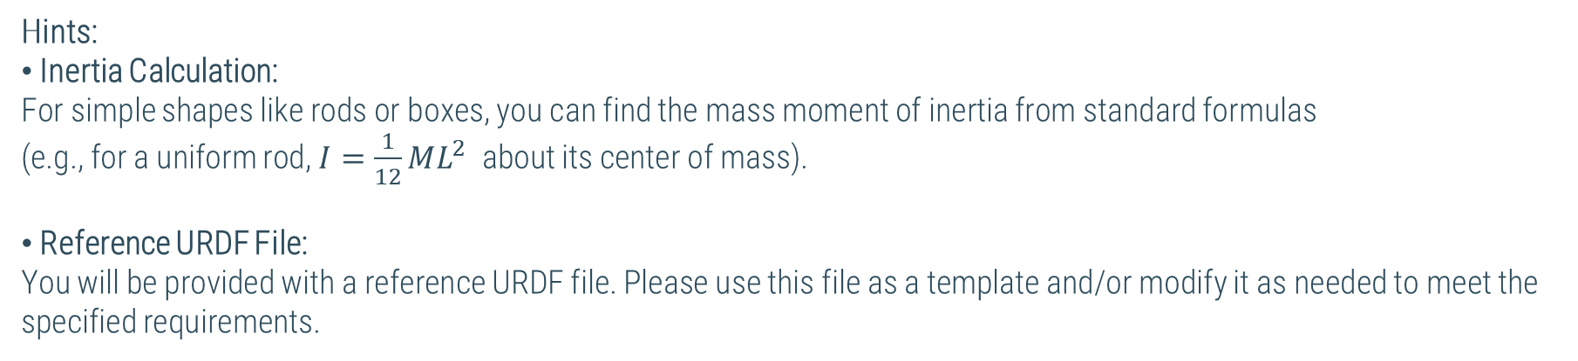
Exercise: Design a 2-DOF Robot with URDF
Hints:
Inertia Calculation: For simple shapes like rods or boxes, you can find the mass moment of inertia from standard formulas
(e.g., for a uniform rod, $I=\frac{1}{12}ML^{2}$ about its center of mass).
Reference URDF File: You will be provided with a reference URDF file. Please use this file as a template and/or modify it as needed to meet the specified requirements.

Slide 47
Bonus
While simple shapes can be easily represented in a URDF file, real-world robots often require more complex geometry. Here's how you can include complex parts in your URDF:
$$L_{5}$$
$$J_{5}$$
Steps to Include Complex Geometry:
Design the Part Using 3D Software:
Use software like SolidWorks to create detailed and complex 3D models of robotic components
Export the Model:
.STL (for mesh geometry)
.DAE (for more advanced models with textures or materials)
Include Inertial Properties:
You can calculate the mass and inertia properties of your part in SolidWorks.
Import into URDF
$$L_{2}$$
$$J_{1}$$
$$J_{3}$$
$$L_{4}$$
$$L_{3}$$
$$J_{4}$$
$$L_{1}$$
$$J_{2}$$
$$L_{0}$$

Slide 48
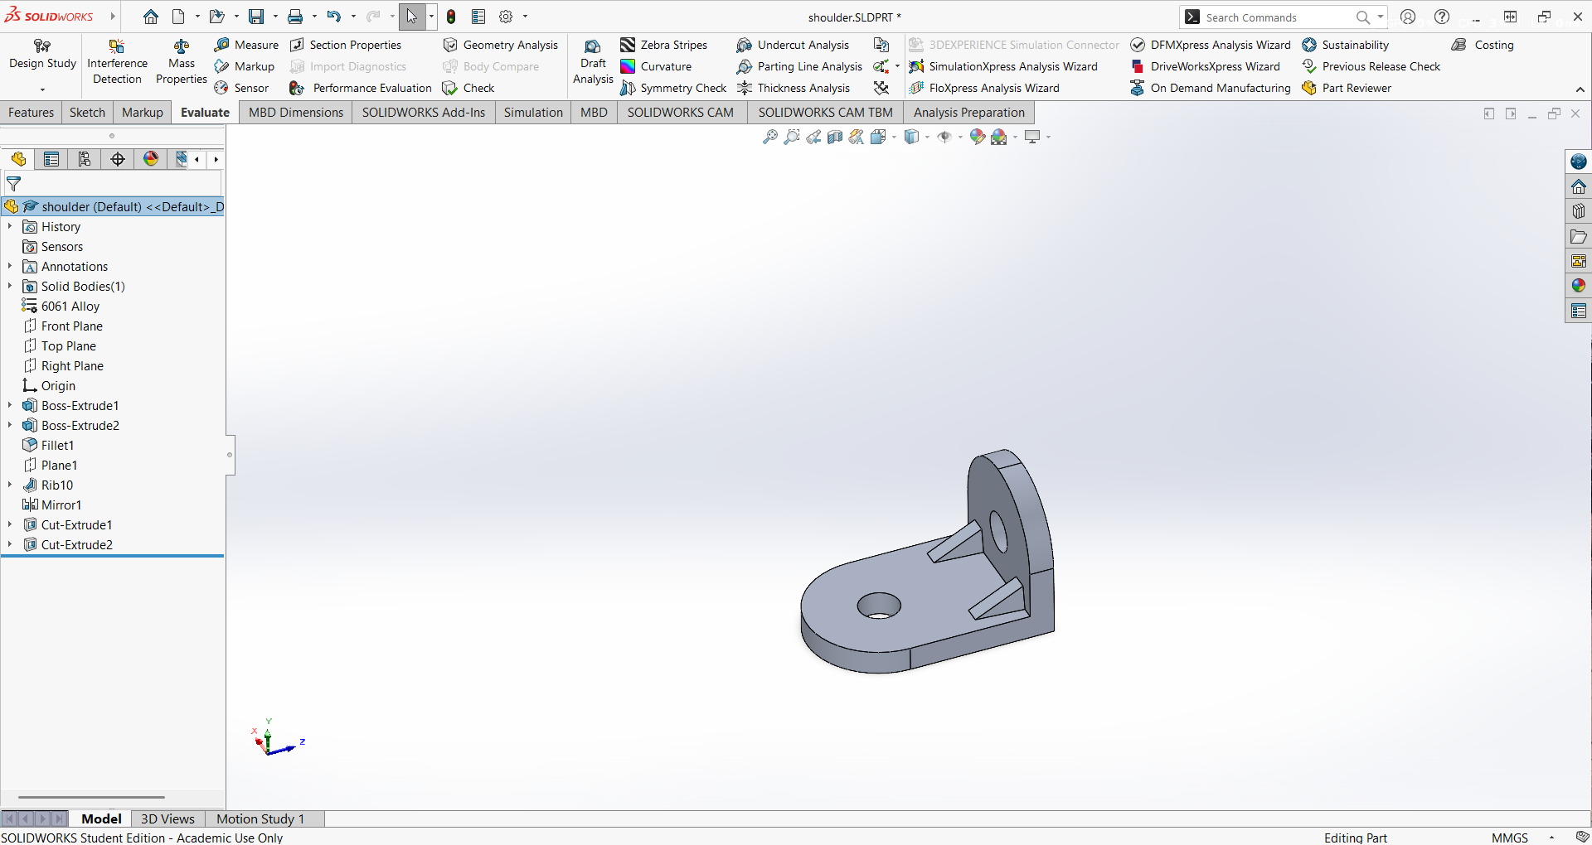
Bonus
Select the material by right-clicking and open the edit material window

Slide 49
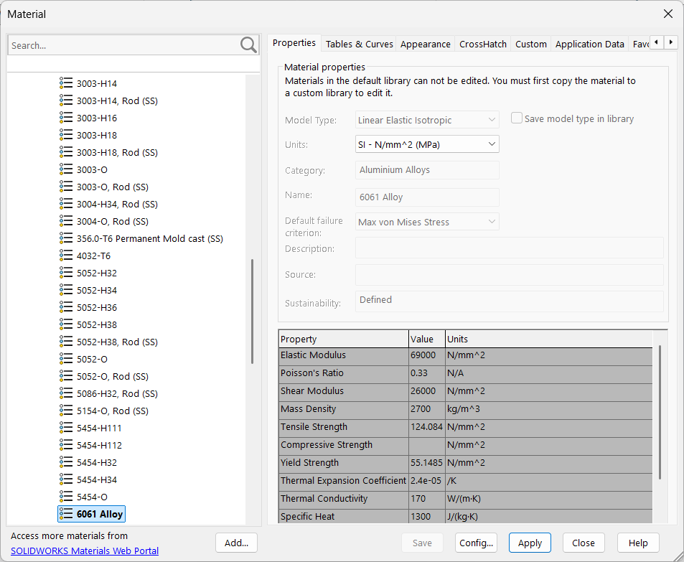
Bonus
You can select different a vast list of materials like steel, wood, titanium etc

Slide 50
Bonus
Select the material by right-clicking and open the edit material window

Slide 51
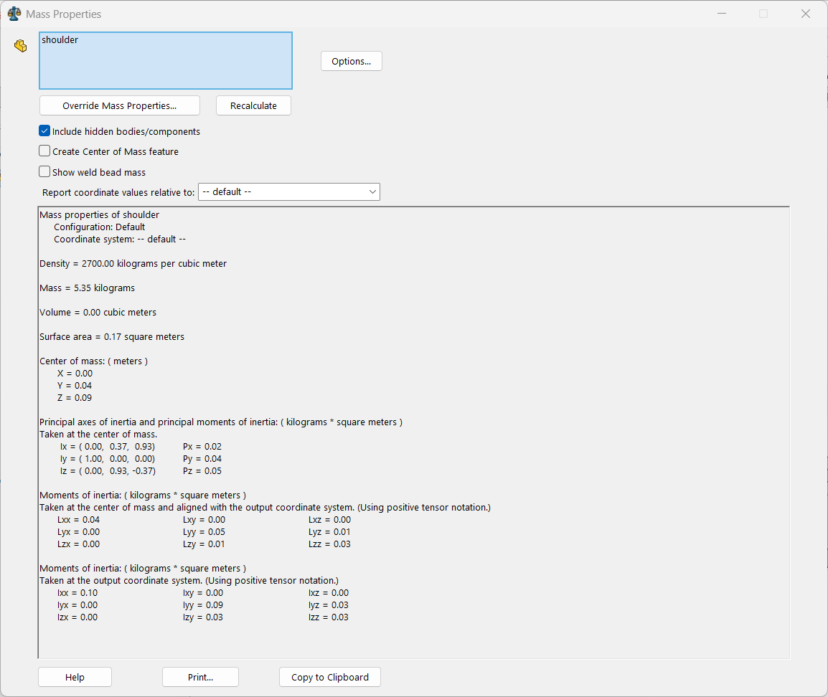
Bonus
Mass
Location of the center of mass
inertia

Slide 52
Bonus
Make sure to specify the correct file path when importing the STL file into the URDF
<visual>
<origin rpy="0 0 0" xyz="0 0 0"/>
<geometry>
<mesh filename="package://robot_description/meshes/base_link.STL"/>
</geometry>
</visual>

