Slide 1


Web Development
19th December 2017

Slide 2
HTML Head Segment
Modifying the Title
Adding icon to the title
<link rel="shortcut icon" href=“wizard.png" type="image/png">
Notes:
Arrays are a collection of JavaScript data values
myArray[3] gives "Wee" as output
myArray.length gives 5
Objects are a set of key : value pairs declared inside curly ({ }) braces
aStudent["name"] or sStudent.name outputs "Ryan"
Objects are also called as dictonary. It works like how a normal languages dictonary, in which the key is the words and the value meaning of the words.

Slide 3
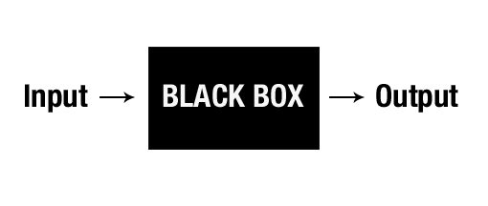
Black Box Model
Notes:
Arrays are a collection of JavaScript data values
myArray[3] gives "Wee" as output
myArray.length gives 5
Objects are a set of key : value pairs declared inside curly ({ }) braces
aStudent["name"] or sStudent.name outputs "Ryan"
Objects are also called as dictonary. It works like how a normal languages dictonary, in which the key is the words and the value meaning of the words.

Slide 4
Good Practise
Pick up those good practise along the way

Slide 5
General
Naming convention
Organise your file & folders
Example : HeartCode |- Assets |- IMG
|_ wizard.png |- CSS
|_ style.css |- JS |_ main.js |_ index.html
Notes:
Arrays are a collection of JavaScript data values
myArray[3] gives "Wee" as output
myArray.length gives 5
Objects are a set of key : value pairs declared inside curly ({ }) braces
aStudent["name"] or sStudent.name outputs "Ryan"
Objects are also called as dictonary. It works like how a normal languages dictonary, in which the key is the words and the value meaning of the words.

Slide 6
HTML
Using div Tag to group content together and modify the style
Placing the CSS in Head Segment
Placing the JavaScript at the bottom of Body Segment
Notes:
Arrays are a collection of JavaScript data values
myArray[3] gives "Wee" as output
myArray.length gives 5
Objects are a set of key : value pairs declared inside curly ({ }) braces
aStudent["name"] or sStudent.name outputs "Ryan"
Objects are also called as dictonary. It works like how a normal languages dictonary, in which the key is the words and the value meaning of the words.

Slide 7
CSS
Using External Style Sheet
Using CSS to modify the position & style rather than breakline
Notes:
Arrays are a collection of JavaScript data values
myArray[3] gives "Wee" as output
myArray.length gives 5
Objects are a set of key : value pairs declared inside curly ({ }) braces
aStudent["name"] or sStudent.name outputs "Ryan"
Objects are also called as dictonary. It works like how a normal languages dictonary, in which the key is the words and the value meaning of the words.

Slide 8
JS
JavaScript

Slide 9
JavaScript - Variables Syntax
Main Variable Type
Number
String
Boolean
Arrays
Objects
var i = 10 ;
var i = “a string” ;
var i = true;
var myArray = [1,2,3,"Wee", "Ryan"]
var aStudent = { "name" : "Ryan", "age" : 12, "gender" : "male"};
Notes:
Arrays are a collection of JavaScript data values
myArray[3] gives "Wee" as output
myArray.length gives 5
Objects are a set of key : value pairs declared inside curly ({ }) braces
aStudent["name"] or sStudent.name outputs "Ryan"
Objects are also called as dictonary. It works like how a normal languages dictonary, in which the key is the words and the value meaning of the words.

Slide 10
JavaScript - Basic Usage
Adding Comments to JavaScript
Single Line Comments
Multi-line Comments
Pop-up Alerts message
Write to console for debug
Access and Change the elements of an HTML document
HTML DOM Object
Single line comments start with //.
Multi-line comments start with /* and end with */
alert(“alert message to display”);
console.log(“writing message to console”);
Notes:
DOM = Document Object Model

Slide 11
JavaScript - Finding HTML Elements
document refers to the current HTML document (web page)
Find an element by:
Element id
Class name
Tag name
document.getElementById(id)
document.getElementsByClassName(name)
document.getElementsByTagName(name)

Slide 12
JQuery
JavaScript Library

Slide 13
JQuery - Selector
Similar to CSS, select the specific element(s)
Element Selector
Class Selector
ID Selector
// select all <p> elements on a page
$("p“)
// find elements with a specific class
$(“.ClassName“)
// Find an element with a specific id
$(“#IDName“)

Slide 14
PLUGINS

Slide 15
Emailjs
http://www.emailjs.com/
Allows sending of email to own accounts
Fee & Easy to use
Minimum configuration
Used in the contact me form segment
Notes:
This is something additional. This is for the email function, usually shown in the content me segment.
This wasn’t needed for Project HeartCode, hence I didn’t go into details. But since I previously had the slides for it, I just include it in.
The example of it is shown in the folder “Another_Template_With_EmailJS”, you could copy the index.html from that folder and place it in the TEMPLATE to see how it work. And view the source to look at how it work and the source code for it.
If you want to know / learn more about it, contact me directly. I didn’t put instruction for this segment. But could be done following the slides instruction (:

Slide 16
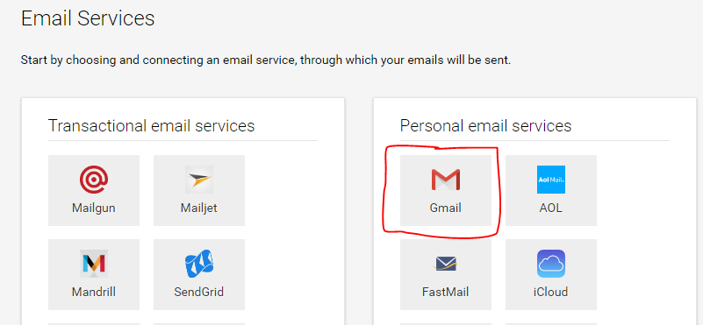
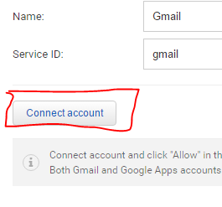
Emailjs – How to
Create an Account
Select Gmail as the Email Service
Connect a Gmail Account
Add services

Slide 17
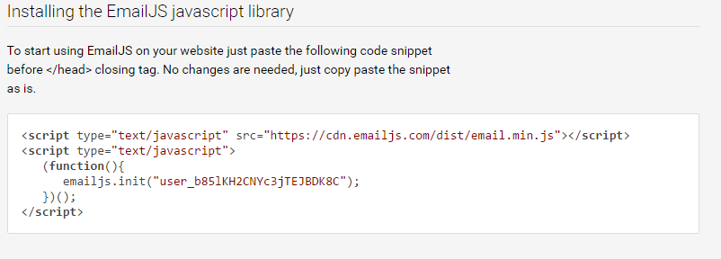
Emailjs – How to
Go to instruction & copy the js script to your HTML

Slide 18
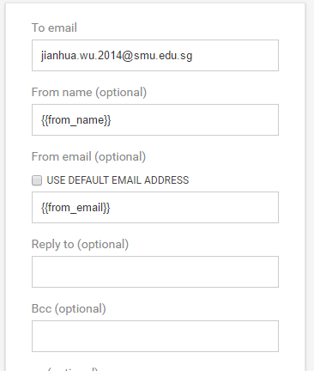
Emailjs – How to
Go to Email template & Edit
Change to the following settings

Slide 19
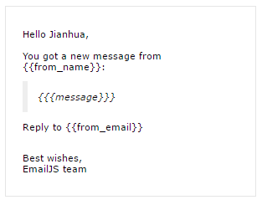
Emailjs – How to
Change the content to the following and Save the changes

Slide 20
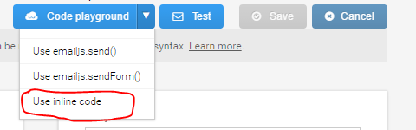
Emailjs – How to
Select “Use inline code” from Code Playground
Copy the code over to our HTML

Slide 21


GitHub
Online Code Repository

Slide 22
Upload to GitHub
Commands
>> git add .
>> git commit –m “short message of what its about”
>> git push –u origin master

Slide 23
Get update from GitHub
Commands
>> git fetch
>> git pull origin master

Slide 24


Thank you!
Any Questions?

