Slide 1
MODEL - VIEW - CONTROLLER
MVC
A quick guide
Morgan Livingston

Slide 2
What is MVC?
MVC is a framework that separates an application into three components Model, View, and Controller. This creates a “separation of concerns” which leads to better division of labor and improved maintenance.

Slide 3
The Three Parts
Model
View
Controller
Manages data and business logic
Handles layout and display for viewer
Routes commands to the model and view

Slide 4
MVC flow architecture
←USER INTERACTING → ←WITH VIEW →
USER
VIEW
DATABASE
←REQUEST PROCESS ←
→ RENDERING THE CONTENT →
↓ RESPONSE DATA ↓
↓ FROM DB ↓
CONTROLLER
↑ REQUESTING DATA ↑
← RETURNING DATA ←
↑ FROM DB ↑
MODEL
→ ASKING MODEL TO PROVIDE DATA →

Slide 5
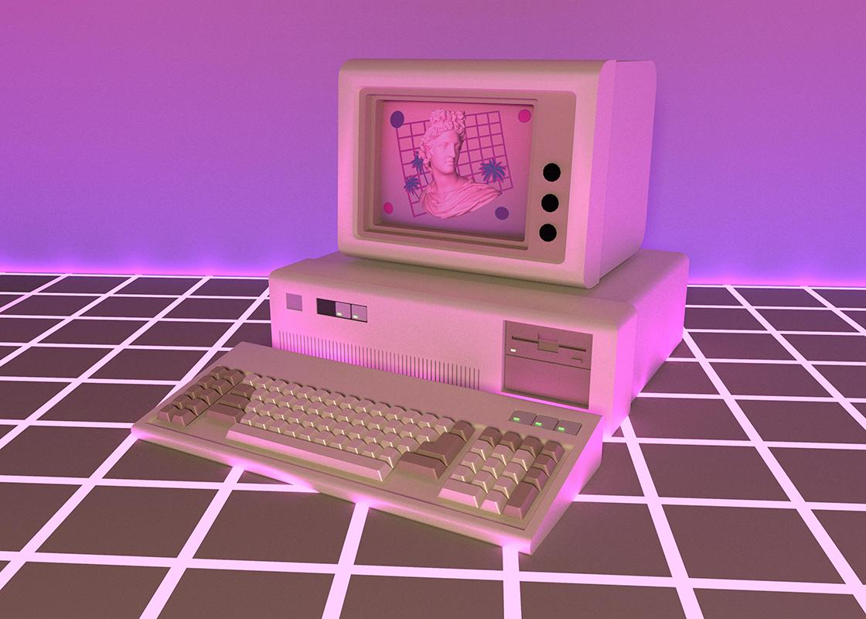
How is MVC helpful?
By creating a road map and sectioning the code into manageable separate files, MVC can help with organization and make the code easier to work with for you and your team.

