Slide 1
California’s Independent Medical Reviews
Are arbitrators persuaded by elements other than the facts?

Slide 2
Is there a systemic bias in whether an insurer’s denial of coverage for a patient’s medical treatment or health service is overturned or upheld?

Slide 3
Dataset
Summary
California Department of Managed Healthcare (DMHC)
Outcomes of independent reviews of patient denial of coverage for medical treatments and health services.
> 28k reviews
Diagnoses, treatments, and patient profiles
“Overturn rate”
Data Processing
Applied medians to missing values in “Days to Review”
Discarded 2.3% of observations due to missing values
Patient age range
Patient gender
Notes:
Overturn rate – the probability that an arbitrator overturns an insurer’s denial of service

Slide 4
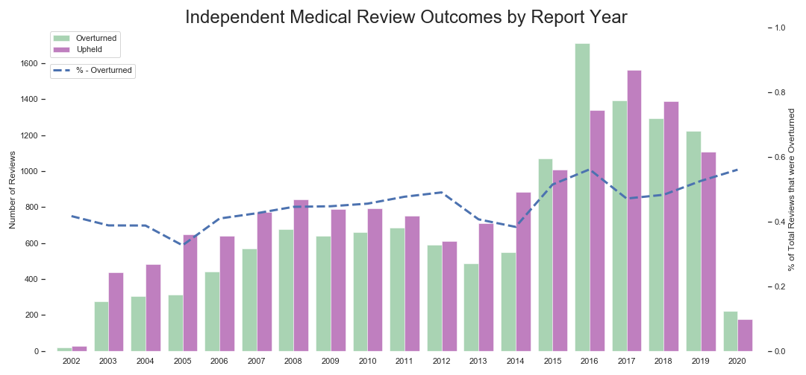
Exploratory
↓ in federal refunds to insurers.
CA implemented
ACA in Oct ‘13
Notes:
- % of Californians uninsured decreases from ~17% 2013 to ~7% in 2018. Source: U.S. Census Bureau

Slide 5
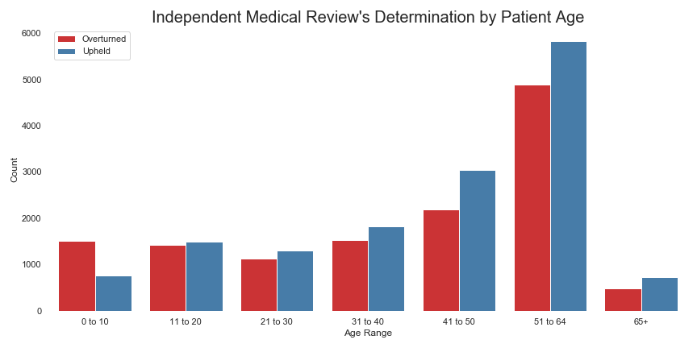
Exploratory (cont’d)
Notes:
- 66% of children’s cases were overturned vs 40 to 50% for all other age groups.

Slide 6
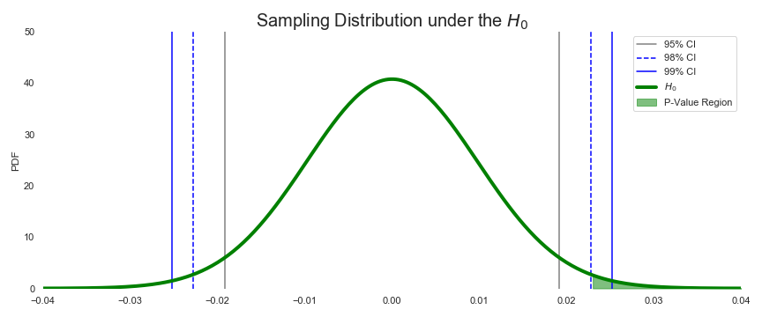
Hypothesis Testing
H₀: Child’s expected “overturn rate” = Expected “overturn rate” of patients who are 11 years and older
H_{A}: Child’s expected “overturn rate” ≥ Expected “overturn rate” of patients who are 11 years and older
Reject H₀
p-value⁽¹⁾ = 0.0101
(1) Both Mann-Whitney U-test and Welch’s T-test (divided by two) arrive at a p-value ~0.0101.
Notes:
With ~98% level of confidence, the claim can be made that a child’s “overturn rate” does NOT equal other patient’s

Slide 7
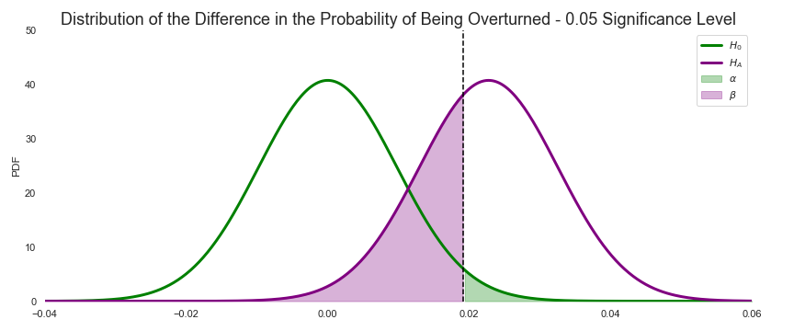
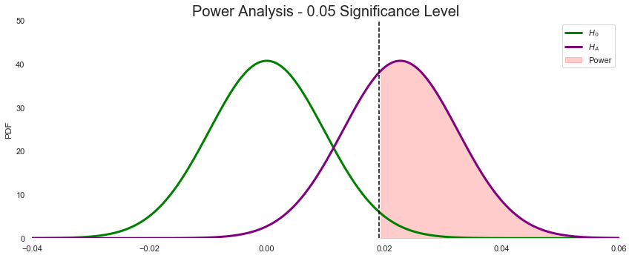
Hypothesis Testing (cont’d)
FPR (α) = 0.025
FNR (β) = 0.358
Power = 0.642
Notes:
Alpha = False Positive Rate = the probability of INCORRECTLY claiming that that expected “overturn rate” children and the remaining of the population do NOT equal.
Beta = False Negative Rate = probability of claiming there is no difference in the “overturn rate” among age groups when in face THERE IS a difference in the overturn rate.
Power – believe the power would increase by increasing a child’s sample size.

Slide 8
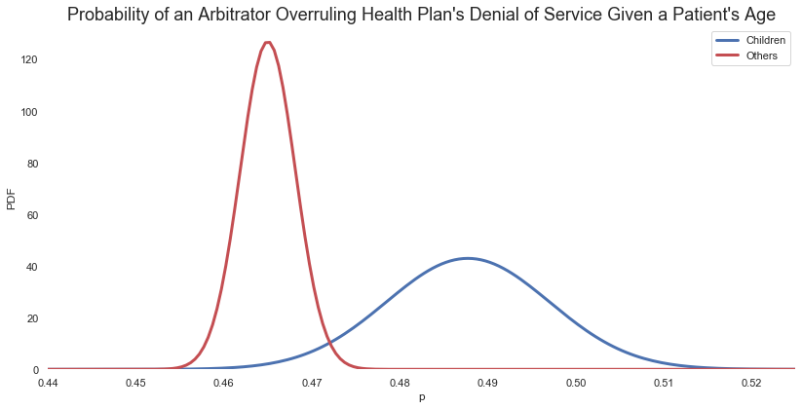
Bayesian Inference
~99% like that probability of a child’s case being overturned is greater than the probability of “other” patient’s being overturned.
Notes:
Children sample size ~ 2,900
Other sample size ~ 25,187
By increasing children’s sample size, I expect standard deviation to decrease. Increase like the probability that child’s case is more likely to be overturned than patients older than 10 years old.

Slide 9
Conclusions
To some degree, the Titanic ethos continues
Children first!
Potential relationship between insurers access to federal funds and the likelihood of an independent reviewer overturning a patient’s denial of service.
Further Discovery
How many patients were denied medical coverage by their health plan since 2001?
How are arbitrators selected? Arbitrators’ profiles?
Which insurer denied coverage for each case?

