Slide 1

Case B:The Artifact Smuggling Operation
Investigators: Morgan E. Brown, Niy’Asia Wiliams, Camille Vickers

Slide 2
Objective
Analyze the digital forensic evidence provided and determine:
The nature of Kenway’s involvement in artifact smuggling
Key financial transactions that link Kenway Exports LLC to the cartel
The significance of the deleted files and their potential impact on the case
Any additional individuals or organizations implicated

Slide 3
Data Integrity Validation
The SHA256 hash is identical to Edward Kenway seized personal storage drive

Slide 4
Kenway’s Involvement
Edward Kenway operated as a central broker, coordinating:
Suppliers: Y.M. (Cairo), D.R. (Istanbul)
Buyers: A.M. (Dubai), F.M. (Paris), L.T. (Hong Kong)
Communications were encrypted via ProtonMail, Tuta.io, and SecureMail
Transactions spanned legitimate exports, crypto wallets, and concealed shipment labels

Slide 5
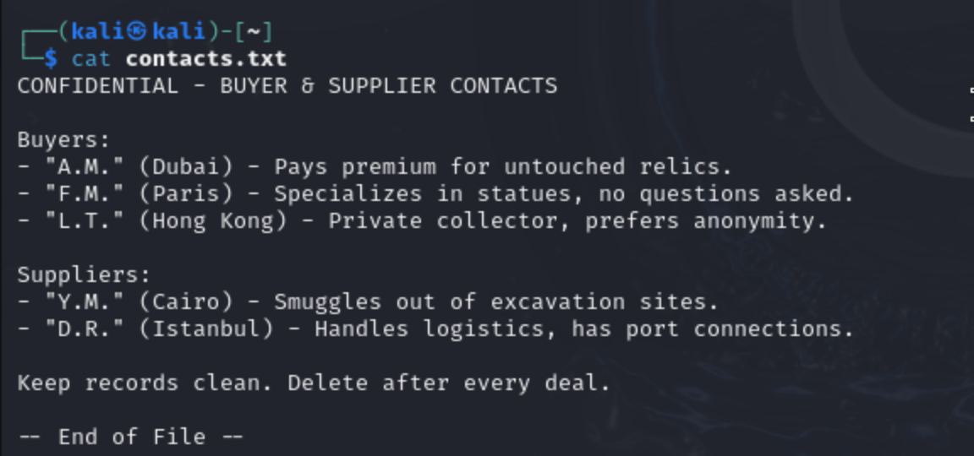
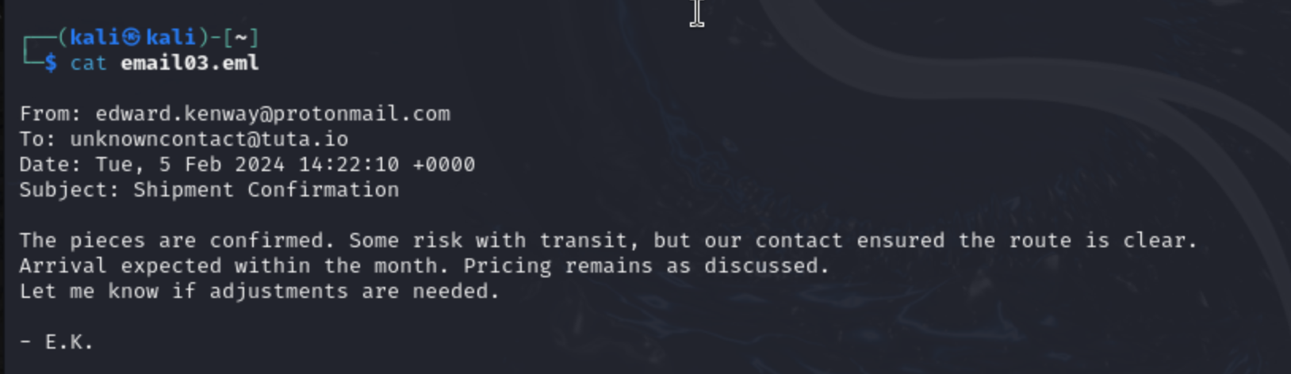
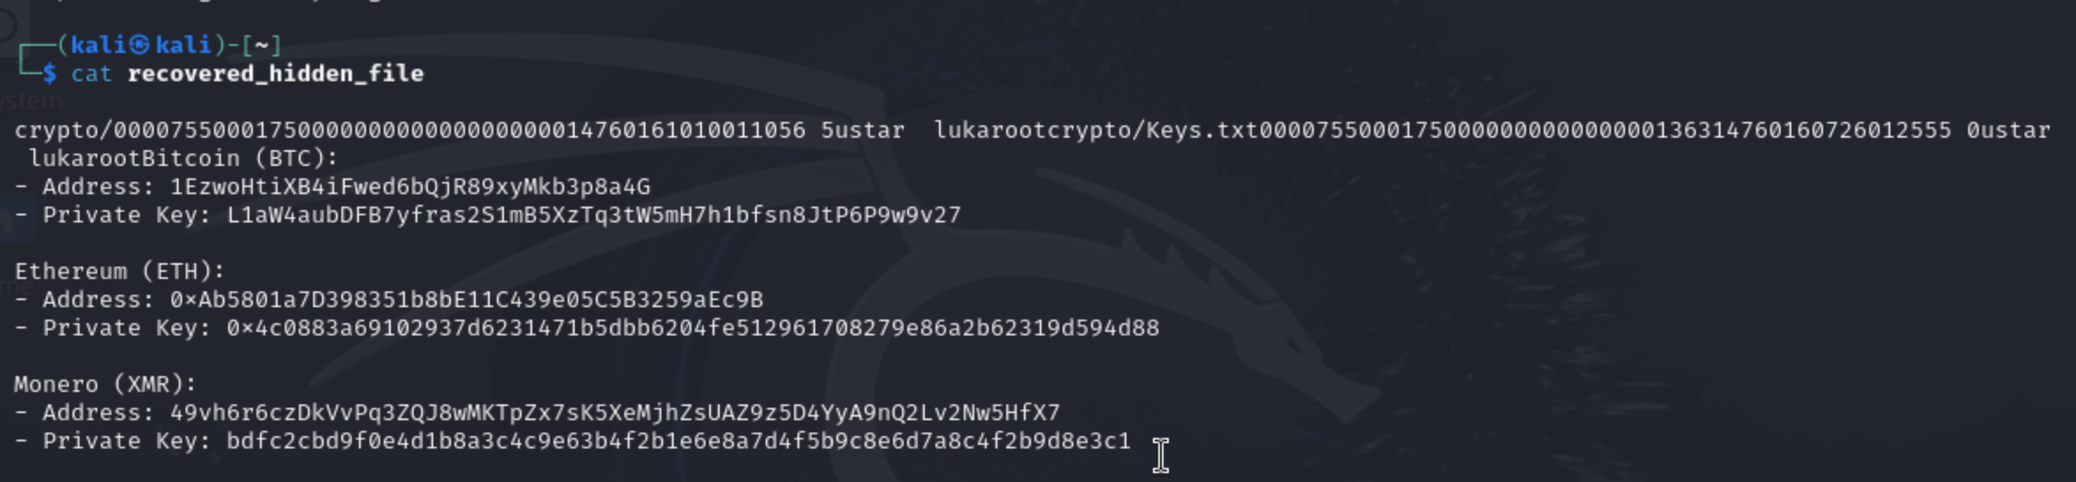
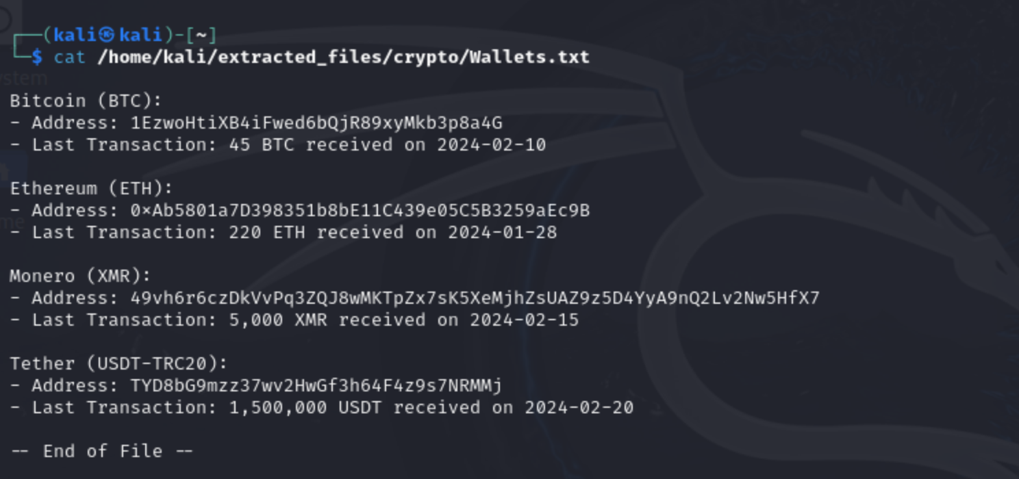
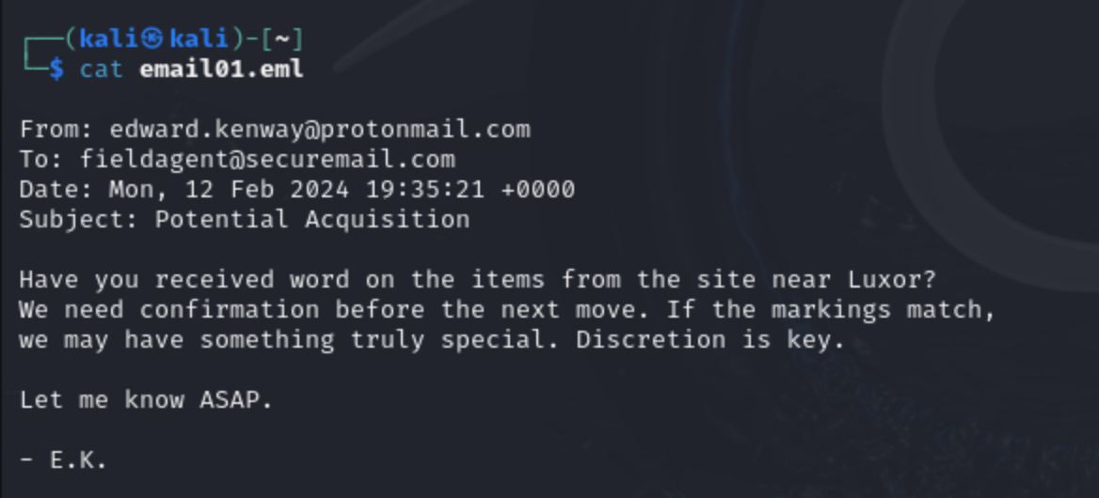
Kenway’s Involvement Findings

Slide 6
Financial Footprints: Examining Kenway Exports LLC’s Alleged Ties to Cartels
After identifying Kenway's involvement we were able to limit our scope to storage and transportational based clues
Once viewing the contents of the midterm.dd file we discovered email conversations between unknownbuyer77@tuta.io and edward.kenway@protomail.com. This sparked interest in finding a possible ledger that'll connect Kenway Exports LLC to the infamous Cartel.

Slide 7
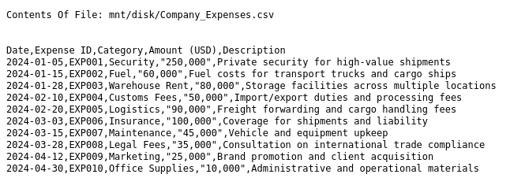

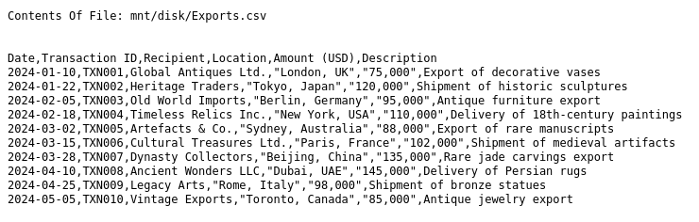
Financial Transactions/Records

Slide 8
The significance of the deleted files
Investigation Summary:
Recovered deleted files from images using PhotoRec and Foremost
Searched recovered data for key terms: "Kenway", "artifact", "export", and "transaction.”
What We Found:
Multiple test files referenced:
“Exporting a copy”
Several “transactions” (see screenshot 1)
Some documents used financial language:
Mentions solicitors, records, and formal agreement
Implies possible hidden or undercover deals
All files are located in recup_dir folders:
It shows us that they had been deleted and were no longer shown through normal access(shown in screenshot 3)
Impact on the Case:
Strong evidence someone intentionally deleted files to hide activities
Supports the theory that there was smuggling or unofficial exports
These deleted documents could be used to serve as digital evidence in court.

Slide 9
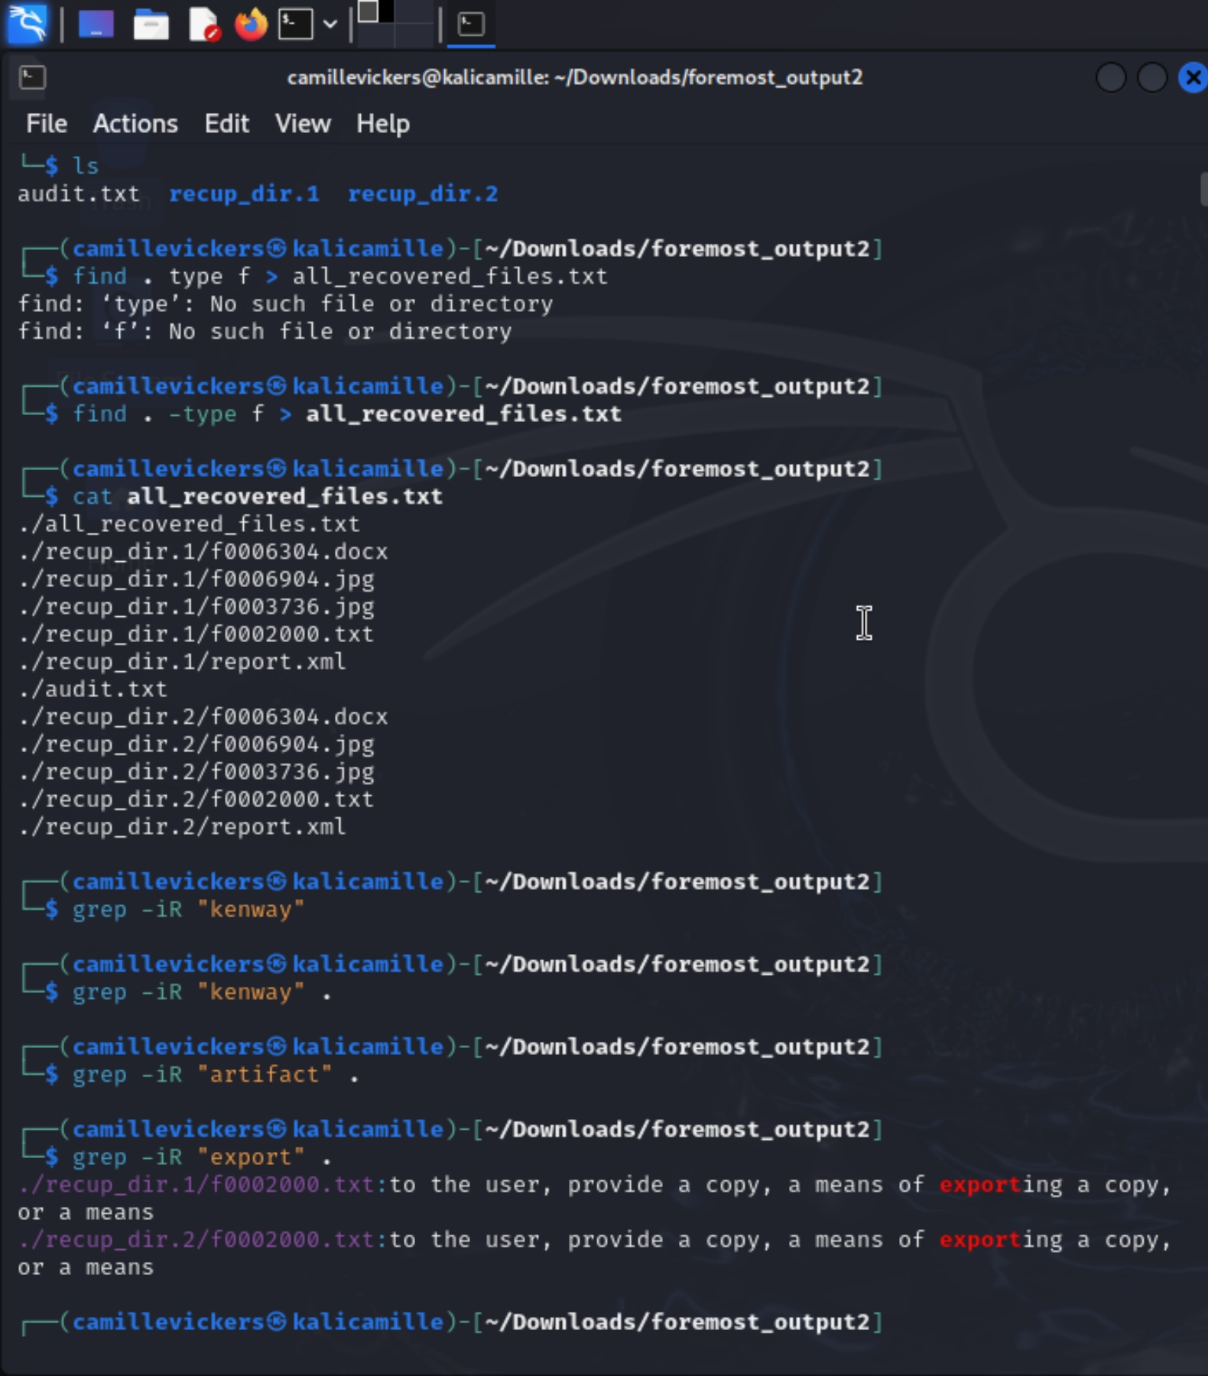
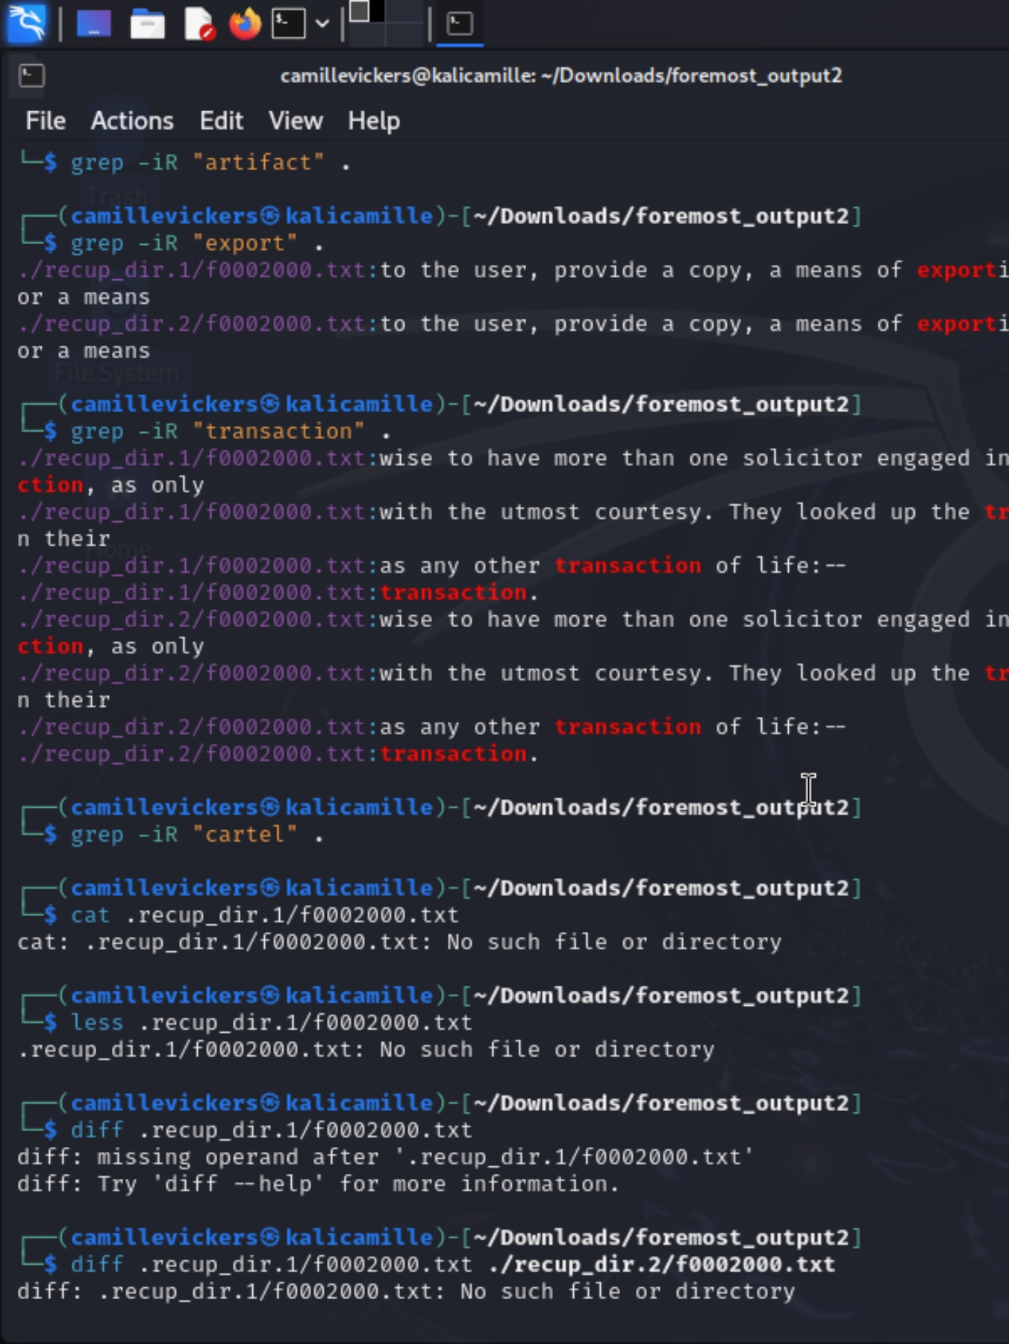
Recovered Deleted Files
Screenshot 1
Screenshot 2
Screenshot 3

Slide 10
Timeline Reconstruction 🕵️‍♂️

Slide 11
Timeline Reconstruction
1 Oct. 24
Global Antiques Ltd. in London receives a shipment of decorative vases.
22 Jan. 24
Heritage Traders (Tokyo) receives a shipment of historic sculptures valued at $120,000.
2 May 24
Kenway emails unknowncontact@tuta.io confirming "shipment pieces are in transit" and the route is clear.
2 Aug. 24
Kenway receives a reply from unknownbuyer770@tuta.io expressing concern about the price and requesting it be adjusted “closer to 1.2”.
2 Dec. 24
Kenway emails fieldagent@securemail.com requesting updates on items from Luxor. Emphasizes discretion and notes the find might be “something truly special.”
15 Mar. 24
Shipment of medieval artifacts valued at $102,000 sent to Cultural Treasures Ltd. in Paris.
28 Mar. 24
Kenway's company logs a $35,000 legal consultation expense.
4 Oct. 24
Ancient Wonders LLC (Dubai) receives a shipment labeled “Persian rugs” worth $145,000.
15 Apr. 24
Files extracted from the disk include cryptocurrency wallets and private keys:
45 BTC
5,000 XMR
220 ETH
1.5 million USDT
30 Apr. 24
$10,000 logged as “Office Supplies”

Slide 12

Recommendations for further Investigation
Issue Legal Requests for Email Account Logs
Coordinate with International Law Enforcement
Forensic Audit of Company Finances
Investigate Shell Companies

