Slide 1
Raspberry Pi 2 way Marketplace
Morgan Batterham
Term 2 Assessment 2

Slide 2
Purpose of Marketplace
Raspberry Pis are very popular with Hobbyists
Many different models with different configurations
For example: Newest model has Micro-HDMI and USB-C while 3b+ has standard HDMI and Micro-USB
Some software is difficult to install and configure

Slide 3
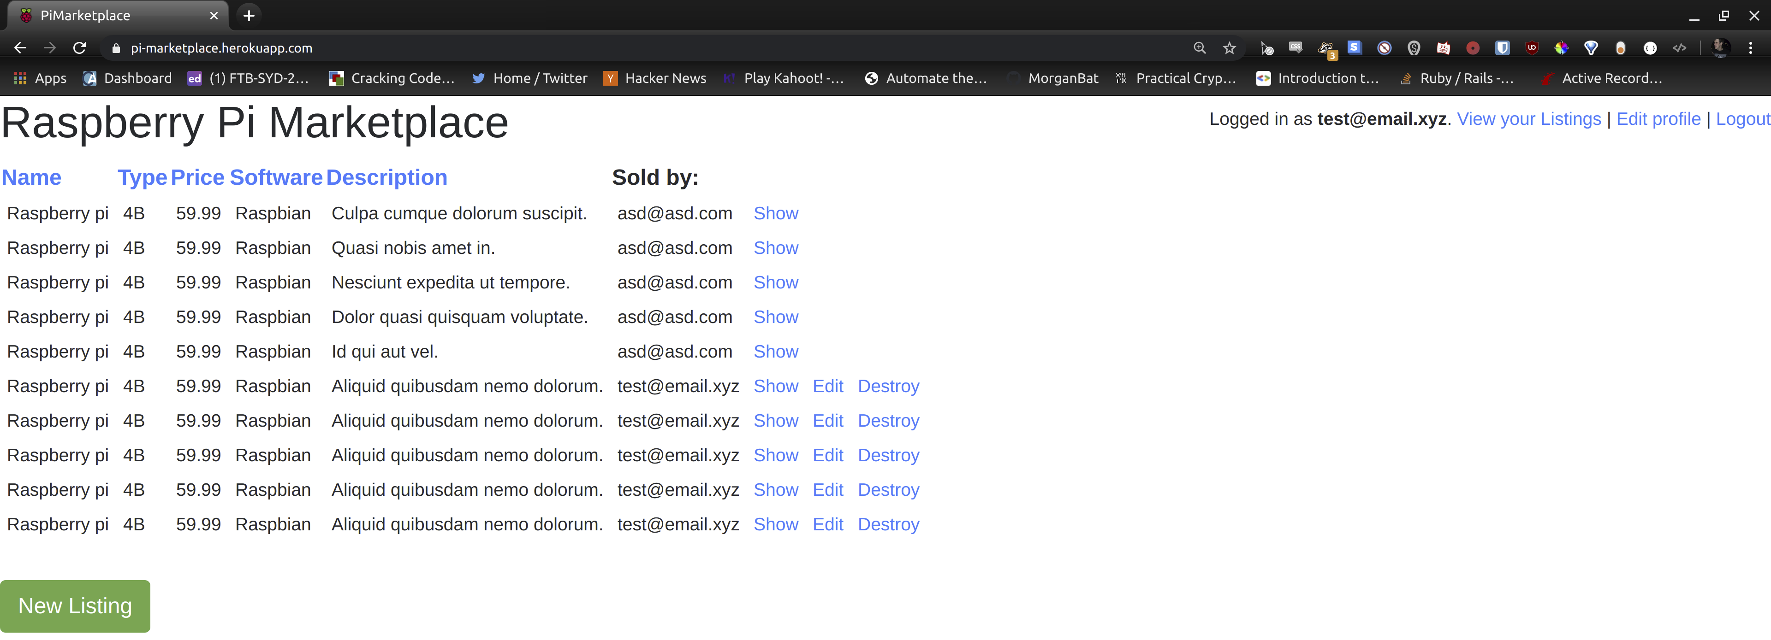
Walkthrough:

Slide 4
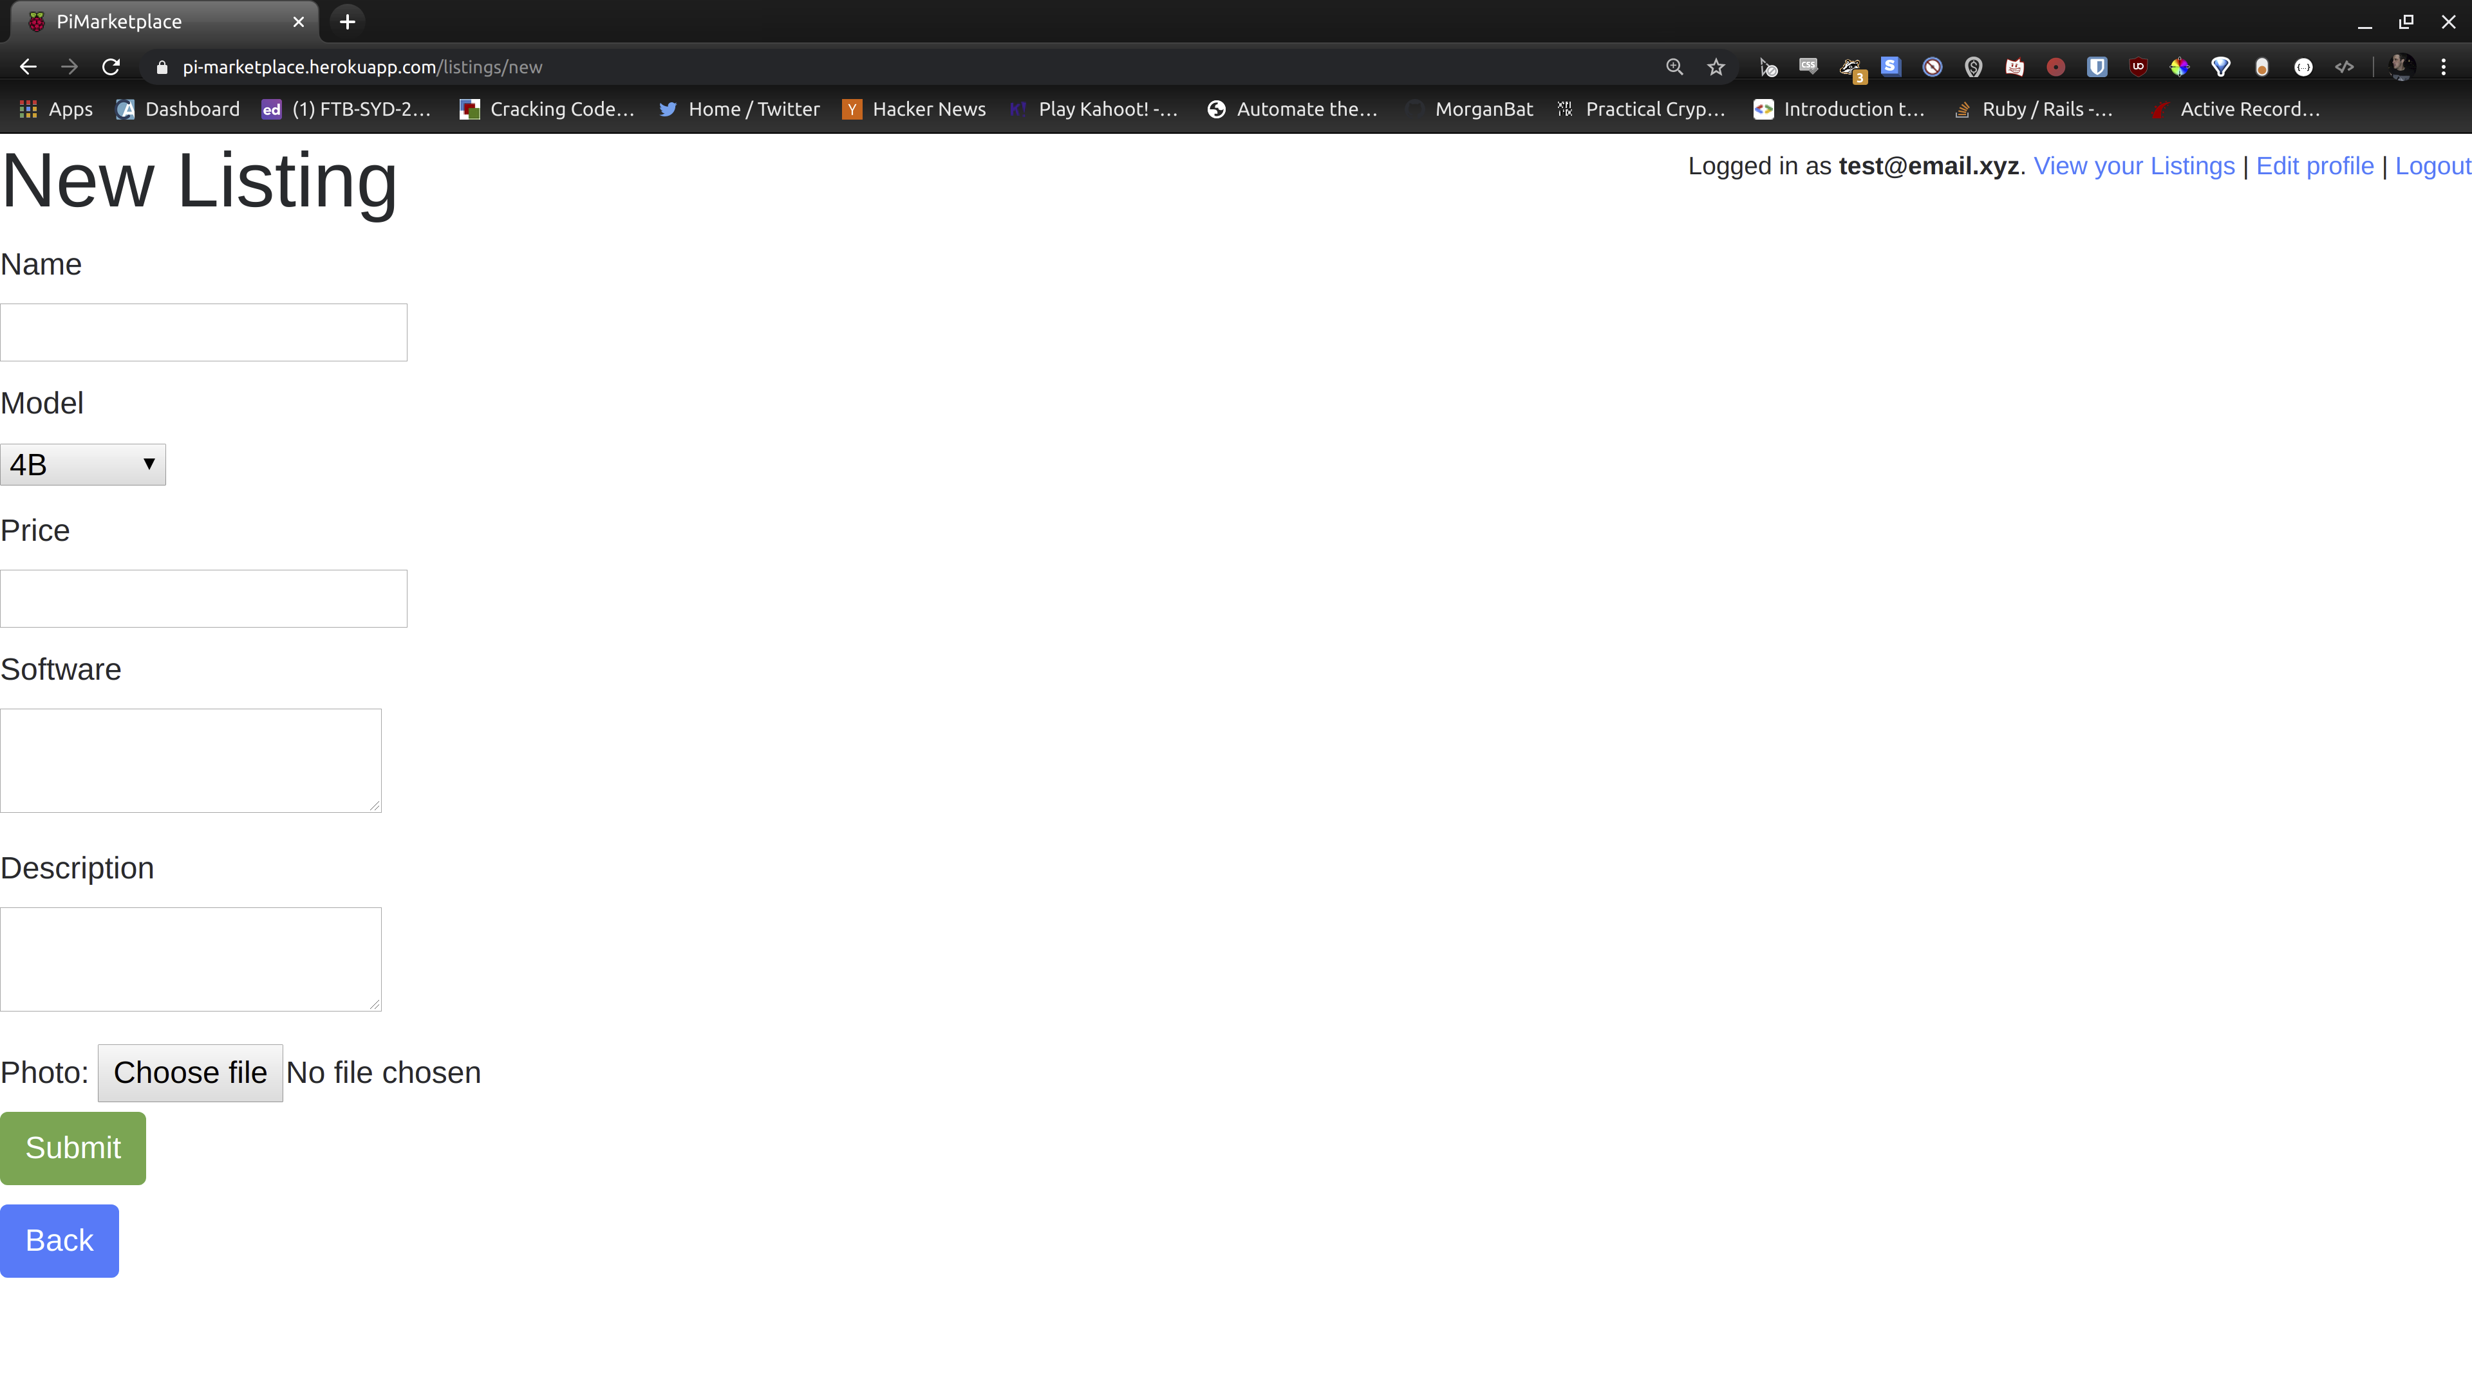
Walkthrough Cont:

Slide 5
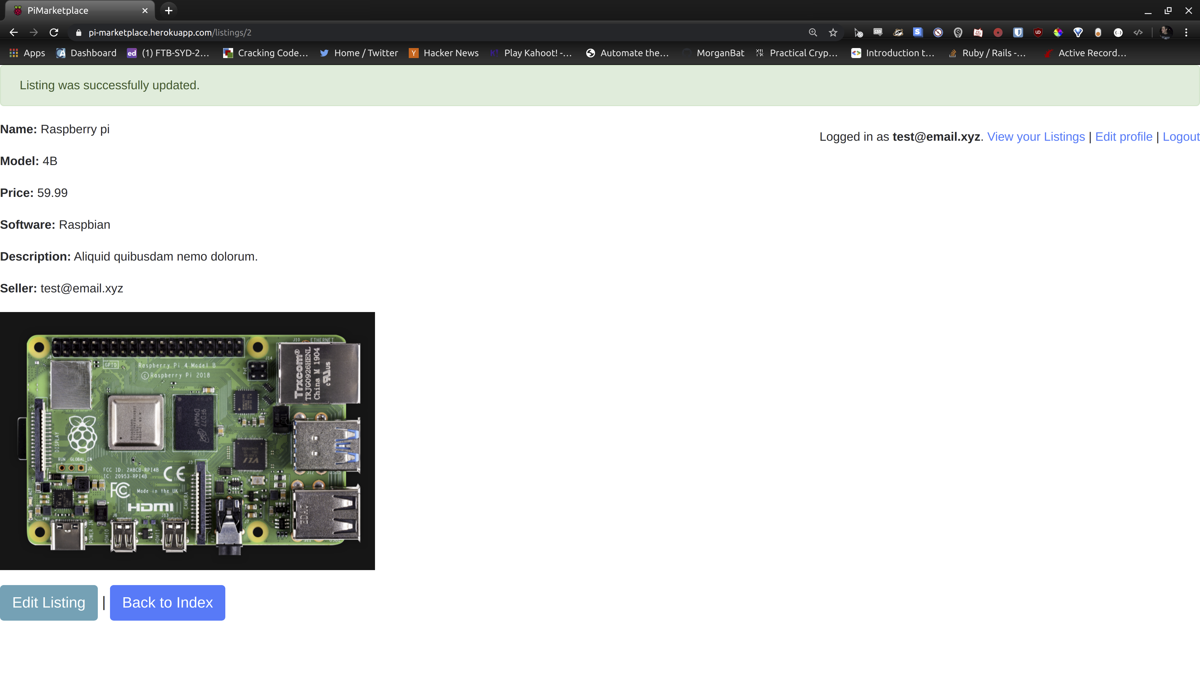
Walkthrough Cont:

Slide 6
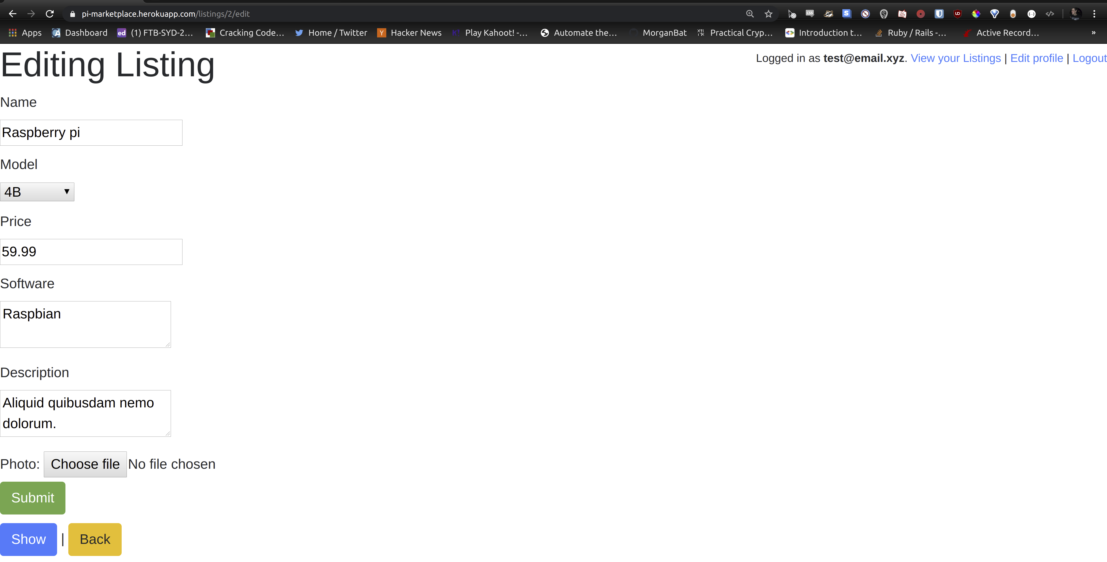
Walkthrough Cont:

Slide 7
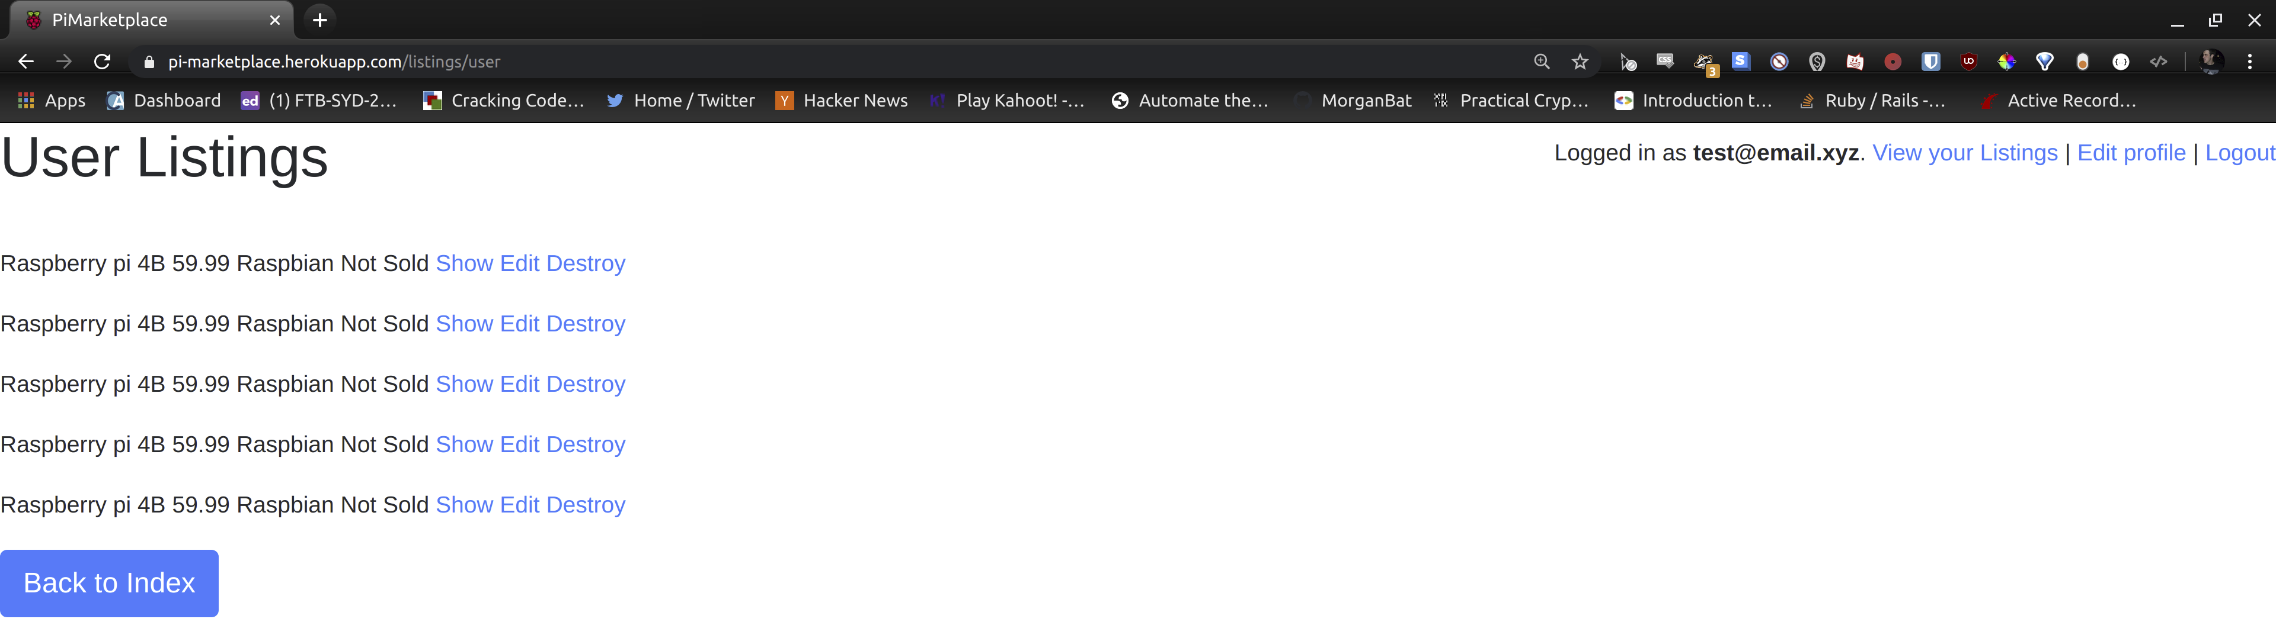
Walkthrough Cont:

Slide 8

Questions?

