Slide 1
Photomosaic Generator
Morgan Grundy

Slide 2
What is my project about?
My project is a photomosaic generator.
A photomosaic is a photo that has been divided into cells, each cell is replaced with another photo that most closely resembles the target.
When viewed at low magnifications the original image is clearly visible, while at high magnifications the smaller images become visible.

Slide 3

Original Photo

Slide 4
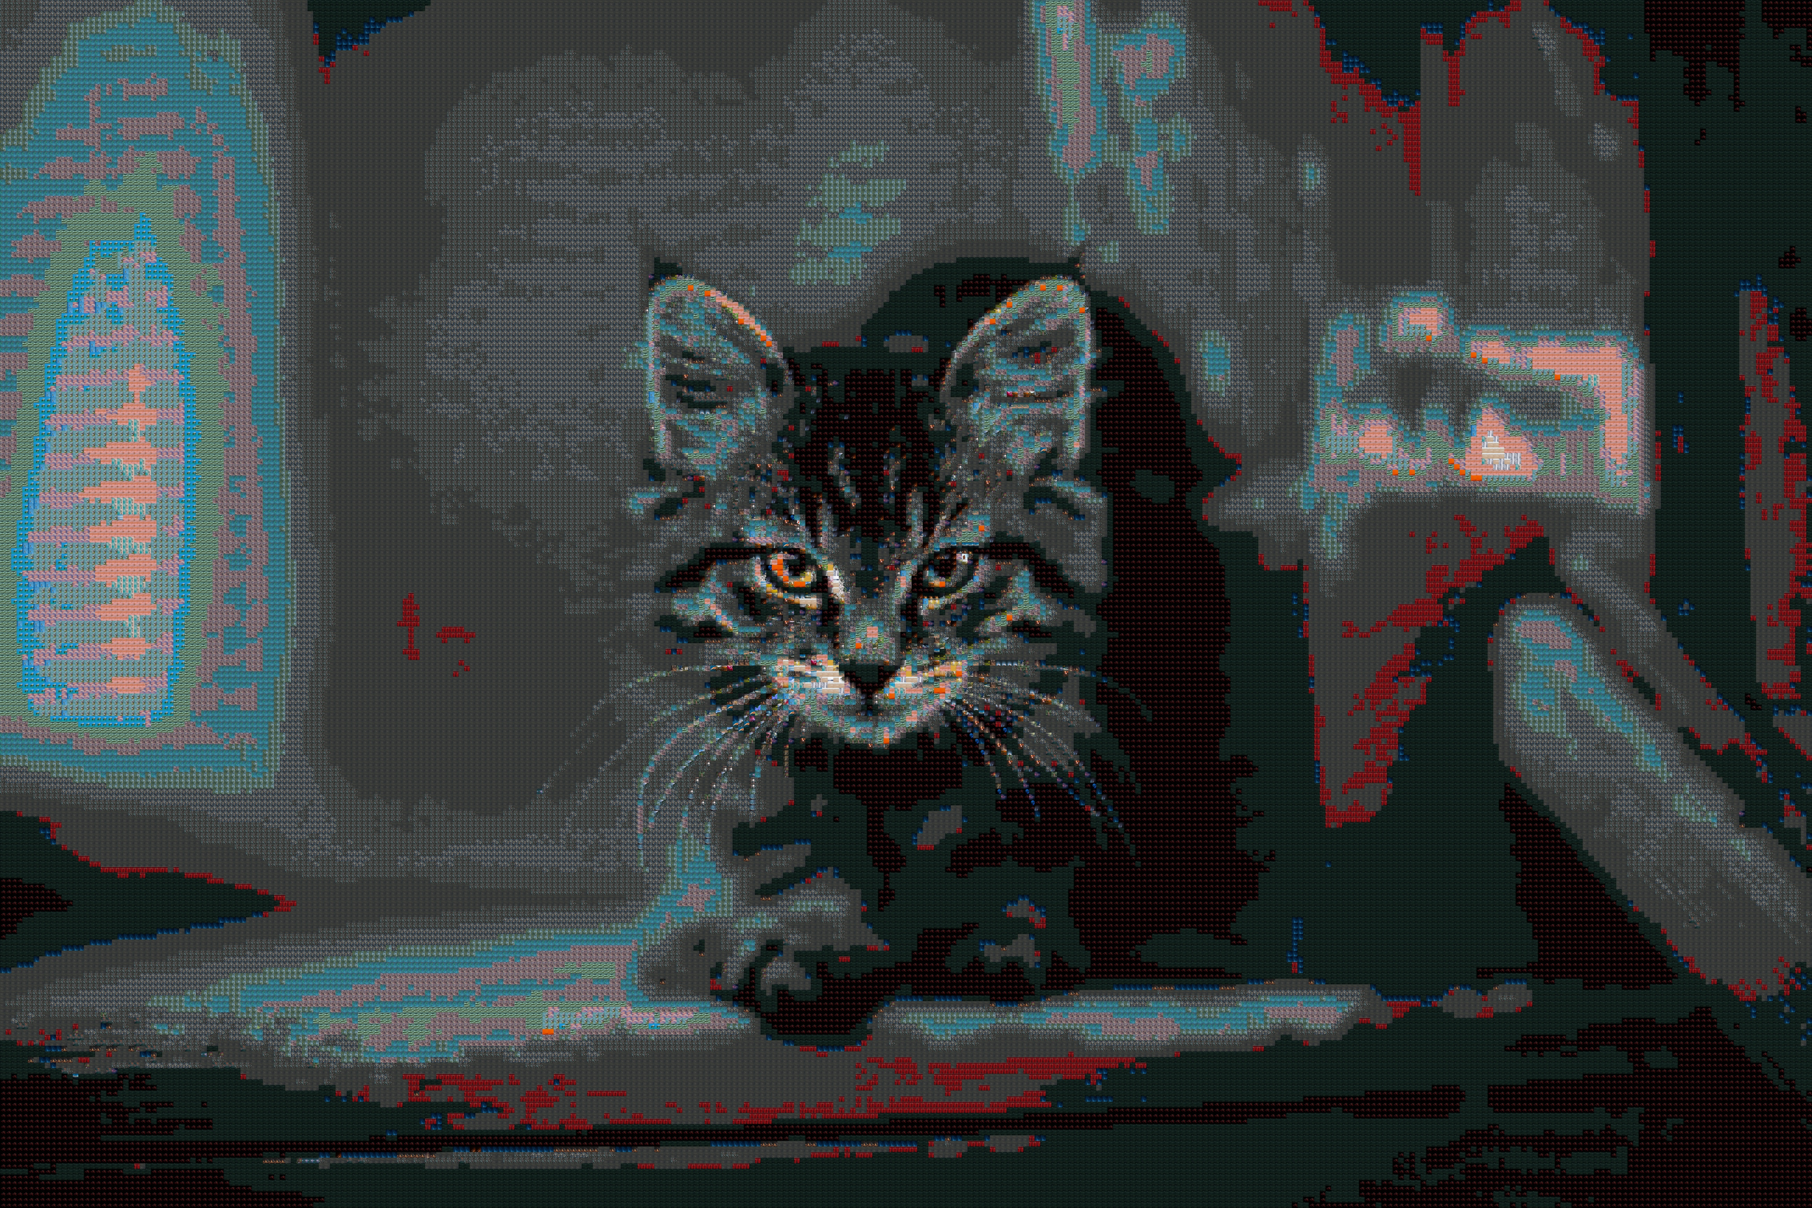
Photomosaic

Slide 5
Photomosaic Zoomed

Slide 6
Photomosaic Zoomed

Slide 7
How am I going to solve the problem?
There are two main approaches:
The simpler method is to downsample each cell to a single pixel and replace it with a photo whose average colour is closest to the target.
The more advanced method avoids downsampling the main photo, by comparing each pixel in a cell against the corresponding pixel in the other photos.

Slide 8
How am I going to solve the problem?
I am using the more advanced method as it can preserve the resolution of the main photo.
Many photomosaic generators modify the colour of the photos or overlay them transparently on the main photo.
I will not be using this method as it is against the true nature of a photomosaic, and it can make the other photos difficult to identify.

Slide 9
How am I going to solve the problem?
There are multiple algorithms for calculating colour difference published by the International Commission on Illumination (CIE), each one more complex but also more accurate than the last.
I plan to implement two of these algorithms, the most recent for accuracy (CIE2000) and the first for speed (CIE76).

Slide 10
How am I going to solve the problem?
Some photomosaics are not made up of simple square/rectangle photos.
Some other common cell shapes are:
Hexagon
Circle
Jigsaw Puzzle

Slide 11
How am I going to solve the problem?
The problem of repeating photos.
Ideally, all photos should be unique, however this would require a very large dataset with near-perfect colour distribution.
Instead I plan to use a range in which every repeat makes the photo a less desirable fit for a cell.

Slide 12
What will you see in my demo in the spring?
An application consisting of three components:
An image preprocessor
The actual photomosaic generator
An image viewer

Slide 13
Preprocessor
The preprocessor will:
Read photos from a given folder recursively
Crop them to be square
Downsample or upsample them to match the cell size
Write photos to a given folder

Slide 14
Photomosaic Generator
The photomosaic generator will:
Generate and save photomosaics
With two colour difference modes (CIE2000 & CIE76)
Support a large quantity of photos
With three cell shapes; Square, Hexagon, Circle
Will display photomosaic with viewer after completion

Slide 15
Image Viewer
The image viewer will:
Read standard image types
Read custom photomosaic type
Support zooming and scrolling
Export photomosaic as standard image type

