Slide 1

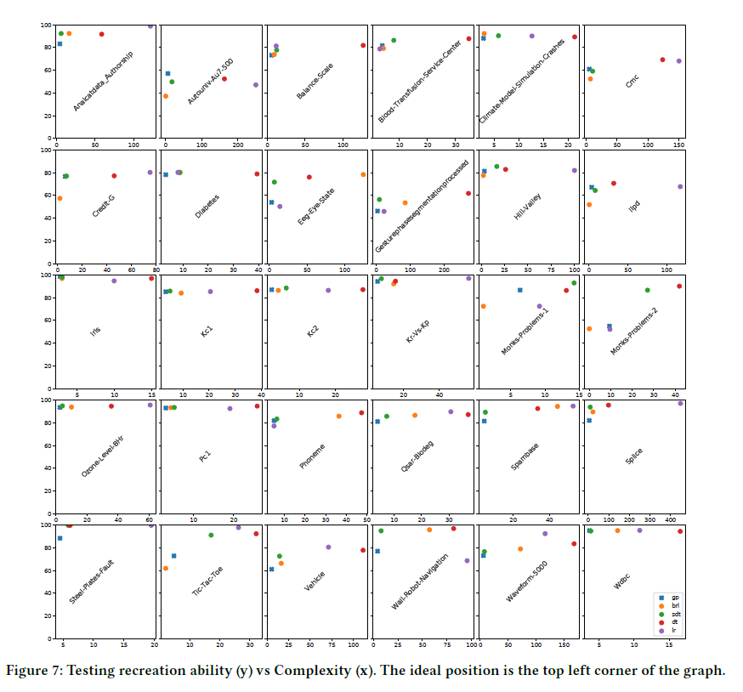
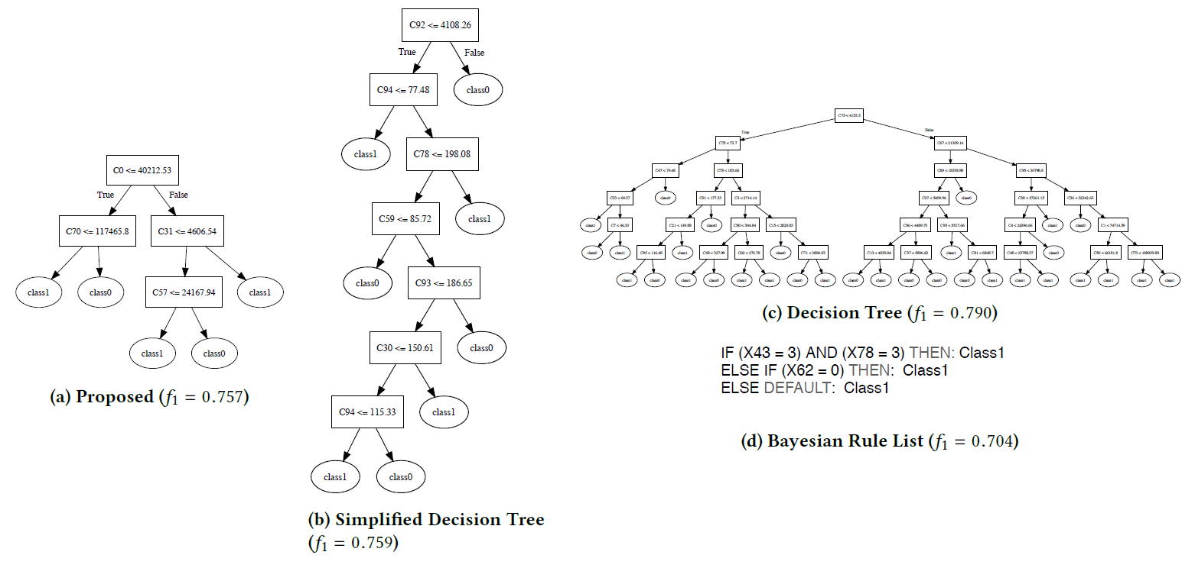
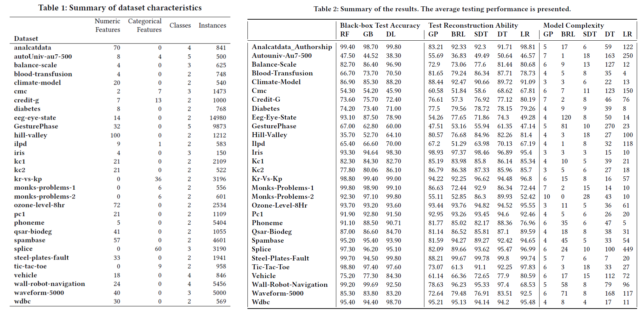
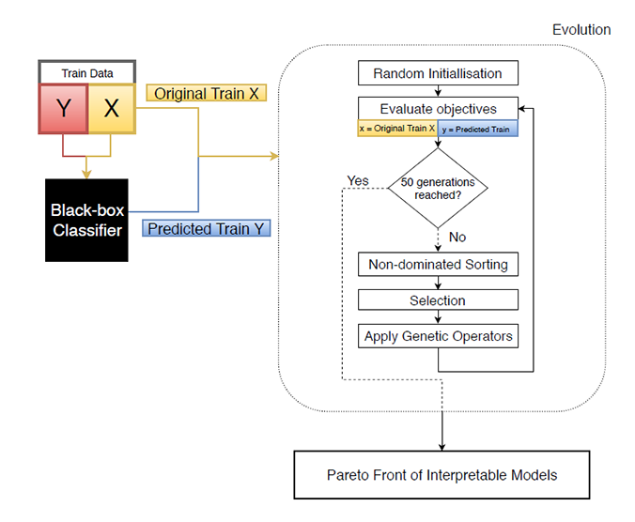
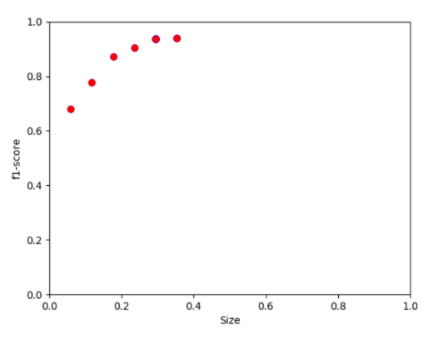
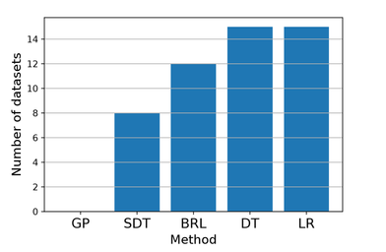
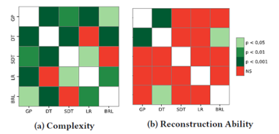
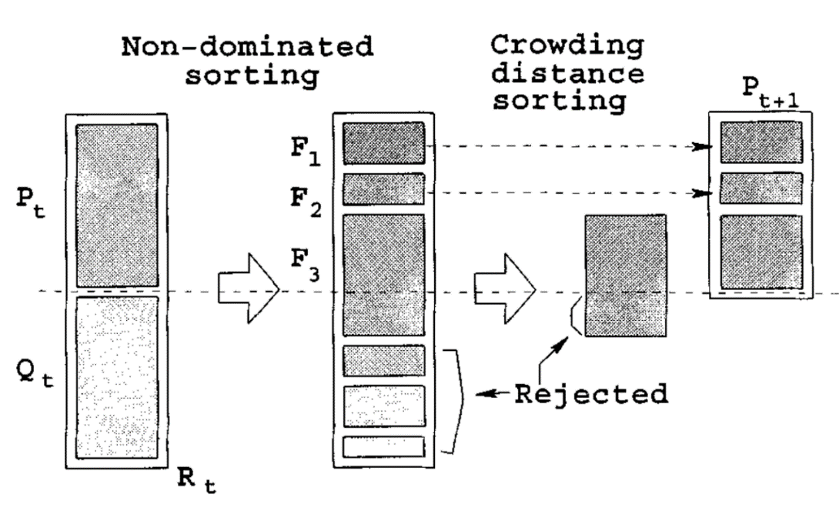

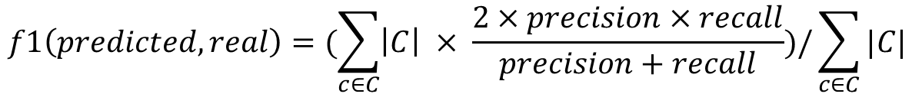
What’s inside the black-box?
A genetic programming method for interpreting complex machine learning models
Morgan Jones
mwj7@aber.ac.uk
Department of Computer Science,
Aberystwyth University,
Aberystwyth, Wales, UK
Introduction
Experiments & Results
Further Analysis
The most useful machine learning techniques are also the least interpretable but for AI to be adopted into more areas it needs to be explainable and it’s decisions justified.
Model extraction functions as an unobtrusive addition that can provide insight into a complex model’s predictions. Decision trees are most naturally interpretable, although current approaches are flawed (greedy tree-construction)
Using multi-objective Genetic Programming we can extract models that provide the reconstruction ability seen previously but ensure human readability by keeping tree complexity to a minimum.
The proposed method’s resulting tree and the Bayesian rule list are by far the simplest interpretable models, both condense a 200 layer neural-network into small human readable form. Although the BRL just predicts 1 class so is considered overly simplistic.
Looking into our evolved tree we can see its splitting points make sense when considering the hill-valley dataset, which "when plotted in order the Y coordinate will create either a Hill or a Valley [13]. We can see the tree is checking the first point, and comparing to the point at 30\%, or the point at 70\%, where the tree is trying to distinguish between classes by finding the common points for the hills/valleys and checking if these are high or low relative to the training data (e.g. a high point at the start, a low point at 30\%, then a high point at 57\% indicates a valley based on this tree).
4 Current Model Extraction methods: Bayesian Rule Lists Logistic Regression Decision Tree Simplified Decision Tree | 3 Black-Box Models : Random Forests Gradient Boosting Deep Neural Network
A broad range of 30 datasets from the OpenML repository [7] were used for comparison. The datasets were restricted to less than 15000 instances, less than 5 classes, and no missing values.
The New Method
We propose a novel model agnostic approach to XAI model extraction. We use NSGA-II paired with strongly typed GP (STGP) to evolve decision tree-like structures which simultaneously balance the complexity and accuracy of the trees. Complexity is minimised and accuracy maximised by our objective functions below.
The reconstruction ability was an f1 measure result of a 10 fold cross-validation across averaged across all three black-box classifiers. For each model extraction method this was done for each dataset.
$$maximise\frac{1}{k}\sum_{i=1}^{k}{f1(predict(fold\left(i\right)),blackbox_predict(fold\left(i\right)))}$$
$$f1\left(predicted, real\right)=(\sum_{c∈C}{\left|C\right| × \frac{2×precision×recall}{precision+recall})/\sum_{c∈C}{|C|}}$$
F1 metric is result of an internal 3 fold cross-validation (k=3) .
$$minimise\sum{split_points}$$
Datasets of particular difficulty:
Autonuniv-Au7-500 and GesturePhase datasets have 5 classes. Perhaps relax push for simple trees on datasets with many classes.
onks-Problems-2 is entirely categorical features. Combining categorical features into a single branch for future work.
For eeg-eye-state, the data is sequential/time-series. The proposed method is not designed for such datasets
We use subtrees to construct features as mathematical expressions, these implicit features allow our trees to learn simpler rules.
Conclusion & Future Work
Elitist NSGA-II with μ+ λ (|μ|=|λ|)
The new method was compared to existing approaches for model extraction, and was found to offer drastically simpler models, with statistically equivalent test accuracy. To our best knowledge, this is the first utilisation of multi-objective optimisation in explainable AI. We also believe this is the first application of GP for model extraction, and shows a promising direction for future developments.
Three focus areas for future work:
Can recreation ability be improved without sacrificing simplicity?
Can we find a more suitable measure of complexity to describe human interpretability?
Is it possible to guide the evolution of the models based on human feedback?
Pareto front of trees to choose from.
Method not dominated on any dataset.
Significantly simpler interpretable models with equivalent accuracy.
Evolutionary training process of our algorithm shown above alongside diagram of non-dominated sorting in NSGA-II.

