Slide 1

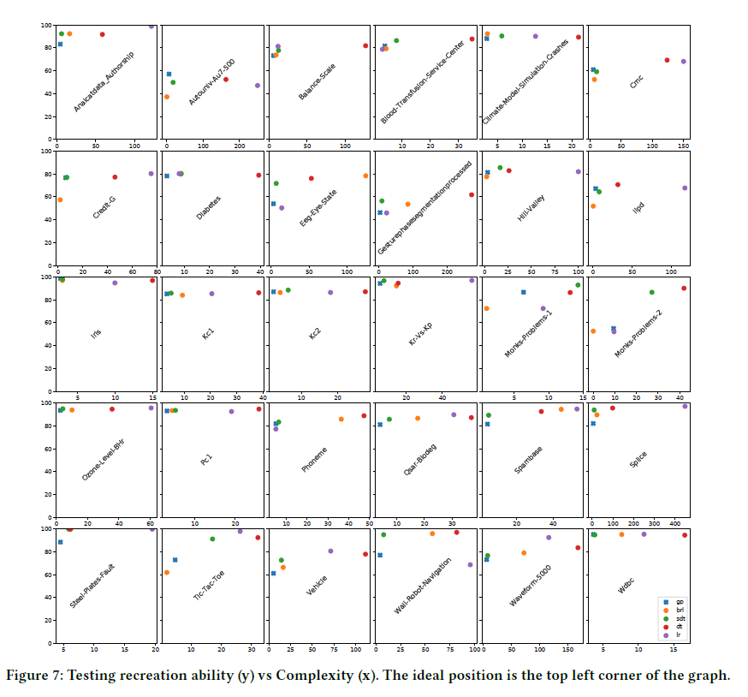
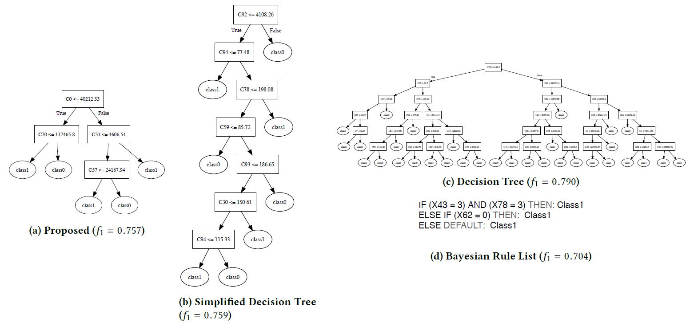
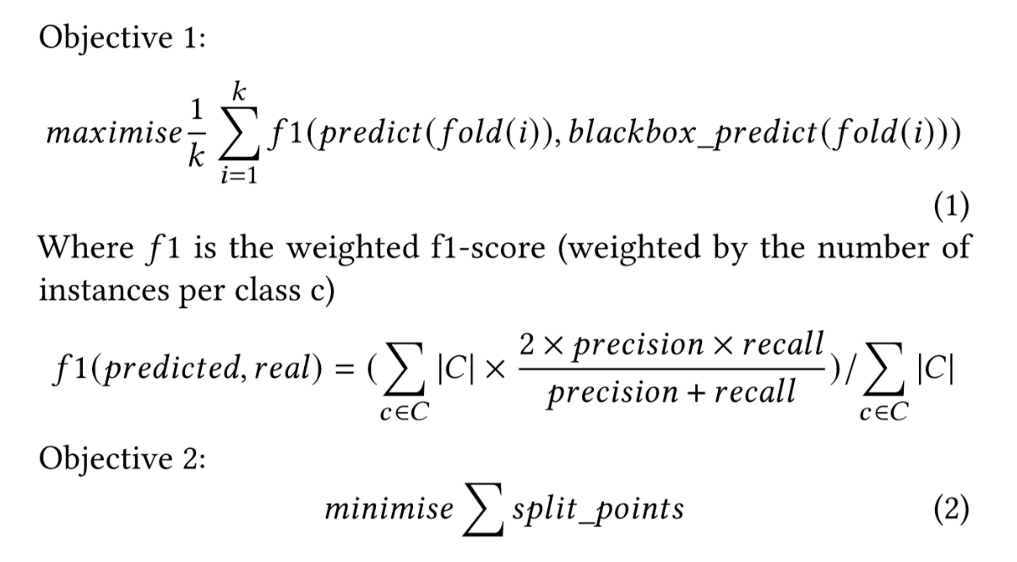
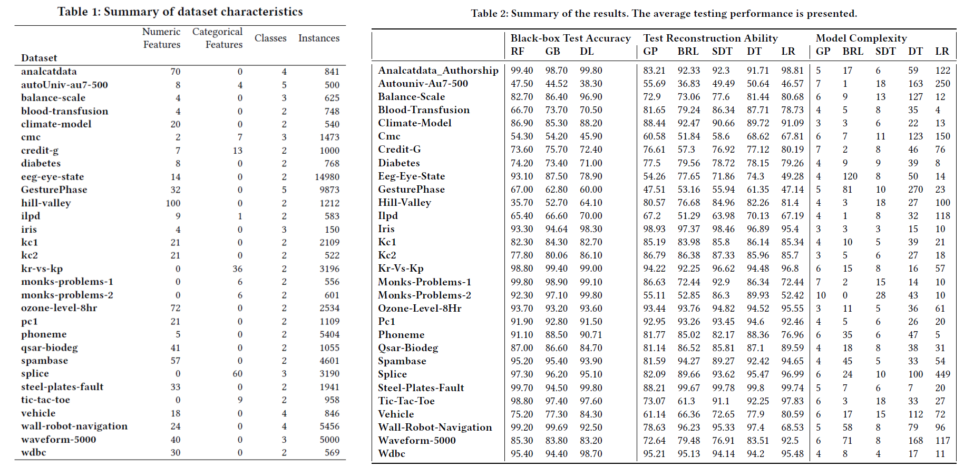
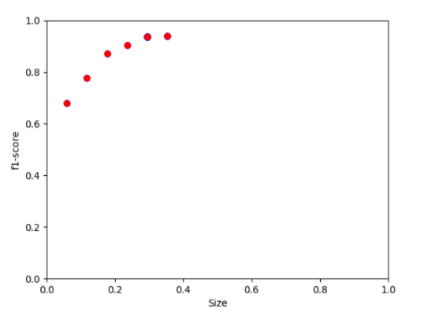
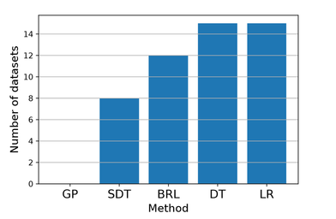
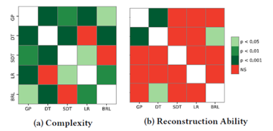
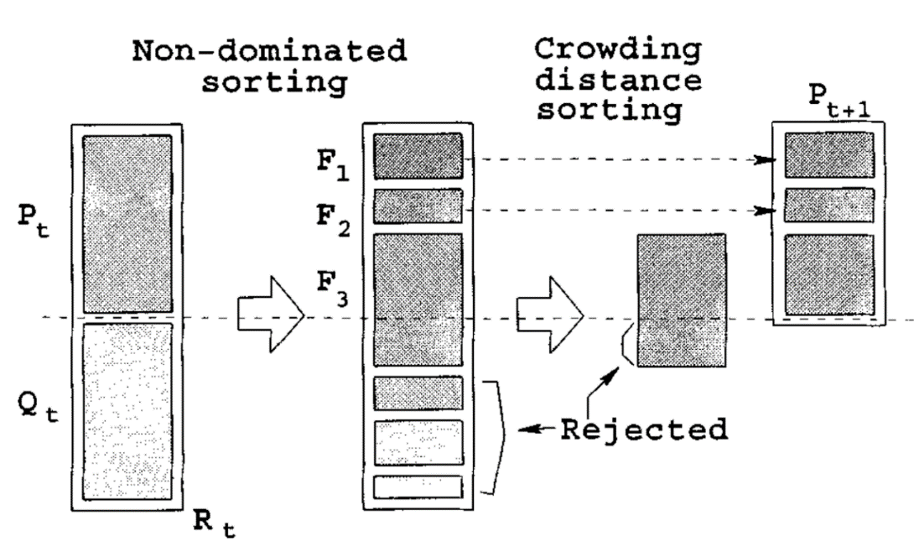
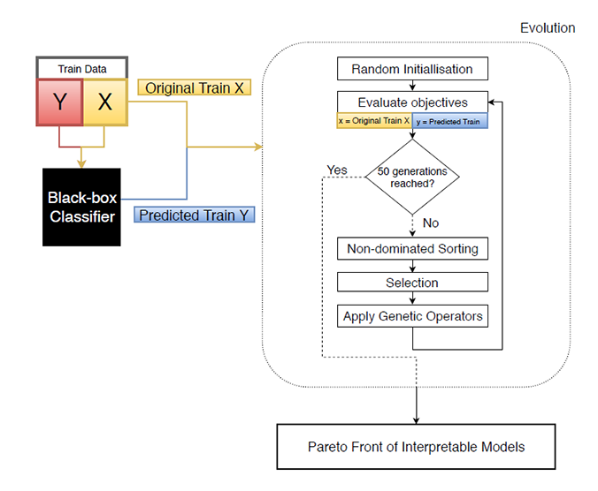

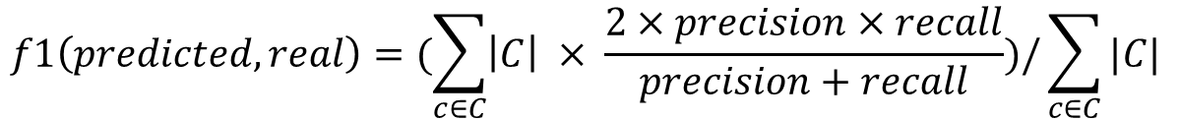
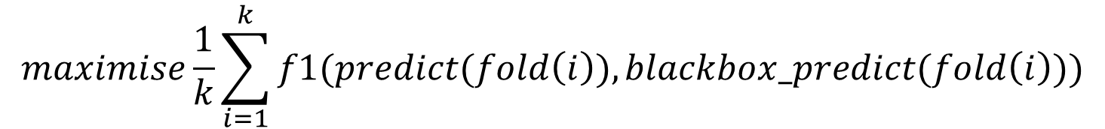
What’s inside the black-box?
A genetic programming method for interpreting complex machine learning models
Morgan Jones
mwj7@aber.ac.uk
Department of Computer Science,
Aberystwyth University,
Aberystwyth, Wales, UK
Experiments & Results
Further Analysis (Hill-Valley Dataset)
The proposed method’s resulting tree and the Bayesian rule list are by far the simplest interpretable models, both condense a 200 layer neural-network into small human readable form. Although the BRL just predicts 1 class so is considered overly simplistic.
Looking into our evolved tree we can see its splitting points make sense when considering the hill-valley dataset, which "when plotted in order the Y coordinate will create either a Hill or a Valley [13]. We can see the tree is checking the first point, and comparing to the point at 30\% (i.e. the 30th feature), or the point at 70\%, where the tree is trying to distinguish between classes by finding the common points for the hills/valleys and checking if these are high or low relative to the training data (e.g. a high point at the start, a low point at 30\%, then a high point at 57\% indicates a valley based on this tree).
4 Current Model Extraction methods: Bayesian Rule Lists Logistic Regression Decision Tree Simplified Decision Tree | 3 Black-Box Models : Random Forests Gradient Boosting Deep Neural Network
Datasets of particular difficulty:
Autonuniv-Au7-500 and GesturePhase datasets have 5 classes. Relax push for simple trees on datastes with many classes.
onks-Problems-2 is entirely categorical features. Combining categorical features into a single branch for future work.
For eeg-eye-state, the data is sequential/time-series. The proposed method is not designed for such datasets
A broad range of 30 datasets from the OpenML repository [7] were used for comparison. These were the 20 most run binary datasets, and 10 most run multiclass datasets. The datasets were restricted to less than 15000 instances, less than 5 classes, and no missing values. These datasets are from a variety of domains, and have a varying number of features (both categorical and numeric), classes, and instances.
The New Method
We propose a novel model agnostic approach to XAI model extraction. We use NSGA-II paired with strongly typed GP (STGP) to evolve decision tree-like structures which simultaneously balance the complexity and accuracy of the trees.
Conclusions & Future Work
The new method was compared to existing approaches for model extraction, and was found to offer drastically simpler models, with statistically equivalent test accuracy. To our best knowledge, this is the first utilisation of multi-objective optimisation in explainable AI. We also believe this is the first application of GP for model extraction, and shows a promising direction for future developments.
Three focus areas for future work:
Can recreation ability be improved without sacrificing simplicity?
Can we find a more suitable measure of complexity to describe human interpretability?
Is it possible to guide the evolution of the models based on human feedback?
$$maximise\frac{1}{k}\sum_{i=1}^{k}{f1(predict(fold\left(i\right)),blackbox_predict(fold\left(i\right)))}$$
$$f1\left(predicted, real\right)=(\sum_{c∈C}{\left|C\right| × \frac{2×precision×recall}{precision+recall})/\sum_{c∈C}{|C|}}$$
$$minimise\sum{split_points}$$
References
REFERENCES GO HERE - TODO
Pareto front of trees to choose from.
Method not dominated on any dataset.
Significantly simpler interpretable models with equivalent accuracy.

