Slide 1

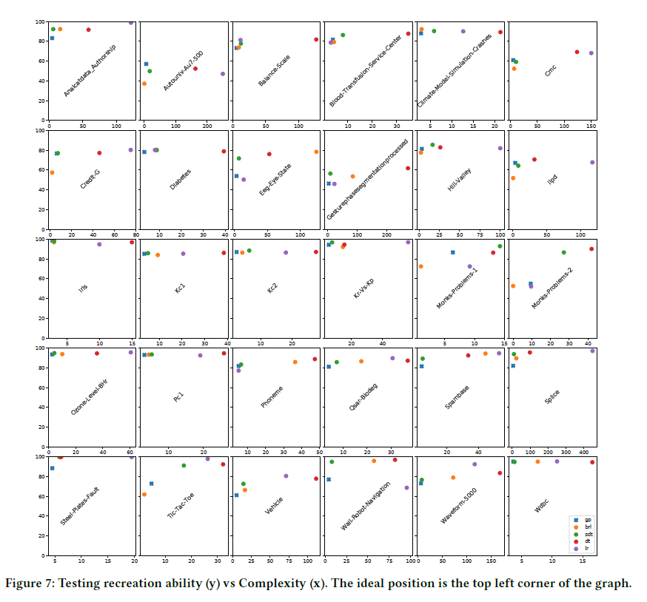
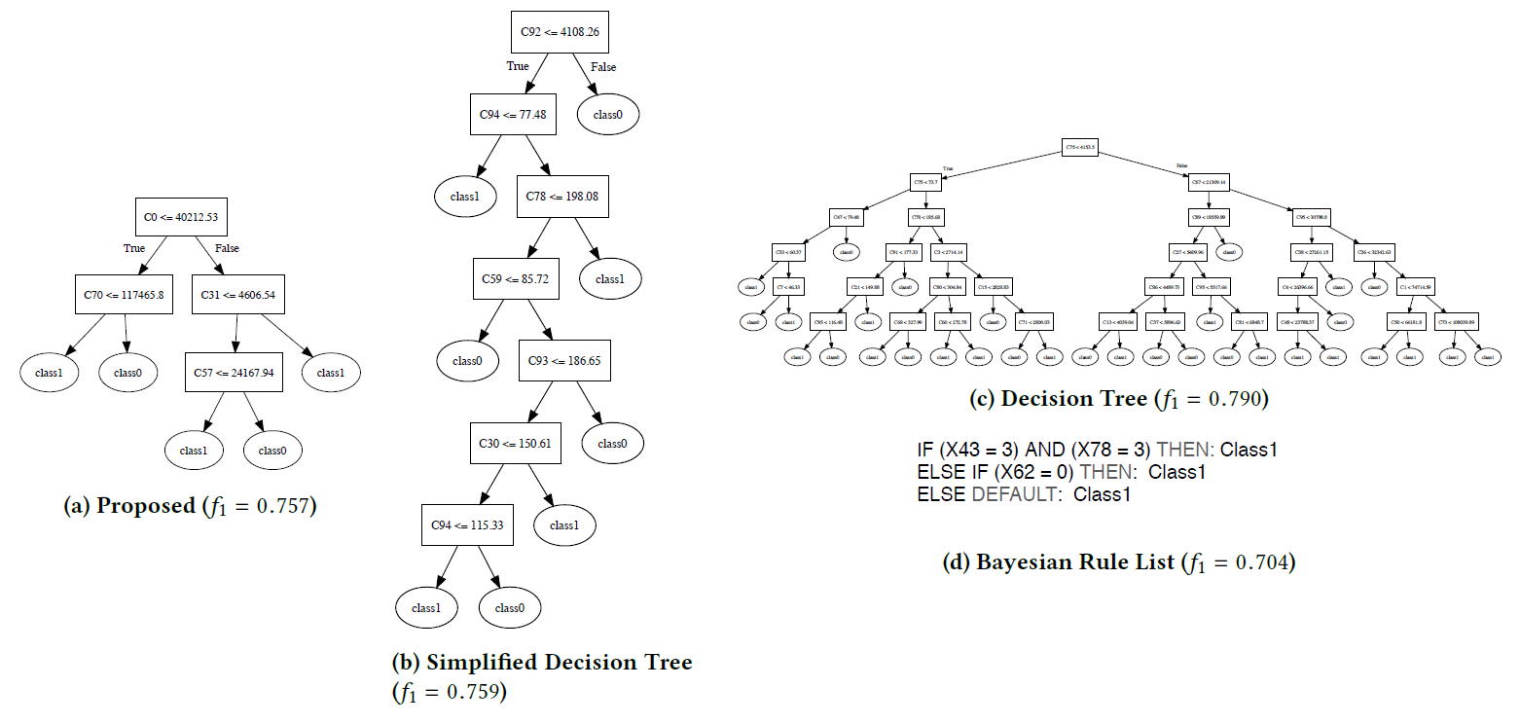
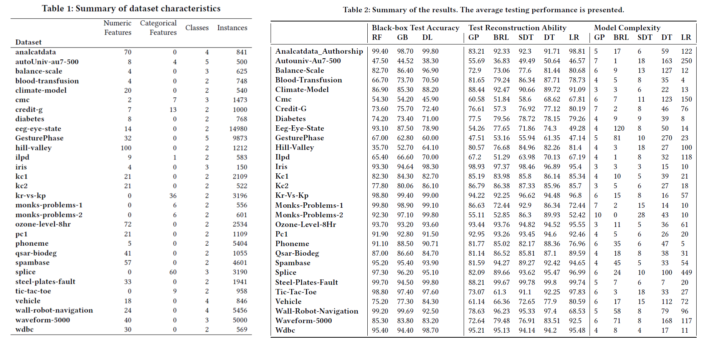
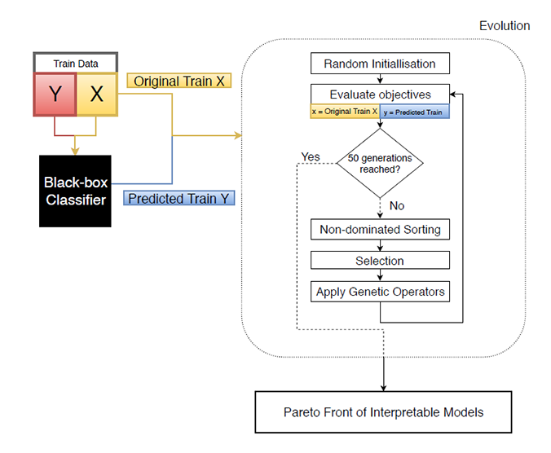
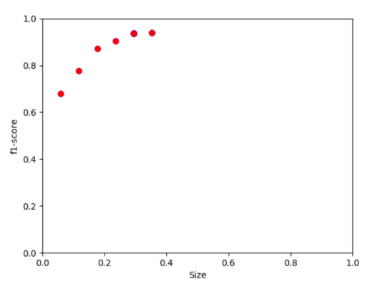
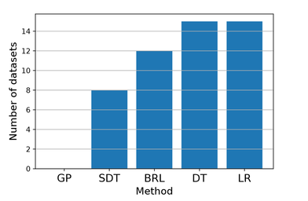
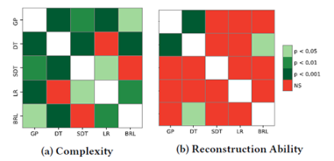
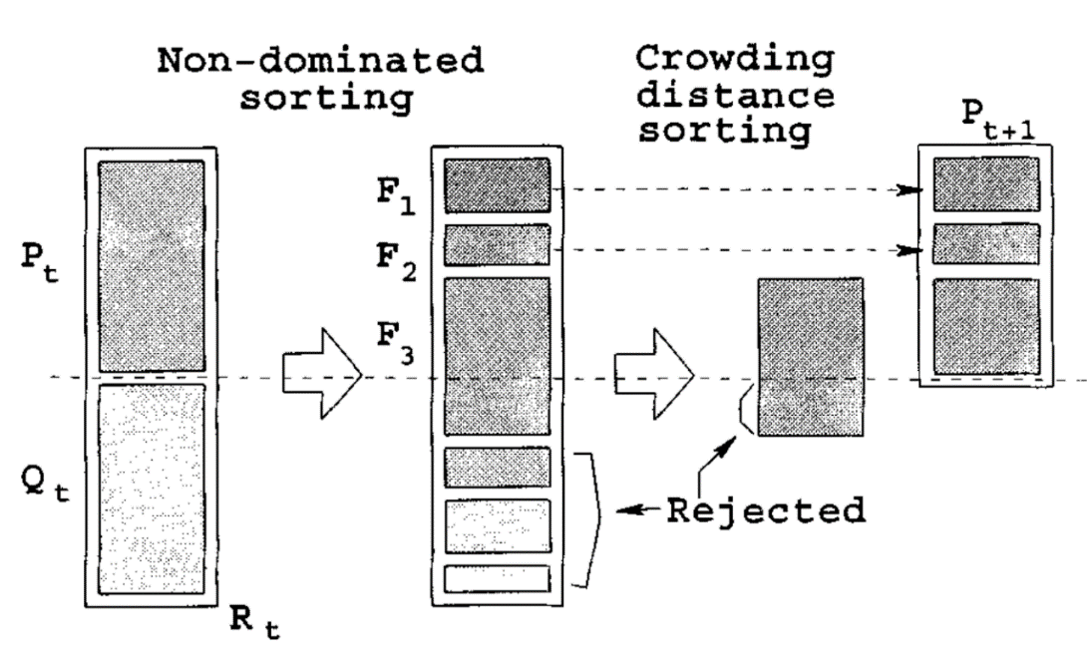

What’s inside the black-box?
A genetic programming method for interpreting complex machine learning models
Morgan Jones
mwj7@aber.ac.uk
Department of Computer Science,
Aberystwyth University,
Aberystwyth, Wales, UK
Introduction
Experiments & Results
Further Analysis
Best performing ML techniques are worst with respect to being interpretable/explainable
Explainability key for adoption of AI in more areas
Model extraction as addition to ML to generate understandable models
Most natural example: decision trees
Greedy tree-construction flawed
Our approach: Multi-objective GP for model extraction
Looking into our evolved tree we can see its splitting points make sense when considering the hill-valley dataset, which "when plotted in order the Y coordinate will create either a Hill or a Valley. We can see the tree is checking the first point, and comparing to the point at 30\%, or the point at 70\%, where the tree is trying to distinguish between classes by finding the common points for the hills/valleys and checking if these are high or low relative to the training data (e.g. a high point at the start, a low point at 30\%, then a high point at 57\% indicates a valley based on this tree).
4 Current Model Extraction methods Bayesian Rule Lists Logistic Regression Decision Tree Simplified Decision Tree | 3 Black-Box Models Random Forests Gradient Boosting Deep Neural Network
The New Method
The reconstruction ability was the f1 measure result of a 10 fold cross-validation averaged across all three black-box classifiers. For each model extraction method this was done for each dataset.
We propose a novel model agnostic approach to XAI model extraction. We use NSGA-II paired with strongly typed GP (STGP) to evolve decision tree-like structures which simultaneously balance the complexity and accuracy of the trees. Complexity is minimised and accuracy maximised by our objective functions below.
Used 30 datasets from the OpenML repository. These were restricted to <15000 instances, <5 classes, and no missing values.
$$maximise\frac{1}{k}\sum_{i=1}^{k}{f1(predict(fold\left(i\right)),blackbox_predict(fold\left(i\right)))}$$
$$f1\left(predicted, real\right)=(\sum_{c∈C}{\left|C\right| × \frac{2×precision×recall}{precision+recall})/\sum_{c∈C}{|C|}}$$
Difficult Datasets
Dataset | Reason | Evaluation
Autonuniv-Au7-500 & GesturePhase | 5 classes | Relax push for simple trees on datasets with many classes
onks-Problems-2 | entirely categorical features | Combining categorical features into a single branch
eeg-eye-state | data is sequential/time-series | The proposed method is not designed for such datasets
$$minimise\sum{split_points}$$
We use subtrees to construct features as mathematical expressions, these implicit features allow our trees to learn simpler rules.
F1 metric is result of an internal 3 fold cross-validation (k=3) .
Conclusion
Elitist NSGA-II with μ+ λ (|μ|=|λ|)
The new method was compared to existing approaches for model extraction, and was found to offer drastically simpler models, with statistically equivalent test accuracy. To our best knowledge, this is the first utilisation of multi-objective optimisation in explainable AI. We also believe this is the first application of GP for model extraction, and shows a promising direction for future developments.
Open Questions
Pareto front of trees to choose from
Method not dominated on any dataset
Significantly simpler interpretable models with equivalent accuracy
Can recreation ability be improved without sacrificing simplicity?
Can we find a more suitable measure of complexity to describe human interpretability?
Is it possible to guide the evolution of the models based on human feedback?
Evolutionary training process of our algorithm shown above alongside diagram of non-dominated sorting in NSGA-II.
Notes:
The proposed method’s resulting tree and the Bayesian rule list are by far the simplest interpretable models, both condense a 200 layer neural-network into small human readable form. Although the BRL just predicts 1 class so is considered overly simplistic.

