Slide 1
A data-driven approach to referable diabetic retinopathy detection
Ramon Pires, Sandra Avila, Jacques Wainer, Eduardo Valle, Micheal D. Abramoff, Anderson Rocha

Slide 2
Diabetic Retinopathy
Sight loss due to diabetes
Notes:
Introduce background of Diabetic Retinopathy. Mentions statistics of DR. Mention the strain on resource and the need for better easier referral. Mention authors partnership with Phelcom Technologies.

Slide 3
Current methods for DR referral
Notes:
Discuss current methods

Slide 4
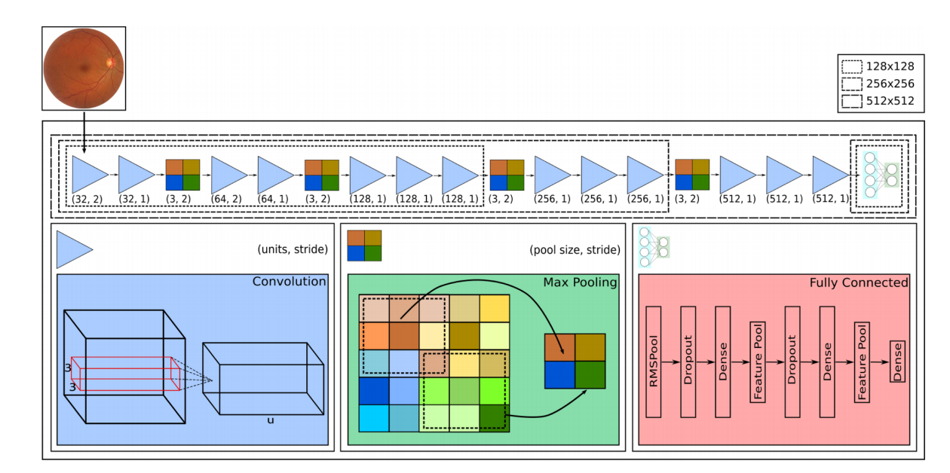
Solution Architecture (CNNs)
Notes:
High level over the solution architecture and a brief description of convolutional neural networks
https://medium.com/@RaghavPrabhu/understanding-of-convolutional-neural-network-cnn-deep-learning-99760835f148

